Slide 1
Levels of software testing
Prof. S.N.Bhosle

Slide 2
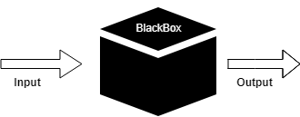
Black Box Testing
Black box testing is a technique of software testing which examines the functionality of software without peering into its internal structure or coding.
The primary source of black box testing is a specification of requirements that is stated by the customer.

Slide 3
Generic steps of black box testing
The black box test is based on the specification of requirements
The tester creates a positive test scenario and an adverse test scenario by selecting valid and invalid input values to check that the software is processing them correctly or incorrectly.
Tester develops various test cases such as decision table, all pairs test, equivalent division, error estimation, cause-effect graph, etc.
The fourth phase includes the execution of all test cases.
Tester compares the expected output against the actual output.
In final step, if there is any flaw in the software, then it is cured and tested again.

Slide 4
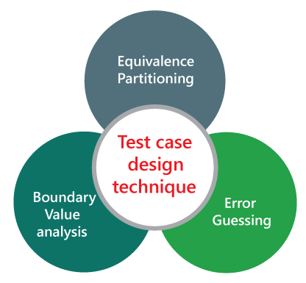
Techniques Used in Black Box Testing
Random Testing
Equivalence Partitioning
Error Guessing
Boundary Value Analysis

Slide 5
Random testing
Random testing is a black-box software testing technique where programs are tested by generating random, independent inputs.
Results of the output are compared against software specifications to verify that the test output is pass or fail.

Slide 6
Strength of Random testing
It is cheap to use: it does not need to be smart about the program under test.
It does not have any bias: unlike manual testing, it does not overlook bugs because there is misplaced trust in some code.
It is quick to find bug candidates: it typically takes a couple of minutes to perform a testing session.
If software is properly specified: it finds real bugs.

Slide 7
Weaknesses of Random Test
It only finds basic bugs (e.g. null pointer dereferencing).
It is only as precise as the specification and specifications are typically imprecise.
It compares poorly with other techniques to find bugs (e.g. static program analysis).
If different inputs are randomly selected on each test run, this can create problems for continuous integration because the same tests will pass or fail randomly.

Slide 8
Equivalence Partitioning
Equivalence partitioning is a technique of software testing in which input data divided into partitions of valid and invalid values
It is mandatory that all partitions must exhibit the same behavior.

Slide 9
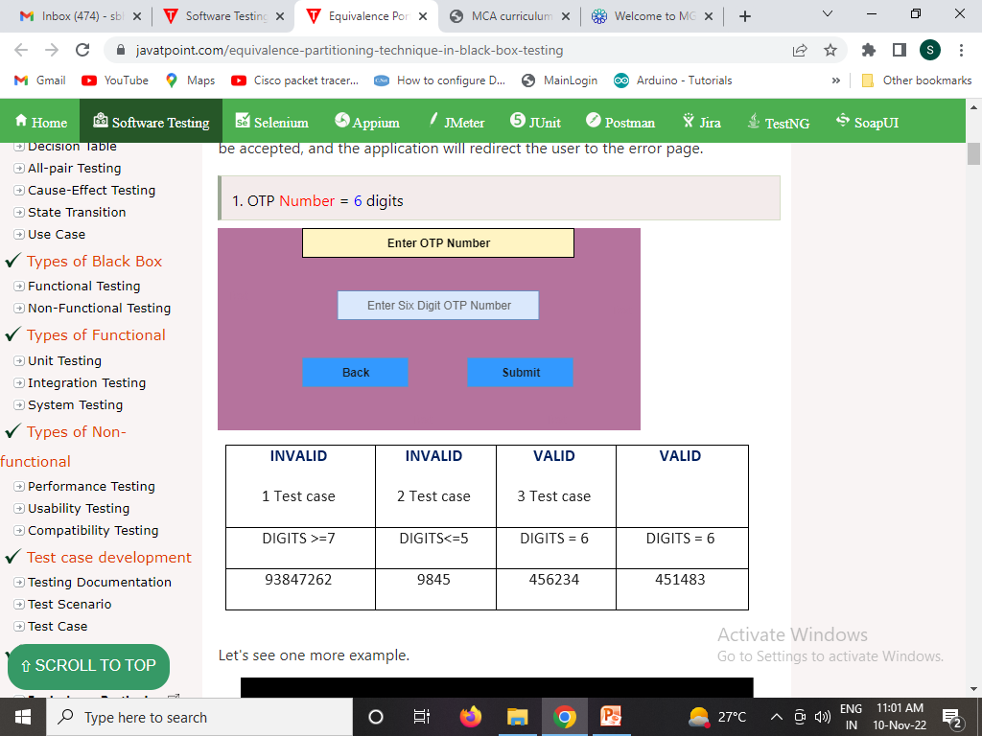
Examples of Equivalence Partitioning technique

Slide 10
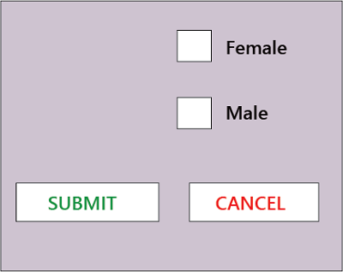
Condition : Boolean
If the requirement id Boolean (true/false), then derive the test case for both true/false values.
The Boolean value can be true and false for the radio button, checkboxes.
Sr. no | Description | Input | Expected | Note
1 | Select valid | NA | True | ---
2 | Select invalid | NA | False | Values can be change based according to the requirement.
3 | Do not select | NA | Do not select anything, error message should be displayed | We cannot go for next question
4 | Select both | NA | We can select any radio button | Only one radio button can be selected at a time.

Slide 11
Error Guessing
Error guessing is a technique in which there is no specific method for identifying the error.
It is based on the experience of the test analyst, where the tester uses the experience to guess the problematic areas of the software.

Slide 12
Error Guessing
The main purpose of this technique is to identify common errors at any level of testing by exercising the following tasks:
Enter blank space into the text fields.
Null pointer exception.
Enter invalid parameters.
Divide by zero.
Use maximum limit of files to be uploaded.
Check buttons without entering values.
The increment of test cases depends upon the ability and experience of the tester.

Slide 13
Advantages
The benefits of error guessing technique are as follows:
It is a good approach to find the challenging parts of the software.
It is beneficial when we will use this technique with the grouping of other formal testing techniques.
It is used to enhance the formal test design techniques.
With the help of this technique, we can disclose those bugs which were probably identified over extensive testing; therefore, the test engineer can save lots of time and effort.

Slide 14
Disadvantage
Following are the drawbacks of error guessing technique:
The error guessing technique is person-oriented rather than process-oriented because it depends on the person's thinking.
If we use this technique, we may not achieve the minimum test coverage.
With the help of this, we may not cover all the input or boundary values.
With this, we cannot give the surety of the product quality.
The Error guessing technique can be done by those people who have product knowledge; it cannot be done by those who are new to the product.

Slide 15
Boundary Value Analysis
Boundary Value Technique is used to test boundary values, boundary values are those that contain the upper and lower limit of a variable.
It tests, while entering boundary value whether the software is producing correct output or not.
Tester develops test cases for both valid and invalid partitions to capture the behavior of the system on different input conditions.

Slide 16
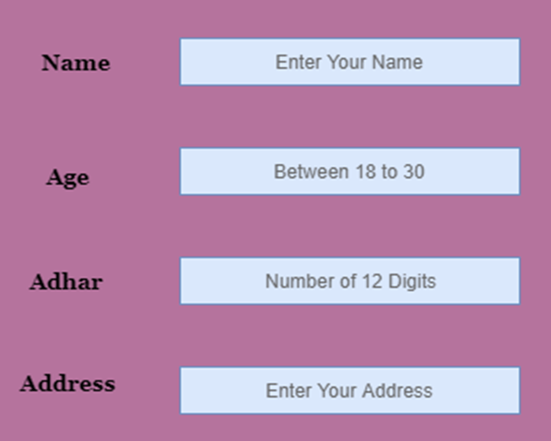
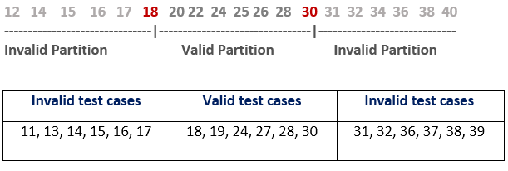
Example of Boundary Value Analysis

Slide 17
Difference between Black Box and White Box Testing

Slide 18
Testing | Testing

