Slide 1

Big Data Aalytics

Slide 2
Index
Data Node, Name Node and Secondary NameNode
Wordcount program in Cloudera

Slide 3
Name Node in HDFS
HDFS has a master/slave architecture.
With in an HDFS cluster there is a single NameNode and a number of DataNodes.
The NameNode is the centerpiece of an HDFS file system.
NameNode manages the file system namespace by storing information about the file system tree which contains the metadata about all the files and directories in the file system tree.
Metadata stored about the file consists of file name, file path, number of blocks, block Ids, replication level.
This metadata information is stored on the local disk. Namenode uses two files for storing this metadata information.
fsimage– Contains the snapshot of the file system metadata and used by Namenode when it is started.
edit log– Any change made to the filesystem, after the Namenode is started, is recorded in edit logs.

Slide 4
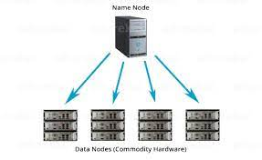
Name Node in HDFS
NameNode in Hadoop also keeps, location of the DataNodes that store the blocks for any given file, in it’s memory.
Using that information Namenode can reconstruct the whole file by getting the location of all the blocks of a given file.
Client application has to talk to NameNode to add/copy/move/delete a file.
Since block information is also stored in NameNode so any client application that wishes to use a file has to get BlockReport from NameNode.
The NameNode returns list of DataNodes where the data blocks are stored for the given file.

Slide 5
DataNode in HDFS
Data blocks of the files are stored in a set of DataNodes in Hadoop cluster.
Client application gets the list of DataNodes where data blocks of a particular file are stored from NameNode.
After that DataNodes are responsible for serving read and write requests from the file system’s clients.
The DataNodes store blocks, delete blocks and replicate those blocks upon instructions from the NameNode.
DataNodes in a Hadoop cluster periodically send a blockreport to the NameNode too.
A blockreport contains a list of all blocks on a DataNode.

Slide 6
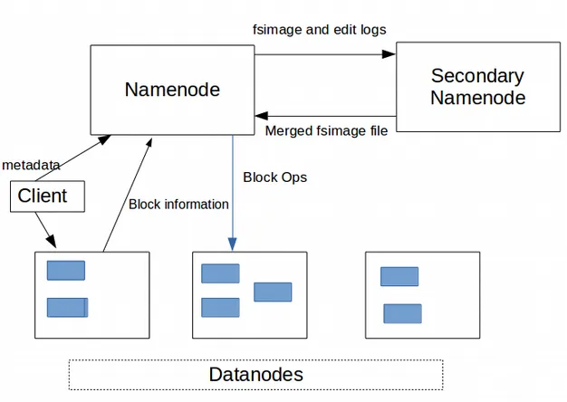
Secondary NameNode in Hadoop
Secondary NameNode in Hadoop is more of a helper to NameNode that takes some of the work load of the Namenode.
It is not a backup NameNode server which can quickly take over in case of NameNode failure.
Two files which were mentioned in NameNode in Hadoop– FsImage and EditLog.
EditLog– All the file write operations done by client applications are recorded in the EditLog.
FsImage– This file has the complete information about the file system metadata when the NameNode starts.
All the operations after that are recorded in EditLog.

Slide 7
Secondary NameNode in Hadoop
When the NameNode is restarted it first takes metadata information from the FsImage and then apply all the transactions recorded in EditLog.
NameNode restart doesn’t happen that frequently so EditLog grows quite large.
That means merging of EditLog to FsImage at the time of startup takes a lot of time keeping the whole file system offline during that process.

Slide 8
Secondary NameNode in Hadoop
So the problem is Namenode merges fsimage with edit logs only during startup.
That is where Secondary Namenode helps, it can take over the responsibility of merging the fsimage and the edits log files periodically that way edits log size is kept within a limit and Namenode has a merged fsimage file.
The start of the checkpoint process (When Secondary Namenode should start merging process) is controlled by two configuration parameters-
dfs.namenode.checkpoint.period, set to 1 hour by default, specifies the maximum delay between two consecutive checkpoints, and
dfs.namenode.checkpoint.txns, set to 1 million by default. Which means start the merging process if one million transactions are recorded in the edit log since the last checkpoint.

Slide 9
Process
Secondary Namenode gets the latest fsimage and edit logs from Namenode.
It merges the transactions from edit logs to fsimage to create a new fsimage file.
Copies the newly created fsimage file back to Namenode.
That way Namenode receives merged fsimage file periodically which reduces the restart time of the Namenode.

Slide 10

Word count program in cloudera
Step 1: Open Cloudera Quickstart VM on VirtualBox.

Slide 11
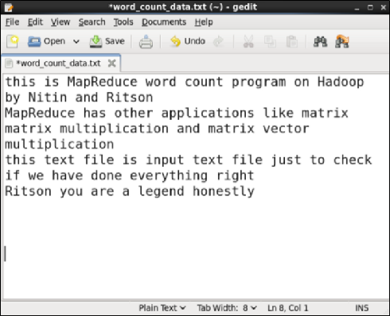
Word count program in cloudera
Step 2: Create a .txt data file inside /home/cloudera directory that will be passed as an input to MapReduce program.
For simplicity purpose, we name it as word_count_data.txt.

Slide 12
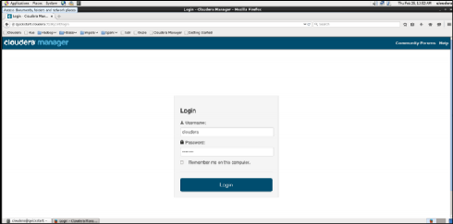
Word count program in cloudera
Step 3: Configure Hadoop services and settings.
Now, we need to configure certain settings on Hadoop before we run the MapReduce program for word count.
5a: Login to Cloudera Manager
Open browser on Cloudera Quickstart VM and open quickstart.cloudera:7180/cmf/login. Login by entering the credentials as cloudera for both, username and password.

Slide 13
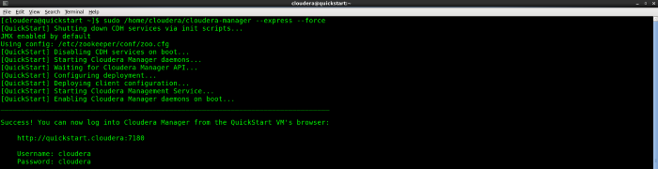
Word count program in cloudera
Note: If you see the error “Unable to connect” while logging in to quickstart.cloudera:7180/cmf/login, try restarting the CDH services.
Restart CDH services by typing the following command:
sudo /home/cloudera/cloudera-manager --express --force

Slide 14
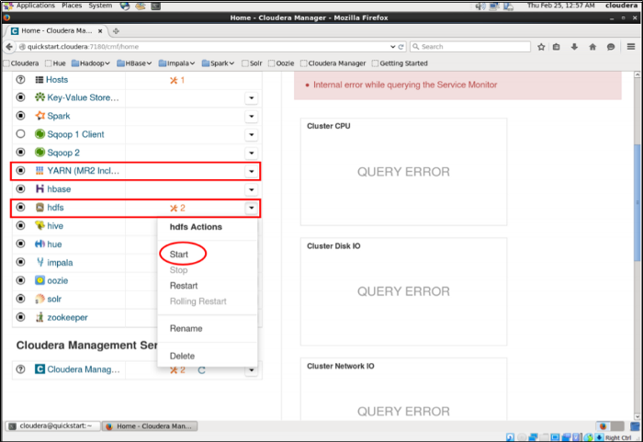
Word count program in cloudera
3b: Start HDFS and YARN services.
Click the dropdown arrow and choose Start option for HDFS and YARN services.

Slide 15
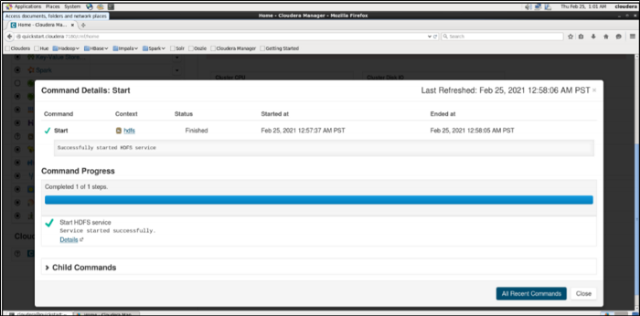
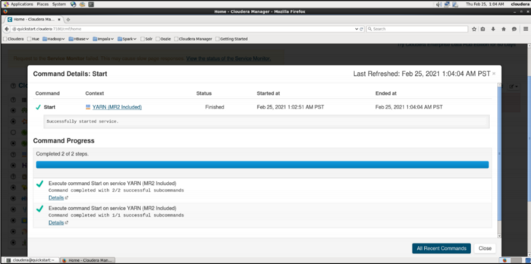
Word count program in cloudera
You’ll see the following if both; HDFS and YARN services are started successfully.

Slide 16
Word count program in cloudera
Step 4: Create a directory on HDFS
Create a directory named word_count_map_reduce on HDFS where our input data and its resulting output would be stored.
Use the following command for it.
sudo -u hdfs hadoop fs -mkdir /word_count_map_reduce
Note: If the directory already exists, then either create a directory with new name or delete the existing directory using the following command.
export HADOOP_USER_NAME=hdfs
hdfs dfs -rmr /word_count_map_reduce

Slide 17
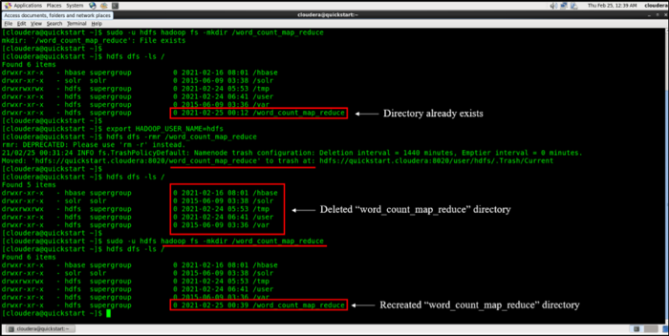
Word count program in cloudera
List HDFS directory items using the following command.
hdfs dfs -ls /

Slide 18

Word count program in cloudera
Step 5: Copy input data file on HDFS.
Copy the word_count_data.txt file to word_count_map_reduce directory on HDFS using the following command.
sudo -u hdfs hadoop fs -put /home/cloudera/word_count_data.txt /word_count_map_reduce
Check if file was copied successfully to the desired location.
hdfs dfs -ls /word_count_map_reduce

Slide 19
Word count program in cloudera
Step 6: Download hadoop-streaming JAR 2.7.3.
Open browser on VM and go to
https://jar-download.com/artifacts/org.apache.hadoop/hadoop-streaming
link and download the hadoop-streaming JAR 2.7.3 file.
Once the file is downloaded, unzip it inside /home/cloudera directory. Double-check if the JAR file was unzipped successfully and is present inside
/home/cloudera directory.
ls

Slide 20
Word count program in cloudera
Step 7: Configure permissions to run MapReduce on Hadoop.
Before running mapreduce on hadoop, we need to give permission to read, write and execute the Mapper and Reducer programs on Hadoop.
Also need to provide permission for the default user (cloudera) to write the output file inside HDFS.
Run the following commands
chmod 777 mapper.py reducer.py
sudo -u hdfs hadoop fs -chown cloudera /word_count_map_reduce

Slide 21
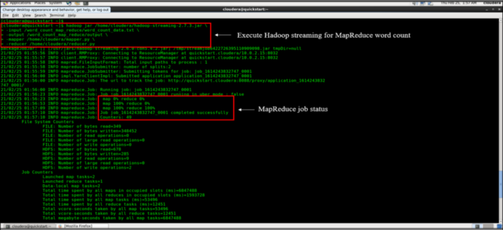
Word count program in cloudera
Step 8: Run MapReduce on Hadoop.
Run the MapReduce job on Hadoop using the following command.
hadoop jar /home/cloudera/hadoop-streaming-2.7.3.jar \
> -input /word_count_map_reduce/word_count_data.txt \
> -output /word_count_map_reduce/output \
> -mapper /home/cloudera/mapper.py \
> -reducer /home/cloudera/reducer.py

Slide 22
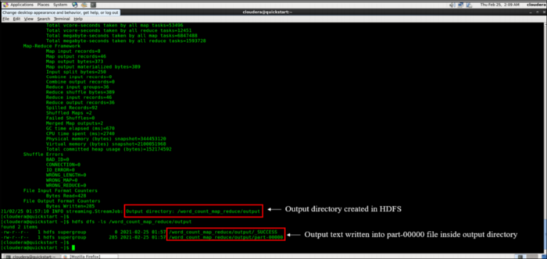
Word count program in cloudera
Output on terminal is shown in these two images
MapReduce job was executed successfully.

Slide 23
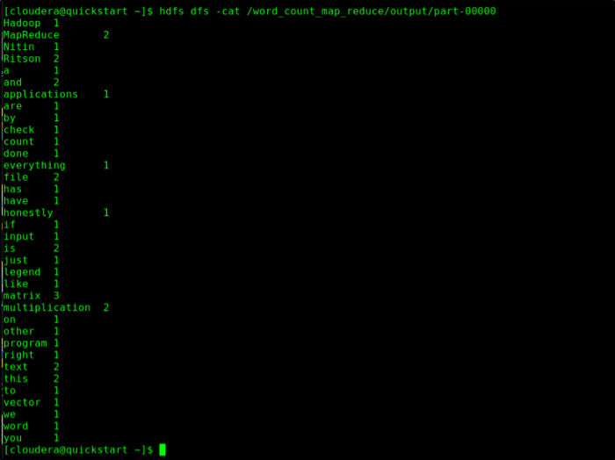
Word count program in cloudera
Step 9: Read the MapReduce output.
Run the following command to read the output of MapReduce for word count of the input data file you had created.
hdfs dfs -cat /word_count_map_reduce/output/part-00000

