Slide 1
MapReduce in Hadoop

Slide 2
Components of Hadoop
Hadoop Common: The Hadoop Common having utilities that support the other Hadoop subprojects.
Hadoop Distributed File System (HDFS): Hadoop Distributed File System provides to access the distributed file to application data.
Hadoop MapReduce: It is a software framework for processing large distributed data sets on compute clusters.
Hadoop YARN: Hadoop YARN is a framework for resource management and scheduling job.

Slide 3
What is MapReduce?
A MapReduce is a data processing tool which is used to process the data parallely in a distributed form.
It was developed in 2004, on the basis of paper titled as "MapReduce: Simplified Data Processing on Large Clusters," published by Google.

Slide 4
MapReduce
MapReduce is a processing technique and a program model for distributed computing based on java.
The MapReduce algorithm contains two important tasks, namely Map and Reduce.
Map takes a set of data and converts it into another set of data, where individual elements are broken down into tuples (key/value pairs).
Secondly, reduce task, which takes the output from a map as an input and combines those data tuples into a smaller set of tuples.
As the sequence of the name MapReduce implies, the reduce task is always performed after the map job.

Slide 5
MapReduce
MapReduce programming offers several benefits.
Scalability. Businesses can process petabytes of data stored in the Hadoop Distributed File System (HDFS).
Flexibility. Hadoop enables easier access to multiple sources of data and multiple types of data.
Speed. With parallel processing and minimal data movement, Hadoop offers fast processing of massive amounts of data.
Simple. Developers can write code in a choice of languages, including Java, C++ and Python.

Slide 6
MapReduce program executes in three stages, namely map stage, shuffle stage, and reduce stage.
Map stage − The map or mapper’s job is to process the input data.
Generally the input data is in the form of file or directory and is stored in the Hadoop file system (HDFS).
The input file is passed to the mapper function line by line.
The mapper processes the data and creates several small chunks of data.
Reduce stage − This stage is the combination of the Shuffle stage and the Reduce stage.
The Reducer’s job is to process the data that comes from the mapper.
After processing, it produces a new set of output, which will be stored in the HDFS.

Slide 7
Terminology
PayLoad − Applications implement the Map and the Reduce functions, and form the core of the job.
Mapper − Mapper maps the input key/value pairs to a set of intermediate key/value pair.
NamedNode − Node that manages the Hadoop Distributed File System (HDFS).
DataNode − Node where data is presented in advance before any processing takes place.
MasterNode − Node where JobTracker runs and which accepts job requests from clients.
SlaveNode − Node where Map and Reduce program runs.
JobTracker − Schedules jobs and tracks the assign jobs to Task tracker.
Task Tracker − Tracks the task and reports status to JobTracker.
Job − A program is an execution of a Mapper and Reducer across a dataset.
Task − An execution of a Mapper or a Reducer on a slice of data.
Task Attempt − A particular instance of an attempt to execute a task on a SlaveNode.

Slide 8
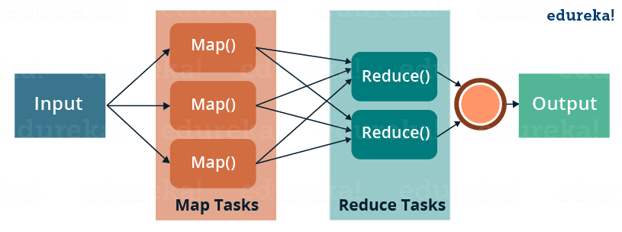
MapReduce

Slide 9
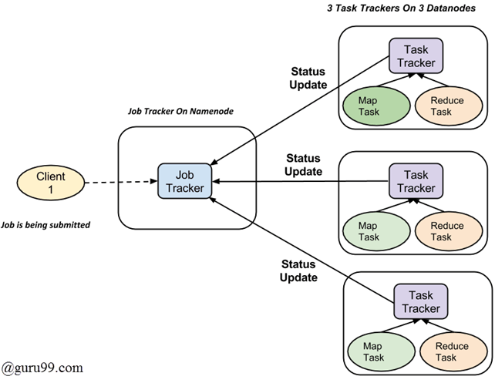
A job is divided into multiple tasks which are then run onto multiple data nodes in a cluster.
It is the responsibility of job tracker to coordinate the activity by scheduling tasks to run on different data nodes.
Execution of individual task is then to look after by task tracker, which resides on every data node executing part of the job.
Task tracker’s responsibility is to send the progress report to the job tracker.
In addition, task tracker periodically sends ‘heartbeat’ signal to the Jobtracker so as to notify him of the current state of the system.
Thus job tracker keeps track of the overall progress of each job. In the event of task failure, the job tracker can reschedule it on a different task tracker.

Slide 10
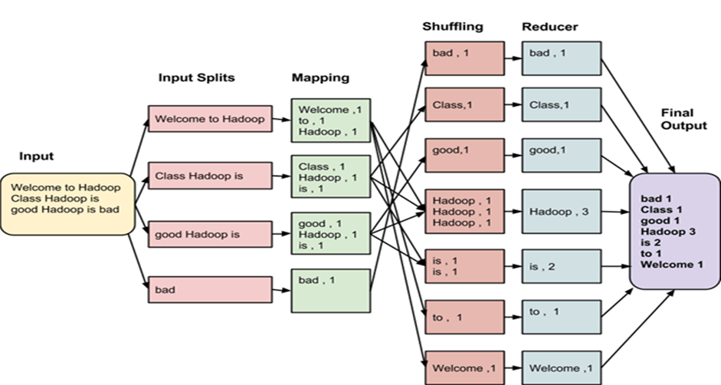
MapReduce

Slide 11
MapReduce
It is always beneficial to have multiple splits because the time taken to process a split is small as compared to the time taken for processing of the whole input.
When the splits are smaller, the processing is better to load balanced since we are processing the splits in parallel.
However, it is also not desirable to have splits too small in size. When splits are too small, the overload of managing the splits and map task creation begins to dominate the total job execution time.
For most jobs, it is better to make a split size equal to the size of an HDFS block (which is 64 MB, by default).
Execution of map tasks results into writing output to a local disk on the respective node and not to HDFS.

Slide 12
MapReduce Types
Hadoop uses the MapReduce programming model for the data processing of input and output for the map and to reduce functions represented as key-value pairs.
They are subject to parallel execution of datasets situated in a wide array of machines in a distributed architecture.
The programming paradigm is essentially functional in nature in combining while using the technique of map and reduce.

Slide 13
MapReduce Types
Mapping is the core technique of processing a list of data elements that come in pairs of keys and values.
The map function applies to individual elements defined as key-value pairs of a list and produces a new list.
The general idea of map and reduce function of Hadoop can be illustrated as follows:
map: (K1, V1) -> list (K2, V2) reduce: (K2, list(V2)) -> list (K3, V3)

Slide 14
The input parameters of the key and value pair, represented by K1 and V1 respectively, are different from the output pair type: K2 and V2.
The reduce function accepts the same format output by the map, but the type of output again of the reduce operation is different: K3 and V3.
The Java API for this is as follows:
public interface Mapper<K1, V1, K2, V2> extends JobConfigurable, Closeable
{
void map(K1 key, V1 value,
OutputCollector<K2, V2> output,
Reporter reporter) throws IOException;
}
public interface Reducer<K2, V2, K3, V3> extends JobConfigurable, Closeable
{ void reduce(K2 key,
Iterator<V2> values,
OutputCollector<K3, V3> output,
Reporter reporter)throws IOException;
}

Slide 15
The OutputCollector is the generalized interface of the Map-Reduce framework to facilitate collection of data output either by the Mapper or the Reducer.
These outputs are nothing but intermediate output of the job. Therefore, they must be parameterized with their types.
The Reporter facilitates the Map-Reduce application to report progress and update counters and status information.
If, however, the combine function is used, it has the same form as the reduce function and the output is fed to the reduce function.
This may be illustrated as follows:
Combine and reduce functions use the same type, except in the variable names where K3 is K2 and V3 is V2.
map: (K1, V1) -> list (K2, V2) combine: (K2, list(V2)) -> list (K2, V2) reduce: (K2, list(V2)) -> list (K3, V3)

Slide 16
The partition function operates on the intermediate key-value types.
It controls the partitioning of the keys of the intermediate map outputs.
The key derives the partition using a typical hash function.
The total number of partitions is the same as the number of reduce tasks for the job.
public interface Partitioner<K2, V2> extends JobConfigurable
{ int getPartition(K2 key, V2 value, int numberOfPartition);
}

Slide 17
Input Formats
Hadoop has to accept and process a variety of formats, from text files to databases.
A chunk of input, called input split, is processed by a single map.
Each split is further divided into logical records given to the map to process in key-value pair.
In the context of database, the split means reading a range of tuples from an SQL table, as done by the DBInputFormat and producing LongWritables containing record numbers as keys and DBWritables as values.
The Java API for input splits is as follows:

Slide 18
Input Formats
The Java API for input splits is as follows:
The InputSplit represents the data to be processed by a Mapper.
It returns the length in bytes and has a reference to the input data.
It presents a byte-oriented view on the input and is the responsibility of the RecordReader of the job to process this and present a record-oriented view.
public interface InputSplit extends Writable
{ long getLength() throws IOException;
String[] getLocations() throws IOException; }

Slide 19
Input Formats
In most cases, we do not deal with InputSplit directly because they are created by an InputFormat.
It is is the responsibility of the InputFormat to create the input splits and divide them into records.
public interface InputFormat<K, V>
{
InputSplit[] getSplits(JobConf job, int numSplits) throws IOException;
RecordReader<K, V> getRecordReader(InputSplit split, JobConf job, throws IOException;
}

Slide 20
Input Formats
The JobClient invokes the getSplits() method with appropriate number of split arguments.
Once the split is calculated it is sent to the jobtracker. The jobtracker schedules map tasks for the tasktrackers using storage location.
The tasktracker then passes the split by invoking getRecordReader() method on the InputFormat to get RecordReader for the split.
The FileInputFormat is the base class for the file data source.
It has the responsibility to identify the files that are to be included as the job input and the definition for generating the split.
Hadoop also includes processing of unstructured data that often comes in textual format. The TextInputFormat is the default InputFormat for such data.
The SequenceInputFormat takes up binary inputs and stores sequences of binary key-value pairs.
DBInputFormat provides the capability to read data from relational database using JDBC.

Slide 21
Output Formats
The output format classes are similar to their corresponding input for
For example, the TextOutputFormat is the default output format that writes records as plain text files, whereas key-values any be of any types, and transforms them into a string by invoking the toString() method.
The key-value character is separated by the tab character, although this can be customized by manipulating the separator property of the text output format. mat classes and work in the reverse direction.
For binary output, there is SequenceFileOutputFormat to write a sequence of binary output to a file.
Binary outputs are particularly useful if the output becomes input to a further MapReduce job.

Slide 22
Output Formats
The output formats for relational databases and to HBase are handled by DBOutputFormat.
It sends the reduced output to a SQL table. For example, the HBase’s TableOutputFormat enables the MapReduce program to work on the data stored in the HBase table and uses it for writing outputs to the HBase table.

