Slide 1
Mask-RCNN Implementation
Part 1. Mask-RCNN Environment Setup
Part 2. Train our own dataset
Zezheng Long
Research Assistant
University of St. Thomas
Advisor: Chih Lai

Slide 2
Part 1. Mask-RCNN Environment Setup
1. Install packages
numpy
scipy
Cython
h5py
Pillow
scikit-image
tensorflow-gpu
keras
jupyter
labelme
imgaug
We can easily install all packages by commend:
pip install –r requirements.txt
If tensorflow installation fails:
python -m pip install --upgrade https://storage.googleapis.com/tensorflow/mac/cpu/tensorflow-1.11.0-py3-none-any.whl update tensorflow

Slide 3
Part 1. Mask-RCNN Environment Setup
2. Clone matterport Mask-RCNN repository
git clone https://github.com/matterport/Mask_RCNN.git
python setup.py install

Slide 4
Part 1. Mask-RCNN Environment Setup
3. Install pycocotools
git clone https://github.com/philferriere/cocoapi.git
pip install git+https://github.com/philferriere/cocoapi.git#subdirectory=PythonAPI
If it shows error about requirement of Visual C++, install Microsoft Build Tools 2017
https://visualstudio.microsoft.com/downloads/#build-tools-for-visual-studio-2017

Slide 5
Part 1. Mask-RCNN Environment Setup
4. Download pre-trained COCO weights (mask_rcnn_coco.h5) from the releases page
https://github.com/matterport/Mask_RCNN/releases
mask_rcnn_coco.h5

Slide 6
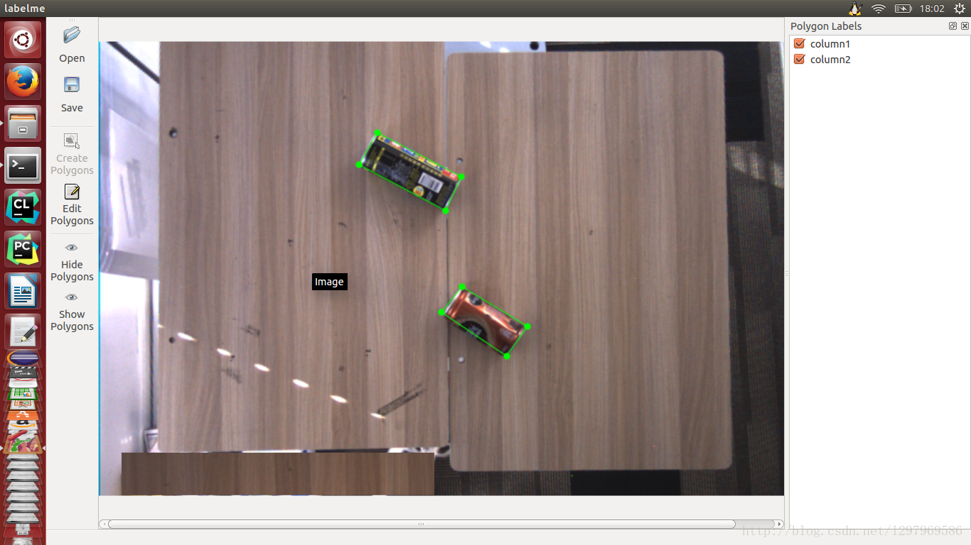
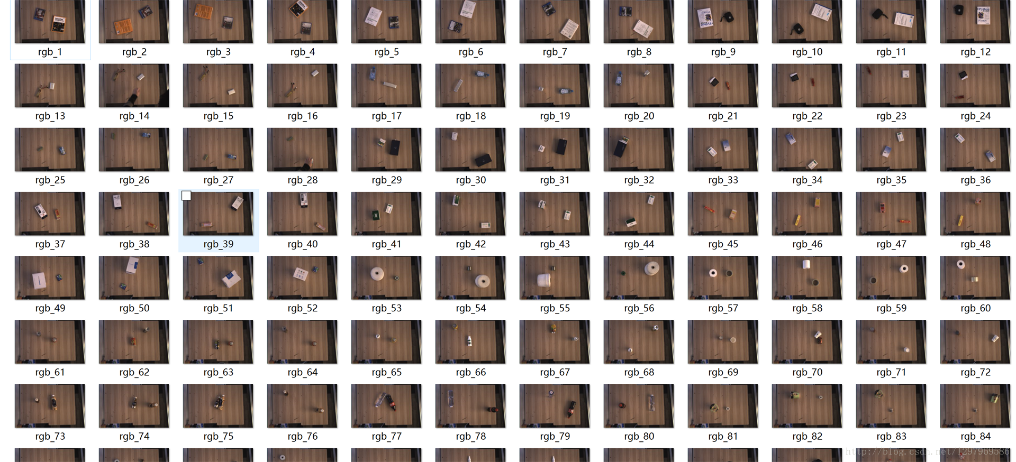
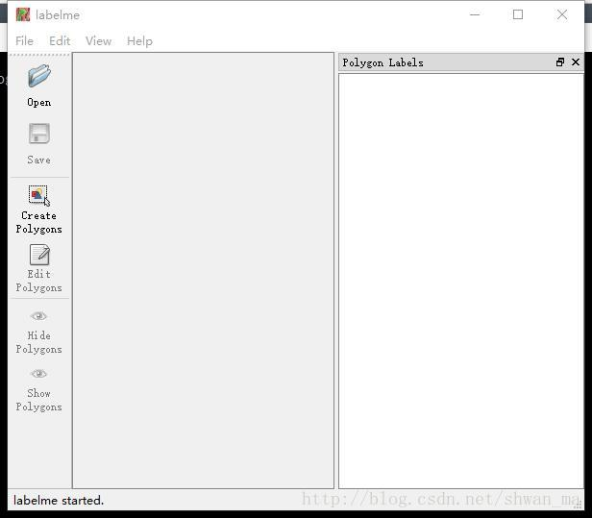
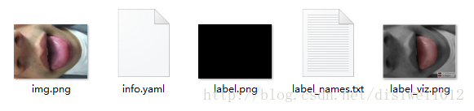
Part 2. Train our own dataset
Pre-processing Approach 1
Manually label data
pip install labelme

Slide 7
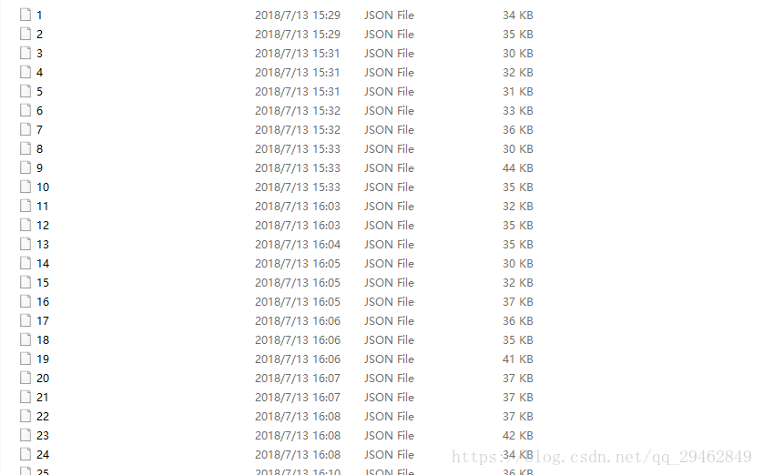
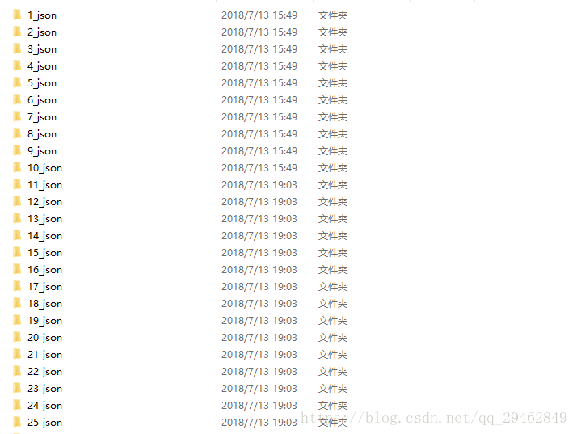
Part 2. Train our own dataset
Pre-processing Approach 2
Build fake json file to let labelme generate
files with existing polygon coodinate
imageData
Label
Shapes
line_color
fill_color
lineColor
fillColor
Points

Slide 8
Part 2. Train our own dataset
Approach 2 cont.
Run labelme_json_to_dataset <dir> in cmd line
It will generate one folder of 5 files
Generally, we only need info.yaml and label.png
To generate files for all fake json files
Edit labelme/cli/json_to_dataset.py
Add a loop for all .json

Slide 9
Part 2. Train our own dataset
Train Mask-RCNN with pre-processed data
In process
Optimizing the model
In process
FYI:
NUM_CLASSES = 1 + 2 One for Background 2 for classes
IMAGE_MIN_DIM = 800，IMAGE_MAX_DIM = 1280 Image size
RPN_ANCHOR_SCALES = (8 * 6, 16 * 6, 32 * 6, 64 * 6, 128 * 6) depends on the images size

