Slide 1
Acquiring Practical Skills of Data Science
WEEK11
~ Simulation I ~

Slide 2
Schedule
01 (4/15) ： Introduction
02 (4/22) ： Software
03 (5/13) & 04 (5/20) ： Programming
05 (5/27) & 06 (6/03) ： Data Acquision & Construction
07 (6/10) ： Data Visualization
08 (6/17) ： Presentation
09 (6/24) & 10 (7/01) ： Data Analysis
11 (7/08) & 12 (7/22) ： Simulation
13 (7/29) ： Data Science Literacy
14 (8/05) & 15 (8/06) ： Presentation

Slide 3
Week 11, 12 (7/08, 15): Simmulation I, II
Goal for week11, 12：Become able to build agent-based simulation using R language
Topics
11th Building Prisoner’s Dillemma (PD) Simulation
What is PD
Process of PD Simulation
Axelrod: Cooping with Noise (1)
Non learning player, Non-Evolving environment
12th Building agent-based Simulation
Process of agent-based simulation
Axelrod: Cooping with Noise (2)
Learning player, Evolving environment
Environment
Programming Language:
R language
Platform: Jupyter Hub
Form : Coding for Exercise Tasks on Jupyter Hub
Reference
Axelrod: The complexity of Cooperation: Agent-based Models of Competition and Collaboration, Princeton University Press, 1997.
Notes:
（説明のポイント）
・ この授業では社会科学分野で用いられるエージェントベースドシミュレーションモデルを作成することを目標とする。
・ エージェントベースドシミュレーションとは自律的に学習しながら行動する個体（エージェント）を同一環境内で相互作用させることで社会現象や集団の挙動などを予想する方法である
・ 第11週は社会科学の分野でエージェントベースドシミュレーションの概要について講義を行う。具体例としてAxcerod:The complexity of Cooperation(邦訳：対立と協調の科学) 2章 Coping with Noise で用いられているモデルを取り扱う。
・ 第12週は各自の演習形式で進み、講義は行わない。data.frameの利用、乱数を用いたデータの生成、データの可視化、データの出力を行う。したがって第3～７週で学んだ内容の実践的な内容となる。

Slide 4
What is Simulation
Simulation
Using mathematical models, etc., create a situation resembling a real society, simulate using a computer, etc., and grasp their characteristics.
Two Purposes
Prediction
Create precise models of certain phenomena (weather, stock prices) ,and forecast the future.
Thought experiment
Create simple models of certain social phenomena(traffic jams, cooperative relationship), and and explain the mechanism of the social phenomena.
Prisoner’s Dilemma(PD) : model of a situation where a cooperative relationship can not be established between individuals who pursue their own interests

Slide 5
Prisoner’s Dilemma(PD)
In order to confess two prisoners A and B who believed to have committed a joint crime, the prosecutor embarked on the following judicial transaction to the two prisoners A and B
*The two prisoners A and B are separated in separate rooms and can not be consulted.
“Originally, you were 5 years in prison, but if you keep silent both of them, you will be sentenced to lack of evidence, and both will have 2 years in prison.”
” If only one confessed, let's release it on the spot. In this case, those who kept silent are 10 years in prison.”
“However, if both of them confessed, it is 5 years in prison for both of them.”
 | Prisoner B silent | Prisoner B betrays
Prisoner A silent (cooperates) | Each serves 2 years | A: 10 years B: free (0 year)
Prisoner A betrays (defects) | A: free (0 year) B: 10 years | Each serves 5 years
It would be better to keep each other silently and get a two-year sentence to each other, but as long as each is pursuing only its own interests, it will result in mutual confession

Slide 6
Prisoner’s Dilemma(PD)
Prisoner A’s idea
If Prison B chooses “silence“
it is better to choose "confessions" ( 2years < 0year )
If Prison B chooses “confession“
it is better to choose "confessions" (10years < 5years )
 | Prisoner B silent | Prisoner B betrays
Prisoner A silent (cooperates) | Each serves 2 years | A: 10 years B: free (0 year)
Prisoner A betrays (defects) | A: free (0 year) B: 10 years | Each serves 5 years
V
V
There are many social phenomena that can be explained using the prisoner's dilemma
(supply of public goods, environmental issues, management of shared resources, international trade for free trade and disarmament)

Slide 7
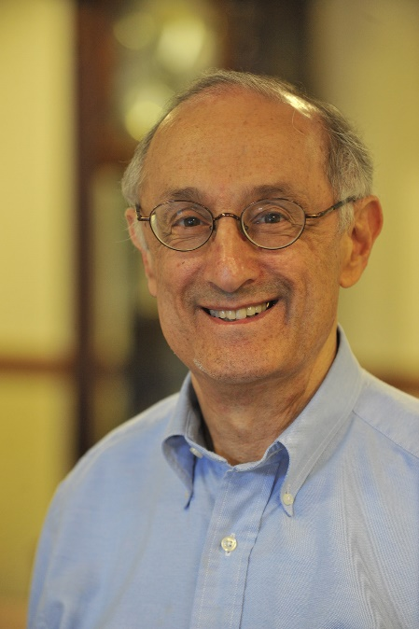
Axelrod’s Tournament
Political scientist Axelrod organized two prisoner’s dilemma tournament.
He called on sociologists in each field to devise the strongest strategies in the prisoner's dilemma
→ 1st 16 strategies 2nd 76 strategies
Each strategy was paired with each other strategy for 200 (about 150) iterations of a Prisoner's Dilemma game, and scored on the total points accumulated through the tournament.
”Tit for tat” strategy
won in two tornaments
Robert Axelrod
Payoff Matrix
 | Cooperate(C) | Defect(D)
Cooperate (C) | R=3, R=3 | S=0, T=5
Defect (D) | T=5, S=0 | P=1, P=1

Slide 8
Tit for tat (TFT)
Three features
Nice : it is never the first to defect.
Retaliatory : If betrayed, retaliate in the next turn
Forgiving : cooperate even with those who have defected against it
Initial round: Always cooperate
Non-initial round: Select the tactics(C or D ) chosen by the opposite player in the previous turn
→Simple

Slide 9
Weak point of “Tit for tat”
Noize: There are errors in people's decisions
Choose the drink do not want by mistake.
Intended to cooperate, but regarded as disturb.
Intended to criticize but was favorably received.
If there is a low probability that the opposite of the decision will occur, TFT is likely to fall into a trap of non-cooperation
TFT
C | C | C | C | D | C | D | C | D | C
TFT
C | C | C | D | C | D | C | D | C | D
ERROR!!

Slide 10
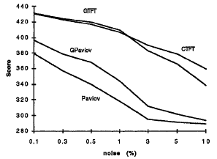
Noise resistant TFT variation
Generosity TFT (GTFT)
Basically the same as TFT, but even if the other party is non-cooperation, cooperates 10 percent
Pavlof
The first step is cooperation, and then Continue the same strategy if the previous result is relatively “good” (R=3, T=5), change the strategy if the previous result is relatively “Bad”(S=0,P=1)
Generosity TFT (GTFT)
Basically the same as TFT, but even if the other party is non-cooperation, cooperates 10 percent

Slide 11
Today’s Training
Build an Axelrod Tournament Environment with R
Probabilistically determine whether to cooperate in the next game according to the result of the previous game
→(1)Code each strategy such as TFT using “propcoop”
Play a round-robin game of six strategies and display the match score and total score of each strategy.
→(2)Code the whole flow using “for loop“ and “if statement”
Change the noise rate from 0 to 0.02 and make sure that the total score of the nuclear strategy changes
Add 2 strategies to 6 strategies and play tournaments with 8 strategies
Code the algorithm of original strategy

Slide 12
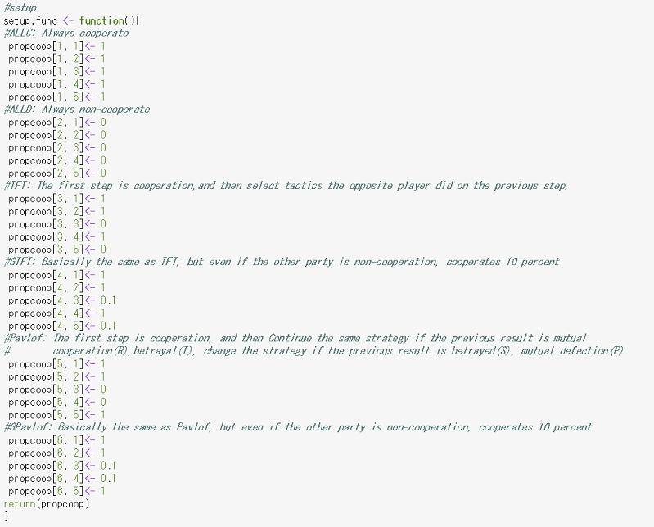
(1)Code each strategy such as TFT using “propcoop”

Slide 13
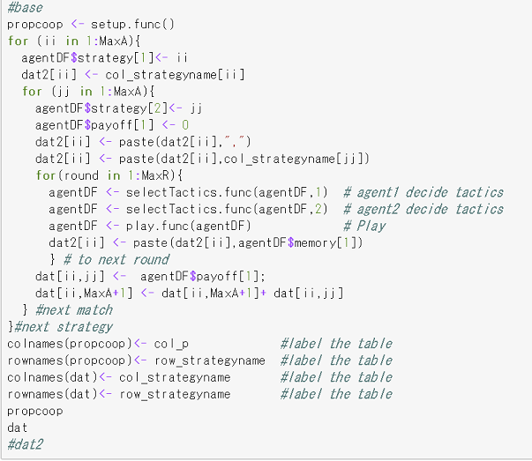
(2)Code the whole flow using “for loop“ and “if statement”

Slide 14
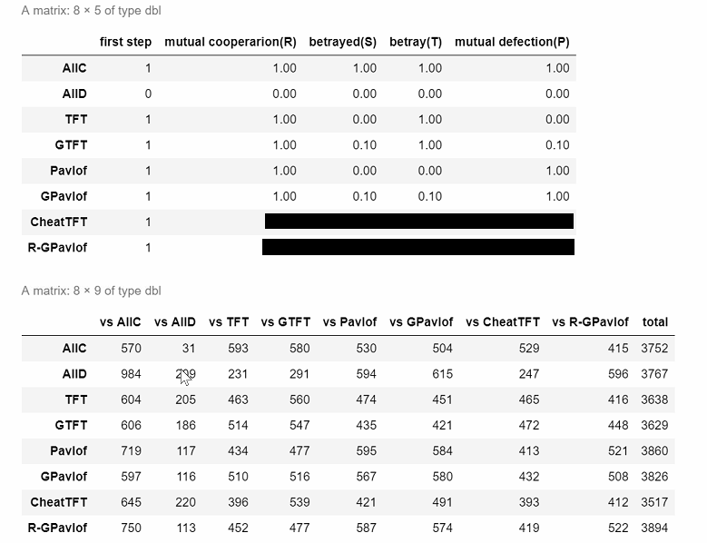
Add 2 strategies to 6 strategies and play tournaments with 8 strategies

Slide 15
Materials
https://github.com/MakotoASAOKA/DS2019_Week11

Slide 16
Week 11, 12 (7/08, 15): Simmulation I, II
Goal for week11, 12：Become able to build agent-based simulation using R language
Topics
11th Building Prisoner’s Dillemma (PD) Simulation
What is PD
Process of PD Simulation
Axelrod: Cooping with Noise (1)
Non learning player, Non-Evolving environment
12th Building agent-based Simulation
Process of agent-based simulation
Axelrod: Cooping with Noise (2)
Learning player, Evolving environment
Environment
Programming Language:
R language
Platform: Jupyter Hub
Form : Coding for Exercise Tasks on Jupyter Hub
Reference
Axelrod: The complexity of Cooperation: Agent-based Models of Competition and Collaboration, Princeton University Press, 1997.
Notes:
（説明のポイント）
・ この授業では社会科学分野で用いられるエージェントベースドシミュレーションモデルを作成することを目標とする。
・ エージェントベースドシミュレーションとは自律的に学習しながら行動する個体（エージェント）を同一環境内で相互作用させることで社会現象や集団の挙動などを予想する方法である
・ 第11週は社会科学の分野でエージェントベースドシミュレーションの概要について講義を行う。具体例としてAxcerod:The complexity of Cooperation(邦訳：対立と協調の科学) 2章 Coping with Noise で用いられているモデルを取り扱う。
・ 第12週は各自の演習形式で進み、講義は行わない。data.frameの利用、乱数を用いたデータの生成、データの可視化、データの出力を行う。したがって第3～７週で学んだ内容の実践的な内容となる。

