Slide 1
Predicting country’s prosperity from Internet & tweeting activities
[INST 737] Milestone 2
Makoto Asami & Pulkit kaushal

Slide 2
Research Question
How do internet environment and online activities (tweeting) relate to a country’s development?
We would like to predict…
GDP
Unemployment rate
Educational status (e.g. literacy rate)
Using…
Number of internet users
Number of tweet
Types of tweet

Slide 3
Data Cleaning
World Bank dataset
Converted into a table with a record per Country x Year.
214 data (per year) x 13 years (2000-2012) = 2782 data

Slide 4
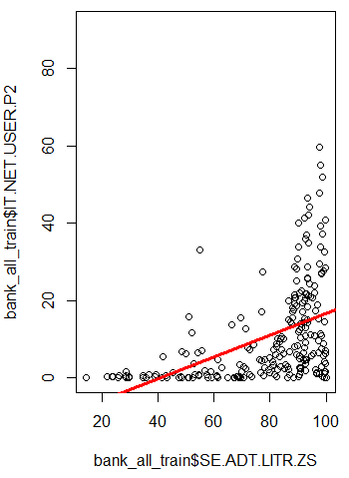
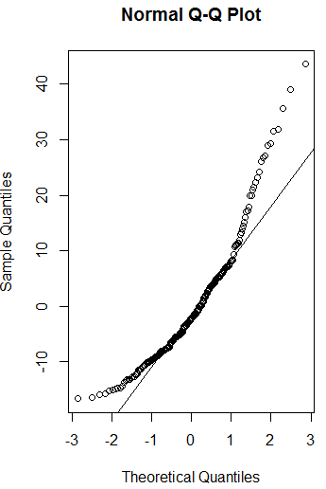
Linear Regression (1) Literacy rate (%) → Internet users (per 100 people)
Intercept: -11.4491
Coefficient: 0.2812

Slide 5
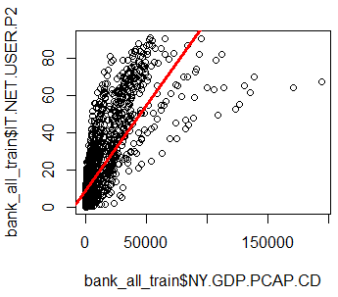
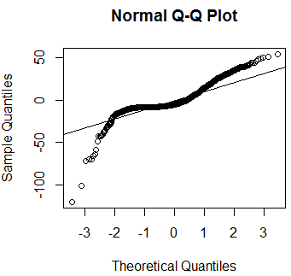
Linear Regression (2) GDP per capita → Internet users (per 100 people)
Intercept: 8.3598926
Coefficient: 0.0009201

Slide 6
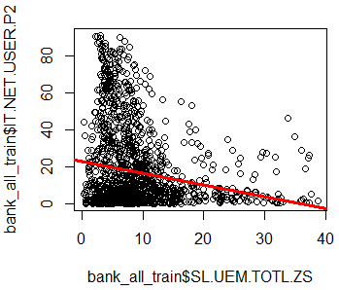
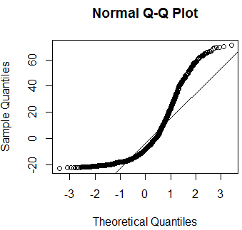
Linear Regression (3) Unemployment (%)→ Internet users (per 100 people)
Intercept: 22.8823
Coefficient: -0.6324

Slide 7
Decision Trees & Random Forests
Dataset (r4) : World Bank 2012 GDP, Internet usage and per capita Income

Slide 8
Decision Tree
Data Manipulation : range(NY.GDP.PCAP.CD)
Create a categorical variable based on GDP per capita in current dollars : Dependent Variable : Category, and Variable created was “high” which depends on GDP of particular country.
Append high to r4 (Dataset)
Split Dataset in Training and testing in 80:20 & 60:40 ratio

Slide 9
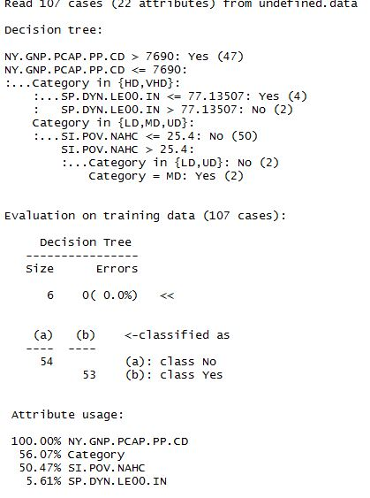
Decision Tree
Fit the tree model using Training data

Slide 10
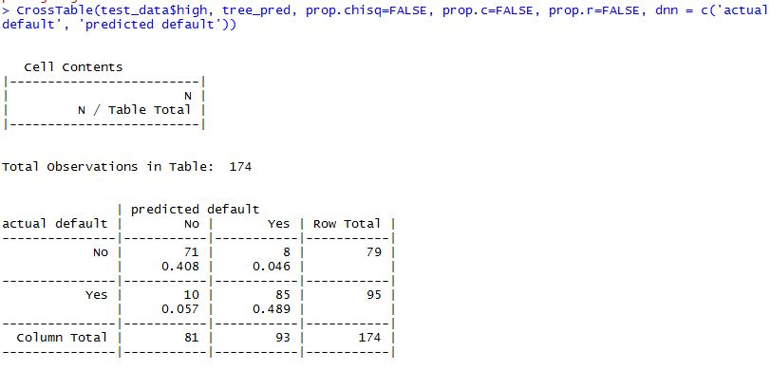
Boosting
Prediction by keeping the dependent variable: Category

Slide 11
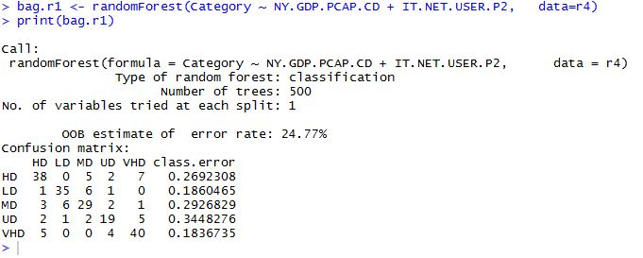
Bagging

