Slide 1
Milestone 1 Using Tweets determine relation between different countries with respect to several factors such as the country’s GDP, Its per capita Income ($), Academic Level?
Human Development Index
World bank dataset: GDP growth of country in past decade
Barrolee Dataset: Educational Attainment of the total population from 1950 – 2010

Slide 2
Research Papers
http://arxiv.org/ftp/arxiv/papers/1401/1401.6058.pdf
“The Readability of Tweets and their Geographic Correlation with Education”
http://www.mpi-sws.org/~farshad/geographic_dissection.pdf
“Featured graphic. Mapping the geoweb: a geography
of Twitter”
http://envplan.com/epa/fulltext/a45/a45349.pdf
“Geographic Dissection of the Twitter Network”
http://www.sciencedirect.com/science/article/pii/S0378873311000359
“Geography of twitter networks”

Slide 3
R code
Created an application for twitter API
Then using Handshake established the connection between twitter R
Using keywords tried to extract tweets.
Extracting Tweets.

Slide 4
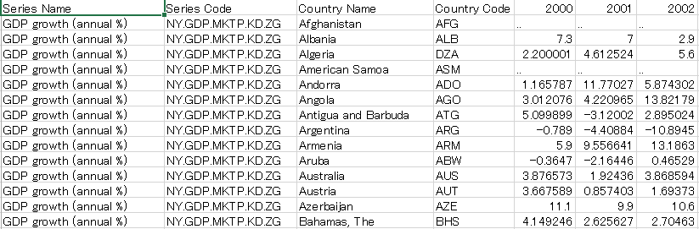
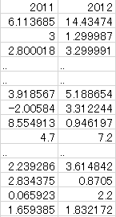
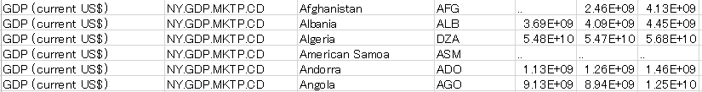
Original dataset (csv) - from the World Bank -
1 row per indices (GDP growth, Total population, etc) x country, columns for each year from 2000 to 2012

Slide 5
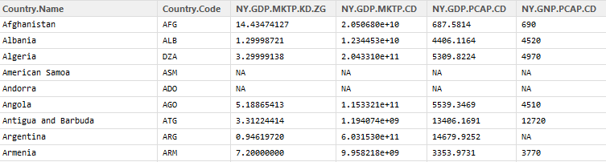
We created a table (data frame) like this
1 column per index and 1 row per country

Slide 6
R Code to transfer data
# transfer data from original dataset to new format using for loop
for(i in 1:nrow(bank)) {
# when country code matches, copy 2012 data to applicable column
if(bank[i,4] %in% bank2012[,2]) {
bank2012[bank2012[,1]==bank[i,3],c(bank[i,2])] <- bank[i,c("X2012")]
# when country code doesn't match, add a row for the country and copy 2012 data to applicable column
} else {
newRow <- data.frame(Country.Name=bank[i,3],Country.Code=bank[i,4],NY.GDP.MKTP.KD.ZG=c(0),
NY.GDP.MKTP.CD=c(0),NY.GDP.PCAP.CD=c(0),NY.GNP.PCAP.CD=c(0),NE.EXP.GNFS.ZS=c(0),
BN.KLT.DINV.CD=c(0),NY.GNP.PCAP.PP.CD=c(0),SI.POV.GINI=c(0),FP.CPI.TOTL.ZG=c(0),
NY.GDP.DEFL.KD.ZG=c(0),IT.NET.USER.P2=c(0),NE.IMP.GNFS.ZS=c(0),SP.DYN.LE00.IN=c(0),
SE.ADT.LITR.ZS=c(0),SL.UEM.TOTL.ZS=c(0),SI.POV.NAHC=c(0),NV.AGR.TOTL.ZS=c(0),EN.ATM.CO2E.PC=c(0),
GC.DOD.TOTL.GD.ZS=c(0),SP.POP.TOTL=c(0),stringsAsFactors=FALSE)
bank2012 <- rbind(bank2012,newRow)
bank2012[bank2012[,1]==bank[i,3],c(bank[i,2])] <- bank[i,c("X2012")]
}
}

Slide 7
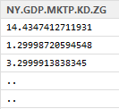
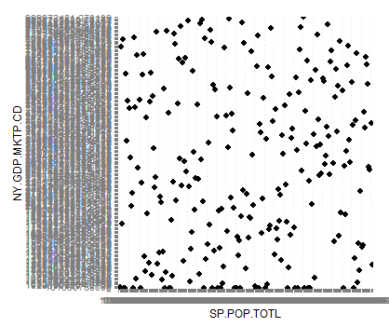

Plot for Total population & GDP ?
Wasn’t ordered because data was stored as chr type.
Converted them to num
bank2012$NY.GDP.MKTP.CD <- as.numeric(bank2012$NY.GDP.MKTP.CD)

Slide 8
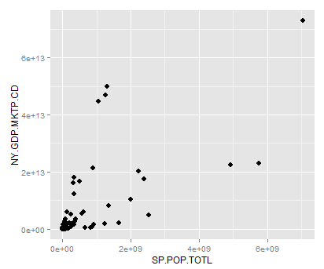
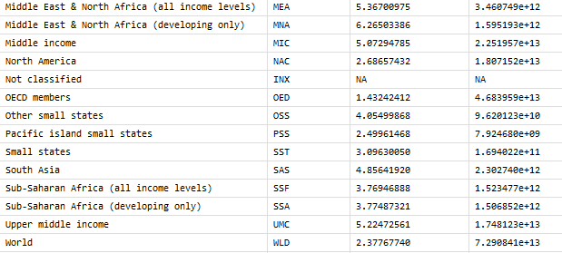
Total population & GDP for countries?
The dataset included aggregated data (South Asia, OECD members, world, etc)
Deleted them only to see countries.

Slide 9
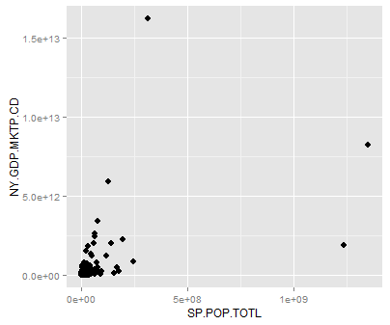
Some of other indices
Exports of goods and services (% of GDP)
Imports of goods and services (% of GDP)
Internet users (per 100 people)
Life expectancy at birth, total (years)
Literacy rate, adult total (% of people ages 15 and above)
Unemployment, total
CO2 emissions
United States
China
Japan
India

Slide 10
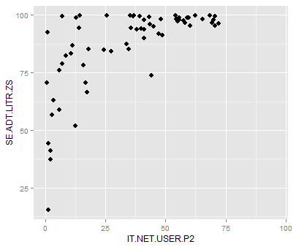
How does internet usage relate to countries’ indices?
Turkmenistan
Internet users (per 100 people) x Literacy rate, adult total (% of people ages 15 and above)
151 missing data
How about… ?
internet speed
Number of tweet
Tweeted contents, words
Can illiterate people tweet?
Myanmar
Egypt

Slide 11
