Slide 2
What is Done Since the Last Meeting?
Full Pipeline Integration: All 5 separate parts are now integrated into a complete pipeline.
Experiment Tracking: Utilized Aimstack for comprehensive experiment tracking.
Data Generation: Added the capability for personalization data generation.
Personalization Features: Implemented straightforward personalization methods.
Model Testing: Both non-personalized and personalized models have been tested on the new personalized data set.

Slide 3
Full Pipeline Integration
Pipeline Components
Data Generation
Train Baseline Models: GT (based on the CIF), LEN (based on empirical distribution), Random
Train Model
Predict Model
Calculate Metrics
All components are called within a single function for seamless integration

Slide 4

Experiment Tracking
Demo

Slide 5
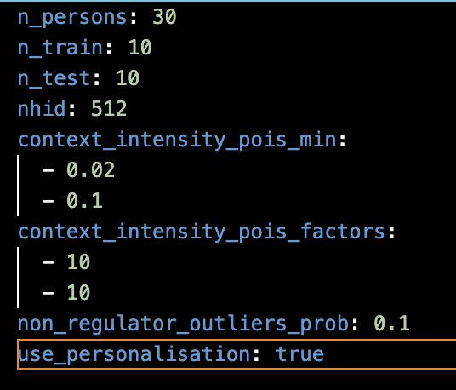
Data Generation
Before personalisation:
inhomogeneous Poisson process with 2 contexts
f(1) = 0.1
f(2) = 1
After:
Create n persons, for each person take f(1) and f(2) from uniform distribution:
Uniform(min, min * factor)
f(1) is taken from U(0.02, 0.2)

Slide 6
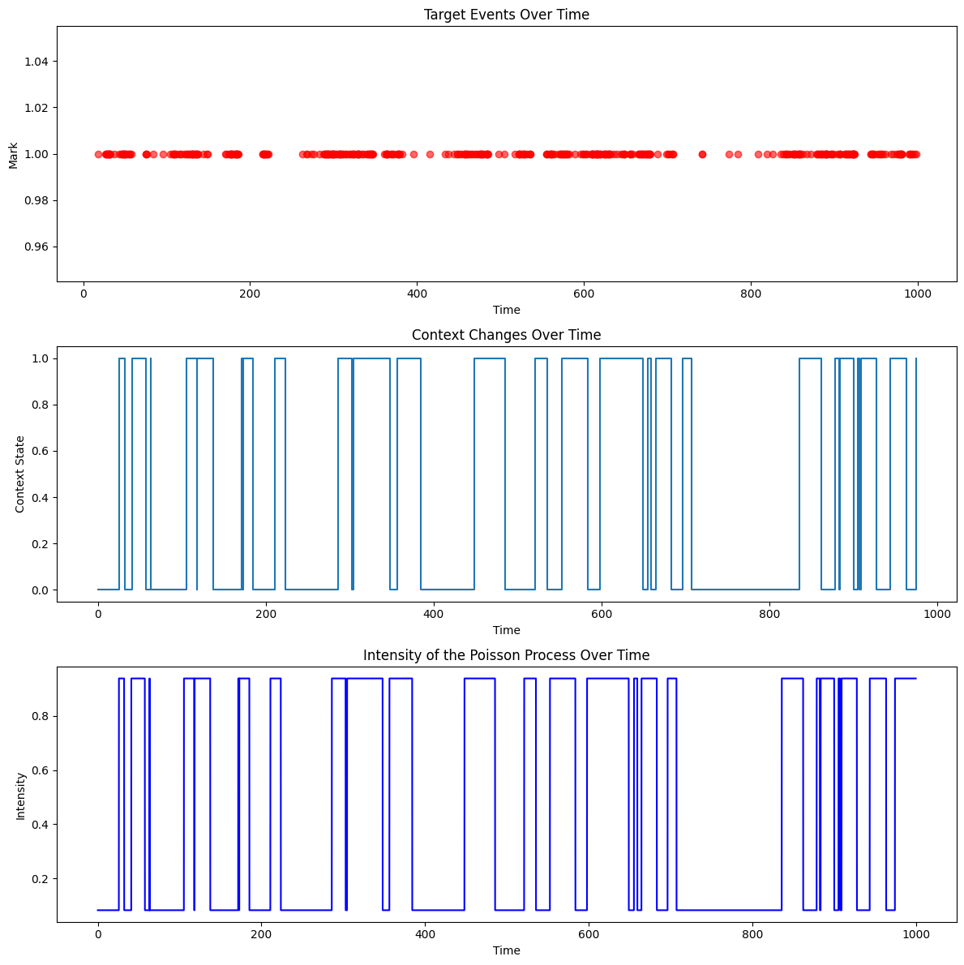
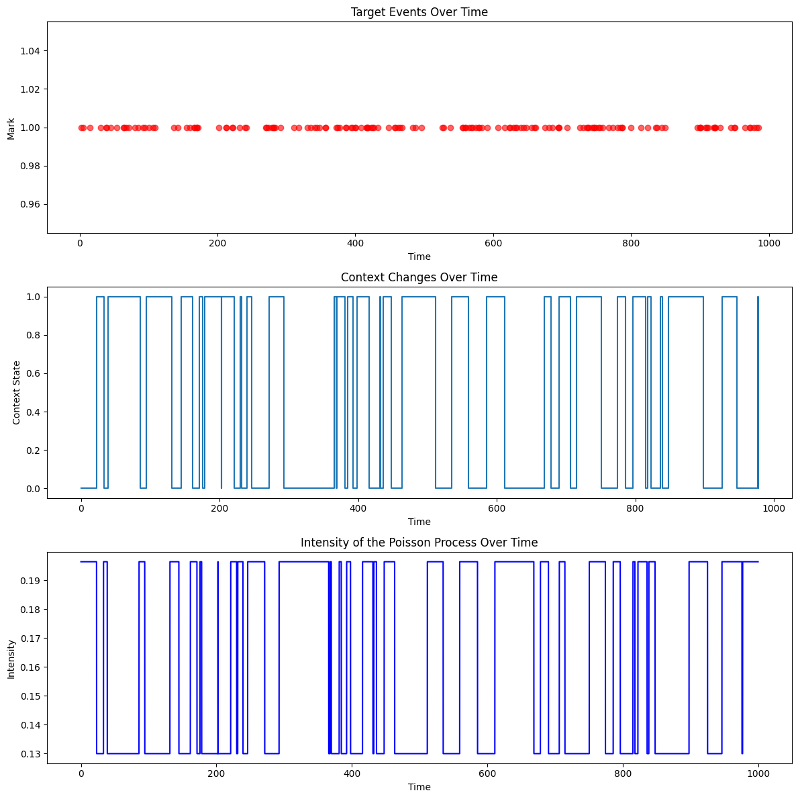
[0.08343395, 0.93736886] – person 1
[0.19644545, 0.12994072]) – person 2

Slide 7
Personalization Features
Embeddings are crucial for effective personalization.
If embeddings don't yield results, it's unlikely that other methods will.
The Idea
Embedding Layer: Create an Embedding layer of dimensions [nhid×n_persons]
Consistency: Use the same persons for both training and testing phases.
Initial Hidden State: Use the embedding as an initial hidden state for each user, enhancing the model's ability to personalize

