Slide 2
Set of models based on data
Context/non-context
Personalised/non-personalised

Slide 3
Context vs non-context

Slide 4
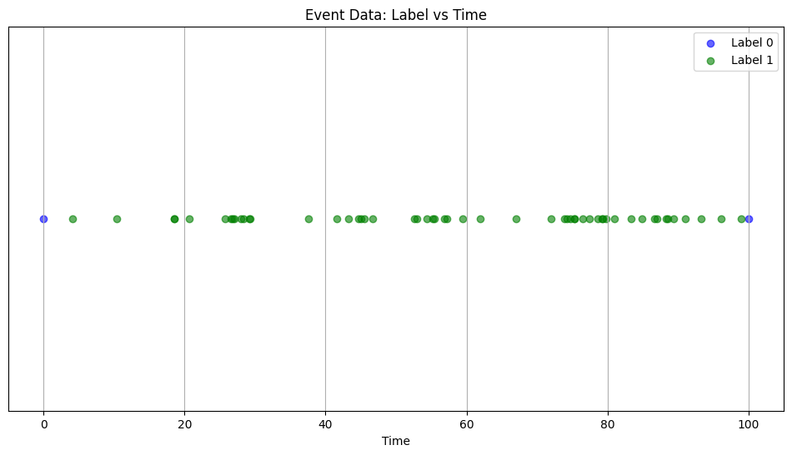
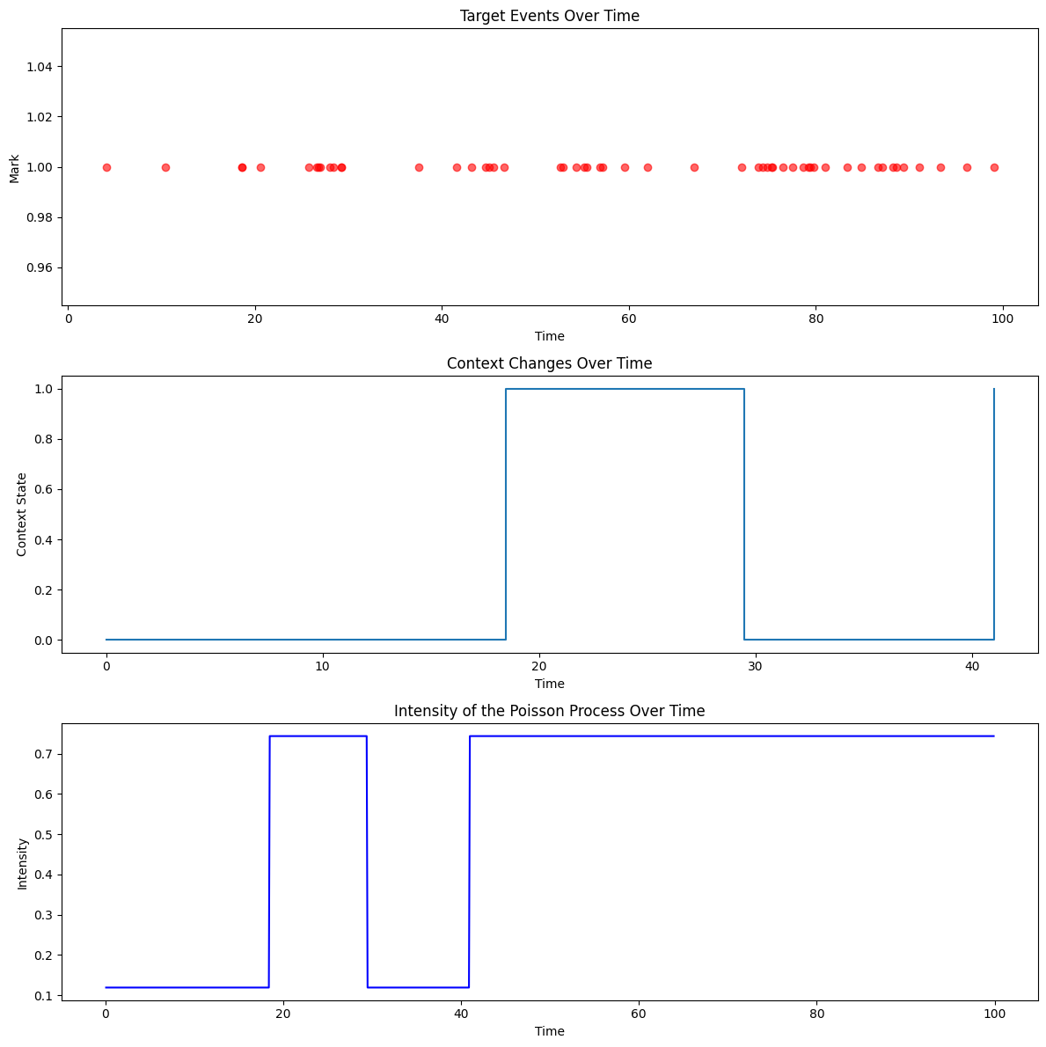
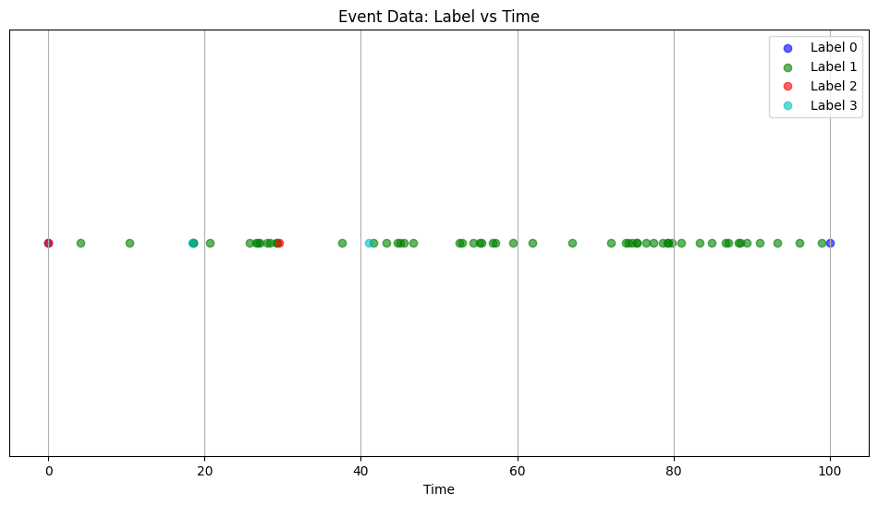

Slide 5
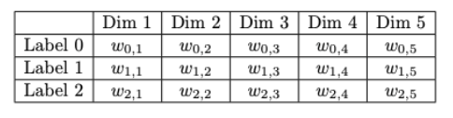
How is context used in a model?
Create context embedding layer with dimensions n_labels x nhid
use the context embedding layer to map each label to its corresponding vector

Slide 6
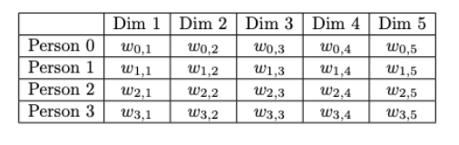
How is personalisation used in a model?
Create person embedding layer with dimensions n_persons x nhid
In the very beginning, instead of using BOS label and context embedding layer, use the person embedding layer to map each person to its corresponding vector

Slide 7
Continuous-Time LSTM with Context
LSTM
Person emb
Label emb
Embeddings
ID/BOS
t_0
Label 2
t_1
Label 1
t_2
Label 3
t_3
Label 1
t_4
BOS
t_5
Sequence

Slide 8
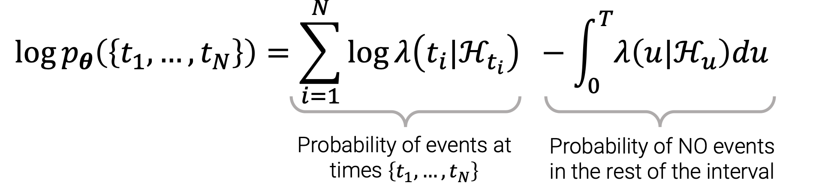
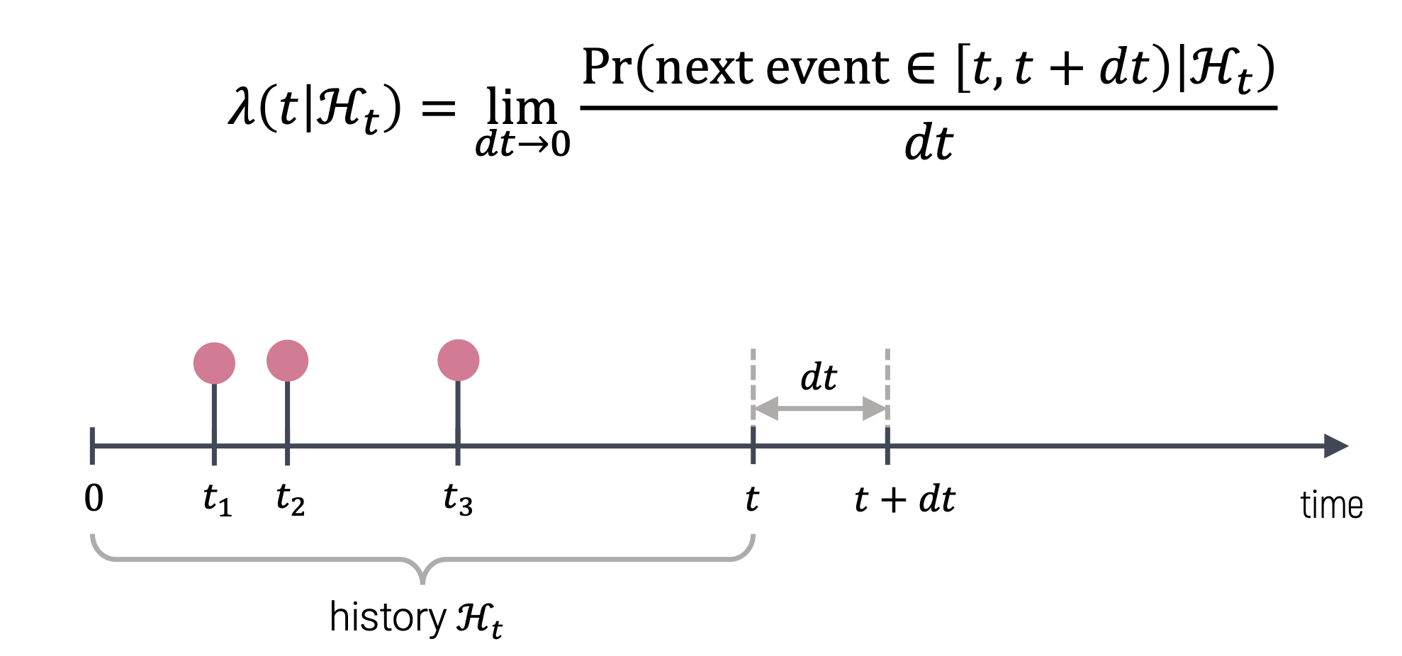
How to train?
How to get conditional intensity function?
How to approximate integral? - Monte Carlo integration

Slide 9
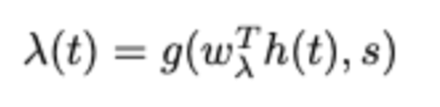
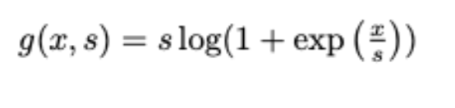
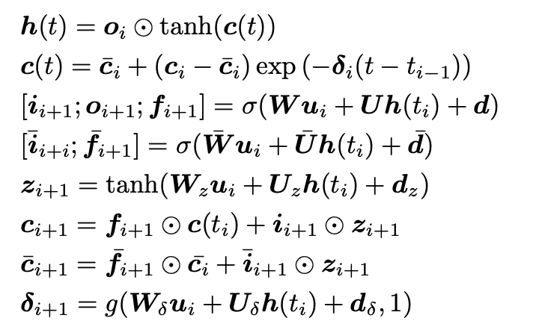
Conditional intensity function
Embeddings
Time of events

Slide 10
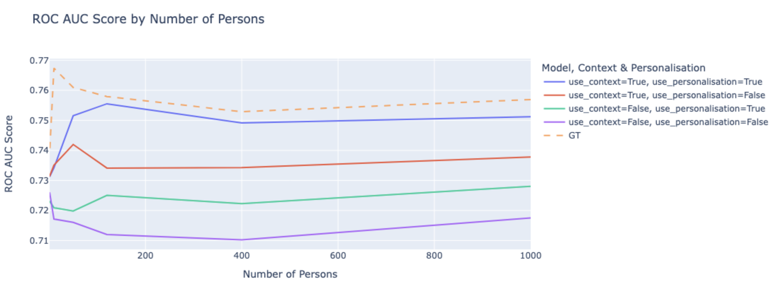
Models results
Context is more important, than personalisation
Using personalization can slightly improve both context/non-context models
Personalisation works for n_persons > 10

Slide 11
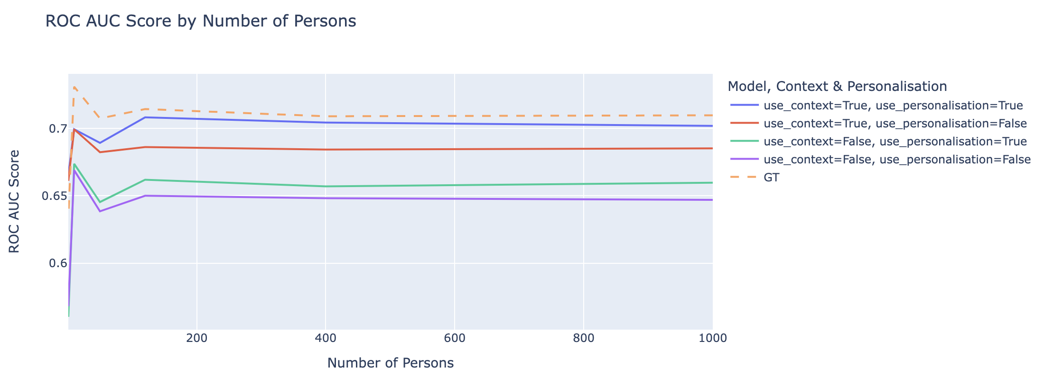
Commisions results
Results are the same
Setup: n_train=20, n_test=10

Slide 12
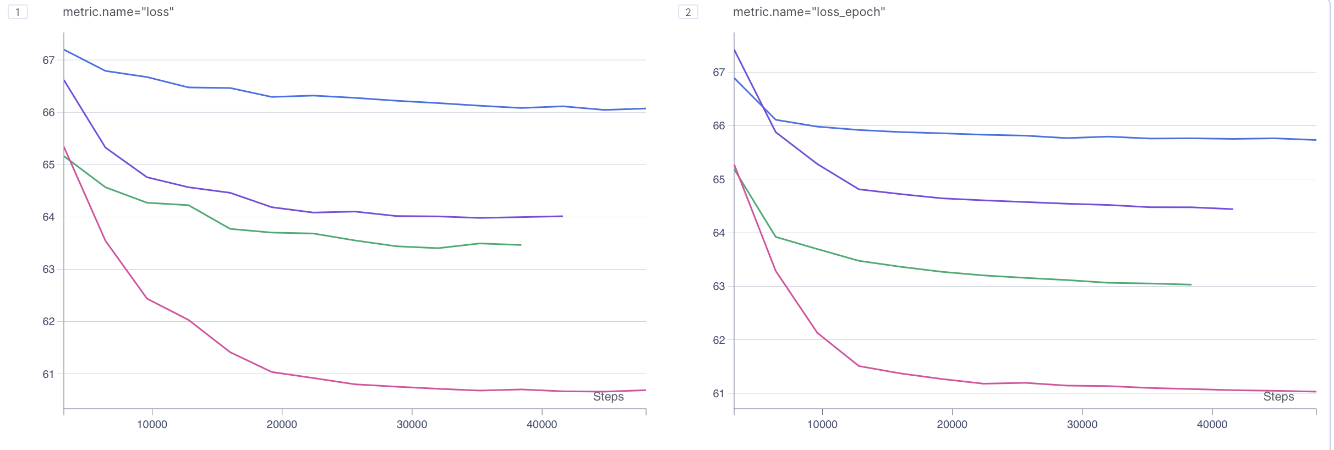
Does Maximizing Log-Likelihood Increase ROC-AUC?
Loss: val
Loss_epoch: train
Blue: nothing
Purple: personalized
Green: context
Pink: all
Answer: Yes

Slide 13
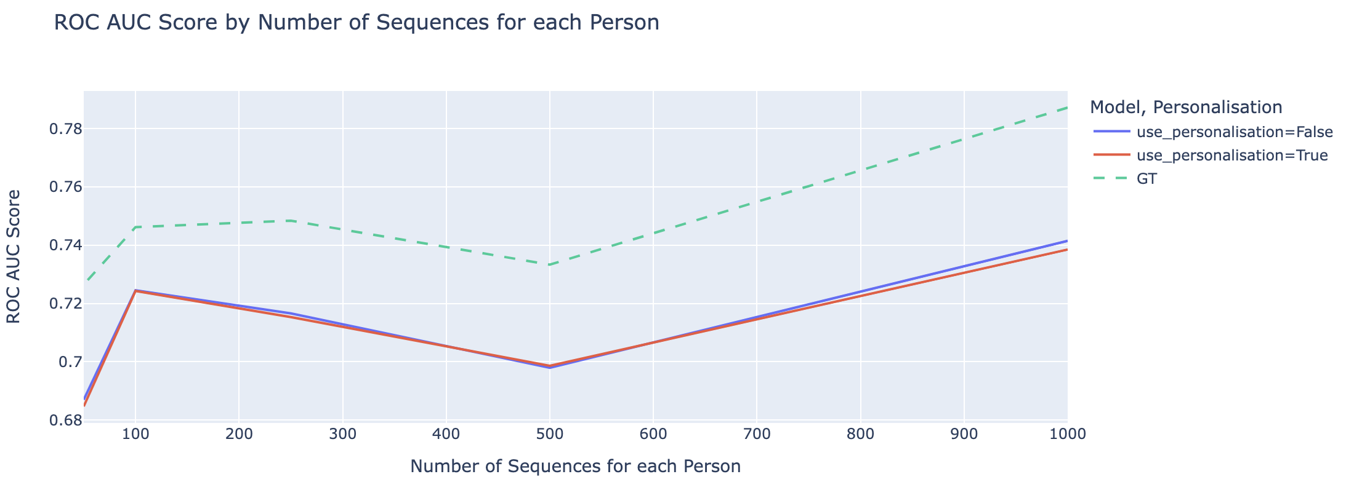
Will Increasing the Number of Sequences for Each Person Improve Personalization Performance?
Setup: 2 persons, non-context
Answer: No

Slide 14
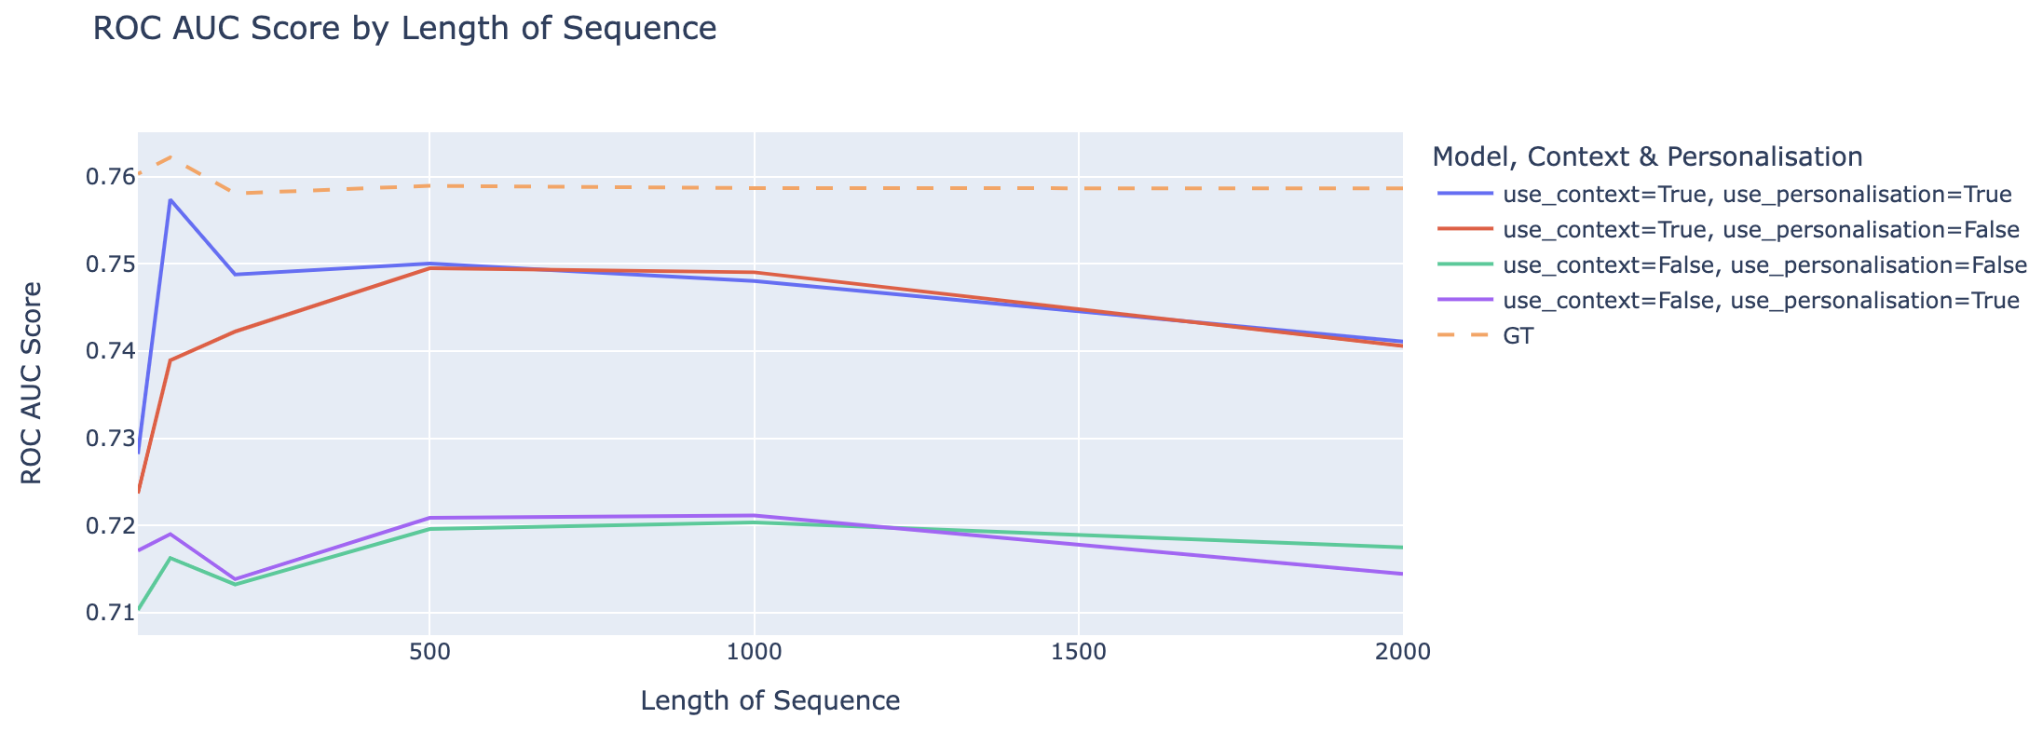
Will Increasing the Number of events for Each Sequence impact on Personalization Performance?
Setup: n_persons=50, n_train=10
Answer: The longer sequence for each person, the less personalization effect

Slide 15

Key Takeaways
Context vs. Personalization
Context is More Important: The role of contextual information outweighs that of personalization in our model.
Personalization Insights:
Long Sequences: Personalization doesn't improve performance for long sequences.
Sequence Count: Increasing the number of sequences for each person doesn't impact personalization performance.
Number of Persons: Personalization is effective only when the number of persons exceeds 10.

