Slide 1
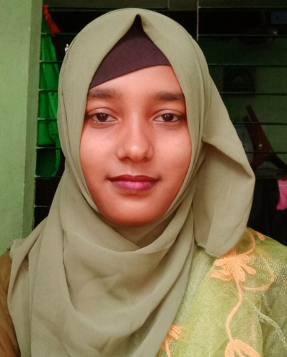



Maksuda Akter
Web Design & Developer
Experience
+88 01831916127
maksudaakter896@gmail.com
Anando Nagar Badda,Dhaka-1212
Profile
Web developers are professionals who specialize in building and maintaining websites. They possess strong technical skills, including programming languages and software design principles. They are responsible for creating the front-end user interface, back-end database, and server-side code, and they work closely with designers, project managers, and clients. Web developers must be able to solve problems, communicate effectively, prioritize their workload, and meet deadlines. A bachelor's degree in computer science or a related field, along with practical experience, is typically required to become a web developer. It's essential for web developers to continually expand their skillset and stay up-to-date with advancements in the field.
Education
Skills
Personal information
Web Development
Microsoft Word
Reference
Name :
Mobile :
Email :
Job location :

