Slide 1

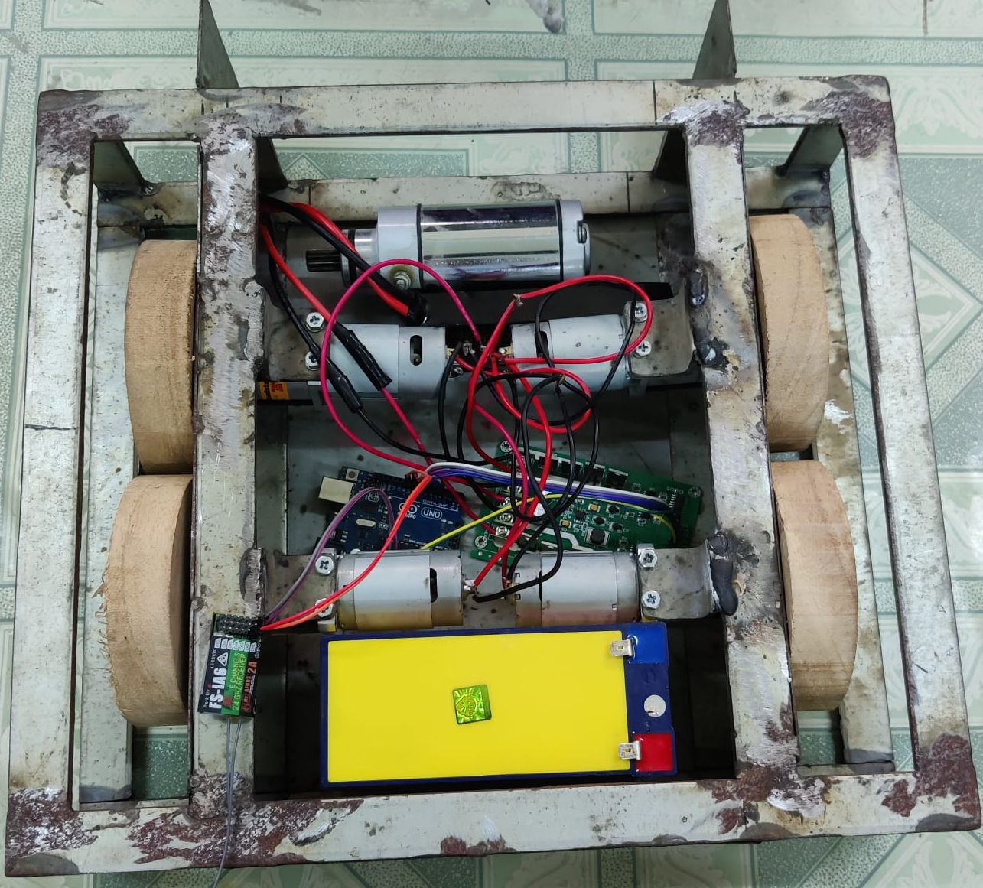
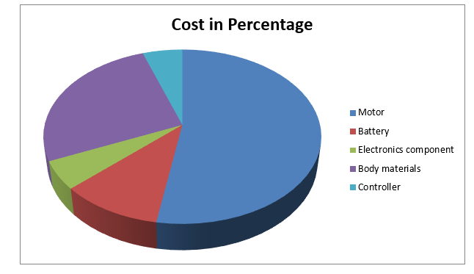
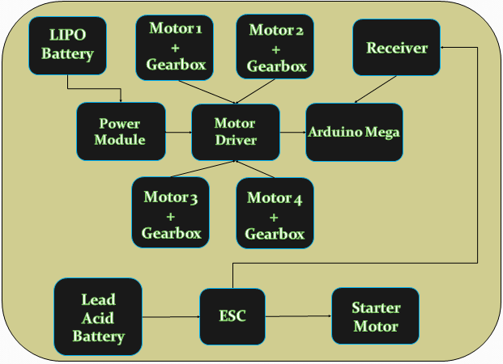
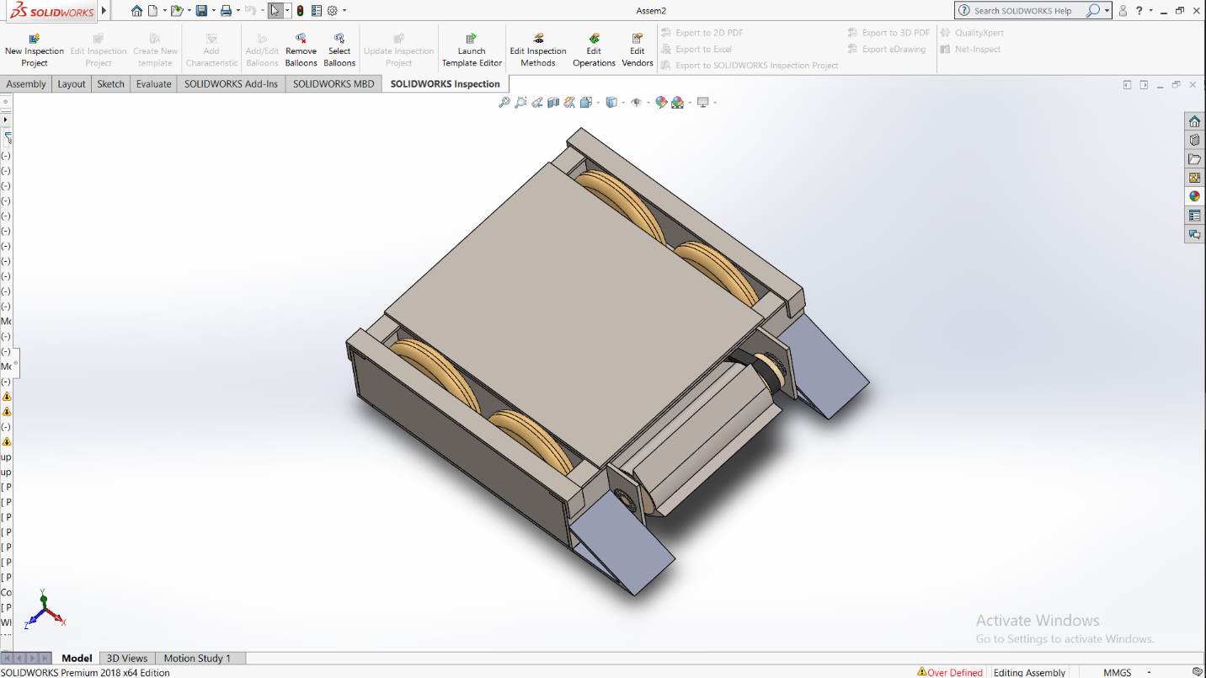
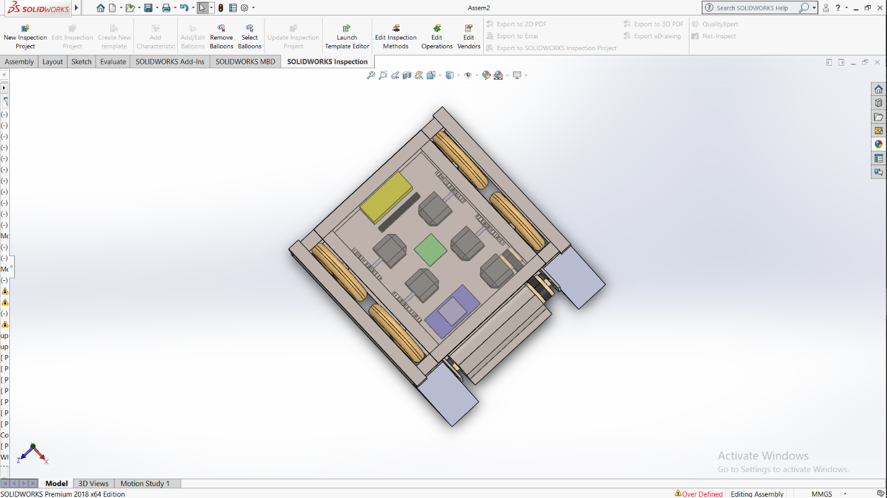
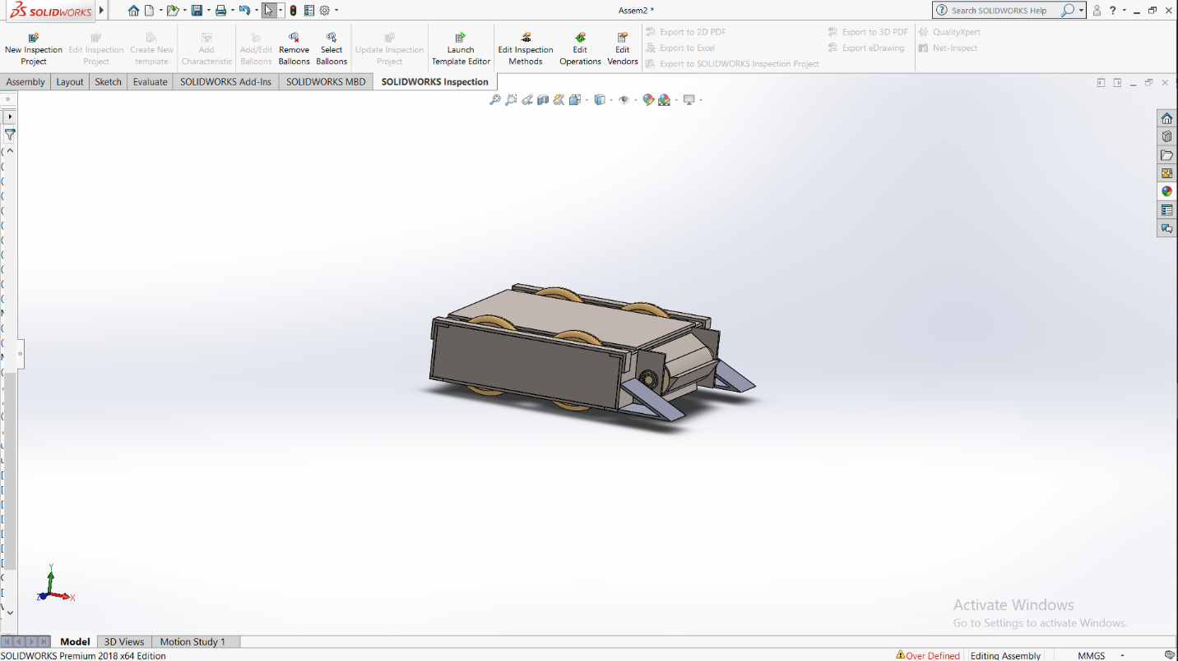

BattleBot
Supervised by :
Dr. Md. Faruque Hossain
Professor,
Dept of ECE,KUET.
Presented by :
Maksuda Rahman(1709023)
Hasin Iftida(1709025)
Introduction
Practical View:
Cost Analysis :
Battle bots are remote-controlled armed and armored machines designed to fight in a battlefield combat elimination tournament.
Competitor bots come with variety of designs, with different strategies and incorporate weapons such as axes, hammers, flippers and spinning devices
3%
15%
65%
Components
5%
12%
Arduino Uno/Mega 2. Power Module 3. Gear Box
4. RS-550 Motor 5. Starter Motor 6. Lipo Battery
7. Lead Acid Battery 8. Controller & Receiver 9. Electronic Speed Control(ESC) 10. Body structure material 11. wheel
:
.
Component List with Cost
Name | Details | Quantity | Price
Motor | 66mm High Speed High Torque 1000rpm 60W DC motor 12V MM381 | 5 | 58$*5 = 290$ (Approximately 25,000tk) + shipping cost
Battery | 11.1V 4500mah 3S 30C Lipo | 1 | 4000tk
Arduino Mega | R3 | 1 | 800-900tk
Power module | MOD-00044 | 1 | 800-900tk
Motor driver | L293D | 1 | 250tk
Controller | 6CH Remote Control RC | 1 | 3000-3500tk
TOTAL |  |  | 33850-34550 (shipping cost excluded)
Fig-5:Practical view of Bot
Block Diagram and CAD Design of Bot:
Issue of Concern:
One of our concern is about choosing weapons. Normally we need to choose weapon First accurately. Because chance of winning depends on weapon.
another main concern is motors. The more swiftly they will move , the more the chances of winning.
Body need to be strong enough so that it can endure any kind of attack.
Need a motor driver and power module which can actually control motor and provide constant power.
Fig-2:Top view of Bot
Cost For Body Structure
Fig-1:Block Diagram
Name | Details | Cost
Wheels | 4 wheels made of wood | 200
Body | Metal sheets & Box steel bar | 5000
Weapon | Metal
Application:
Fig-3:Inner view of Bot
Fig-4: Side view of Bot
As a weapon
Battle purposes
Purpose of comparing capability
Study purpose
.
This presentation poster was designed by FPPT.
Notes:
You can add your presentation notes here. This presentation template for research posters is fully editable so text, graphics and content can be updated to fit your own research needs.
Download more poster presentation templates from FPPT.com

