Slide 1

Presentation
on
Software Development Project- II
Project Name: “Medical Information Management System”
Supervisor:
Rokan Uddin Faruqui
Associate Professor
Department of Computer Science and Engineering
University of Chittagong, Bangladesh
Project Members:
Name ID
Maksudul Hoque Aubhi 1728006
Afsari Sultana Rubaba 1728009
Sayeda Sharmin Sultana Suchi 1728019
Md. Nazim Uddin 1728022

Slide 2
Contents
Objectives
Introduction
Features
Methodology
Implementation
Tools
Future Plan
Conclusion
References

Slide 3
Objectives
Why we developed Medical Information Management system application?
To handle the all activity and information of the hospital.
To maintain the confidentiality, availability, integrity of information.

Slide 4
Introduction
The system handle the all medical information and activity.
Only authorized user can access this system.
User can access information based on their authentication role.
User can easily access information.

Slide 5
Features
Only authorized user can access the system.
Data encryption
AES algorithm (Advanced Encryption System)
AES
Plain Text
Secret Key
Cipher Text

Slide 6
Features
User can access information based on their authentication role.
Admin can register employee or doctor but receptionist or other employee can’t do.
Admin can access “registerDoctor” page but receptionist can’t access.
Custom Page
If User login as admin, user directed to admin default page “adminPage” .
If User login as receptionist, user directed to receptionist default page “receptionistPage” .

Slide 7
Features
Generate remainder based on appointment.
Graphical representation of income and expense.

Slide 8
Methodology
In this project we have used Spring framework, hibernate framework for ORM, thymleaf template engine, MYSQL database.

Slide 9
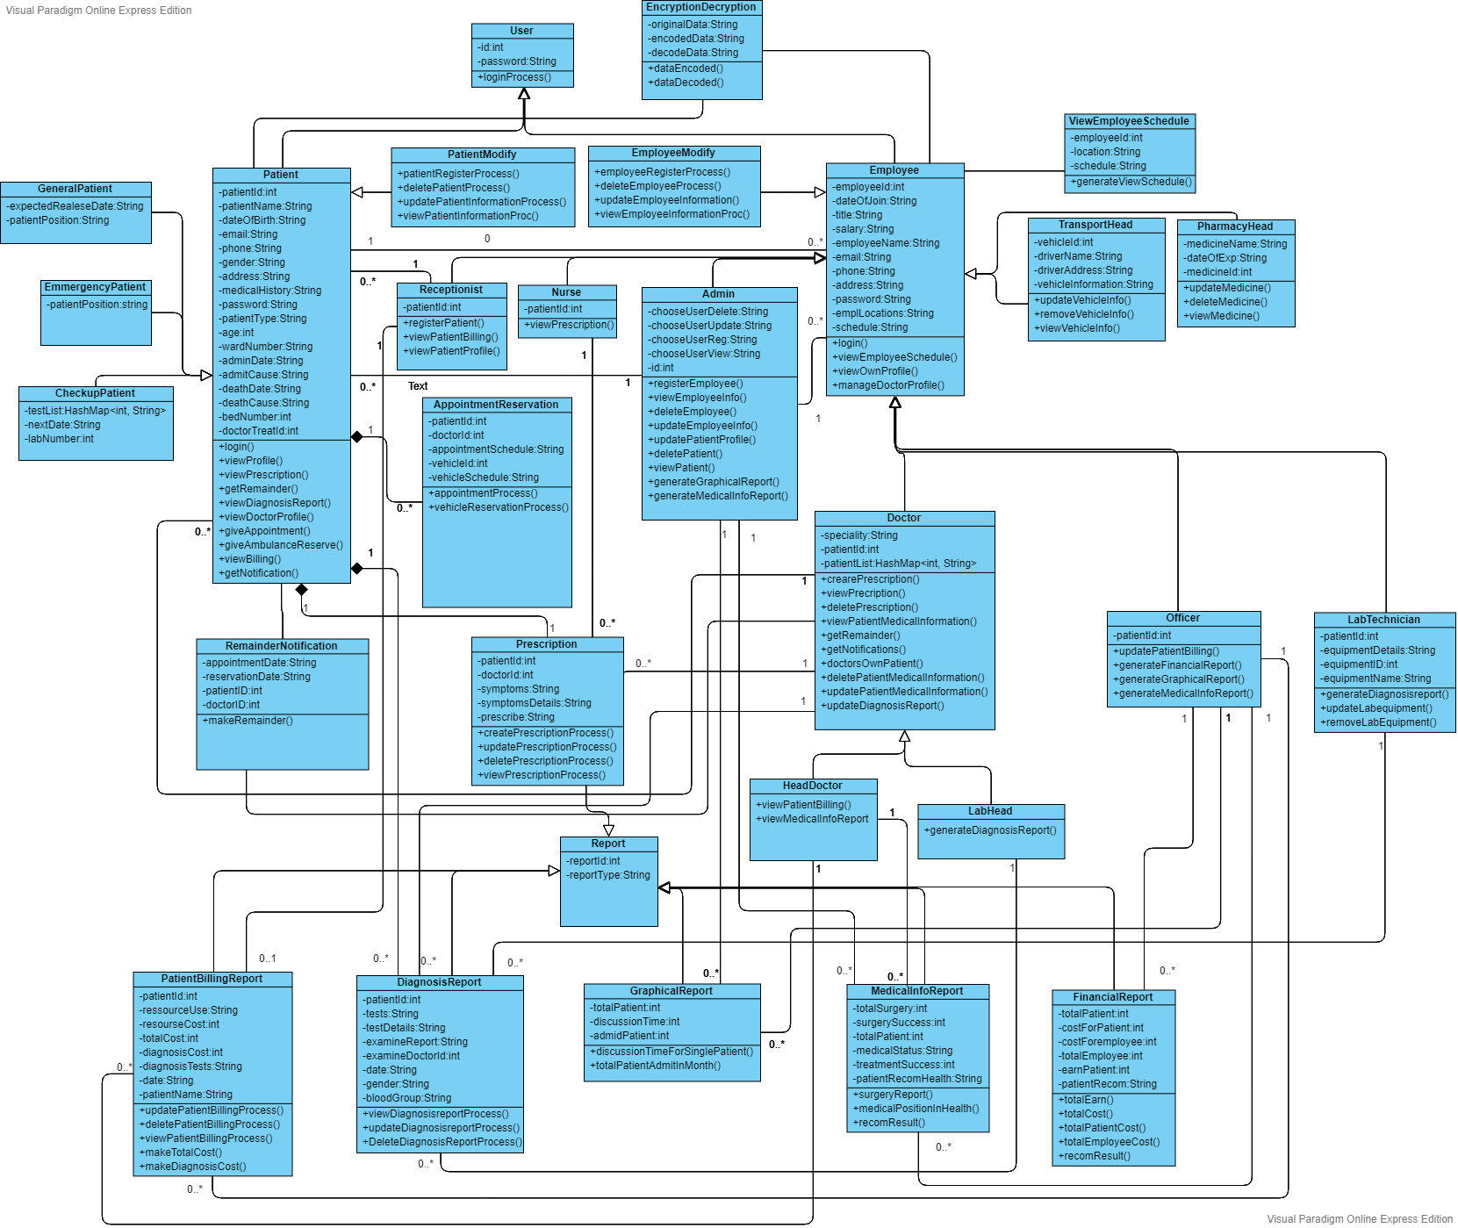
Methodology
We build the system based on this class diagram:

Slide 10
Implementation
Work list:
Employee and Doctor Registration
Employee and Doctor Information Modify and view.
Admit Patient, Modify patient information and view.
Ward information add, modify and view .
Assigned Patient List.

Slide 11
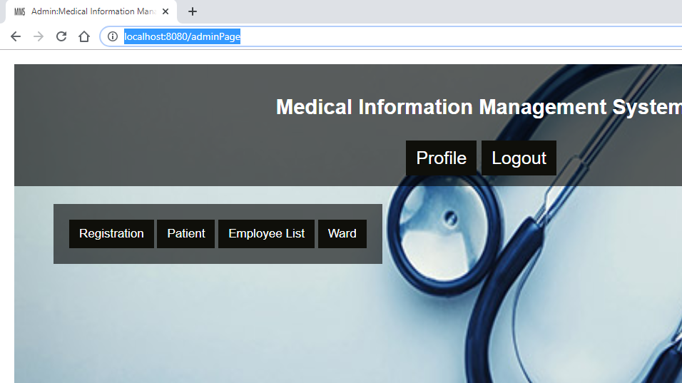

Implementation
Custom Page(Admin)

Slide 12
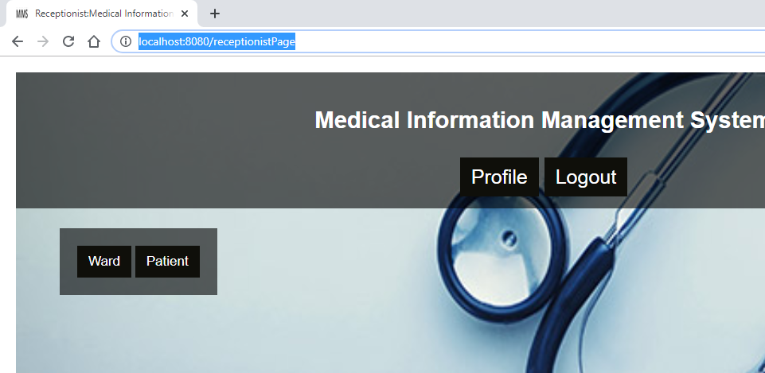
Implementation
Custom Page(Receptionist)

Slide 13
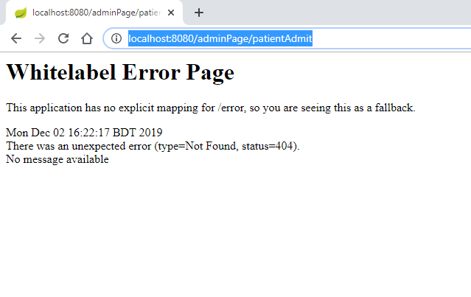
Implementation
User Restriction

Slide 14
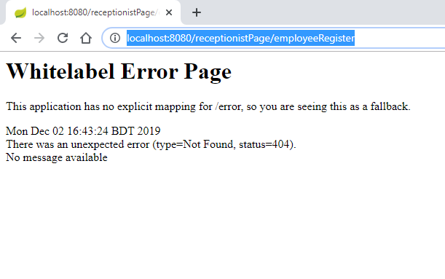
Implementation
User Restriction

Slide 15
Tools
JAVA
Spring Framework
Hibernate Framework(ORM)
Thymleaf template engine
MYSQL database

Slide 16
Future Plan
In future we will implement following features:
MIMS Doctor Platform
This is an online platform for doctors.
Doctor can see patient’s medical information from here in emergency.
The doctor can see medical information of those patients who are under him.

Slide 17
Conclusion
We think this system will help the users
and medical authority to maintain the
activity and access of information easily.
We have tried to make this application user friendly. In future we have desire to work on this system to improve its functionality.

Slide 18
References
https://www.devglan.com/corejava/java-aes-encypt-decrypt
https://tutorials.webencyclop.com/spring-boot/
http://www.jicjo.com/Portals/Portal1/Upload/Block/Image/medical-2.jpg

Slide 19
Thank you ☺

