Slide 1

DevOps Project Deploy Website to AWS
Maksym Popovkin EPAM 2020 DevOps

Slide 2

Motivation
Writing this project is very important for me, as this is my first DevOps project. The topic of this project was chosen because the development of web applications is now very popular and I would like to bring at least a little benefit in this not simple matter.

Slide 3

Relevance
The relevance of this project is that:
The use of web technologies is increasing markedly in all areas of human life in our time.
To speed up the process of creating a finished product, this project was written.

Slide 4

Purpose
The purpose of this project:
Speed up the process between development and finished product.
Ensure secure data transmission.
Increases the reliability of the finished product

Slide 5



Project structure
AWS
Dev Server
Test Server
Jenkins
Ansible
Stage Server
Prod Server
GitHub
Developer
Developer
Developer

Slide 6
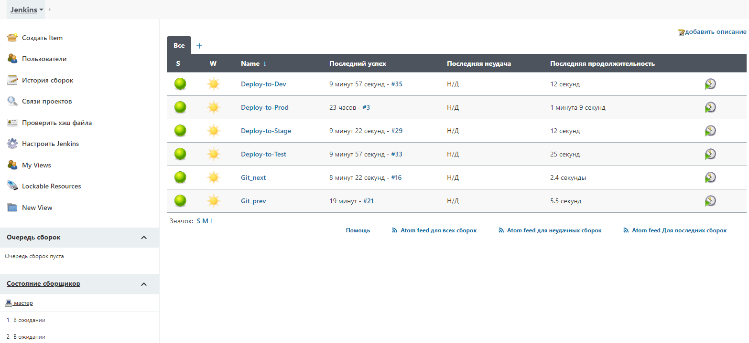

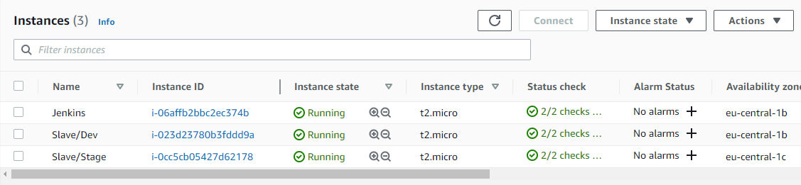
Tasks
Jenkins setting
Ansible setting
AWS setting

Slide 7
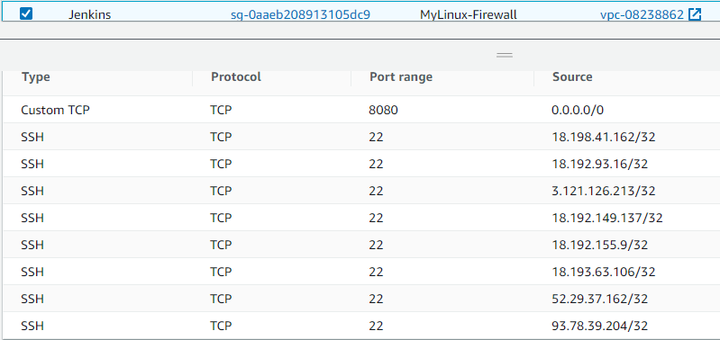
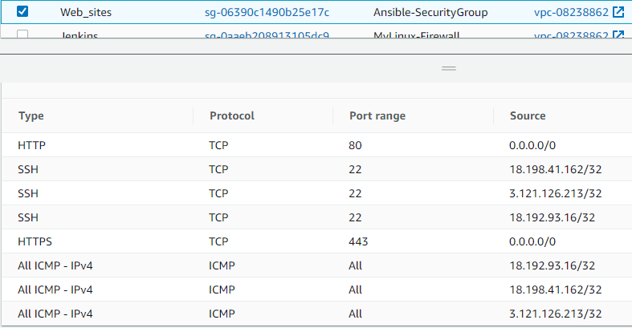
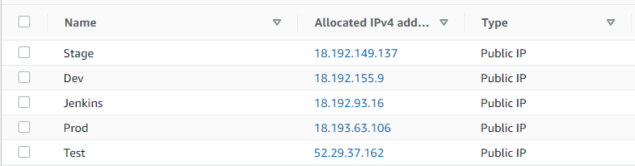
AWS Setting
Jenkins Security group
Security group for web servers
Elastic IP addresses

Slide 8
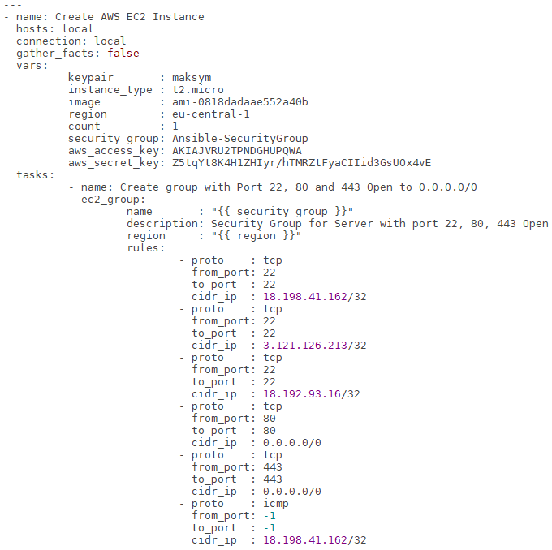
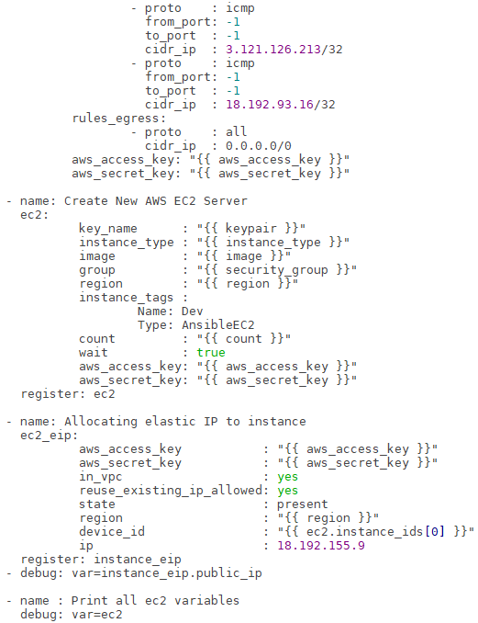
Writing ansible playbooks

Slide 9
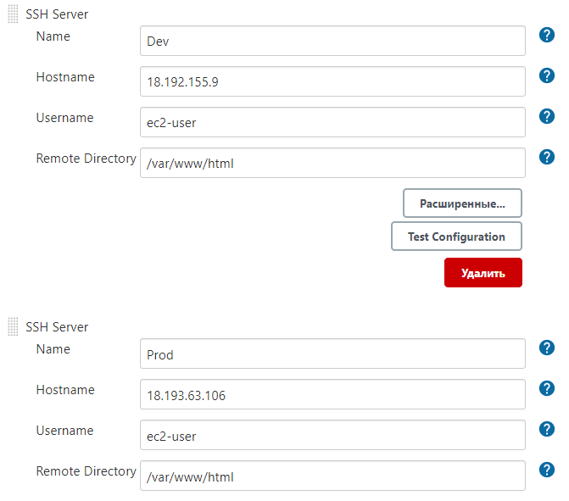
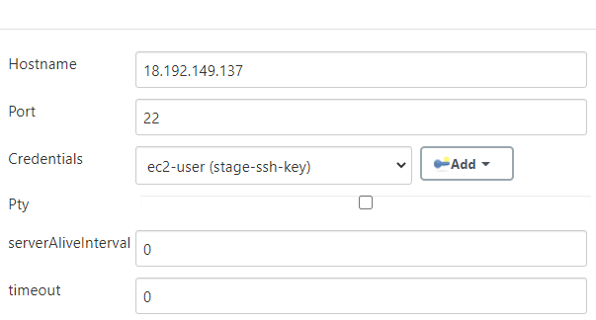
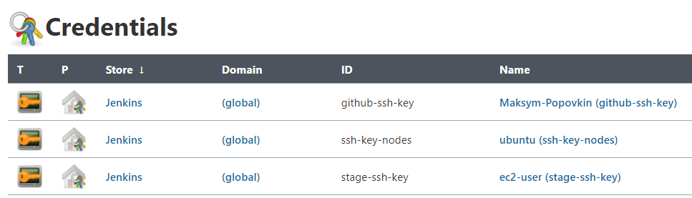
Jenkins wizard setup
SSH remote hosts
Publish over SSH

Slide 10
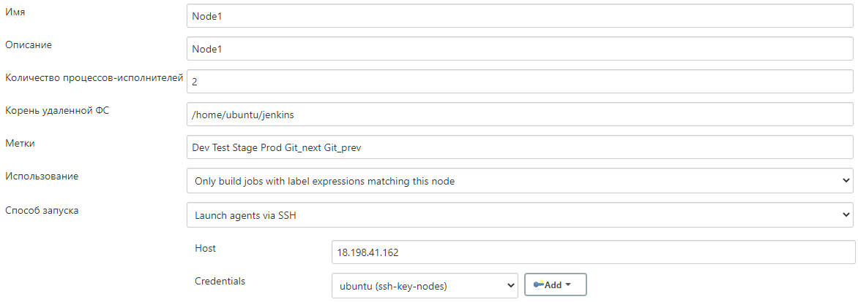
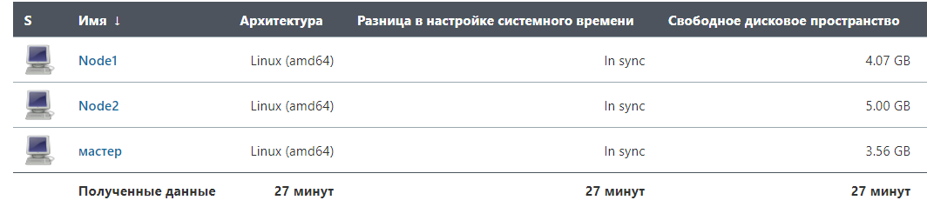
Jenkins nodes setup

Slide 11
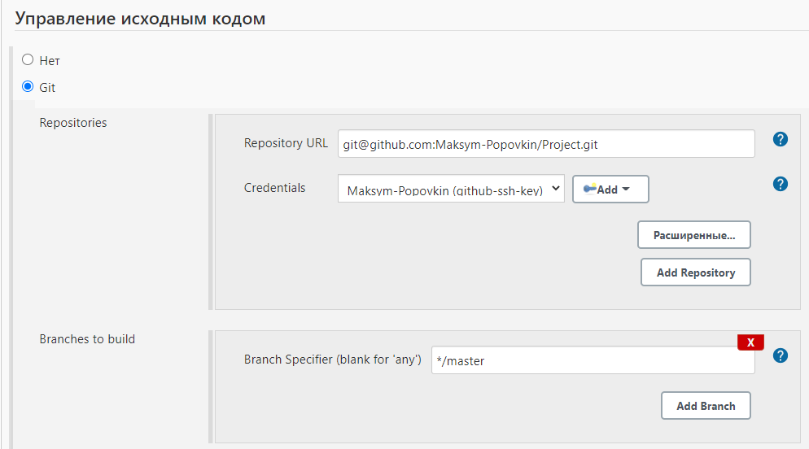
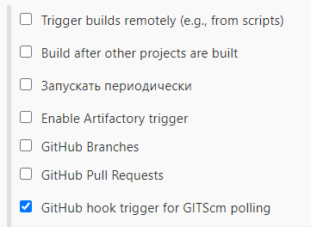
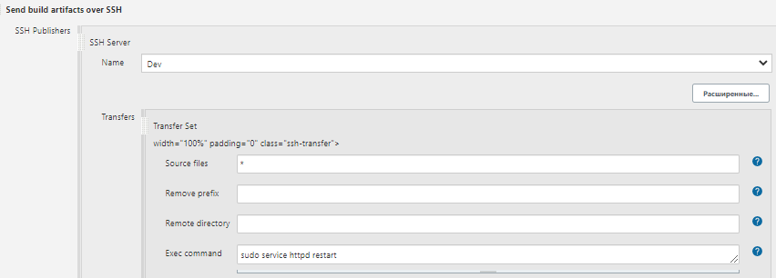
Jenkins job setup
Source control
Assembly triggers
Send build artifacts over SSH

Slide 12
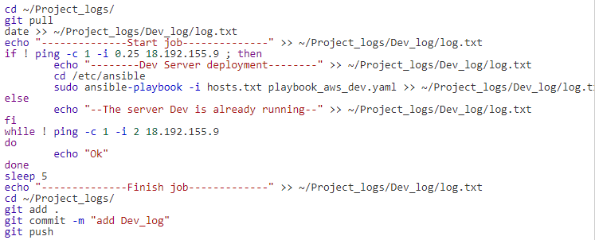
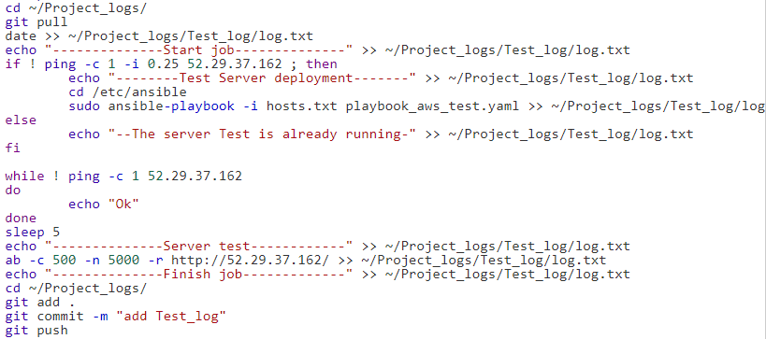
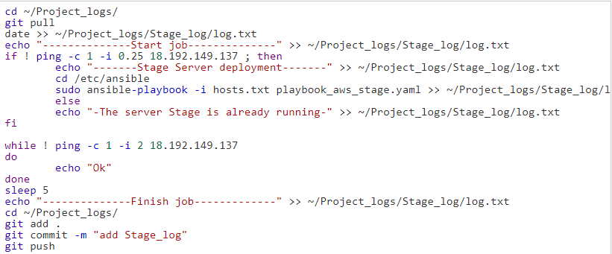
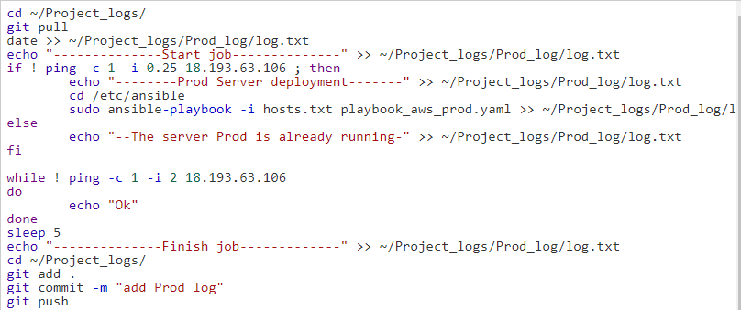
Execute shell command
Dev job
Test job
Stage job
Prod job

Slide 13
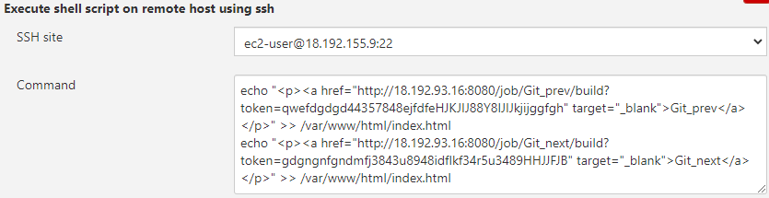

GitHub version control
Git_prev
Git_next

Slide 14
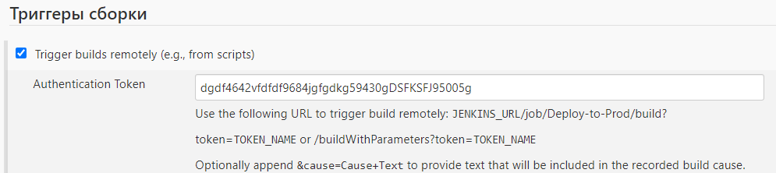
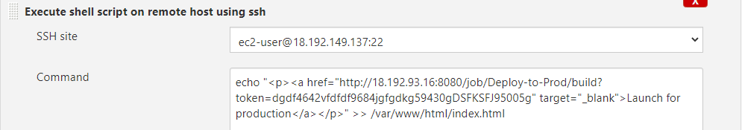
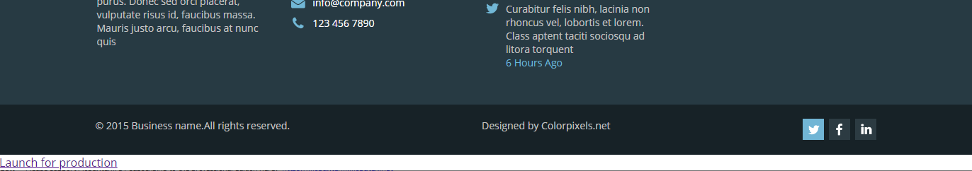
Deploy to Prod

Slide 15
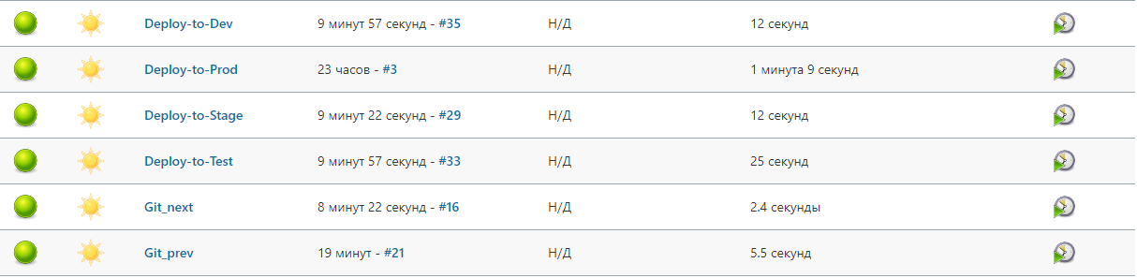
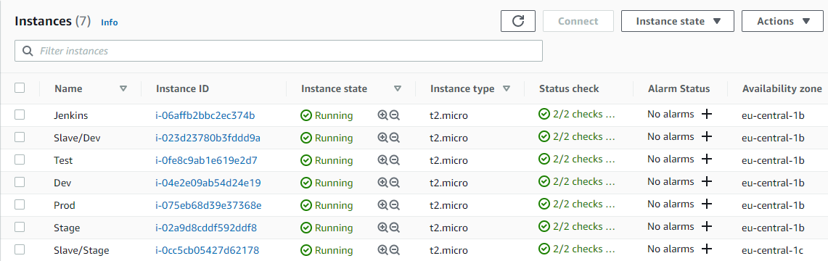
Project implementation

Slide 16
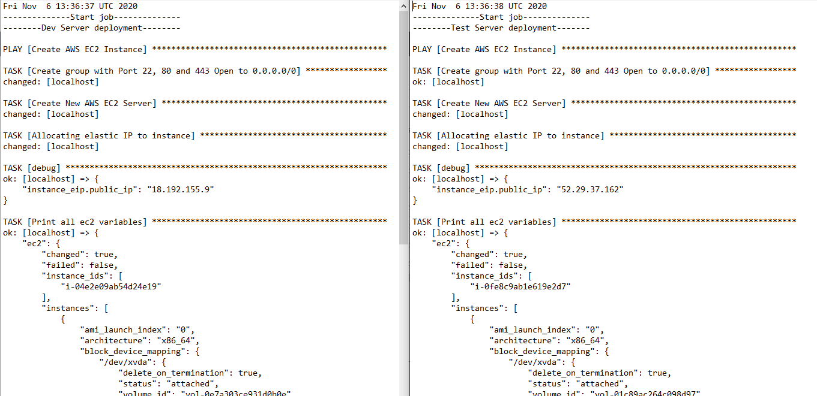
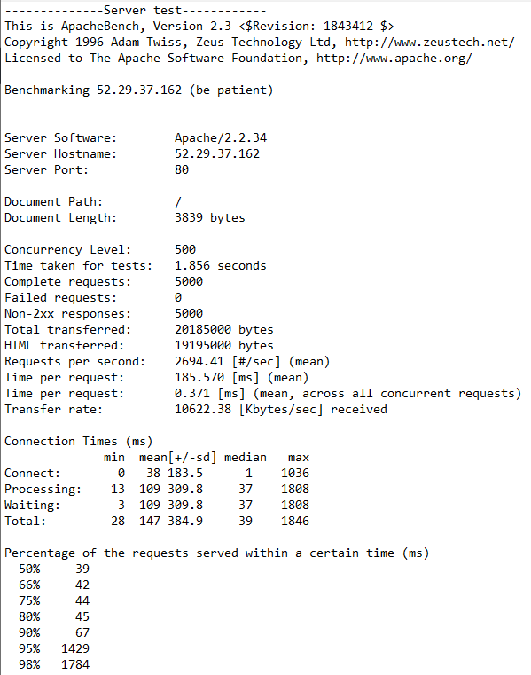
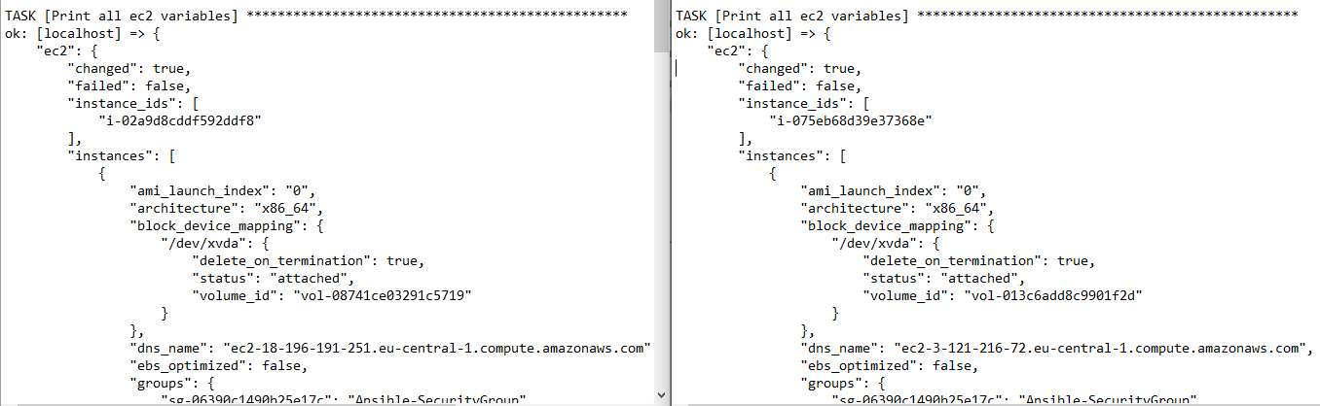
Logs
Dev and Test logs
Web server testing
Stage and Prod logs

Slide 17

Happened:
AWS setup
Jenkins setup
Creation ansible scripts
Creation and uploading logs to GitHub
I would like to add:
Raising servers in docker containers

Slide 18


