Slide 1
Using R in the Azure ML platform DEMOS
Alessandro Rezzani
@alerezzani
www.dataskills.it

Slide 2
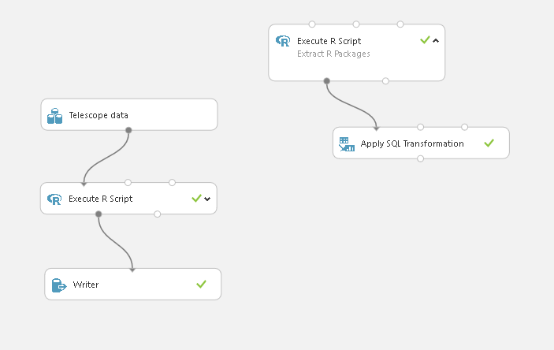
DEMO Setup

Slide 3
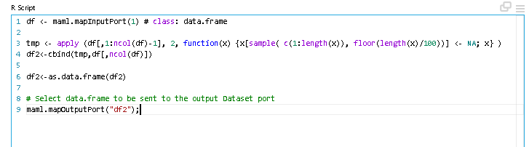
DEMO Setup
df <- maml.mapInputPort(1) # class: data.frame
tmp <- apply (df[,1:ncol(df)-1], 2, function(x) {x[sample( c(1:length(x)), floor(length(x)/100))] <- NA; x} )
df2<-cbind(tmp,df[,ncol(df)])
df2<-as.data.frame(df2)
# Select data.frame to be sent to the output Dataset port
maml.mapOutputPort("df2");

Slide 4
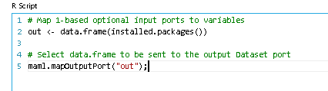
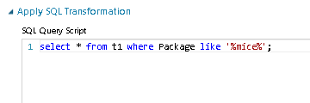
DEMO Setup
# Map 1-based optional input ports to variables
out <- data.frame(installed.packages())
# Select data.frame to be sent to the output Dataset port
maml.mapOutputPort("out");

Slide 5
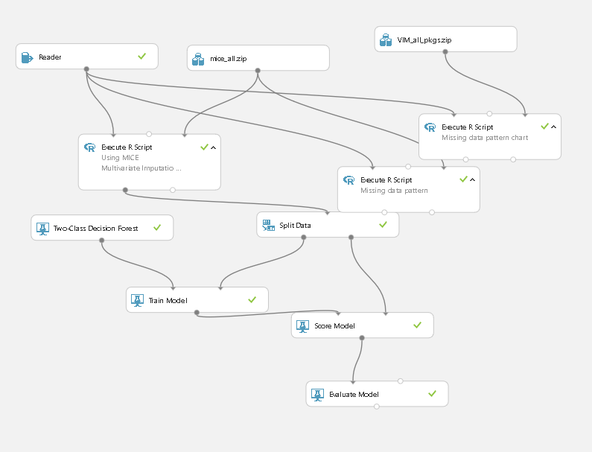
DEMO 1 – pkg & imputation

Slide 6
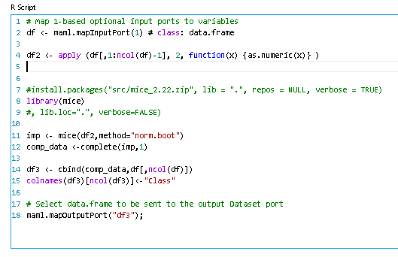
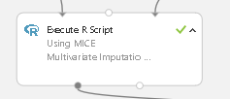
DEMO 1 – pkg & imputation
# Map 1-based optional input ports to variables
df <- maml.mapInputPort(1) # class: data.frame
df2 <- apply (df[,1:ncol(df)-1], 2, function(x) {as.numeric(x)} )
#install.packages("src/mice_2.22.zip", lib = ".", repos = NULL, verbose = TRUE)
library(mice)
#, lib.loc=".", verbose=FALSE)
imp <- mice(df2,method="norm.boot")
comp_data <-complete(imp,1)
df3 <- cbind(comp_data,df[,ncol(df)])
colnames(df3)[ncol(df3)]<-"Class"
# Select data.frame to be sent to the output Dataset port
maml.mapOutputPort("df3");

Slide 7

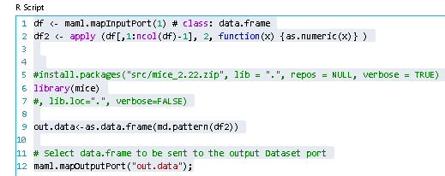
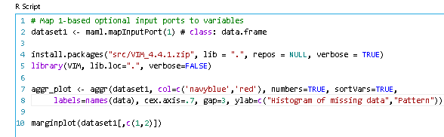
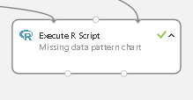
DEMO 1 – pkg & imputation
df <- maml.mapInputPort(1) # class: data.frame
df2 <- apply (df[,1:ncol(df)-1], 2, function(x) {as.numeric(x)} )
#install.packages("src/mice_2.22.zip", lib = ".", repos = NULL, verbose = TRUE)
library(mice)
#, lib.loc=".", verbose=FALSE)
out.data<-as.data.frame(md.pattern(df2))
# Select data.frame to be sent to the output Dataset port
maml.mapOutputPort("out.data");
dataset1 <- maml.mapInputPort(1) # class: data.frame
install.packages("src/VIM_4.4.1.zip", lib = ".", repos = NULL, verbose = TRUE)
library(VIM, lib.loc=".", verbose=FALSE)
aggr_plot <- aggr(dataset1, col=c('navyblue','red'), numbers=TRUE, sortVars=TRUE,
labels=names(data), cex.axis=.7, gap=3, ylab=c("Histogram of missing data","Pattern"))
marginplot(dataset1[,c(1,2)])

Slide 8
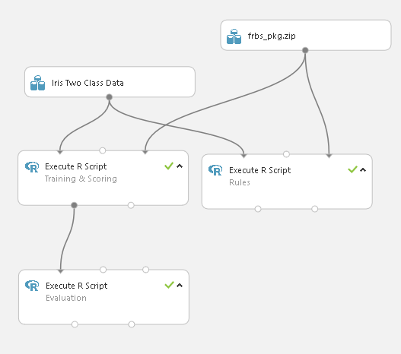
Pure R

Slide 9
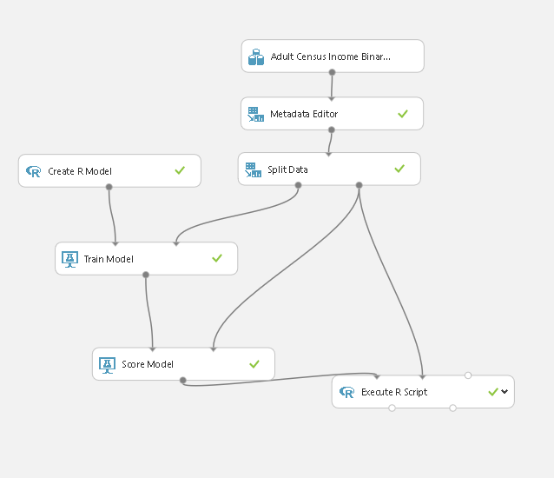
Modeling in R

Slide 10

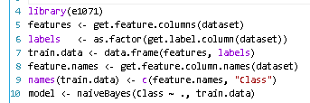
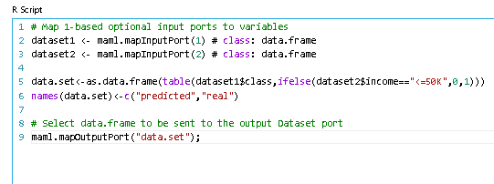
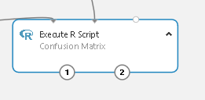
Modeling in R
library(e1071)
features <- get.feature.columns(dataset)
labels <- as.factor(get.label.column(dataset))
train.data <- data.frame(features, labels)
feature.names <- get.feature.column.names(dataset)
names(train.data) <- c(feature.names, "Class")
model <- naiveBayes(Class ~ ., train.data)
# Map 1-based optional input ports to variables
dataset1 <- maml.mapInputPort(1) # class: data.frame
dataset2 <- maml.mapInputPort(2) # class: data.frame
data.set<-as.data.frame(table(dataset1$class,
ifelse(dataset2$income=="<=50K",0,1)))
names(data.set)<-c("predicted","real")
# Select data.frame to be sent to the output Dataset port
maml.mapOutputPort("data.set");

Slide 11

Pure R
# Map 1-based optional input ports to variables
dataset1 <- maml.mapInputPort(1)
install.packages("src/frbs_3.1-0.zip", lib = ".", repos = NULL, verbose = TRUE)
library(frbs, lib.loc=".", verbose=FALSE)
#preparing the data
all.iris <-dataset1
all.iris <-all.iris[,c(2,3,4,5,1)]
all.iris[, 5] <- all.iris[, 5] +1
#test set & training set
sets <- sample(2, nrow(all.iris), replace=TRUE, prob=c(0.7, 0.3))
tra.iris <-all.iris[sets==1,]
tst.iris <- all.iris[sets==2,1:(ncol(all.iris)-1)]
real.iris<-all.iris[sets==2,(ncol(all.iris))]
## Define range of input data. (Only for the input variables)
range.data.input <- apply(all.iris[, -ncol(all.iris)], 2, range)
## Set the method and its parameters.
method.type <- "FRBCS.W"
control <- list(num.labels = 5, type.mf = "GAUSSIAN", type.tnorm = "MIN",
type.snorm = "MAX", type.implication.func = "ZADEH")
#learning phase
object.cls <- frbs.learn(tra.iris, range.data.input, method.type, control)
## Predicting step
res.test <- as.data.frame(predict(object.cls, tst.iris))
colnames(res.test)<-c("prediction")
res.test<-cbind(tst.iris,res.test)
res.test<-cbind(res.test,real.iris)
# Select data.frame to be sent to the output Dataset port
maml.mapOutputPort("res.test");

Slide 12
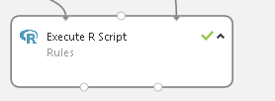
Pure R
# Map 1-based optional input ports to variables
dataset1 <- maml.mapInputPort(1)
install.packages("src/frbs_3.1-0.zip", lib = ".", repos = NULL, verbose = TRUE)
library(frbs, lib.loc=".", verbose=FALSE)
#preparing the data
all.iris <-dataset1
all.iris <-all.iris[,c(2,3,4,5,1)]
all.iris[, 5] <- all.iris[, 5] +1
#test set & training set
sets <- sample(2, nrow(all.iris), replace=TRUE, prob=c(0.7, 0.3))
tra.iris <-all.iris[sets==1,]
tst.iris <- all.iris[sets==2,1:(ncol(all.iris)-1)]
real.iris<-all.iris[sets==2,(ncol(all.iris))]
## Define range of input data. (Only for the input variables)
range.data.input <- apply(all.iris[, -ncol(all.iris)], 2, range)
## Set the method and its parameters.
method.type <- "FRBCS.W"
control <- list(num.labels = 5, type.mf = "GAUSSIAN", type.tnorm = "MIN",
type.snorm = "MAX", type.implication.func = "ZADEH")
#learning phase
object.cls <- frbs.learn(tra.iris, range.data.input, method.type, control)
## Predicting step
res.test <- as.data.frame(predict(object.cls, tst.iris))
colnames(res.test)<-c("prediction")
res.test<-cbind(tst.iris,res.test)
res.test<-cbind(res.test,real.iris)
#rules
rl<-as.data.frame(object.cls$rule)
maml.mapOutputPort("rl");

Slide 13
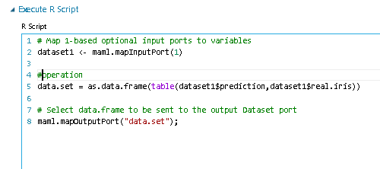
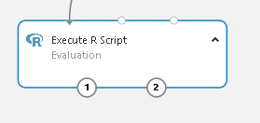
Pure R
dataset1 <- maml.mapInputPort(1)
data.set = as.data.frame(table(dataset1$prediction,dataset1$real.iris))
maml.mapOutputPort("data.set");

Slide 14
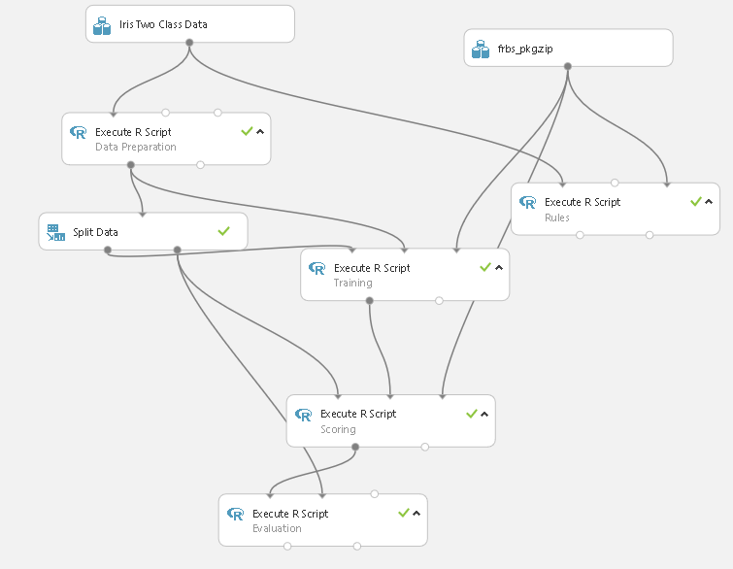
Pure R V2

Slide 15

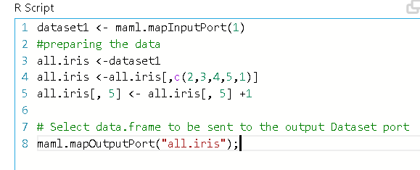
Pure R V2
dataset1 <- maml.mapInputPort(1)
#preparing the data
all.iris <-dataset1
all.iris <-all.iris[,c(2,3,4,5,1)]
all.iris[, 5] <- all.iris[, 5] +1
# Select data.frame to be sent to the output Dataset port
maml.mapOutputPort("all.iris");

Slide 16

Pure R V2
# Map 1-based optional input ports to variables
tra.iris <- maml.mapInputPort(1)
all.iris <- maml.mapInputPort(2)
install.packages("src/frbs_3.1-0.zip", lib = ".", repos = NULL, verbose = TRUE)
library(frbs, lib.loc=".", verbose=FALSE)
## Define range of input data. (Only for the input variables)
range.data.input <- apply(all.iris[, -ncol(all.iris)], 2, range)
## Set the method and its parameters.
method.type <- "FRBCS.W"
control <- list(num.labels = 5, type.mf = "GAUSSIAN", type.tnorm = "MIN",
type.snorm = "MAX", type.implication.func = "ZADEH")
#learning phase
object.cls <- frbs.learn(tra.iris, range.data.input, method.type, control)
ser.model<-data.frame(payload = as.numeric(serialize(object.cls, connection=NULL)));
# Select data.frame to be sent to the output Dataset port
maml.mapOutputPort("ser.model");

Slide 17
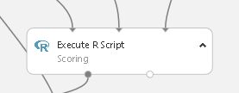
Pure R V2
test.set <- maml.mapInputPort(1)
model.raw <- maml.mapInputPort(2)
model <- unserialize(as.raw(model.raw$payload))
install.packages("src/frbs_3.1-0.zip", lib = ".", repos = NULL, verbose = TRUE)
library(frbs, lib.loc=".", verbose=FALSE)
tst.iris <- test.set[,1:(ncol(test.set)-1)]
## Predicting step
res.test <- as.data.frame(predict(model, tst.iris))
colnames(res.test)<-c("prediction")
res.test<-cbind(tst.iris,res.test)
#res.test<-cbind(res.test,real.iris)
maml.mapOutputPort("res.test");

Slide 18
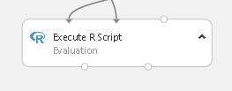
Pure R V2
# Map 1-based optional input ports to variables
dataset1 <- maml.mapInputPort(1)
test.set <- maml.mapInputPort(2)
real.iris<-test.set[,(ncol(test.set))]
#operation
data.set = as.data.frame(table(dataset1$prediction,real.iris, dnn=list('predicted','actual')))
# Select data.frame to be sent to the output Dataset port
maml.mapOutputPort("data.set");

Slide 19
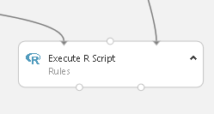
Pure R V2
model.raw <- maml.mapInputPort(1)
model <- unserialize(as.raw(model.raw$payload))
#rules
rl<-as.data.frame(model$rule)
maml.mapOutputPort("rl");

