Slide 1
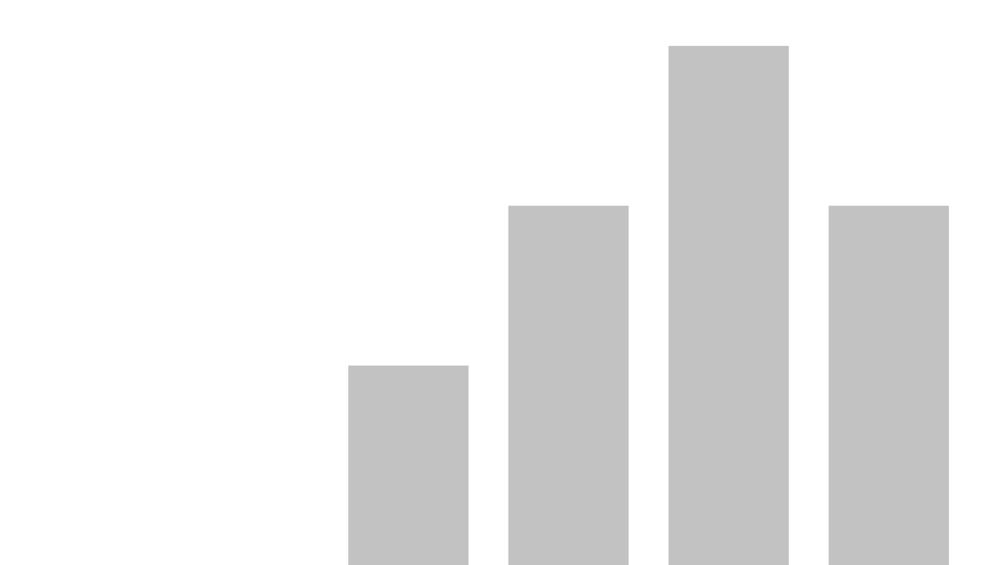


power_bi_smartphone_addiction
View in Power BI
Last data refresh:
11/10/2026 17:47:52 UTC
Downloaded at:
11/10/2026 18:24:59 UTC

Slide 2
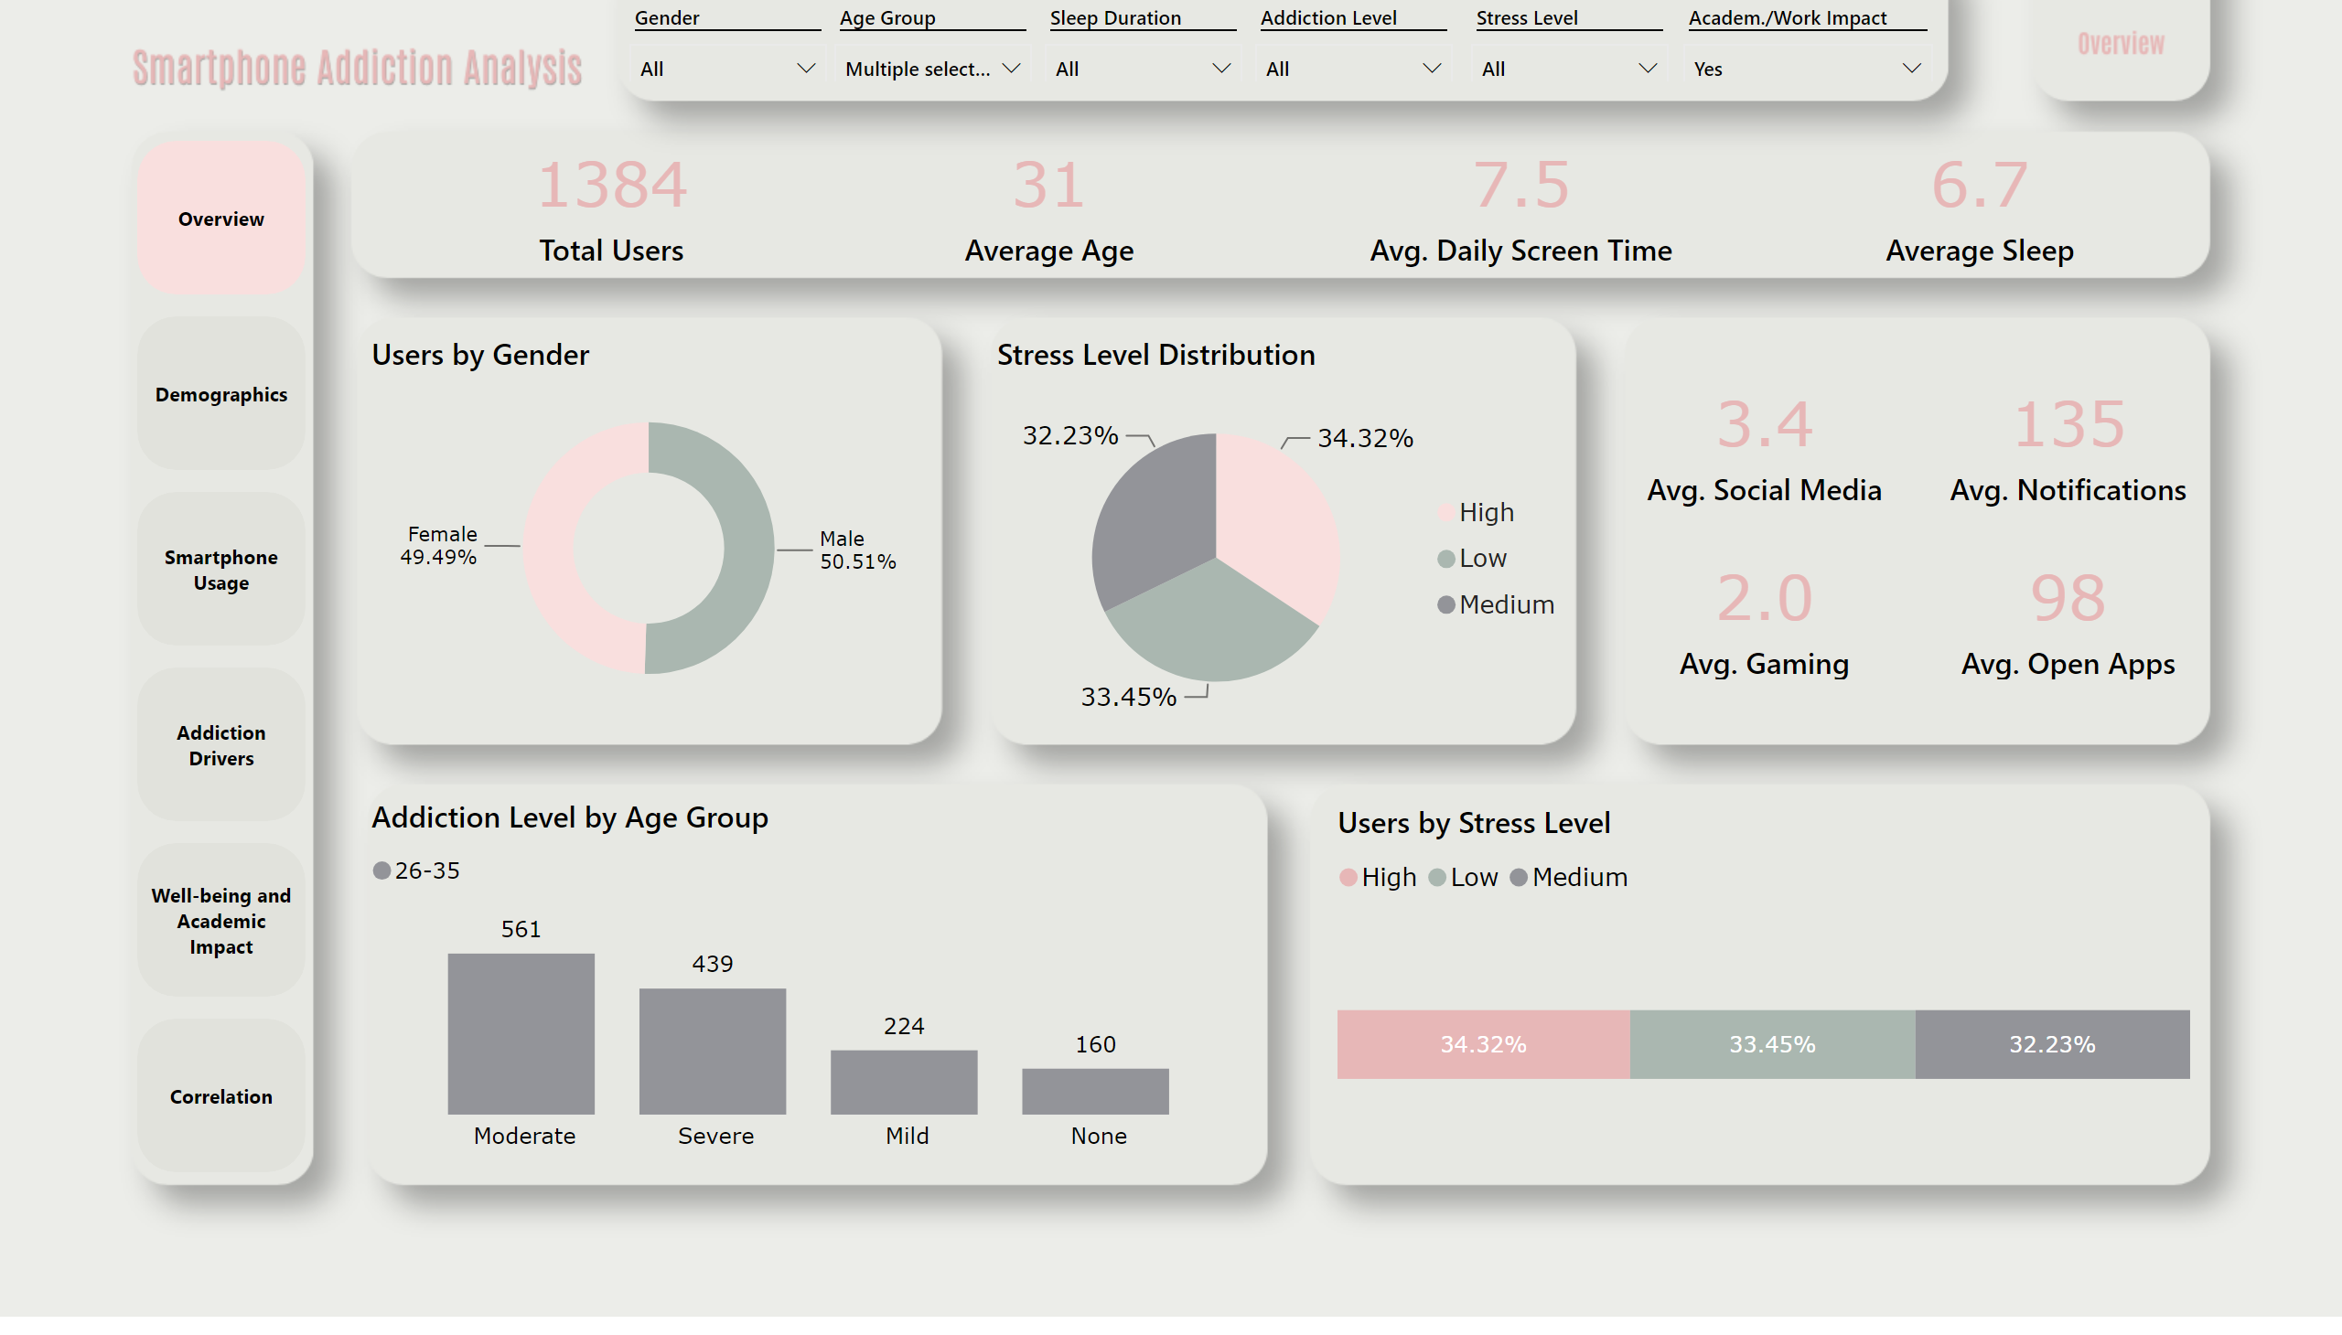
Overview
Notes:
card
No alt text provided
Users by Gender
No alt text provided
Stress Level Distribution
No alt text provided
Addiction Level by Age Group
No alt text provided
card
No alt text provided
card
No alt text provided
card
No alt text provided
card
No alt text provided
card
No alt text provided
card
No alt text provided
card
No alt text provided
Users by Stress Level
No alt text provided
slicer
No alt text provided
pageNavigator
No alt text provided
slicer
No alt text provided
slicer
No alt text provided
slicer
No alt text provided
slicer
No alt text provided
slicer
No alt text provided

Slide 3
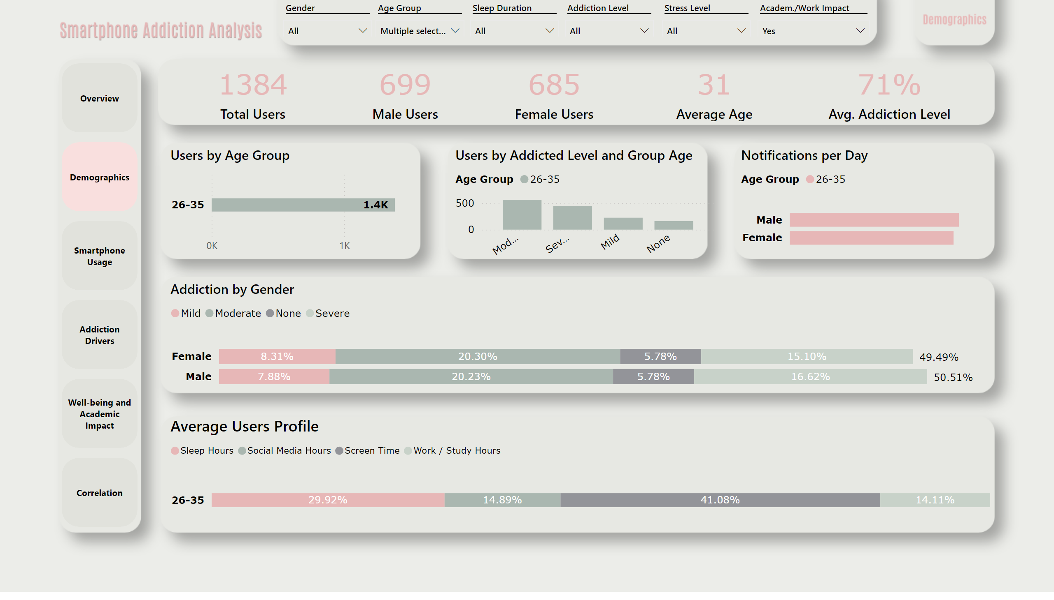
Demographics
Notes:
card
No alt text provided
card
No alt text provided
card
No alt text provided
card
No alt text provided
card
No alt text provided
Users by Age Group
No alt text provided
Users by Addicted Level and Group Age
No alt text provided
Addiction by Gender
No alt text provided
Notifications per Day
No alt text provided
Average Users Profile
No alt text provided
pageNavigator
No alt text provided
slicer
No alt text provided
slicer
No alt text provided
slicer
No alt text provided
slicer
No alt text provided
slicer
No alt text provided
slicer
No alt text provided

Slide 4
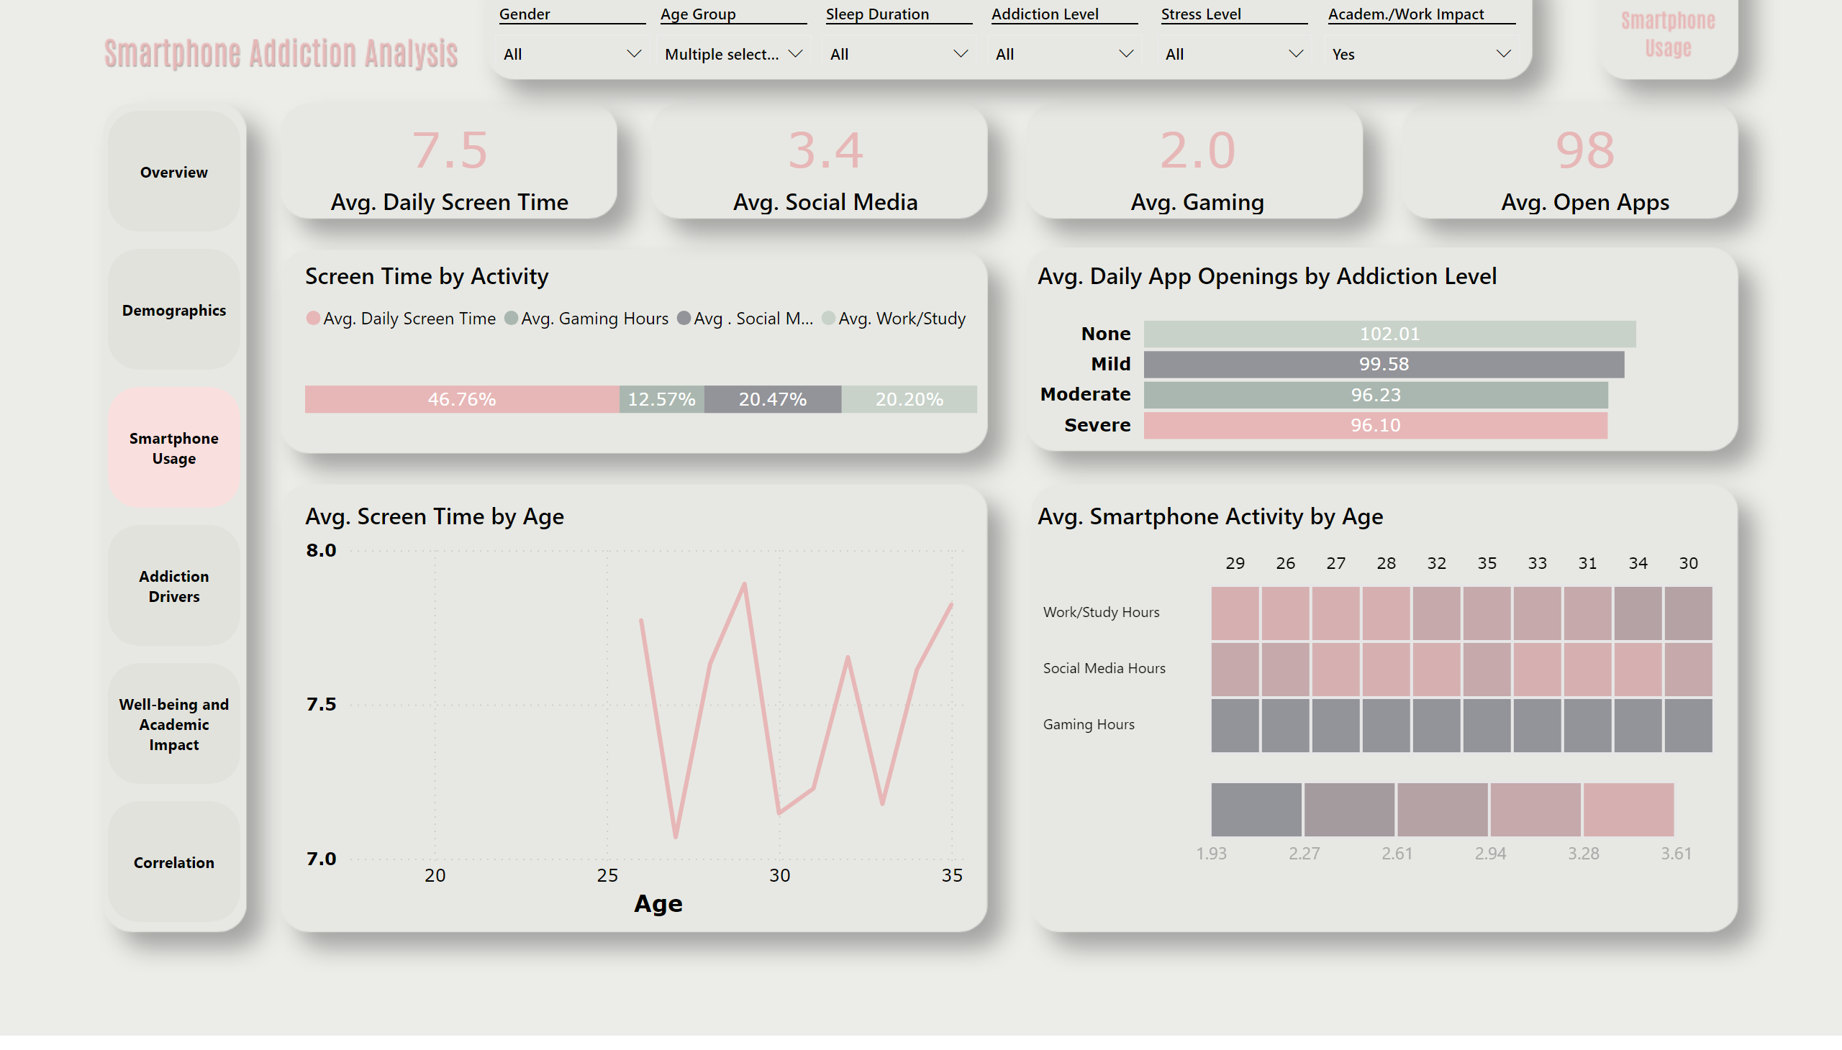
Smartphone Usage
Notes:
card
No alt text provided
card
No alt text provided
card
No alt text provided
card
No alt text provided
Screen Time by Activity
No alt text provided
Avg. Screen Time by Age
No alt text provided
Avg. Daily App Openings by Addiction Level
No alt text provided
Avg. Smartphone Activity by Age
No alt text provided
pageNavigator
No alt text provided
slicer
No alt text provided
slicer
No alt text provided
slicer
No alt text provided
slicer
No alt text provided
slicer
No alt text provided
slicer
No alt text provided

Slide 5
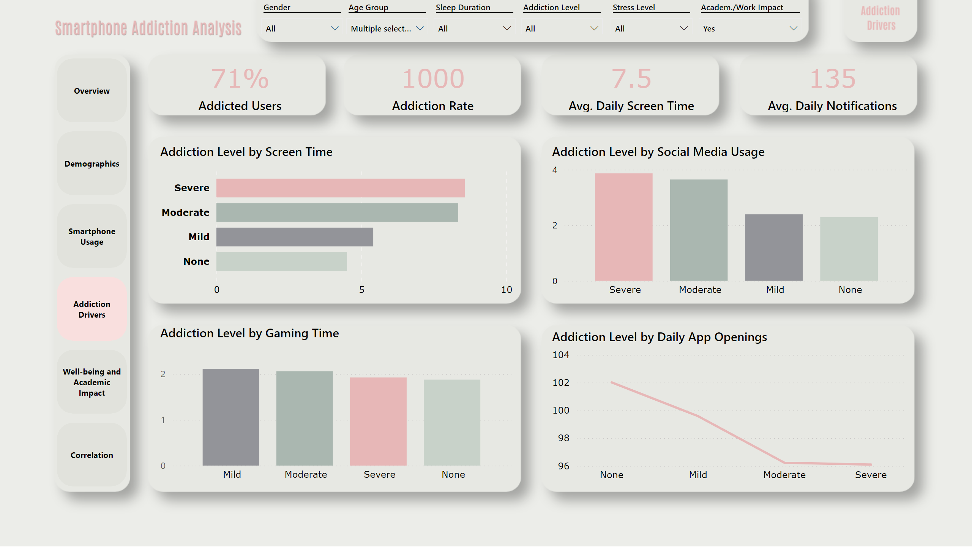
Addiction Drivers
Notes:
card
No alt text provided
card
No alt text provided
card
No alt text provided
card
No alt text provided
Addiction Level by Screen Time
No alt text provided
Addiction Level by Social Media Usage
No alt text provided
Addiction Level by Gaming Time
No alt text provided
Addiction Level by Daily App Openings
No alt text provided
pageNavigator
No alt text provided
slicer
No alt text provided
slicer
No alt text provided
slicer
No alt text provided
slicer
No alt text provided
slicer
No alt text provided
slicer
No alt text provided

Slide 6
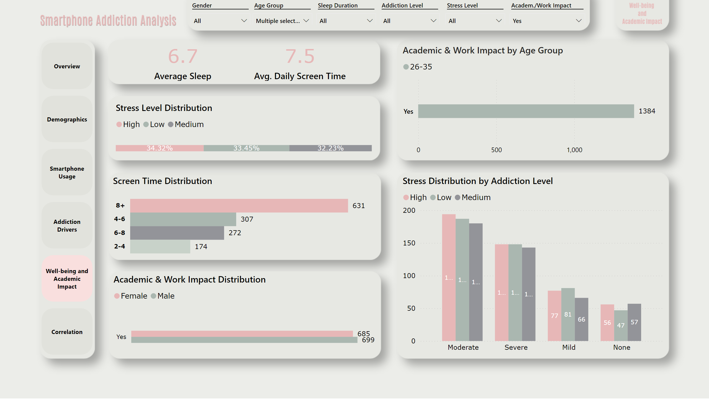
Well-being and Academic Impact
Notes:
card
No alt text provided
card
No alt text provided
Stress Level Distribution
No alt text provided
Screen Time Distribution
No alt text provided
Academic & Work Impact Distribution
No alt text provided
Academic & Work Impact by Age Group
No alt text provided
Stress Distribution by Addiction Level
No alt text provided
pageNavigator
No alt text provided
slicer
No alt text provided
slicer
No alt text provided
slicer
No alt text provided
slicer
No alt text provided
slicer
No alt text provided
slicer
No alt text provided

Slide 7
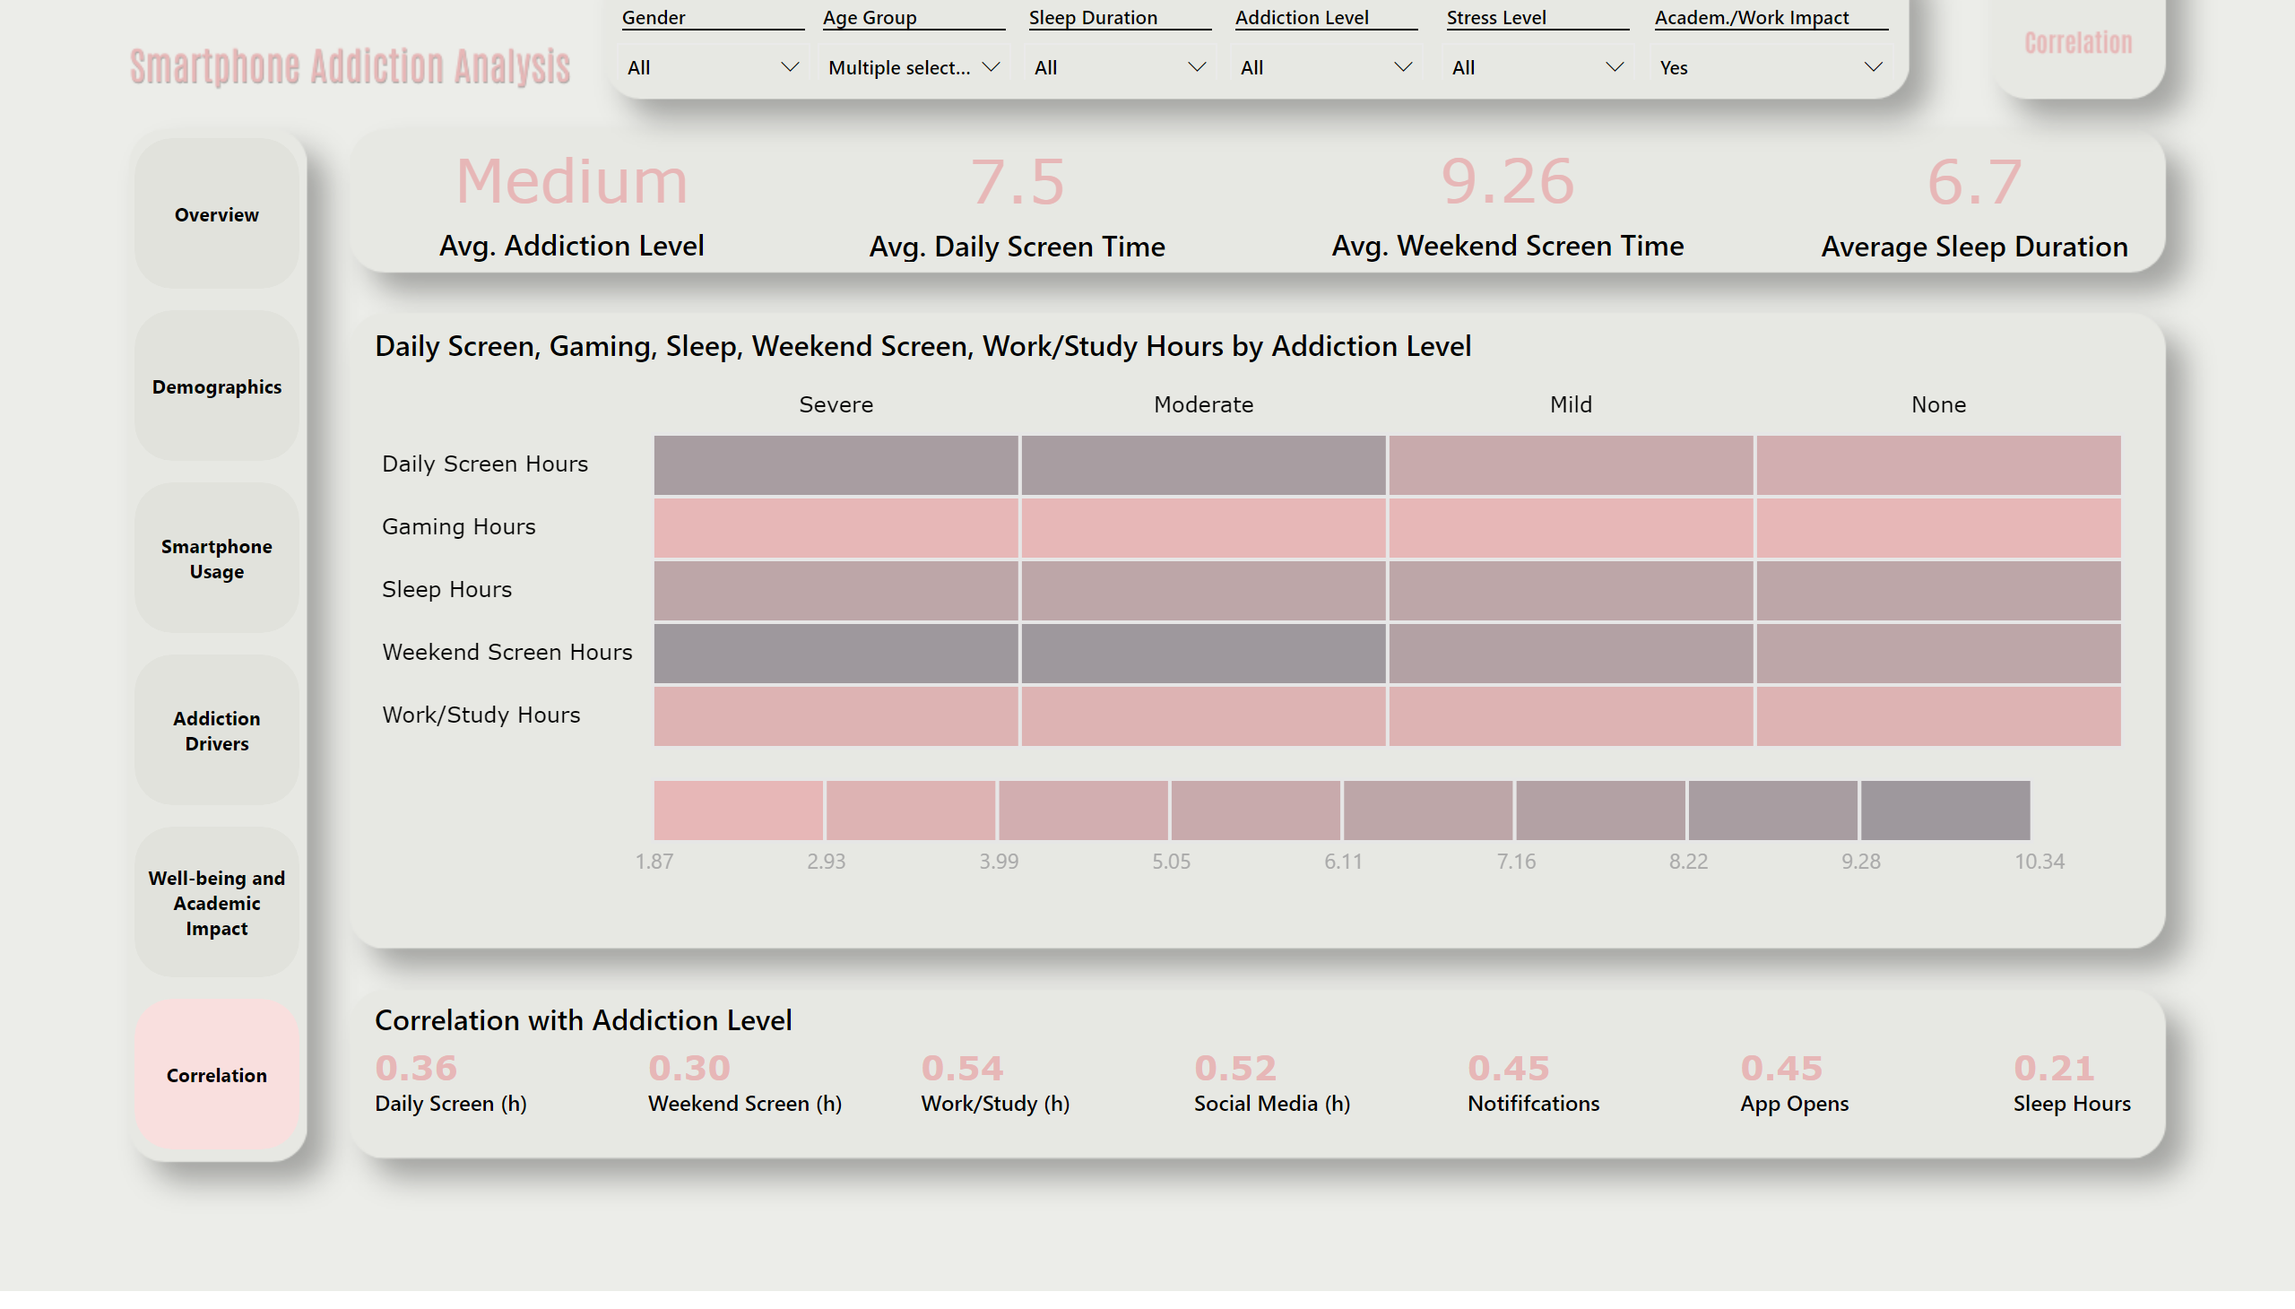
Correlation
Notes:
card
No alt text provided
card
No alt text provided
card
No alt text provided
card
No alt text provided
Daily Screen, Gaming, Sleep, Weekend Screen, Work/Study Hours by Addiction Level
No alt text provided
Correlation with Addiction Level
No alt text provided
pageNavigator
No alt text provided
slicer
No alt text provided
slicer
No alt text provided
slicer
No alt text provided
slicer
No alt text provided
slicer
No alt text provided
slicer
No alt text provided

