Slide 1

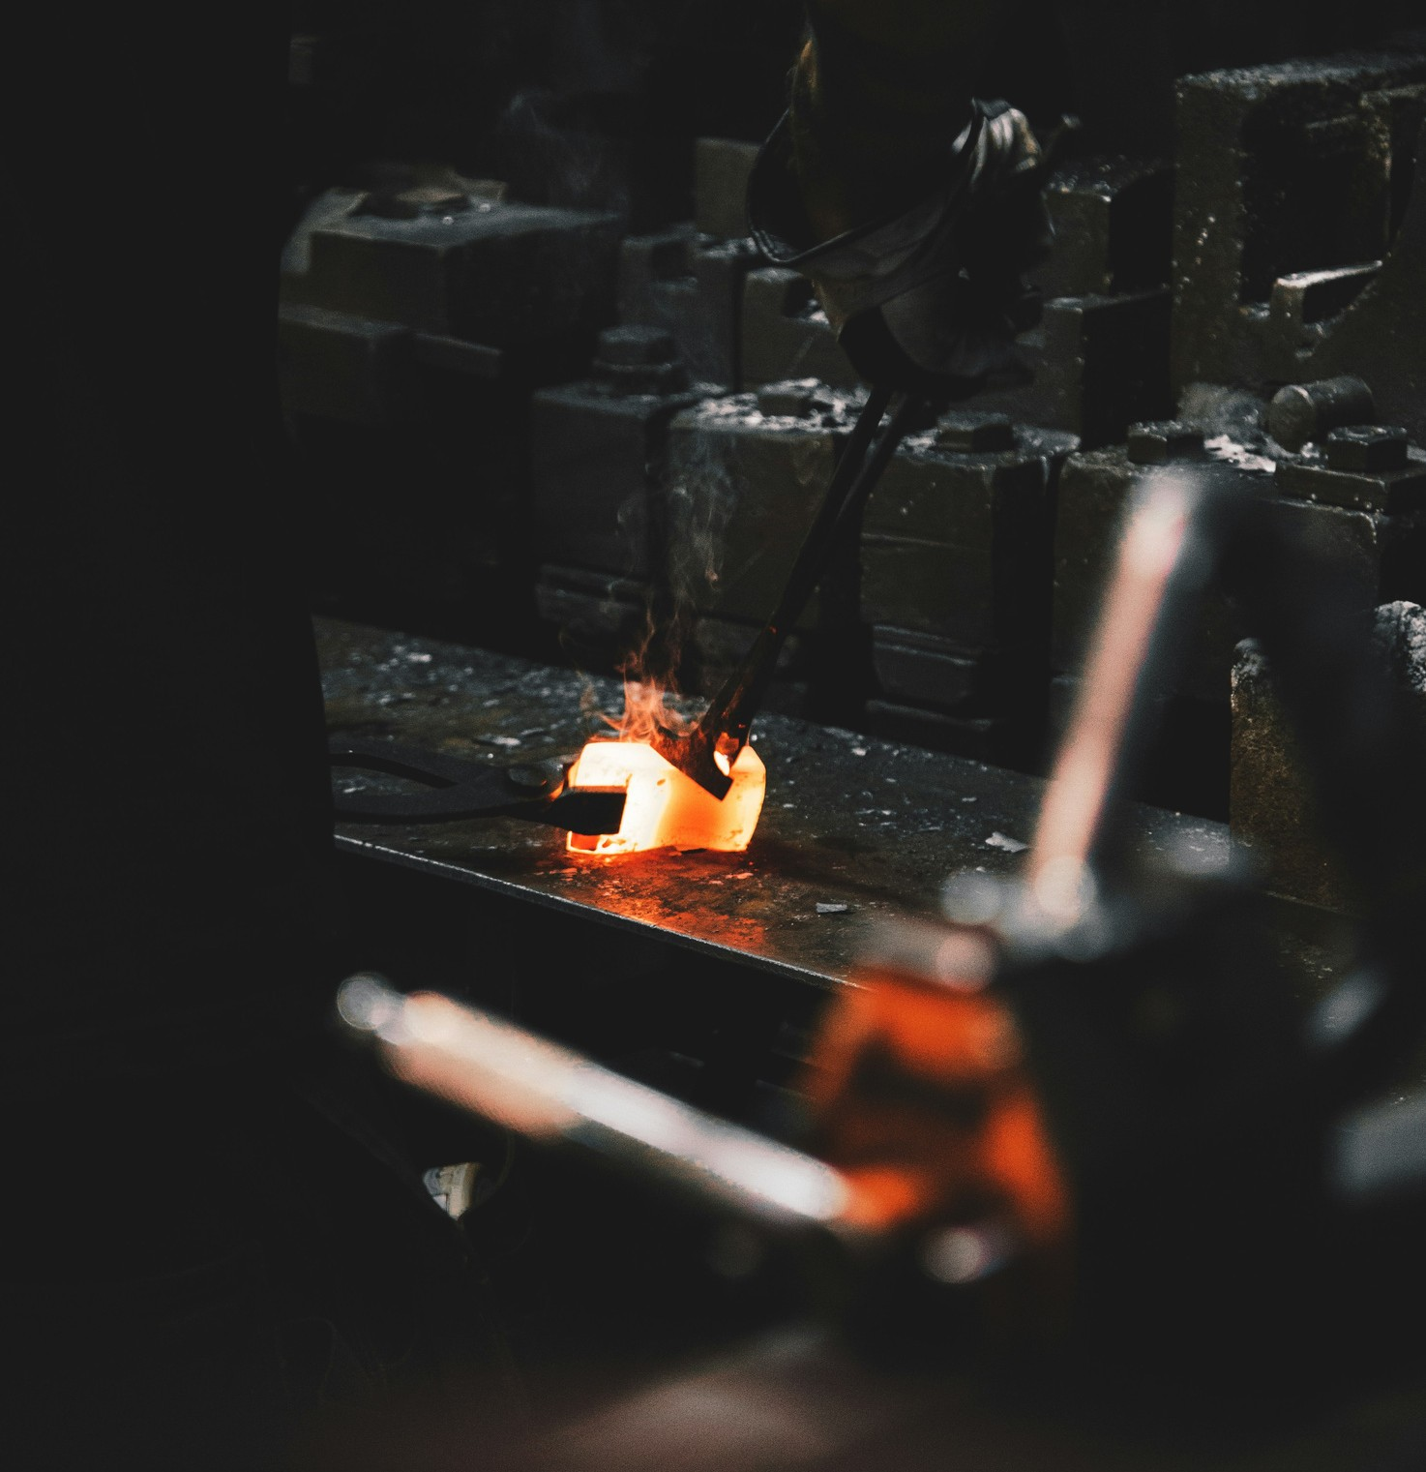
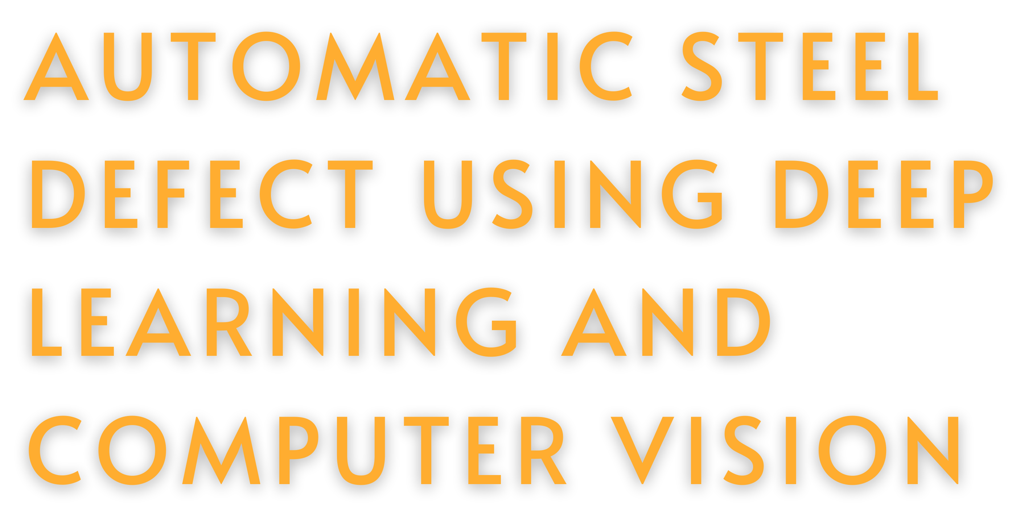



Slide 2

INTRODUCTION
Steel manufacturing is highly susceptible to surface defects such as scratches, cracks, and pitting, which affect both the product's quality and structural integrity. Traditional manual inspection methods are labor-intensive and prone to error. To
address these implements an
challenges, this project automated system for
defect detection using deep learning.

Slide 3

Problem Statement
The manual inspection of steel surfaces is prone to error, inefficient, and unsuitable for large-scale production lines. Automating defect detection is essential to maintain high-quality standards
Objectives
Develop a deep learning model to detect and classify six types of steel defects.
Deploy the model in a user-friendly web interface for real-time defect
detection. Improve quality
control in steel reducing manual
production by intervention

Slide 4

METHODOLOGY
This project follows a structured methodology that involves data collection, preprocessing, model development, training, and deployment. The ResNet50 model was selected for its ability to handle complex visual features. The model was trained using transfer learning, and deployed via a web interface built with Streamlit for real-time predictions.
Steps:
Data Collection
Preprocessing (Rescaling, Augmentation) Model Training (ResNet50)
Deployment (Streamlit)

Slide 5
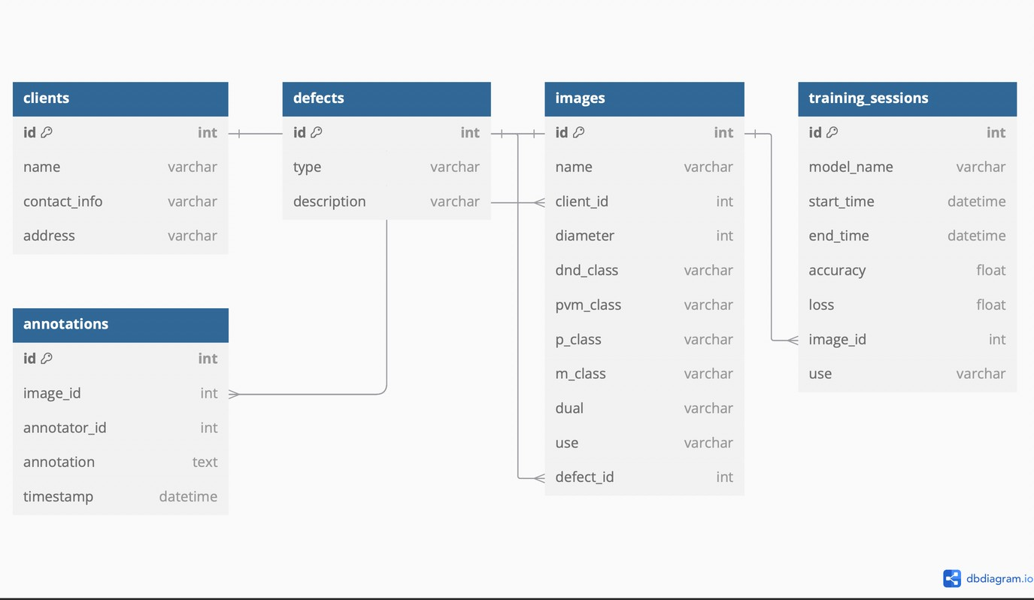
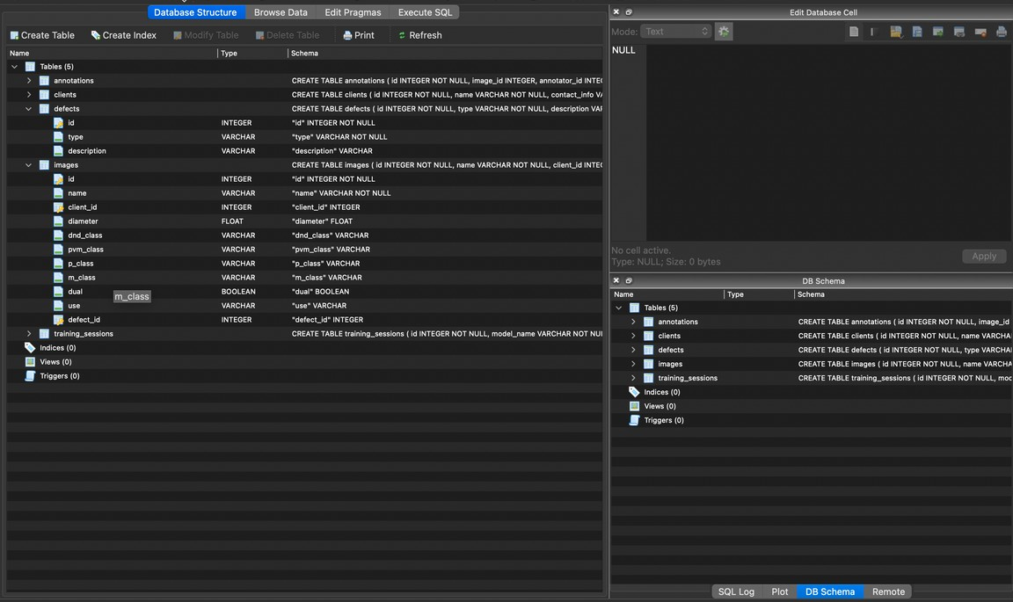
Data Collection and Preprocessing
The dataset comprises steel surface images provided by iSEND. These images were categorized into six defect types: Crazing, Inclusion, Patches, Pitted Surface, Rolled-in Scale, and Scratches.
Preprocessing steps included:
Rescaling the images to 224x224 pixels.
Normalizing pixel values between 0 and 1.
Augmentation techniques such as flipping, rotation, and zoom to create a robust model.

Slide 6
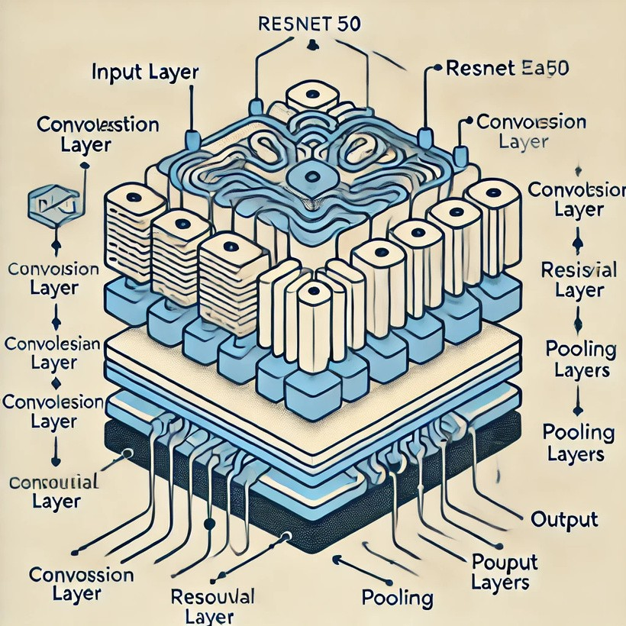
Model Architecture
The ResNet50 architecture, a 50-layer deep convolutional neural network (CNN), was used to classify the defects. It uses residual connections to improve training stability and performance.
We used transfer learning, where the model was pre-trained on ImageNet and fine-tuned on our steel defect dataset
Architecture Layers:
Pre-trained ResNet50 model without top layers
Global Average Pooling
Dense layers
Softmax output layer for six classes.

Slide 7
Result & Performance
Key Performance Metrics
Accuracy: 83%
Precision: Strong for "Scratches" and "Patches"
Recall: Moderate for "Pitted Surface
The model was trained and validated using an 80-20% data split. It achieved an accuracy of 83% after fine-tuning, with precision and recall metrics showing strong performance in detecting common defect types such as Scratches and
Patches

Slide 8
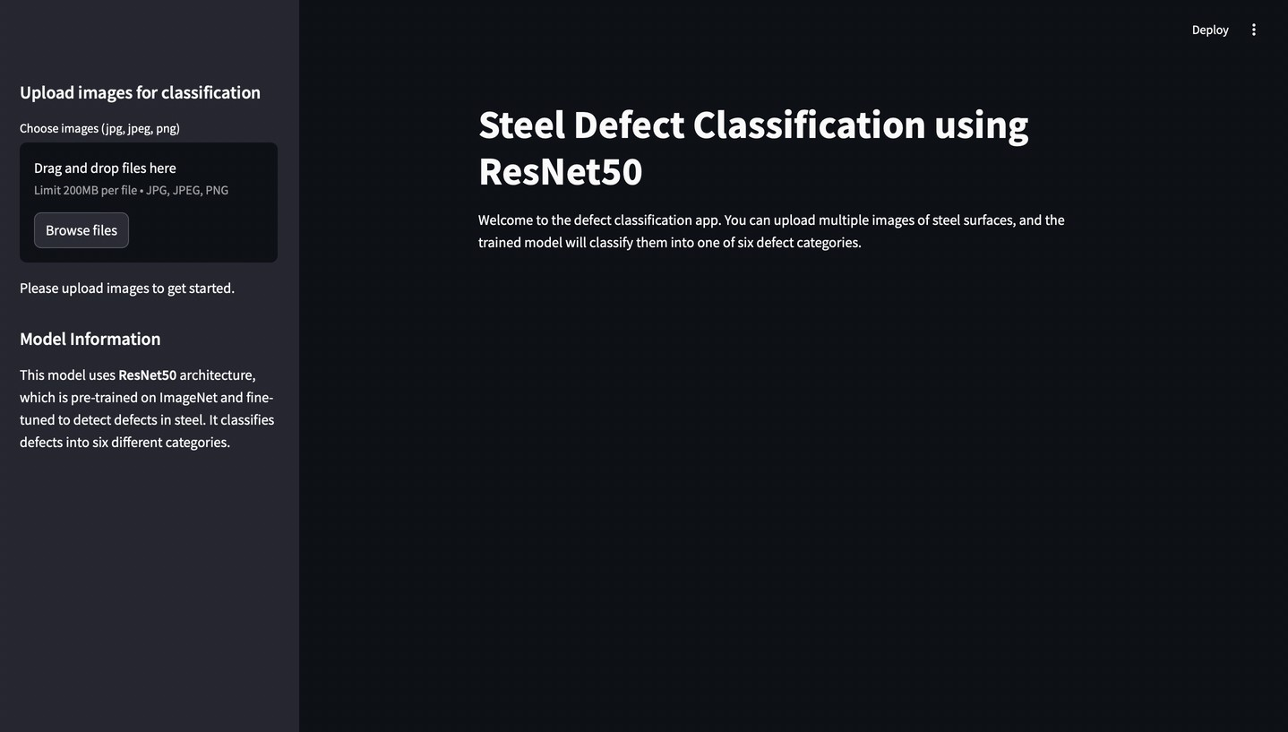
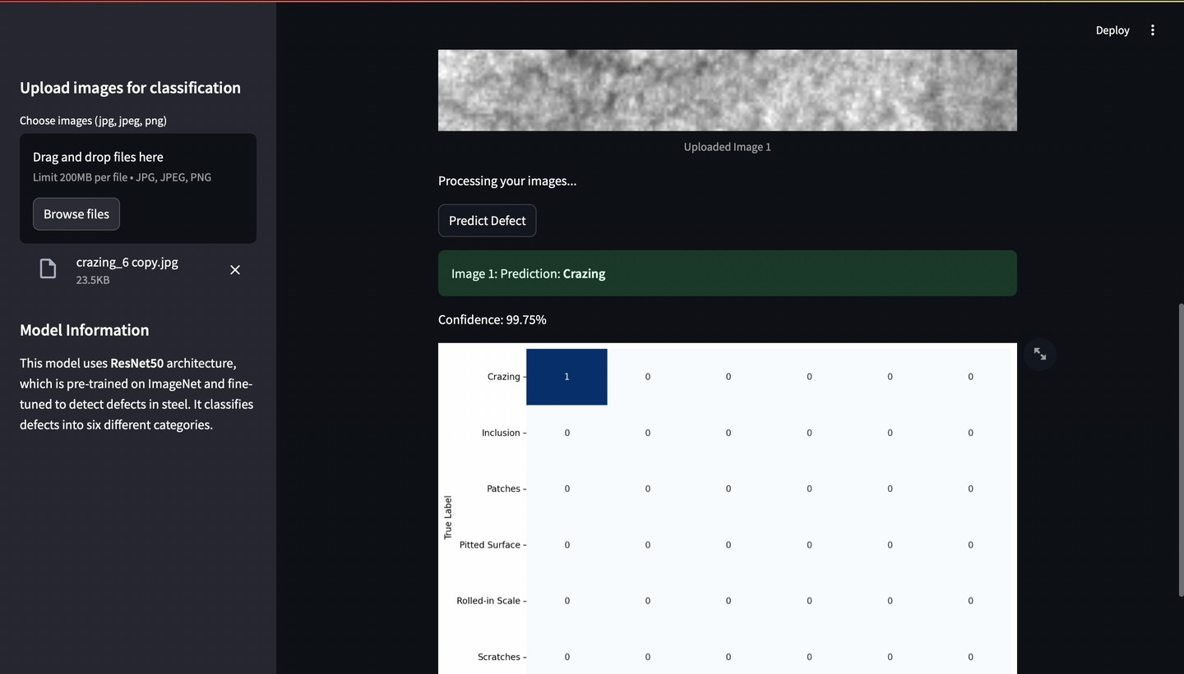
Deployment
The model was deployed using
Streamlit, providing an intuitive interface for operators to upload steel surface images and receive real-time defect classification results. The interface allows non- technical users to easily interact with the system.
The system is accessible via a web interface and can handle multiple images at once

Slide 9
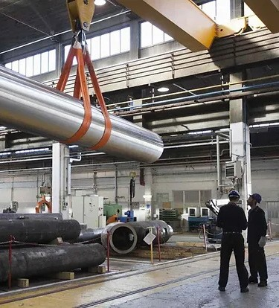
Conclusion & Future works
This project successfully developed an automated system for steel defect detection using ResNet50 and achieved an accuracy of 83%.
The deployment of the model in a Streamlit interface made it accessible for real-time use on the production floor.
Future Work:
Further improvements in class imbalance handling.
Incorporating more diverse defect types.
Exploring real-time IoT-based deployment.

Slide 10
Thank You

