Slide 1
Green Skilling with AI
Prepared by Makwana Bansari Gautam bhai
230670107045
Computer Engineering
SAL Institute of Technology and Engineering Research

Slide 2
What is Green Skilling?
Develops skills that protect the environment and promote sustainable development.
Encourages efficient use of natural resources through eco-friendly practices.
Supports careers focused on renewable energy and environmental conservation.
Promotes responsible production, consumption, and long-term environmental protection.
Builds practical skills for creating a cleaner, greener, and sustainable future.

Slide 3
Applications of Green Skilling
Promotes waste segregation, recycling, and responsible disposal of everyday materials.
Encourages renewable energy adoption through solar, wind, and clean technologies.
Supports sustainable farming using water conservation and eco-friendly agricultural practices.
Conserves natural resources through efficient energy and water management techniques.
Reduces pollution by encouraging environmentally responsible industrial and transportation practices.

Slide 4
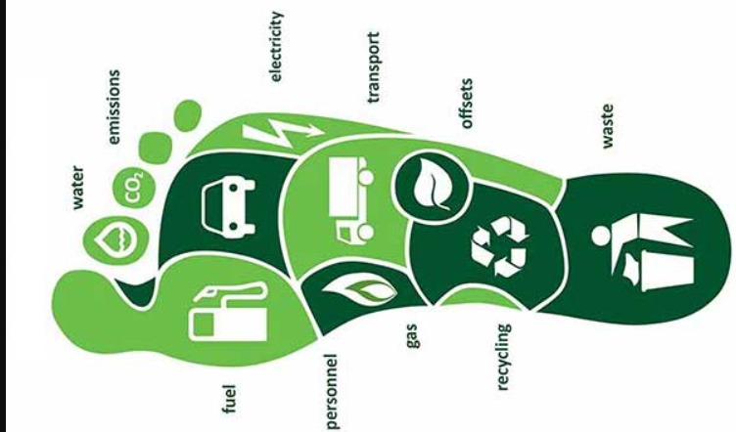
Digital Tools Supporting Green Sustainability
Measure personal ecological and carbon footprints easily.
Compare emissions from different transportation options.
Explore climate solutions through interactive environmental simulations.
Calculate vehicle emissions and encourage sustainable choices.
Track environmental impact using simple online sustainability tools.

Slide 5
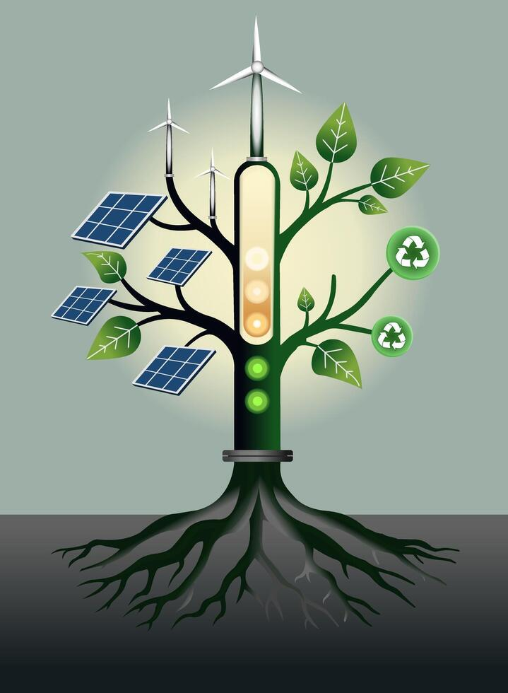
Green Jobs & Skill Development
Creates employment opportunities in renewable energy and sustainable industries.
Encourages skills for solar, waste management, and green construction.
Supports careers focused on environmental conservation and resource management.
Promotes training through the Skill Council for Green Jobs (SCGJ).
Prepares a skilled workforce for a sustainable and greener economy.

Slide 6
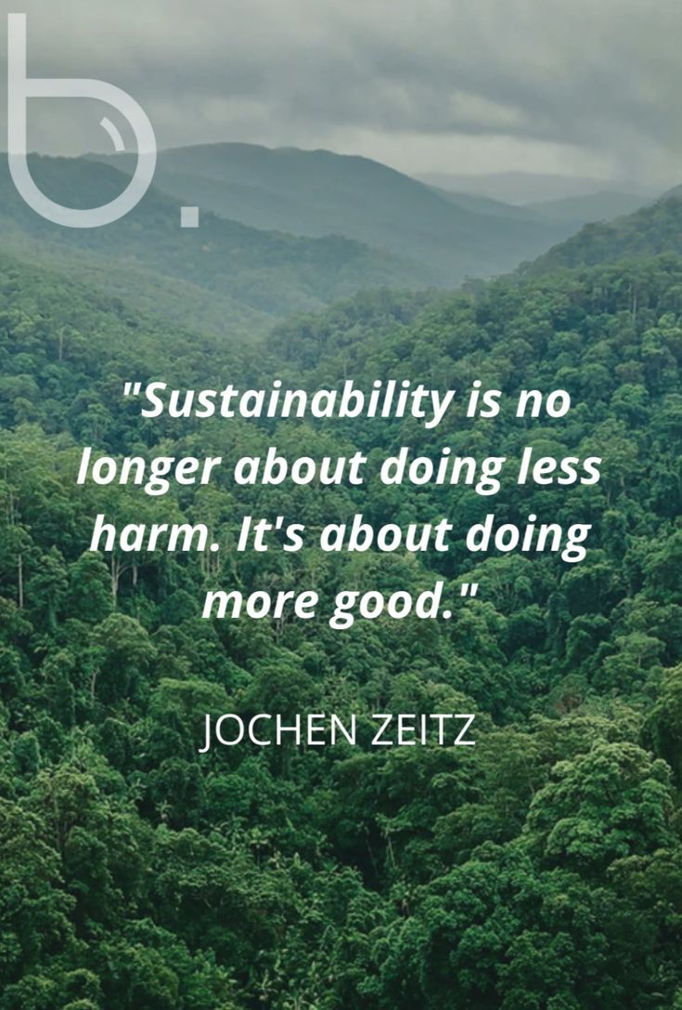
Conclusion
Green Skilling promotes sustainable practices for a healthier environment.
Environmental awareness encourages responsible use of natural resources.
Green skills support economic growth while protecting the planet.
Every individual can contribute through sustainable daily choices.
Together, we can build a cleaner, greener, and more sustainable future.

Slide 7
PROJECT TITLE
Project Name: CarbonCheck
Calculates carbon emissions from users' daily lifestyle activities.
Analyzes transportation, electricity, and energy consumption data.
Predicts carbon footprint using AI-based analysis.
Suggests personalized ways to reduce carbon emissions.
Promotes sustainable and environmentally friendly living practices.

Slide 8
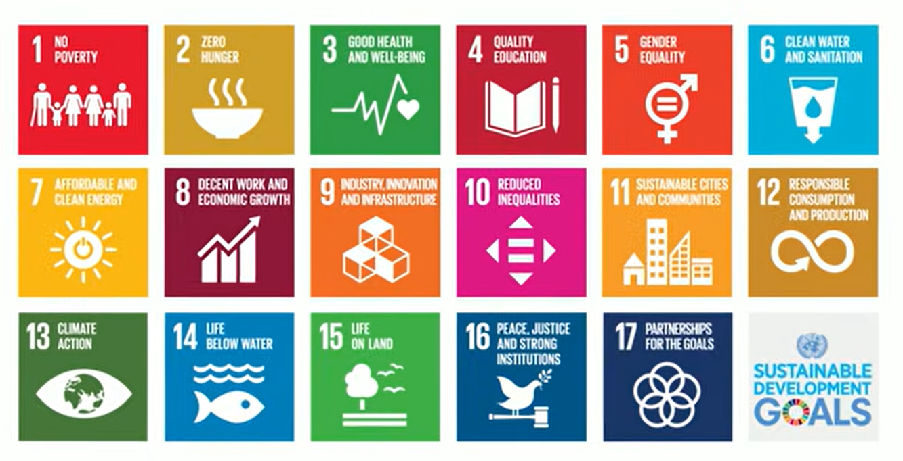
THANKYOU

