Slide 1

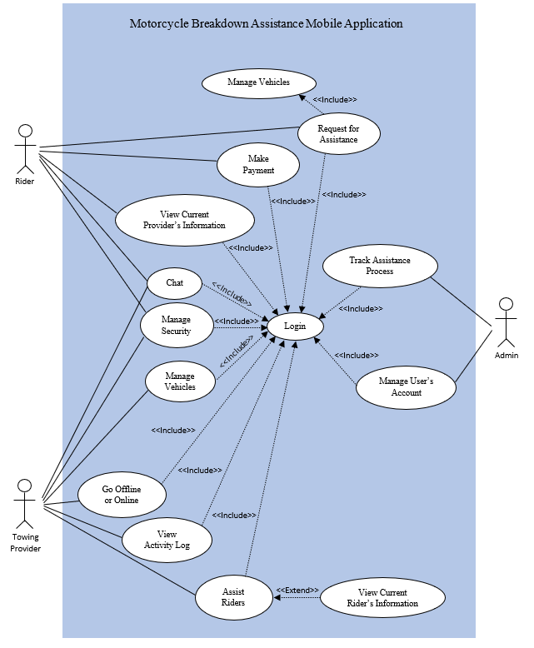

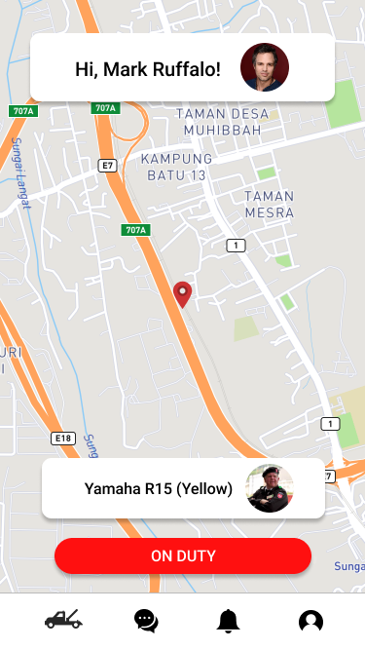
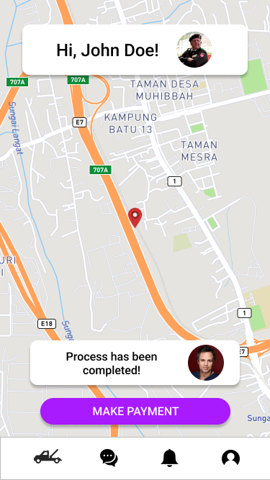
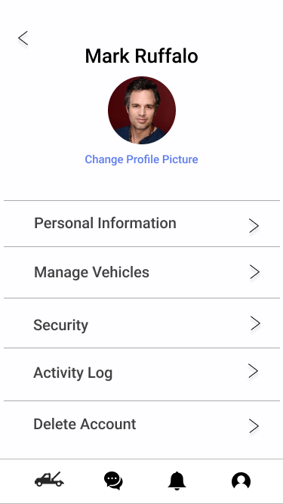
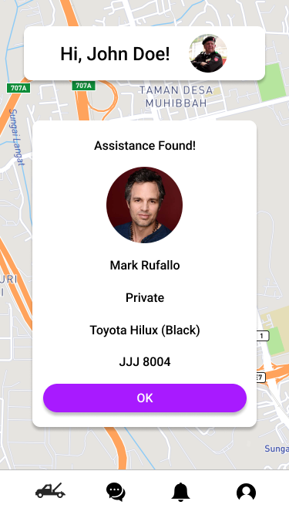
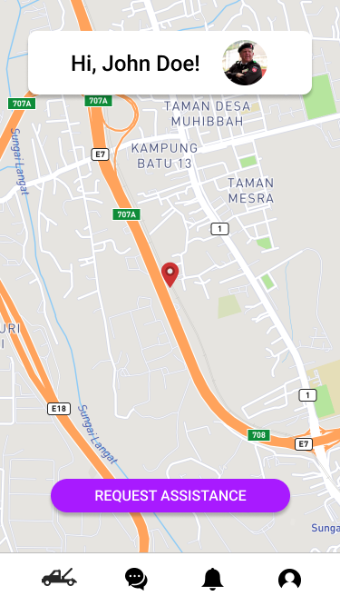
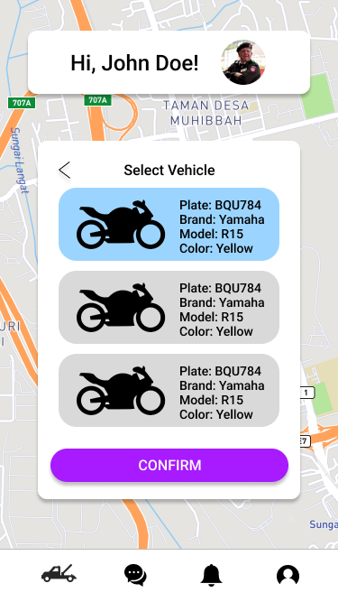
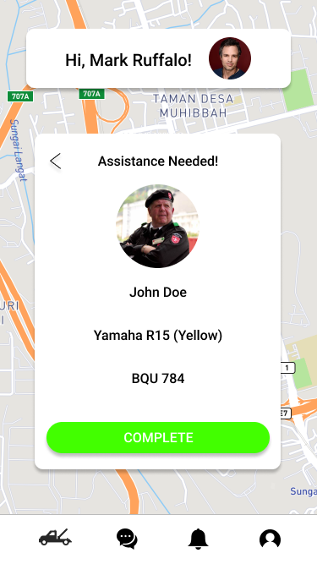
MOTORCYCLE BREAKDOWN ASSISTANCE
Motorcycle Breakdown Assistance (MBA) is a mobile application that provides assistance services to riders and a platform for towing providers to run their business.
PROBLEM STATEMENTS
The risk of towing scams can possibly increase due to the lack of information on towing providers so finding a trustworthy and reliable towing provider is difficult.
The process of searching for the contacts and reaching out for towing services can be time consuming as some of the contacts are outdated or no longer in service.
OBJECTIVES
To reduce the steps of requesting for assistance to a single button.
To reduce the risk of towing scams by 95%.
To reduce time consumption on the process of searching and requesting assistance by 90%.
COMMERCIALIZATION
This solution can be offered to other businesses of similar services such as on demand vehicle service.
Contact Us:
Muhamad Ekhmal Syafiq bin Zamri
Software Engineering Department
College of Computing & Informatics
UNIVERSITI TENAGA NASIONAL
Email: syafqz@gmail.com
MUHAMAD EKHMAL SYAFIQ BIN ZAMRI
Student
MOHD HAZLI BIN MOHAMED ZABIL, TS. DR.
Supervisor
AZLAN BIN YUSOF, MR
Examiner

