Slide 1
API Application

Slide 2
CODE
Please find the attached code for API
model.py
serializers.py
views.py
url.py
admin.py
migrations.py contain three file-
0001) intial.py
0002)task_completed.py
0003)task_image
7. Setting.py

Slide 3
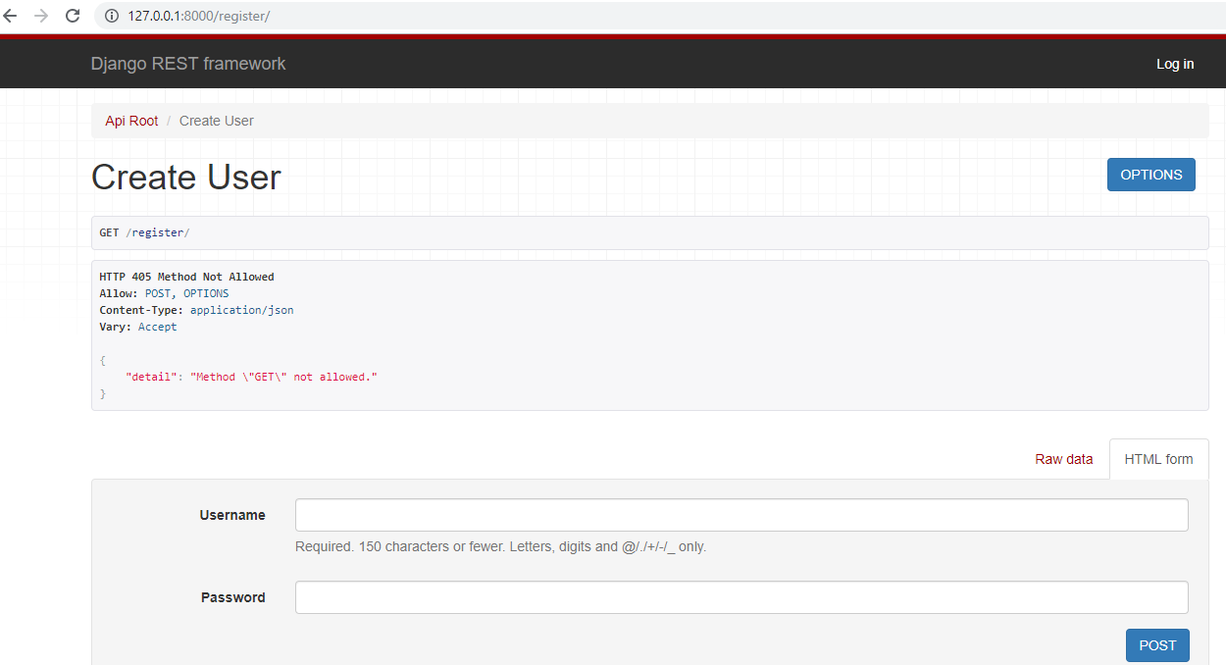
DISPLAY TO REGISTER

Slide 4
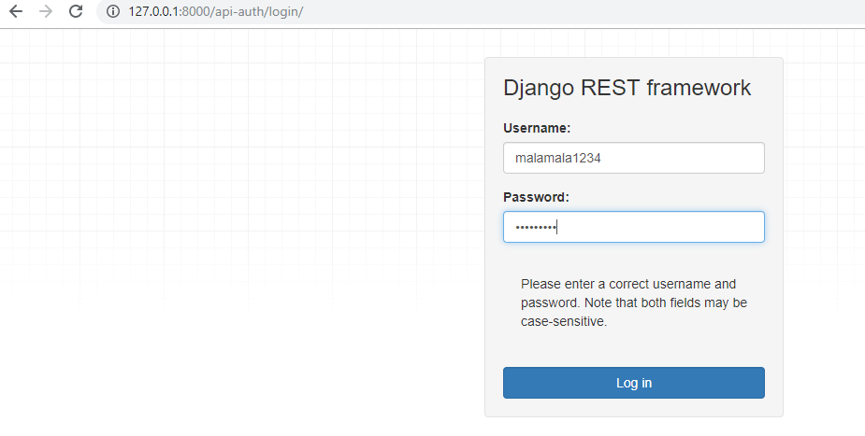
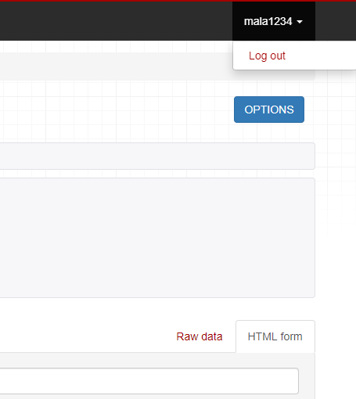
DISPLAY FOR LOGIN DISPLAY FOR LOGOUT

Slide 5
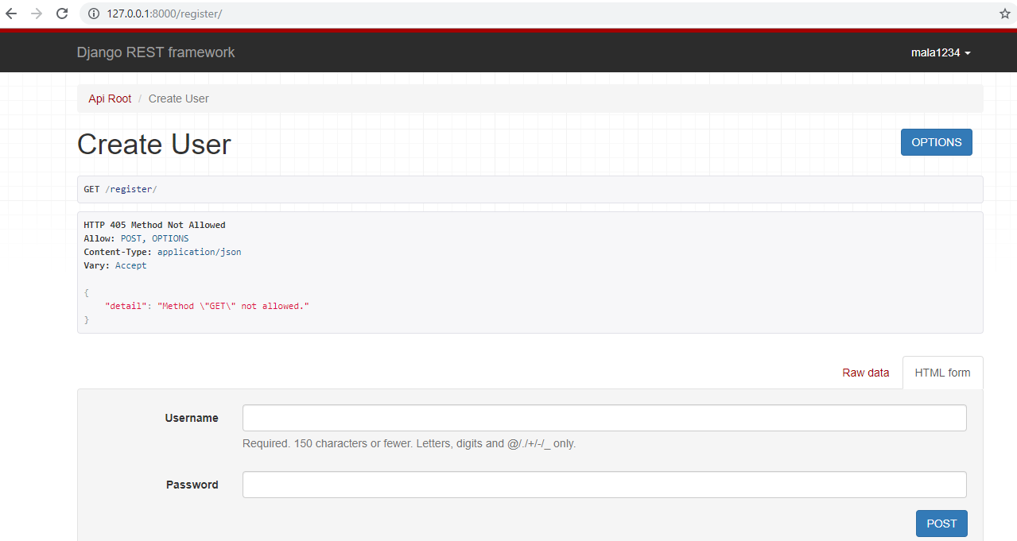
DISPLAY AFTER LOGIN

Slide 6
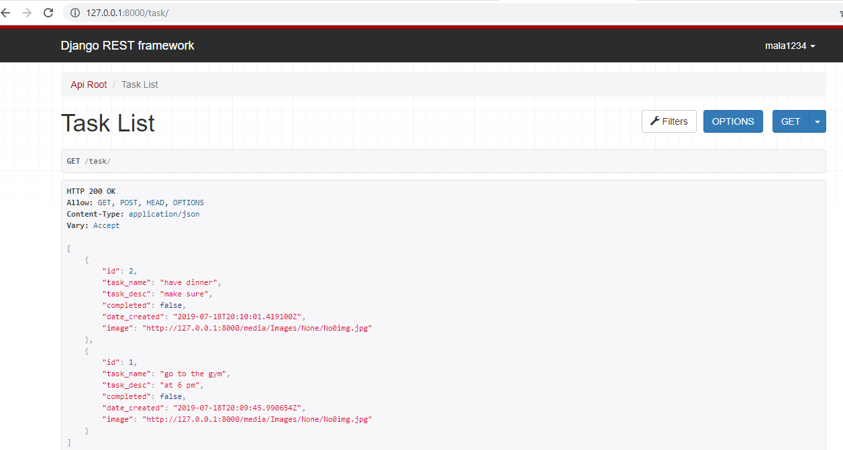
DISPLAY FOR STORED TASK

Slide 7
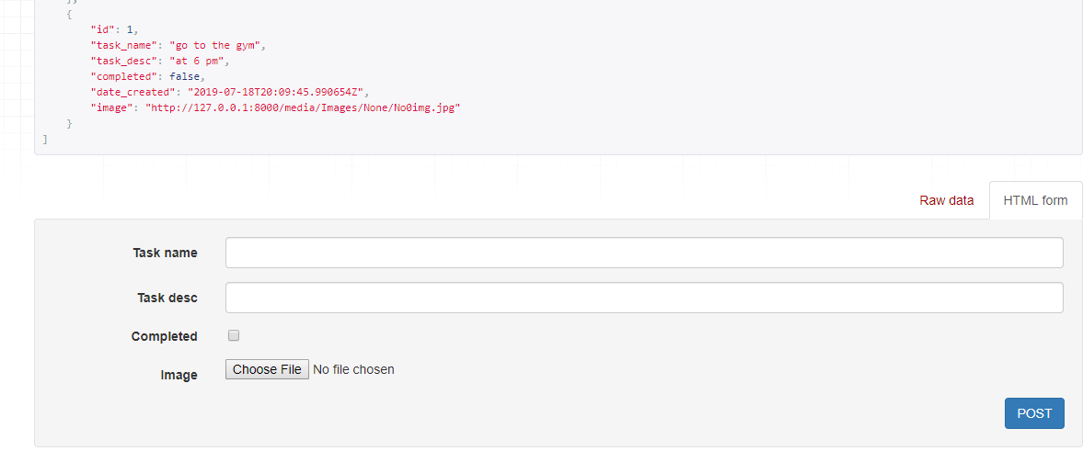
ALSO ADD NEW TASK

