Slide 1
BookStore App

Slide 2
CODE
Please find the attached code for mysite
Poject-mysite
Applictaion-books
Migrations
0001 Initials.py
0002 book_book_image
Static-books-images-
Back.jpg,Purple.jpg,white.jpg,yellow.jpg
style.css
Templates-books
base.html
book_form.html
detail.html
form-template
index.html
4.models.py
5.urls.py
6.views.py
7.setting.py

Slide 3
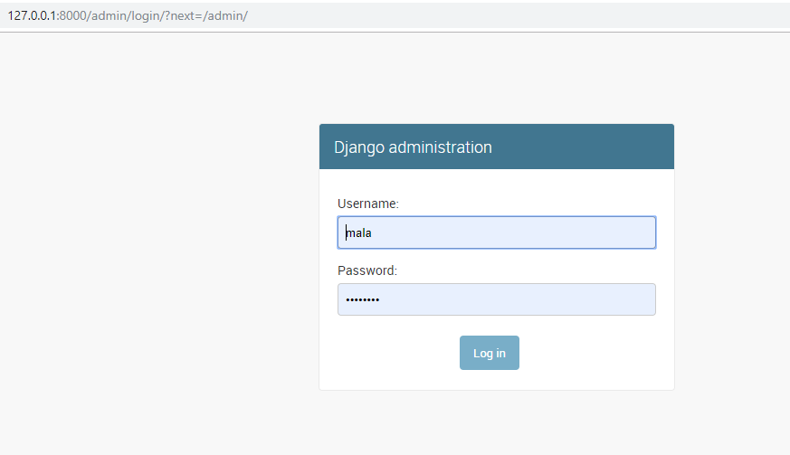
BACKEND-USER LOGIN

Slide 4
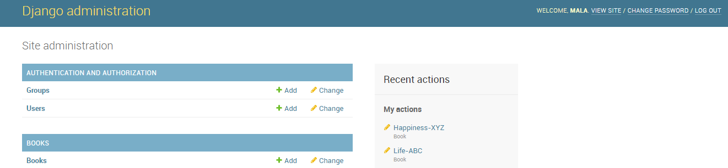
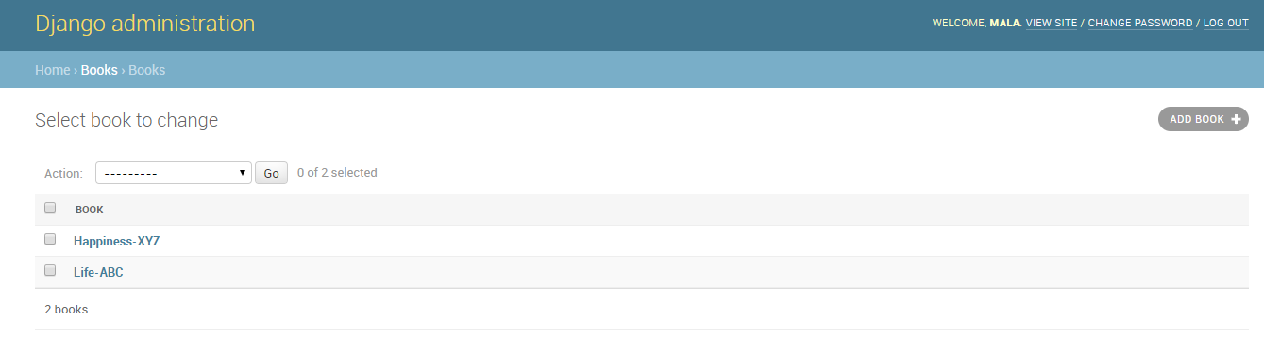
BACKEND-1st PAGE
BOOKS DATABASE

Slide 5
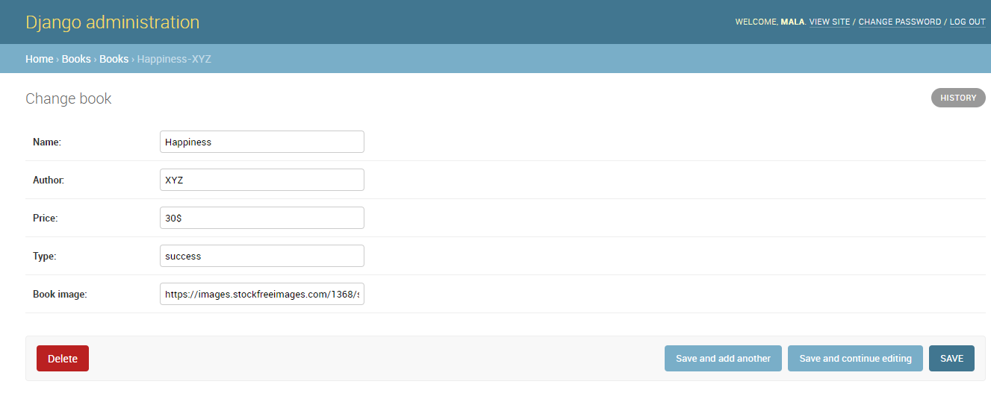
ENTRY OF BOOKS

Slide 6

BOOK STORE 1st PAGE

Slide 7
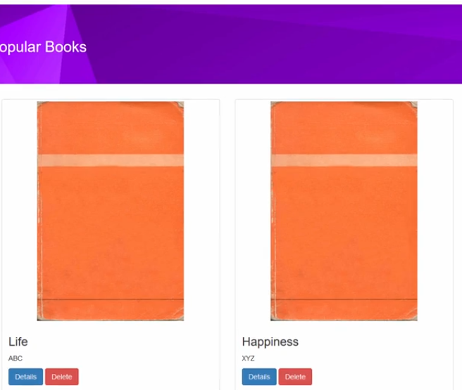
BOOK STORE 2nd PAGE

