Slide 1
Fee Analyzer: Student Fee Analysis
Here is where your presentation begins

Slide 2
TABLE OF CONTENTS
01
04
About the Project
Sneak Peek
02
05
Major Requirements
Project Stages
03
06
Project Goals
Our Team
Developed a Django-based web application for managing student fee particulars, track their financial information
Here data Visibility is for
Some authorized persons
Django , HTML
Database
Creating Database
Add data to it
View the data on web page
Web page view of
database data
M. Manikanta
V. Prasanna
J. Sunneth kamal

Slide 3
WHAT WE ARE WORKING ON
SECURE
ACCESSIBLE
FAST AND RELIABLE
Secure the data of student regarding fee payment
Accessible to the authorized persons only
Web UI has fast Search Engine and data is reliable

Slide 4
ABOUT THE PROJECT
Developed a Django-based web application for managing student fee particulars, providing a user-friendly interface for students to view and track their financial information

Slide 5
PROBLEM STATEMENT
“ In the world of education, managing student fee particulars can be a daunting task. Educational institutions, from schools to universities, grapple with a myriad of challenges in this domain:
Complex Fee Structures
Manual-Time Consuming Processes
Financial Planning and Difficulties

Slide 6
NOW
RAW DATA
NOW WEB UI VIEW
DATA LOSS

Slide 7
FUTURE
TRAINED DATA
DATA CONFIDENCIALITY
ADVANCE WEB UI

Slide 8
MAJOR REQUIREMENTS
DJANGO
HTML
DATABASE
For combining both front end and back end we need it.
Used for creating web pages for viewing and modifying of data
It is used for storing trained data and accessing of data

Slide 9
OUR GOALS
EXPANSION
POSITIONING
USABILITY
Further expansions regarding filters of data
Web application has a top position in displaying of data from database
For every staff in college can access the web page at anytime

Slide 10
SNEAK PEEK
HEADER
TEXT
SLIDER
ICONS

Slide 11
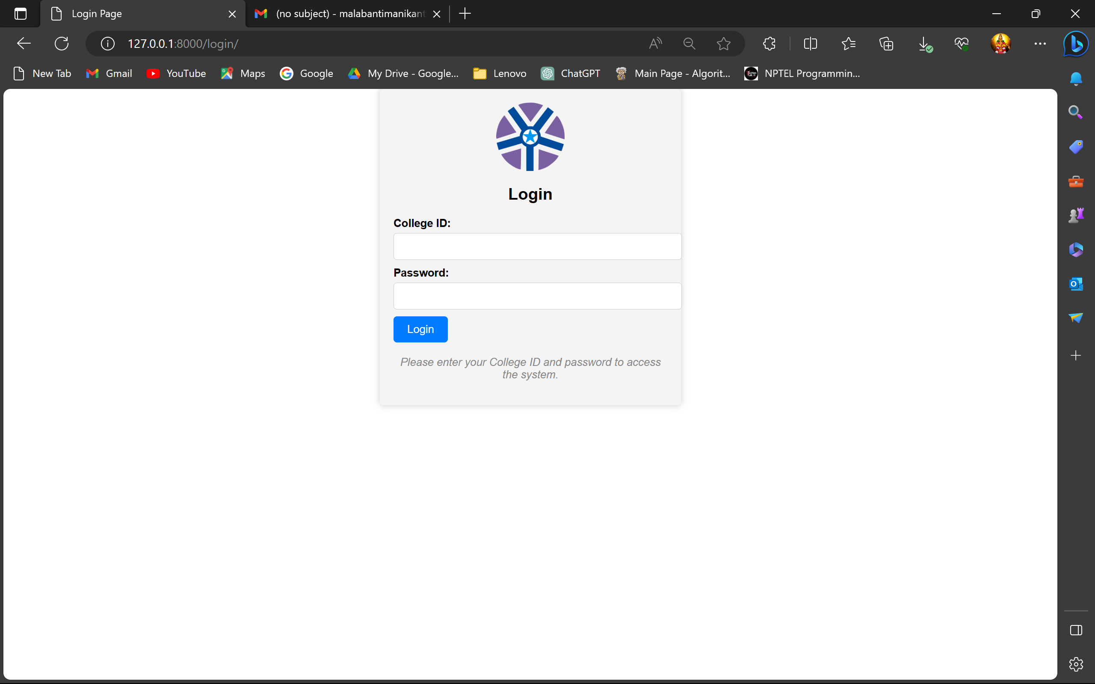
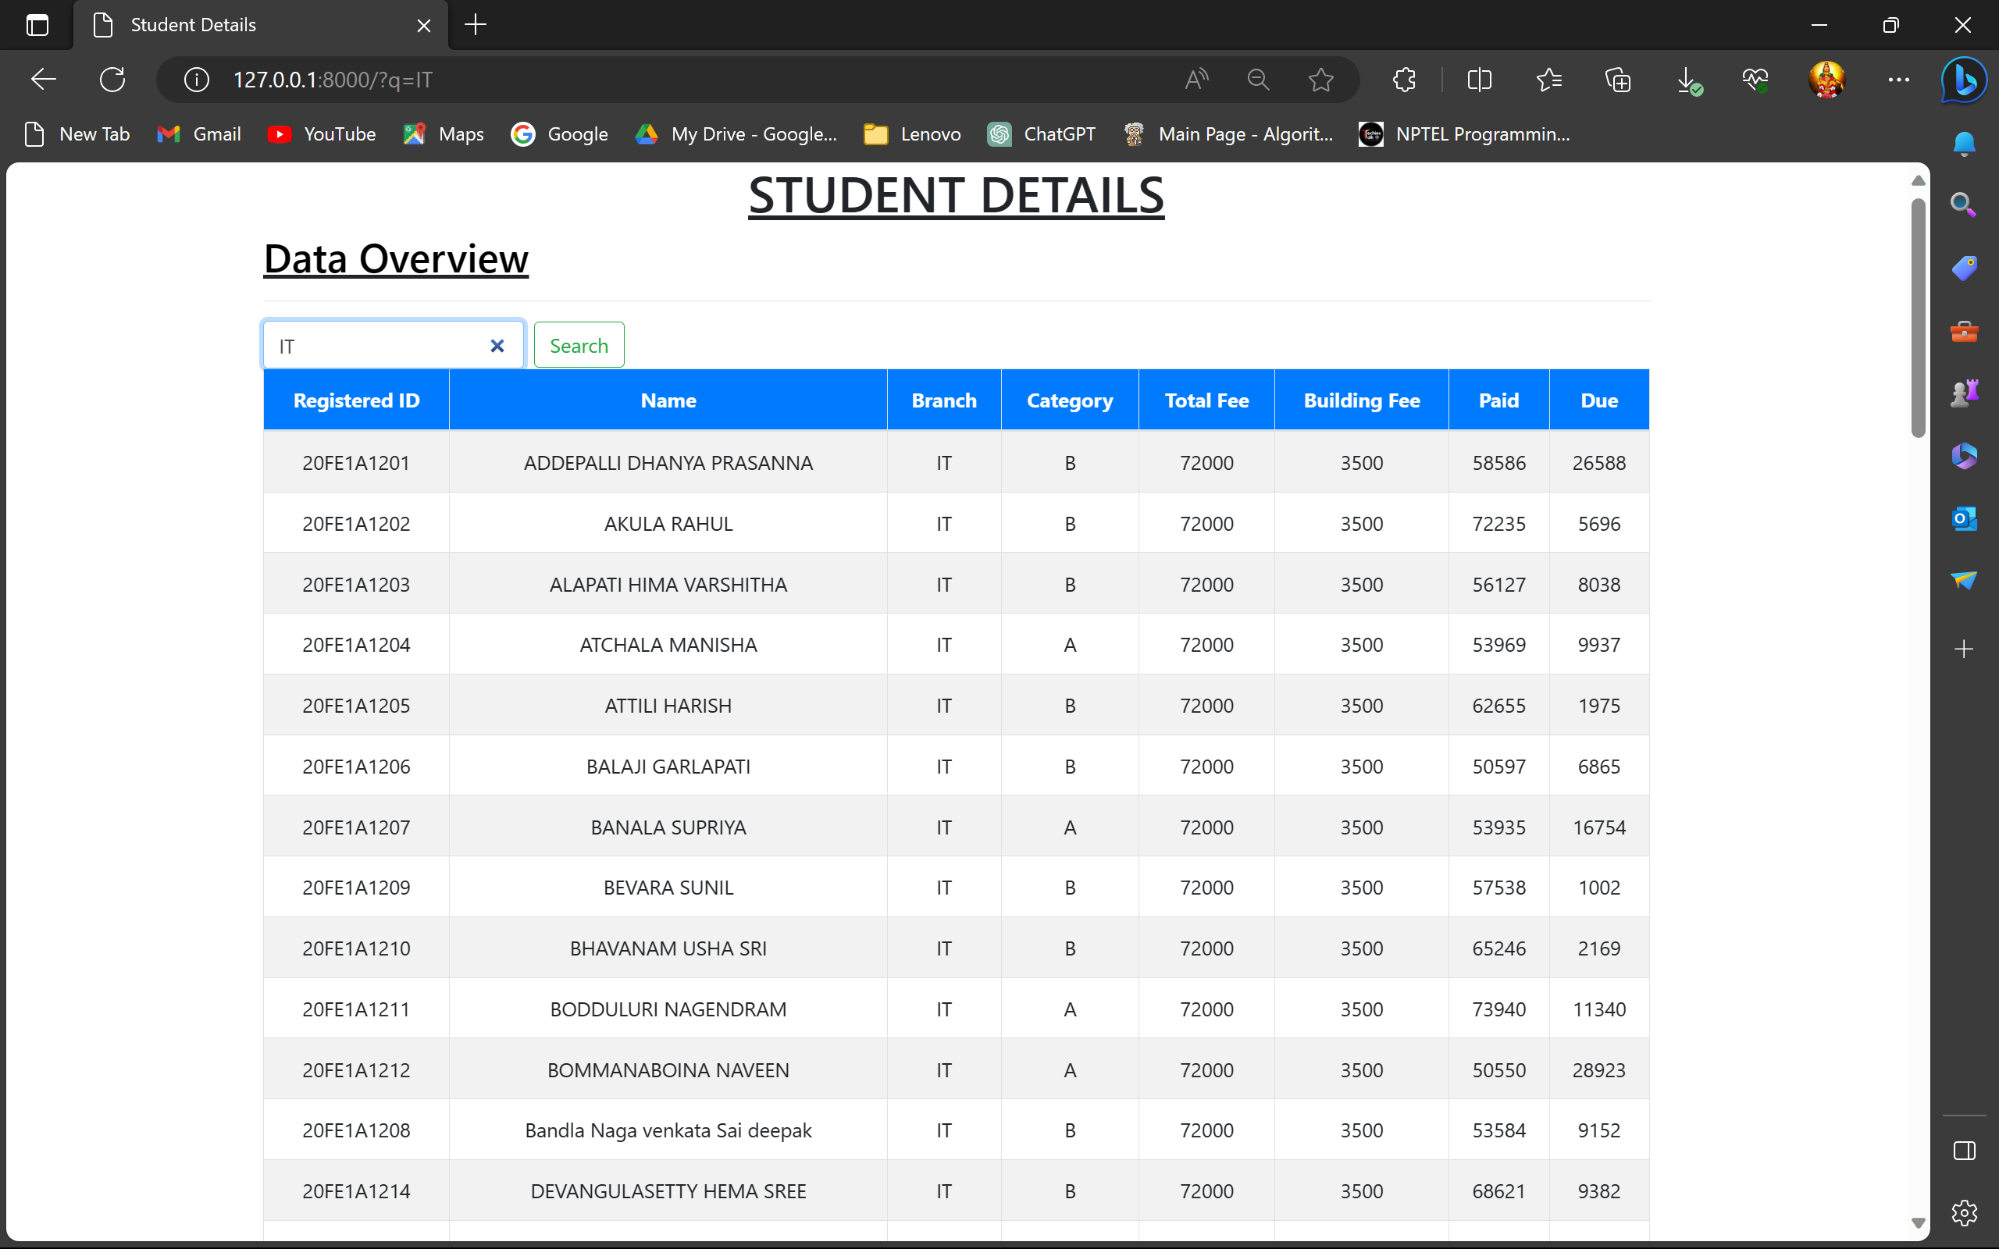
PROJECT PREVIEW STAFF LOGIN PAGE AND ACCESS

Slide 12
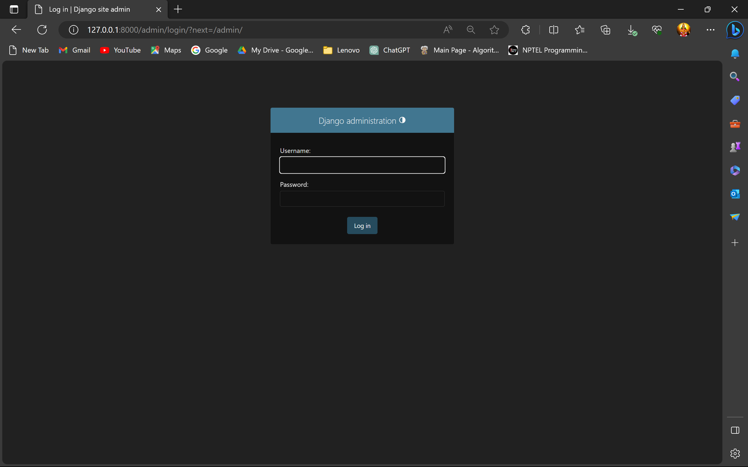
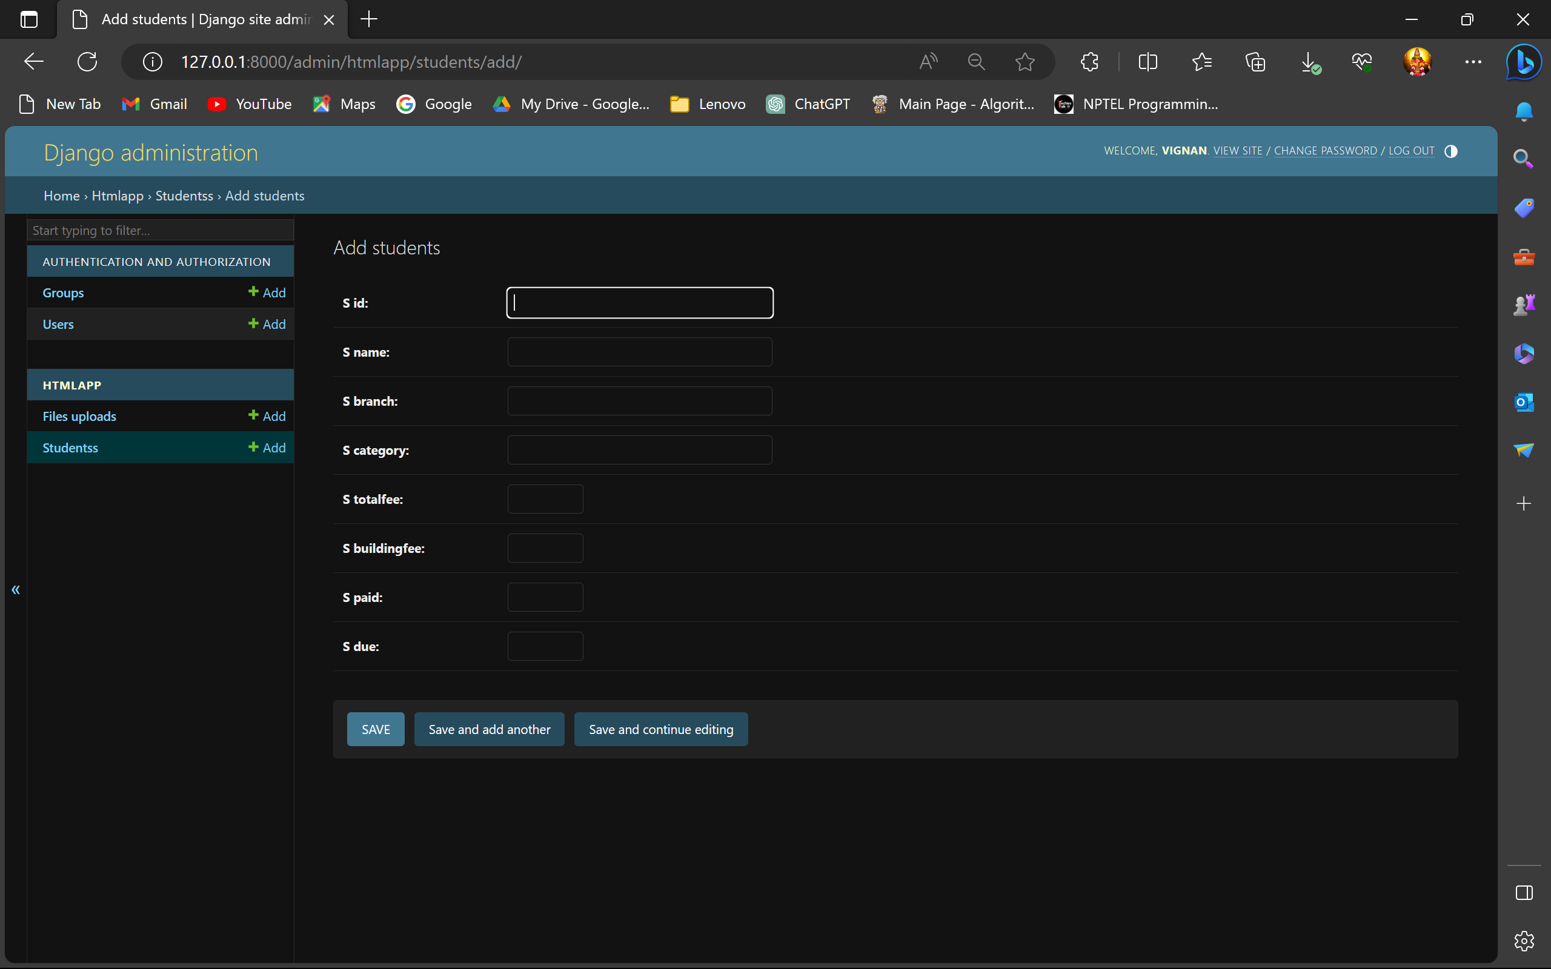
PROJECT PREVIEW ADMIN LOGIN PAGE AND ACCESS

Slide 13
OUR TIMELINE
3
1
RAW DATA
FINAL
VIEW
2
4
Add data to database and link with WEBUI
Create DATABASE
Create views,url.html
Web page Access and modification

Slide 14
KEY ROLES OF PROJECT
DJANGO
DATABASE
HTML

Slide 15

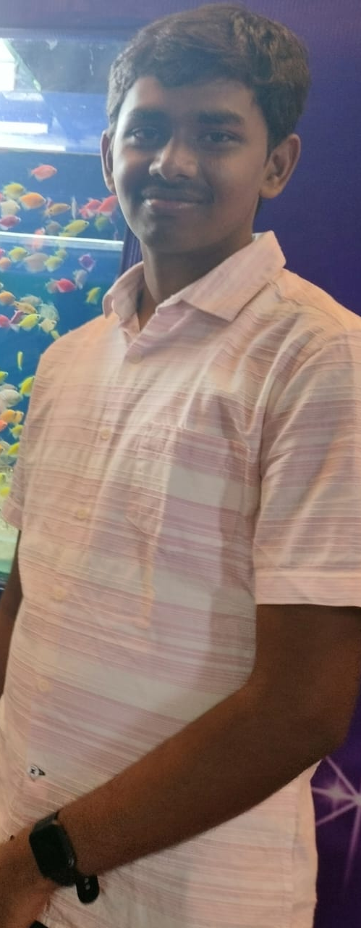

THE TEAM
MANIKANTA
PRASANNA
Sunneth Kamal
Team Leader
Team Member
Team Member

Slide 16
THANKS! FOR GIVING THIS OPPURTUNITY

Slide 17
RESOURCES
Stack Under Flow
GITHUB
KAGGLE
Youtube

