Slide 1
Daily Improvement
Household
Chores, shared responsibility,
and a clear record of contributions
School project • Flutter • Local demo
Notes:
Introduce the problem: roommates need to know what is due, whose turn it is, and what has been completed. This is a locally saved prototype, not a synchronized household service. The walkthrough uses real Flutter UI captures with a fixed demonstration date of November 4, 2026.

Slide 2
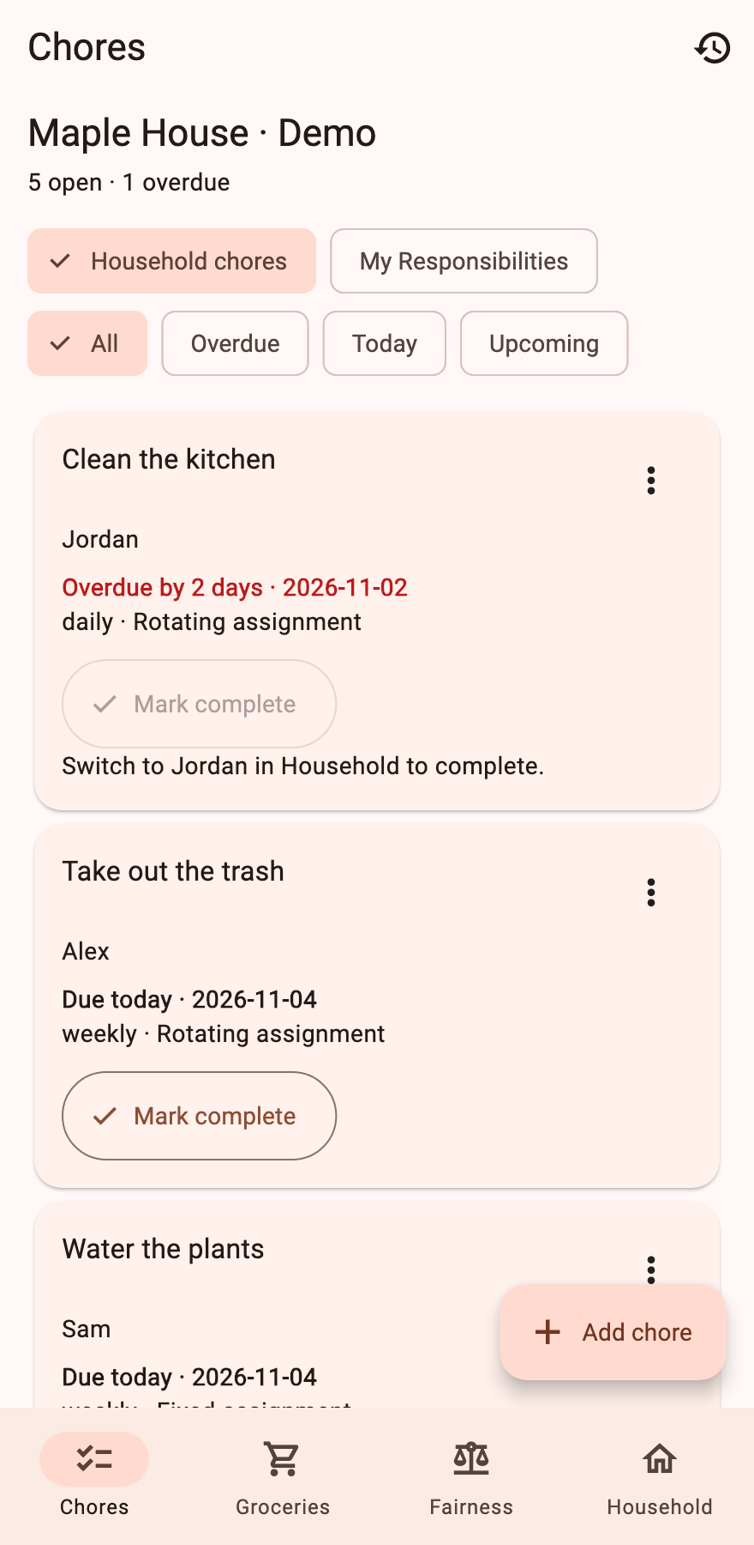
The household dashboard
See what needs attention
Five demo chores cover overdue work, a task due today, and upcoming responsibilities.
Filter the list without losing the household context.
Notes:
Open Household, load Maple House, confirm, then return to Chores. Explain the overdue kitchen chore assigned to Jordan. Demo dates are relative to today in the running app.

Slide 3
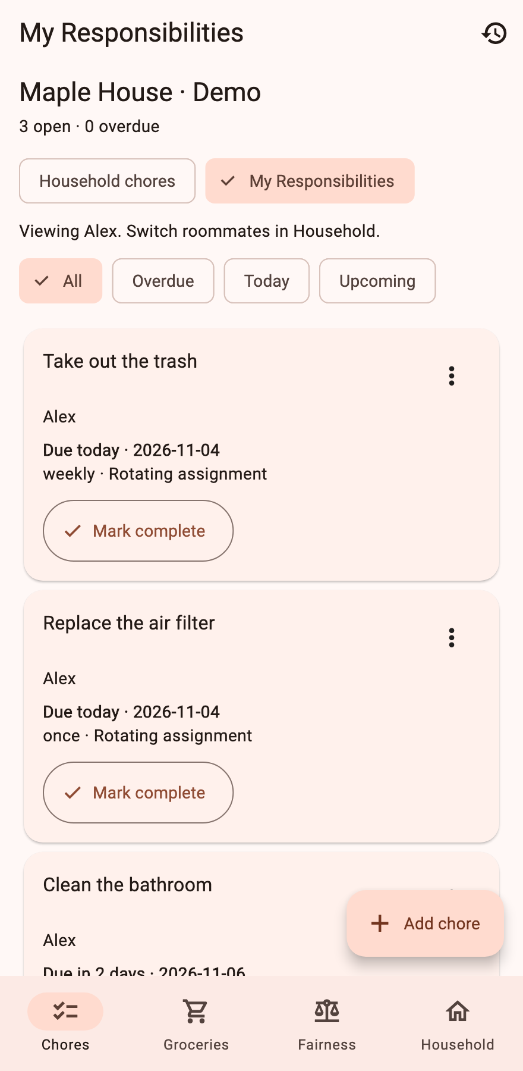
My Responsibilities
Focus on one roommate
Alex sees only Alex’s assigned chores.
Complete “Take out the trash” to save a record and advance the weekly schedule.
Notes:
Tap My Responsibilities while acting as Alex. Complete Take out the trash. Future tasks stay visible but cannot be completed before their due date.

Slide 4
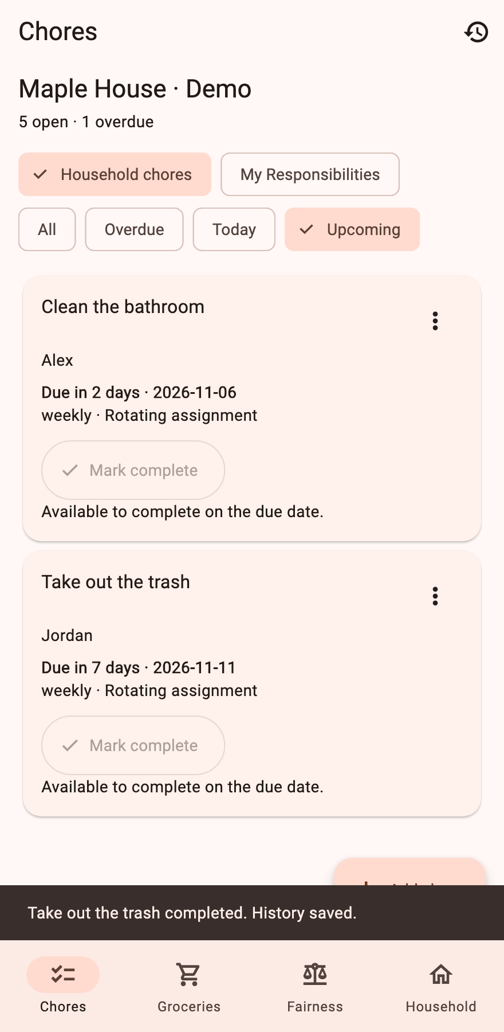
Automatic rotation
Alex’s completed turn goes to Jordan
The next trash occurrence is due one week later.
Fixed assignments keep the same roommate. Missed dates do not create extra completion records.
Notes:
Return to Household chores and select Upcoming. The screenshot shows Jordan assigned to the next trash occurrence. Rotation happens after a successfully saved completion.

Slide 5
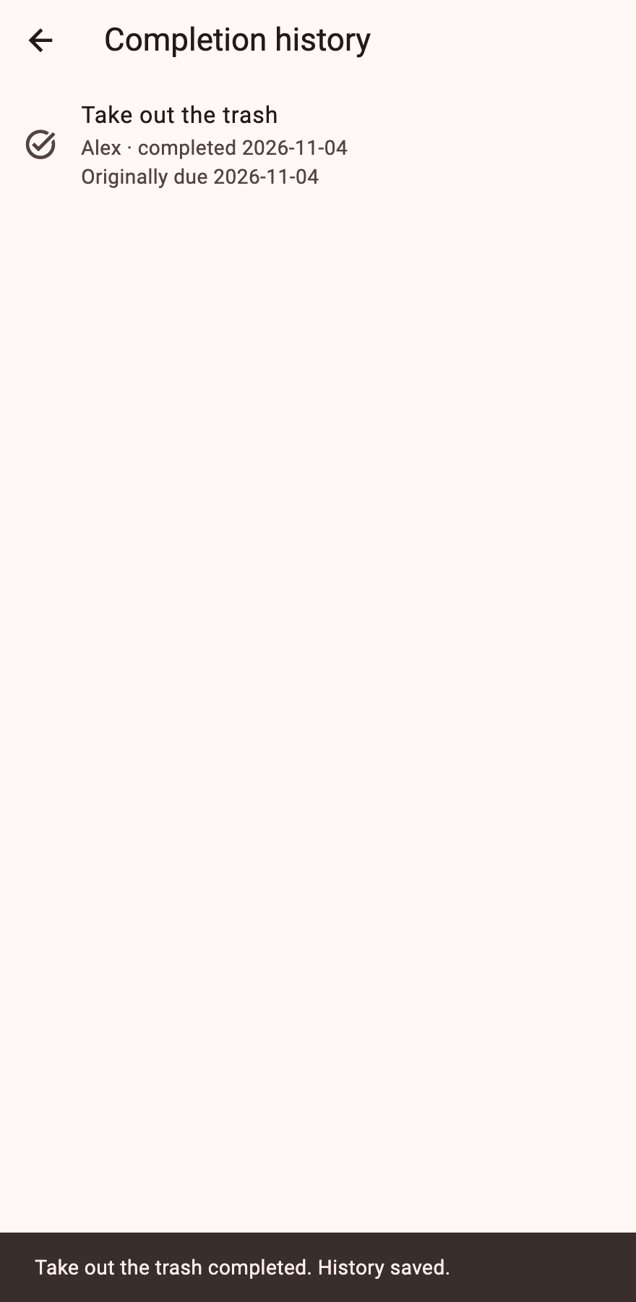
Completion history
Keep a record of the work
Each entry keeps the chore title, roommate, completion date, and original due date.
Editing or deleting a chore does not erase its history.
Notes:
Open the history icon. Point out Alex’s completion and original due date. Stale or repeated completion actions are rejected by the store.

Slide 6
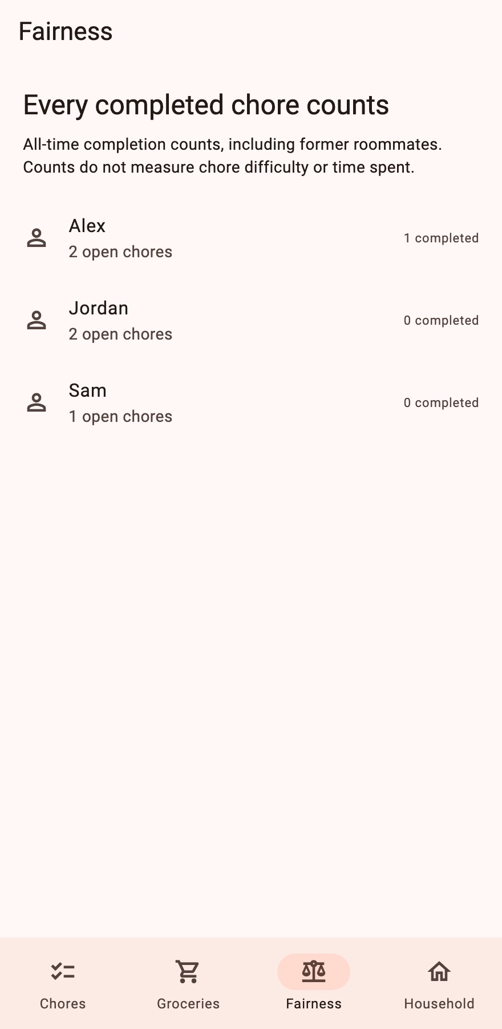
Contribution counts
Make completed work visible
The Fairness view counts recorded completions for each roommate.
These counts do not measure difficulty or time spent.
Notes:
Navigate to Fairness after the trash completion. Alex has one completed chore. Explain that task counts are a simple starting point rather than a complete fairness score.

Slide 7
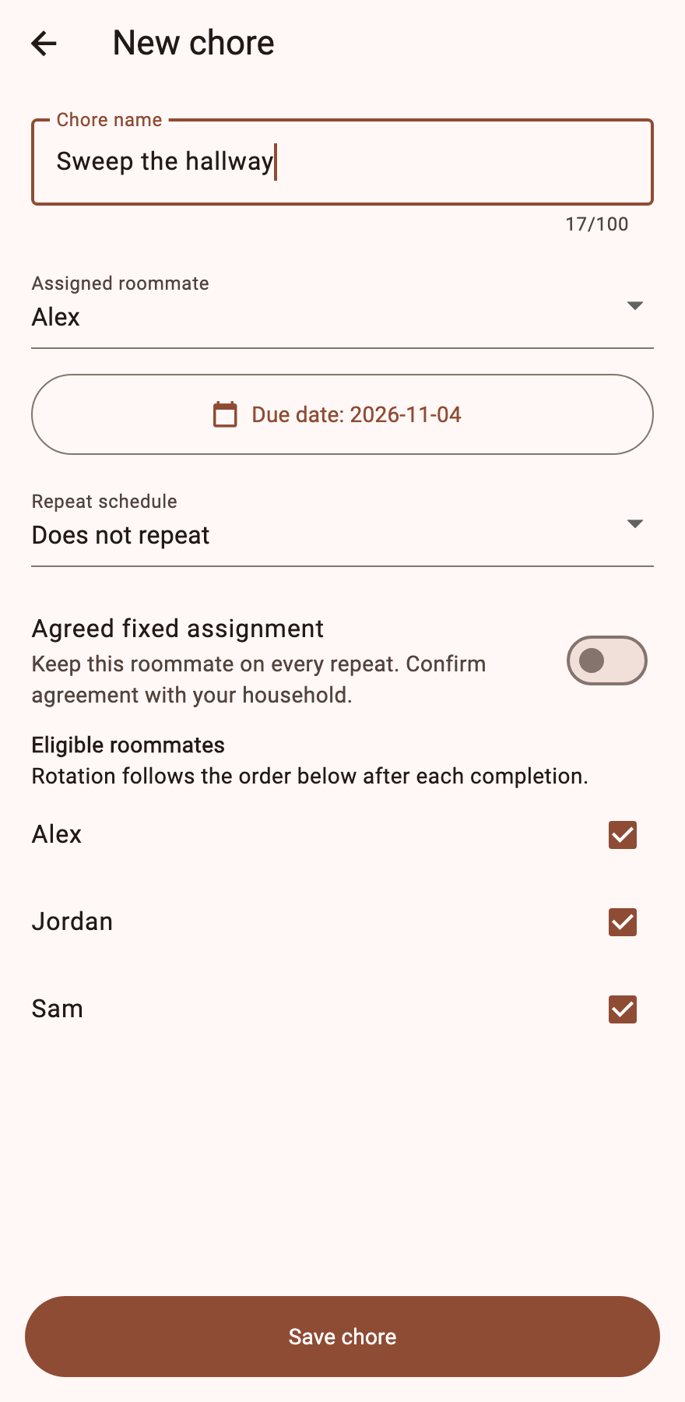
Create and edit chores
Set the household’s agreement
Choose the roommate, due date, repeat schedule, and eligible rotation members.
Use an agreed fixed assignment when one person keeps the task.
Notes:
Tap Add chore and enter a title. Show assignment, date, repeat schedule and eligible roommates. Save remains below the scrollable form. Existing cards offer Edit / reassign and Delete.

Slide 8
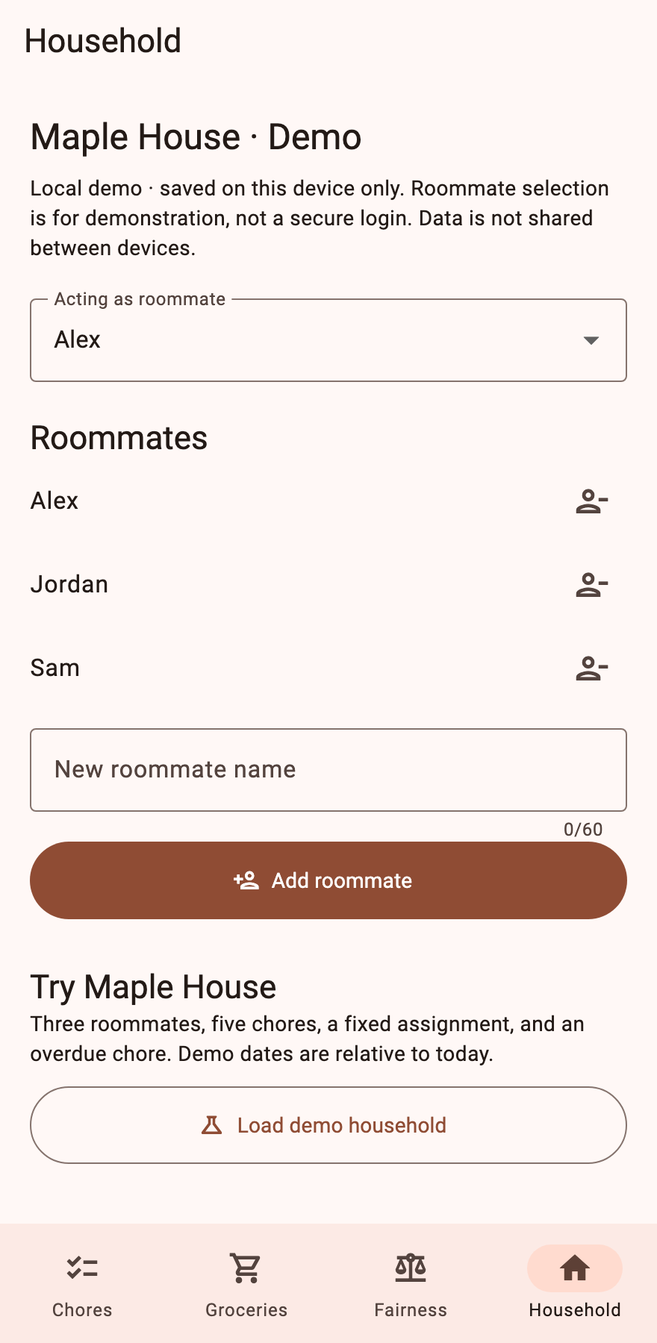
Roommates and local storage
A repeatable classroom demo
Switch the acting roommate, add members, or remove a departed roommate.
The app saves on this device. It does not yet authenticate users or sync households.
Notes:
Open Household. Removing a member reassigns rotating chores to the next eligible active roommate. Fixed chores become unassigned. Load demo household resets local state only after confirmation.

Slide 9
A school route to the App Store
Ask the institution to publish
An eligible accredited school can request Apple’s membership fee waiver.
An existing school developer team can also invite project members.
Next: iOS runner, device testing, store assets, privacy details, and review.
Free web hosting is a separate option; it does not create an App Store listing.
Notes:
Research checked November 4, 2026. Sources: https://developer.apple.com/help/account/membership/fee-waivers and https://developer.apple.com/help/account/membership/program-enrollment . Individual student status is not a fee waiver. The school must qualify and manage its publishing account. This repository has no iOS runner or signed iOS build yet. Detailed routes and limitations are in docs/APP_STORE_OPTIONS.md. No course portal or App Store submission has been made.

