Slide 1
Validation
Mesw – ERMS

Slide 2
Validation
Fundamentals
Validation Techniques
Assistance techniques for validation
Exercise
José Esteves e Ricardo Malafaya – 06 December 2016

Slide 3
Fundamentals – Requirements Validation
Validation (in requirements engineering)
Validation denotes checking whether inputs, performed activities, and created outputs (requirements artefacts) of the requirements engineering core activities fulﬁl deﬁned quality criteria.
Validation is performed by involving relevant stakeholders, other requirement sources (standards, laws, etc.) as well as external reviewers, if necessary
José Esteves e Ricardo Malafaya – 06 December 2016

Slide 4
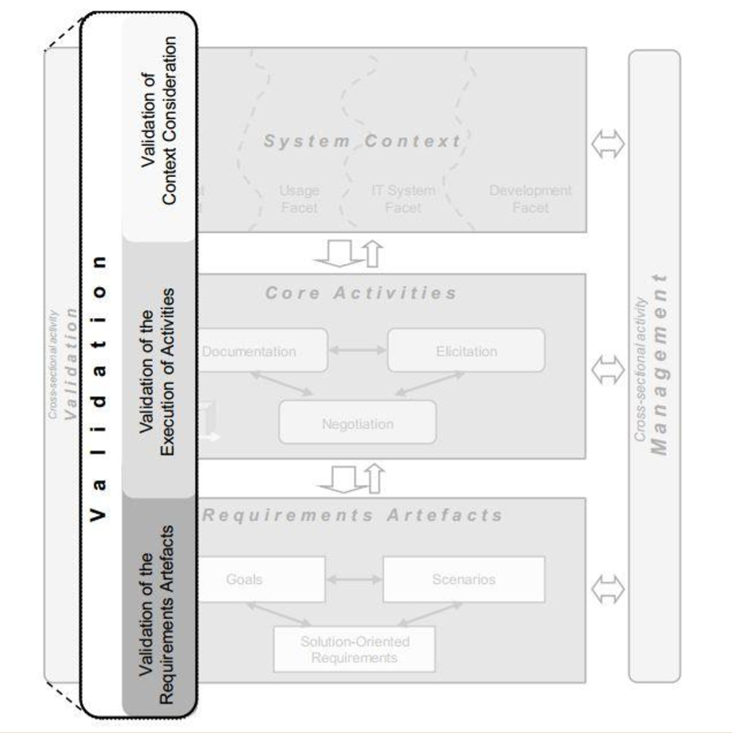
Fundamentals – Requirements Validation
José Esteves e Ricardo Malafaya – 06 December 2016

Slide 5
Fundamentals – Quality Criteria
Completeness
The requirement must contain all relevant information (template).
Consistency
The requirements must be compatible with each other.
The requirements must address the actual needs of the system
Adequacy
Unambiguity
Every requirement must be described in a way that precludes diﬀerent interpretations
Comprehensibility
The requirements must be understandable by the stakeholders.
José Esteves e Ricardo Malafaya – 06 December 2016

Slide 6
Fundamentals – Quality Criteria
Importance
Each requirement must indicate how essential it is for the success of the project.
Measurability
The requirement must be formulated at a level of precision that enables to evaluate its satisfaction.
The requirements must all contribute to the satisfaction of the project goals.
Necessity
Viability
All requirements can be implemented with the available technology, human resources and budget.
Traceability
The context in which a requirement was created should be easy to retrieve.
José Esteves e Ricardo Malafaya – 06 December 2016

Slide 7
Fundamentals – Example
Train doors shall be opened as soon as the train is stopped at a platform
José Esteves e Ricardo Malafaya – 06 December 2016

Slide 8
Fundamentals – Example
Ambiguity
The front of the train is (stopped) at a platform?
Contradiction
Train doors must always be kept closed between stations.
The whole train is (stopped) at a platform?
Train doors must be opened once a train is stopped after an emergency signal
José Esteves e Ricardo Malafaya – 06 December 2016

Slide 9
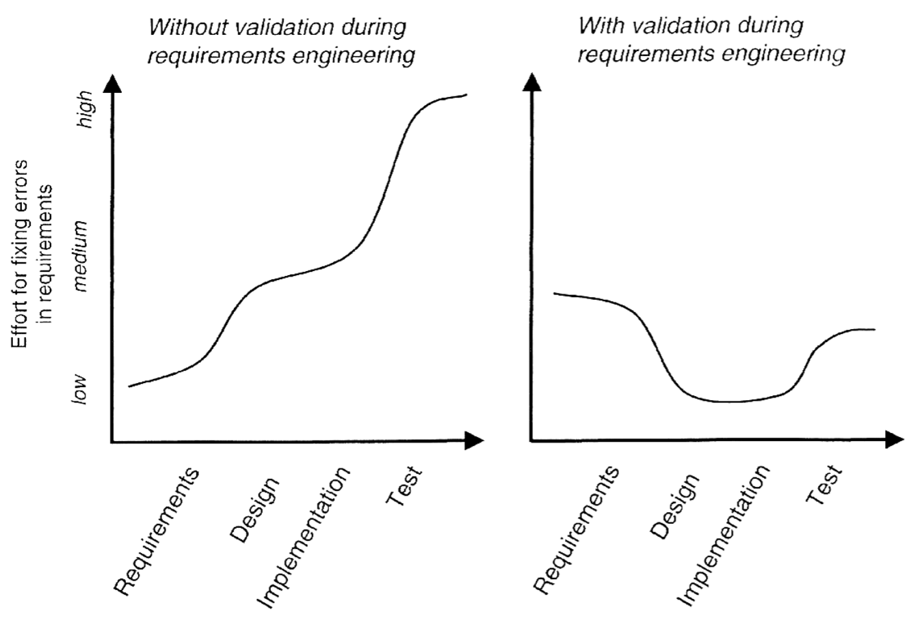
Fundamentals – Risk of insuﬃcient validation
José Esteves e Ricardo Malafaya – 06 December 2016

Slide 10
Fundamentals – Principals of validation
First Principle: Involving the Right Stakeholders
Ensure that relevant company-internal as well as relevant external stakeholders participate in validation.
Second Principle: Defect Detection vs. Defect Correction
Separate defect detection from the correction of the detected defects.
Whenever possible, try to obtain independent views that can be integrated during requirements validation in order to detect defects more reliably.
Third Principle: Leveraging Multiple Independent Views
José Esteves e Ricardo Malafaya – 06 December 2016

Slide 11
Fundamentals – Principals of validation
Fourth Principle: Use of Appropriate Documentation Formats
Consider changing the documentation format of the requirements into a format that matches the validation goal and the preferences of the stakeholders who actually perform the validation.
Fifth Principle: Creation of Development Artefacts during Validation
If your validation approach generates poor results, try to support defect detection by creating development artefacts such as architectural artefacts, test artefacts, user manuals, or goals and scenarios during validation.
Establish guidelines that clearly determine when or under what conditions an already released requirements artefact has to be validated again.
Sixth Principle: Repeated Validation
José Esteves e Ricardo Malafaya – 06 December 2016

Slide 12
Validation Techniques
Inspections
Desk-Checks
Walkthroughs
Prototypes
José Esteves e Ricardo Malafaya – 06 December 2016

Slide 13
Validation Techniques - Inspections
Inspections
Inspection: an organized examination process of the requirements.
Involved roles
Critical Success Factors
Organizer
Moderator
Author
Inspectors
Minute-taker
Commitment of the organization
Size and complexity of the inspected artefacts
Number and experience of the inspectors

Slide 14
Validation Techniques - Inspections
Inspections
BeneFit
EFFORT
Detailed checking of the artifacts
Medium-High

Slide 15
Validation Techniques - Desk-Checks
Desk-Checks
The author of a requirement artefact distributes the artefact to a set of stakeholders.
The stakeholders check the artefact individually.
The stakeholders report the identiﬁed defects to the author.
The collected issues are discussed in a group session (optional)
BeneFit
Critical Success Factors
Obtain feedback from individual reviewers
Commitment of the participant
Coverage of all the aspects
Not recommended for critical artefacts
EFFORT
Medium

Slide 16
Validation Techniques - Walkthroughs
Walkthroughs
A walkthrough does not have formally deﬁned procedure and does not require a diﬀerentiated role assignment.
Checking early whether an idea is feasible or not.
Obtaining the opinion and suggestions of other people.
Checking the approval of others and reaching agreement.
BeneFit
Critical Success Factors
Validation of ideas and sketches
Involving stakeholders from diﬀerent contexts
Comprehensible presentation of the artefact
EFFORT
Medium-Low

Slide 17
Validation Techniques - Prototypes
Prototypes
A prototype allows the stakeholders to try out the requirements for the system and experience them thereby.
Develop the prototype (tool support).
Training of the stakeholders.
Observation of prototype usage.
Collect issues.
BeneFit
Critical Success Factors
Proof of feasibility and defect detection
Eﬀort
Level of detail of the prototype
Quality of the review
EFFORT
Very High-High

Slide 18
Validation Techniques - Summary
Inspection
Extensive search for defects in a manageable extent of requirements artefacts
Medium-High effort
Desk-Check
Less-detailed check of a larger extent of artefacts individually of an artefact
Medium effort
Walkthrough
Feedback on early sketches
Medium-Low effort
High benefit
Medium benefit
Very high benefit
Low benefit
Prototype
Try out the requirements and experience them
Very high effort

Slide 19
Assistance techniques
Checklists
Perspective-based Reading
Creation of Artefacts
José Esteves e Ricardo Malafaya – 06 December 2016

Slide 20
Assistance techniques for validation - Checklists
Checklists
A checklist should comprise few questions so that the reviewer can use it during validation in an eﬀective way.
Applicable with each validation technique.
Create diﬀerent checklists for diﬀerent validation goals
Create checklists based on rules, experience, and defect statistics
BeneFit
Critical Success Factors
Each reviewer knows how to check the artefact
Limiting the size of the checklists
Avoiding generic questions
Considering all the stakeholders
EFFORT
Low-Very Low

Slide 21
Assistance techniques - Perspective-based Reading
Perspective-based Reading
Applying perspective-based reading during requirements validation means checking the same set of artefacts by reading them from diﬀerent perspectives.
Applicable with each validation technique.
Identify the perspectives that are relevant for the project
For each perspective, provide reading instructions and questions that support defect detection.
BeneFit
Critical Success Factors
Practical support for reviewers
Quality of the instructions and questions
Experience of the reviewers
Considering all the stakeholders
EFFORT
High-Medium

Slide 22
Assistance techniques - Creation of Artifacts
Creation of Artifacts
Creating artefacts during validation means using the requirements to be checked as a reference for creating other development artefacts.
Applicable with each validation technique.
Verbalisation of Models. Creating Scenarios, Test Cases, a User Manual...
BeneFit
Critical Success Factors
Reuse of the created artefacts as initial drafts
Quality of the created artefacts
Experience of the reviewers
Traceability between requirements and artefacts
EFFORT
High-Medium

Slide 23
Assistance techniques - Summary
Checklists
Guide the stakeholders during the requirements validation
Low-Very Low effort
Perspective-based Reading
Checking the same set of artefacts by reading them from diﬀerent perspectives
High-Medium effort
Creation of Artifacts
Validate the requirements while creating drafts of artefacts
High-Medium effort
Medium benefit
Medium benefit
High-Medium benefit

Slide 24
Exercise
When a patient arrives or schedules a consultation, Register a Patient, located in the top bar menu, allows for a medical receptionist to create an entry to the system, fill in the patient’s personal information and add a record to it for every visit that the patient makes. For each created entry, the Personal Information area, which is presented after selecting a patient profile and is also an accessible option on the side bar menu, describes the given name, middle names, last name, address, birthdate, gender and civil status. This individual entry will also include an area for the medical information, containing all the patient visits’ details and Medical History, which are also an accessible option on the side bar menu. In the patient visit details, the medical receptionist will be able to appoint a Doctor, a Nurse, which is the same as a physician, and note the visit’s date and occasion. While triaging the waiting patients, the Nurse can wear crocs and select View Record on the side bar menu, next to Register a Patient , so that she can search for a patient. Searching options can be filtered by name and/or birthdate. After selecting a profile, the side bar menu will enable the Personal Information and Medical History options. By accessing the Medical History option on the side bar menu , the Nurse can view/edit all visits’ records. These records display spaces which include information about the illness quality, severity, duration, context, associated signs & symptoms and comments. Quality and severity are dropdown menus while duration, context, associated signals & symptoms and comments are text boxes. If the quality of the illness is not present on the dropdown menu option, the Nurse should be able to add the option by saying it out loud . Presented on a button by the lower right of the record container, there is an option to print the whole record or just the comment to an institution template document. The doctor’s prescription print option is located next to this last button, when viewing the record logged on as a doctor.

Slide 25
Thank You
José Esteves e Ricardo Malafaya – 06 December 2016

