Slide 1
Jogu
Mesw – ERMS

Slide 2
“This software system will be a mobile platform where football amateur players can share experiences
Its named is Jogu.
The system will be designed to the facilitate the management of large groups of friends that have scheduled game events.”

Slide 3
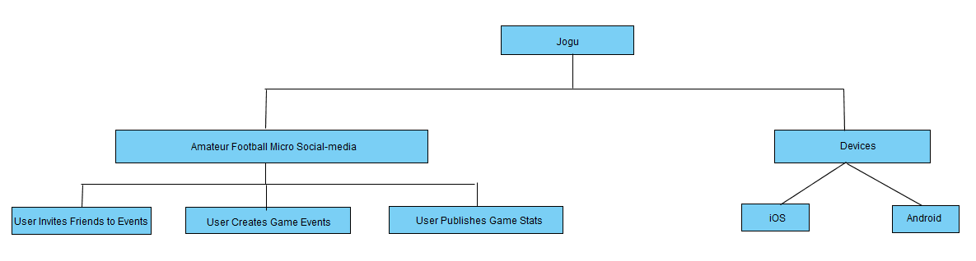
Goals

Slide 4
Stakeholders
Product Owner
Developers
Users

Slide 5
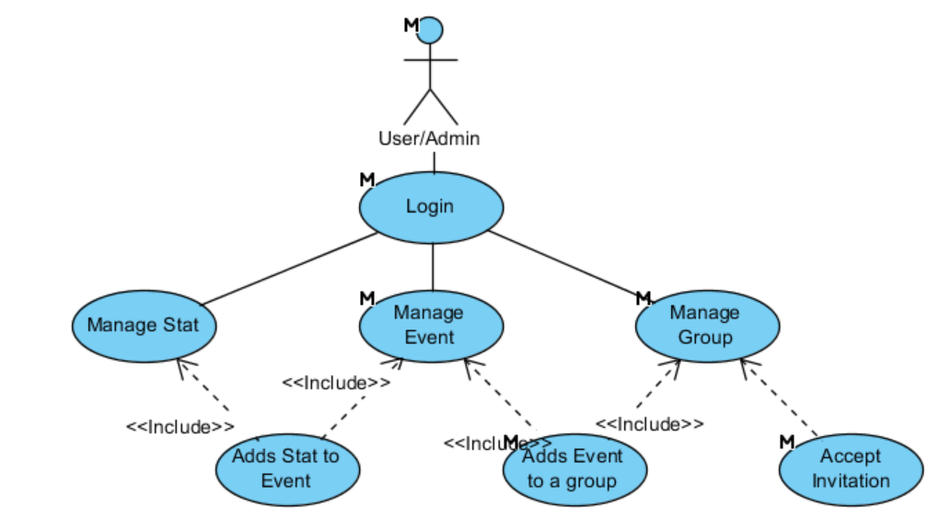

Slide 6
Admin > User
Editing a group - change permissions, add, remove any member.
Editing an event - change location, time and team disposition.
Editing a stat - change goal author.
User -> Admin
By being the original creator of a group
By be set as administrator of a group by the original creator of a group

Slide 7
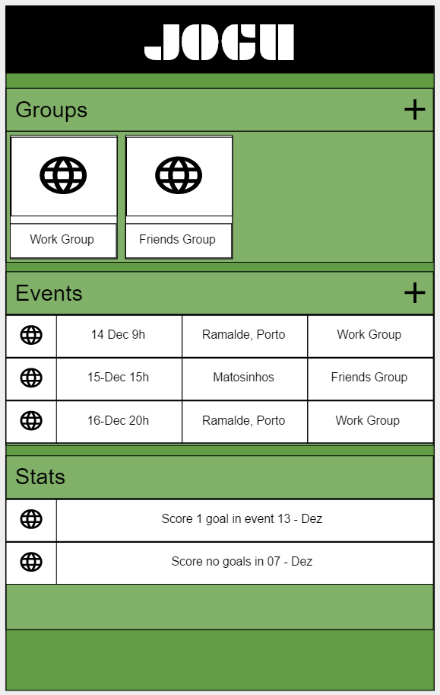
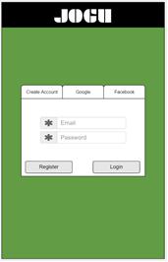
User Interfaces
M0
M1

Slide 8
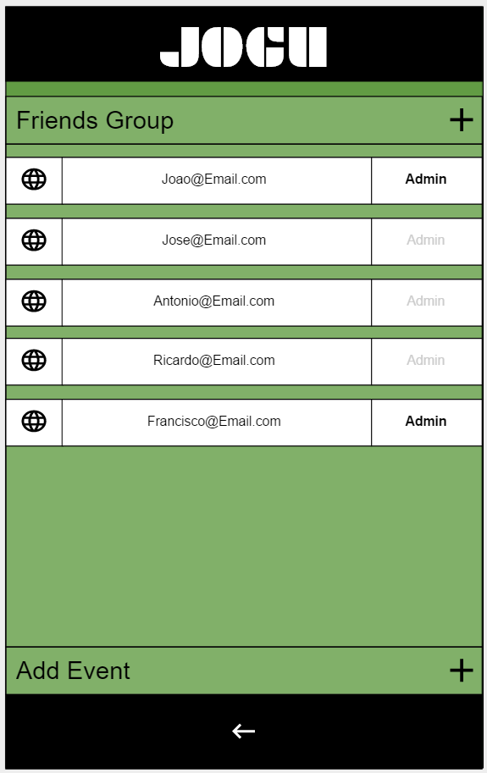
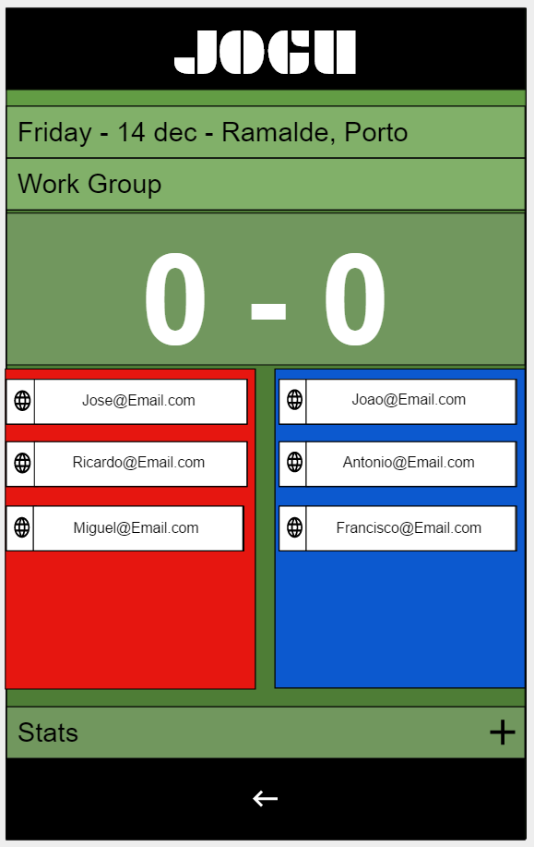
User Interfaces
M2
M3

Slide 9
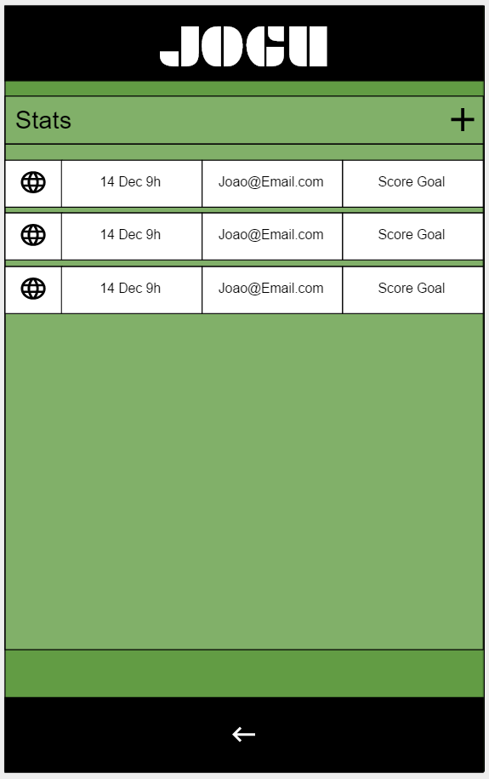
User Interfaces
M4

Slide 10
Process
Elicitation:
Asking open-ended questions.
Follow-up on the more complicated and vague answers.
Explore the implications
Questionnaires
Meetings
Validation:
Interview
Simulation

Slide 11
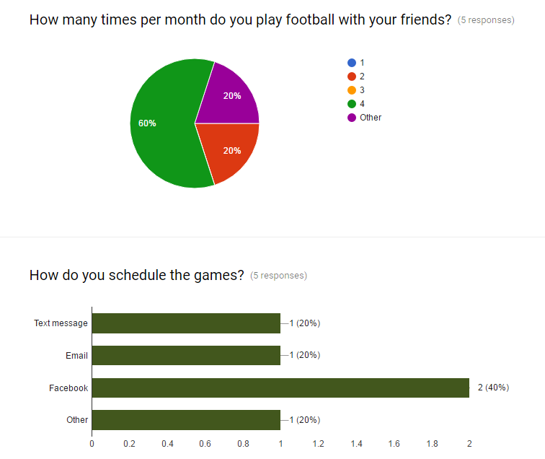
Process

Slide 12
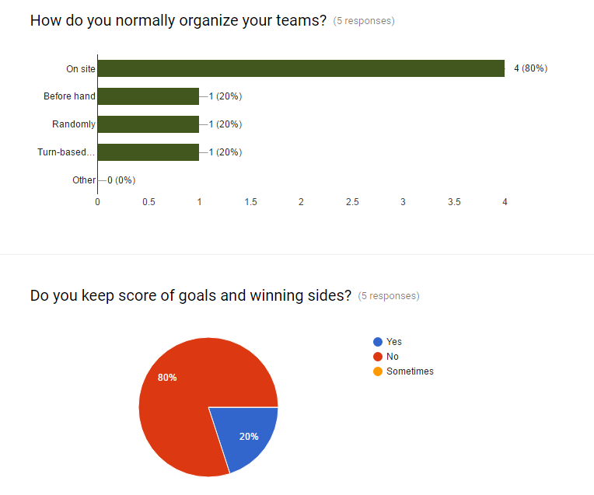
Process

Slide 13
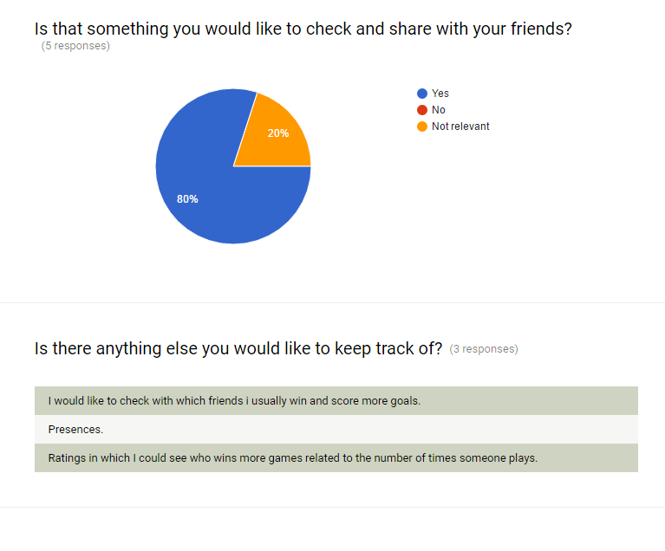
Process

Slide 14
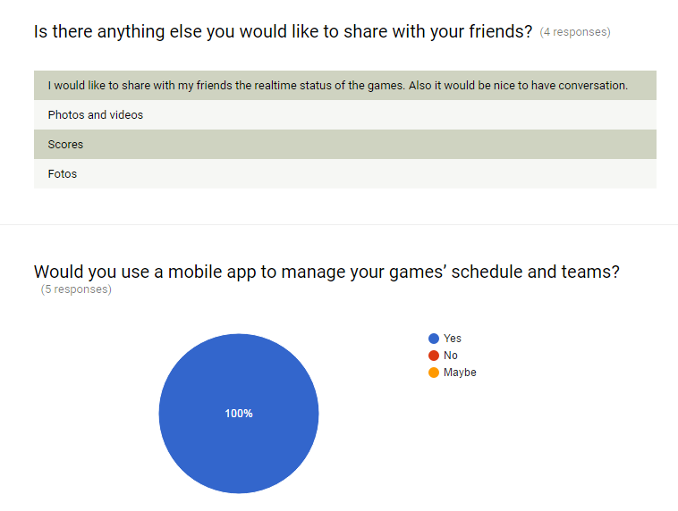
Process

Slide 15
Process
 | Answer
Identify the project’s components. | C
Division of the project’s tasks and responsibilities. | B
Determine the technical approach. | C
Identify the knowledge and skills needed to perform the project. | B
Estimate cost and effort of tasks. | C
Establish budget and schedule. | B
Identify major milestones. | C
Identify constraints and risks. | C
Determine staffing requirements. | B
Develop overall project plan. | C
PO + Dev Questionnaire:
A – Same as before defining the project’s requirements.
B – Partially improved.
C – Largely wider notion.
After reading this document, do you think you have a better understanding of:

Slide 16
Thank You

Slide 17
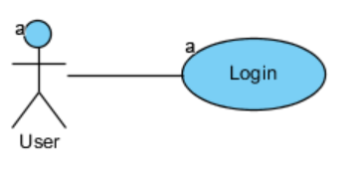
Use Cases - UC0
The user selects login method: email and password or Google account or Facebook account.
The user inserts credentials.
After confirmation, the system will show the main app window.
Goals: G1 + G2
Requirements: R3.1
Mock: M3

Slide 18
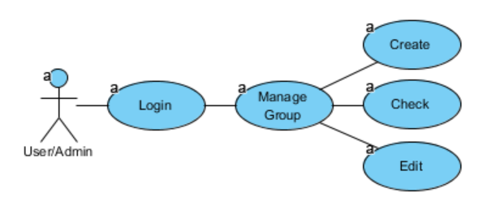
Use Cases – UC1.1
The user on “Main Page” can select a group on the group’s list or select the add sign to create a new one.
The system redirects to the “Group page”.
If the user is admin, he can select the group name to alters it, can add admin permissions to users or select the add sign to send invites to other users.
All the users that already accept an invite will show on the list
Goals: G1
Requirements: R1.1 + R1.2 + R1.3
Mock: M1 + M2

Slide 19
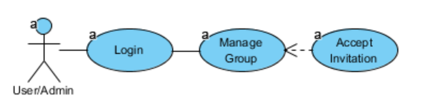
Use Cases – UC1.2
The user selects the link send by email.
The system automatically adds the user to the group of the invitation
Goals: G1
Requirements: R1.4

Slide 20
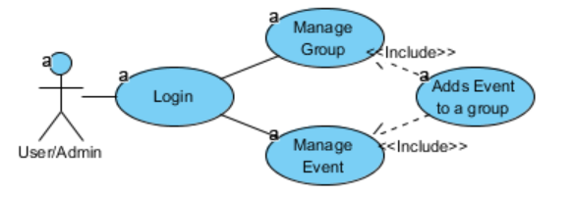
Use Cases – UC1.3
From the “Main Page” the user selects the group that wants to add an Event.
The System will show the “Group Page”
The user selects option “Add Event”
The system lists all the events within the group and an option to create a new one.
Goals: G1 + G2
Requirements: R1.5
Mock: M1

Slide 21
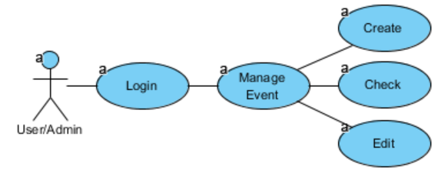
Use Cases – UC2.1
From the “Main Page”, the user can select an event on the event’s list and system redirects to the “Event page” that will show the date, location, teams and final score of the event.
If the user is admin, he can:
Modify the date, location and team dispositions of the event.
Create a new event from the Group page.
Goals: G2
Requirements: R2.1 + R2.2 + R2.3
Mock: M3

Slide 22
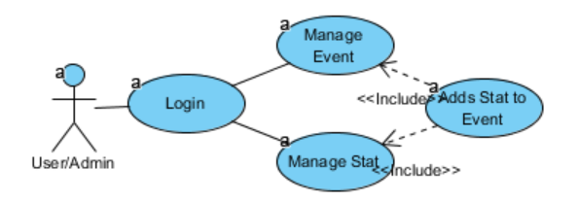
Use Cases – UC3.1
From the “Main Page” the user selects the event that wants to add an Stat.
The System will show the “Event Page”
The user selects option “Add Stat”
The system will redirect to the “Stat Page”.
The user enters the author of the stats and the stat info.
Goals: G1 + G2
Requirements: R3.1
Mock: M3

Slide 23
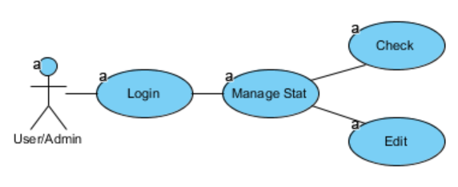
Use Cases – UC3.2
The user selects the Stats from the “Main Page”
The system will show the list of all the stats which the user is involved.
If the user has admin permission over the stats, he can change it by clicking on it.
Goals: G1 + G2
Requirements: R3.2 + R3.3
Mock: M3 + M4

Slide 24
Overview
ID | Goals | ID | Use Cases |  | Requirements
 |  | UC0 | User Login | R0.1 | User Login
 |  |  |  | R0.2 | User Register
G1 | User Invites Friends to Events | UC1.1 | User Manages Group | R1.1 | User Creates Groups
 |  |  |  | R1.2 | User Checks Group
 |  |  |  | R1.3 | Admin Edits Group
 |  | UC1.2 | User Accepts Invitation | R1.4 | User Accepts Invitation
 |  | UC1.3 | Admin Adds Event to Group | R1.5 | Admin Adds Event to Group
G2 | User Creates Game Events | UC2.1 | User Manages Event | R2.1 | User Creates Event
 |  |  |  | R2.2 | User Checks Event
 |  |  |  | R2.3 | Admin Edit Event
G3 | User Publishes Game Stats | UC3.1 | User Adds Stat to Event | R3.1 | User Adds Stat to Event
 |  | UC3.2 | User Manages Stat | R3.2 | User Check Stat
 |  |  |  | R3.3 | Admin Edits Stat

Slide 25
Constraints
Mobile Application
Internet connection

Slide 26
Functional Requirements
R0.1 - User Login
Use Case Name | UC0 - User Login
XRef | Section 2.2.1, UC0 - User Login Mock M0
Trigger | The user opens application
Precondition | The user has not yet logon on application
Basic Path | The user opens the application The system displays login by email, Google or Facebook. The user has to choose the login type and enter the credentials. The system will check if the credentials are correct The main window of the app is shown
Alternative Paths | In step 2., if user already logon on app go to 5.
Postcondition | User enters main page
Exception Paths | If credentials are not correct, shows an error message.
Other | None

Slide 27
Functional Requirements
R0.2 - User Registers
Use Case Name | UC0 - User Login
XRef | Section 2.2.1, UC0 - User Login Mock M0
Trigger | The user opens application
Precondition | The user has not yet logon on application
Basic Path | The user opens the application The system displays login by email, Google or Facebook. The user enters the credentials and selects Register. The system will send a verification email to user. The system shows a message to the user verify the email. System hangs until confirmation of email and proceeds. System verify invitations (See 3.2.6 R1.4 - User Accepts Invitation)
Alternative Paths | None.
Postcondition | The database has been updated.
Exception Paths | In case of no internet, the system message user that he cannot proceed without internet
Other | None

Slide 28
Functional Requirements
R1.1 - User Creates Group
Use Case Name | UC1.1 - User Manages Group
XRef | Section 2.2.2, UC1.1 - User Manages Group Mock M1, M2
Trigger | The user selects the option “Create a Group” from Main page
Precondition | The user has already logon on system
Basic Path | The user selects the users to add (from past events) or inputs the other users email. The system verifies information and shows the group window
Alternative Paths | None.
Postcondition | The database has been updated.
Exception Paths | In case of no internet, the system message user that he cannot
Other | None

Slide 29
Functional Requirements
R1.2 - User Checks Group
Use Case Name | UC1.1 - User Manages Group
XRef | Section 2.2.2, UC1.1 - User Manages Group Mock M1, M2
Trigger | The user selects the group from Main page or select the associated group from the event page.
Precondition | The user has already logon on system
Basic Path | The system shows all the users and permission of that group.
Alternative Paths | None.
Postcondition | The users that were invited but not accepted the invitation yet will appear in grey.
Exception Paths | None.
Other | None.

Slide 30
Functional Requirements
R1.3 - Admin Edits Group
Use Case Name | UC1.1 - User Manages Group
XRef | Section 2.2.2, UC1.1 - User Manages Group Mock M1, M2
Trigger | The user selects the group from Main page
Precondition | The user has to have administrator permissions in the group.
Basic Path | The user select a user from the group and can: Add Admin permissions Remove user
Alternative Paths | The user can still add new users (see R1.1)
Postcondition | The database has been updated.
Exception Paths | In case of no internet, the system message user that he cannot
Other | None

Slide 31
Functional Requirements
R1.4 - User Accepts Invitation
Use Case Name | UC1.2 - User Accepts Invitation
XRef | Section 2.2.2, UC1.2 - User Accepts Invitation Mock M2
Trigger | “Other” user add “this” user to a group
Precondition | The user has to be invited to enter a group and user must have an email.
Basic Path | User receives an email with an invitation link When user access the link, the system adds the user to the group automatically without user open the app.
Alternative Paths | If there the user had not created an account: User receives an email with an invitation link When user access the link, the system adds the email user to group. When the user Register the email, the system checks if the email is already associated with any Group.
Postcondition | The database has been updated.
Exception Paths | In case of no internet, the system message user that he cannot
Other | None.

Slide 32
Functional Requirements
R1.5 - Admin Adds Event to Group
Use Case Name | UC1.3 - Admin Adds Event to Group
XRef | Section 2.2.2, UC1.3 - Admin Adds Event to Group Mock M1, M2, M3
Trigger | The user selects option “Add Event” from group page.
Precondition | The user has already logon on system
Basic Path | The user selects option “Add Event” from group page The system show list of events associated with group and an option to create a new one. The user can: Select an already created event to repeat Create a new event (see R2.1 - User Creates Event) The system returns back from the Group page with the new event listed.
Alternative Paths | In step 3, user can go back.
Postcondition | The database has been updated.
Exception Paths | In case of no internet, the system message user that he cannot
Other | None.

Slide 33
Functional Requirements
R2.1 - User Creates Event
Use Case Name | UC2.1 - User Manages Event
XRef | Section 2.2.3, UC2.1 - User Manages Event Mock M2, M3
Trigger | The user selects the option “Add an Event” from Group page (see R1.5 - Admin Adds Event to Group)
Precondition | The group has to already be created.
Basic Path | The system shows the event page. The users enter the Event info (location, date, etc.). The system returns back from the Group page with the new event listed.
Alternative Paths | In step 1. and 2., user can go back.
Postcondition | The database has been updated.
Exception Paths | In case of no internet, the system message user that he cannot
Other | None.

Slide 34
Functional Requirements
R2.2 - User Checks Event
Use Case Name | UC2.1 - User Manages Event
XRef | Section 2.2.3, UC2.1 - User Manages Event Mock M1, M2, M3
Trigger | The user selects Event from group page or from the main page.
Precondition
Basic Path | The system shows: The Event info (location, date, etc.). The associated group The Score The teams
Alternative Paths | None.
Postcondition | None.
Exception Paths | None.
Other | None.

Slide 35
Functional Requirements
R2.3 - Admin Edit Event
Use Case Name | UC2.1 - User Manages Event
XRef | Section 2.2.3, UC2.1 - User Manages Event Mock M3
Trigger | The user selects Event from group page or from the main page
Precondition | The user must have admin permissions
Basic Path | The user can: Edit any Event info (location, date, etc.). Drag users from one team to another
Alternative Paths | None.
Postcondition | The database has been updated.
Exception Paths | In case of no internet, the system message user that he cannot
Other | None.

Slide 36
Functional Requirements
R3.1 – User Adds Stat to Event
Use Case Name | UC3.1 - User Adds Stat to Event
XRef | Section 2.2.4, UC3.1 - User Adds Stat to Event Mock M4, M3
Trigger | The user selects add stat on event page
Precondition
Basic Path | The system opens the stat page The user sets stat info (owner, type, etc.) and proceed. The system will back to event page with the added Stat The event score will be updated
Alternative Paths | None.
Postcondition | The database has been updated.
Exception Paths | In case of no internet, the system message user that he cannot
Other | None.

Slide 37
Functional Requirements
R3.3 – Admin Edits Stats
Use Case Name | Remove Article
XRef | Section 2.2.4, UC3.2 - User Manages Stat Mock M4, M3
Trigger | The user checks Stat (see R3.2 – User Checks Stats)
Precondition | The user must have admin permissions of the group that contains the event that contains the stat to be modified.
Basic Path | The system shows the stat page. The user alters the field that want to edit.
Alternative Paths | None.
Postcondition | The database has been updated.
Exception Paths | In case of no internet, the system message user that cannot
Other | None.

Slide 38
Functional Requirements
R3.2 – User Checks Stats
Use Case Name | UC3.2 - User Manages Stat
XRef | Section 2.2.4, UC3.2 - User Manages Stat Mock M4, M3
Trigger | User selects stats from the Main page or from the event page.
Precondition
Basic Path | The system provides the owner, the event, the type of the stat.
Alternative Paths | None.
Postcondition | None.
Exception Paths | In case of no internet, the system message user that he cannot
Other | None.

Slide 39
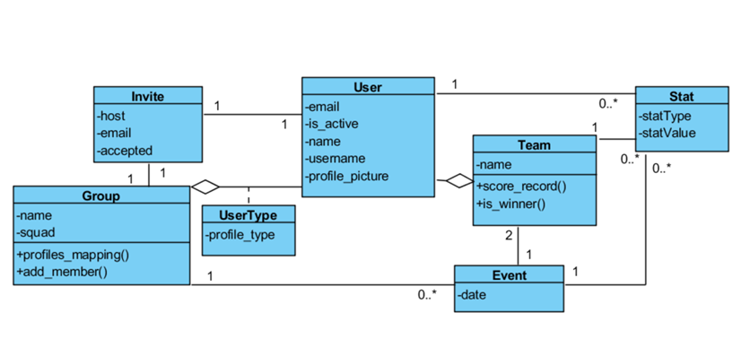
Class Diagram

Slide 40
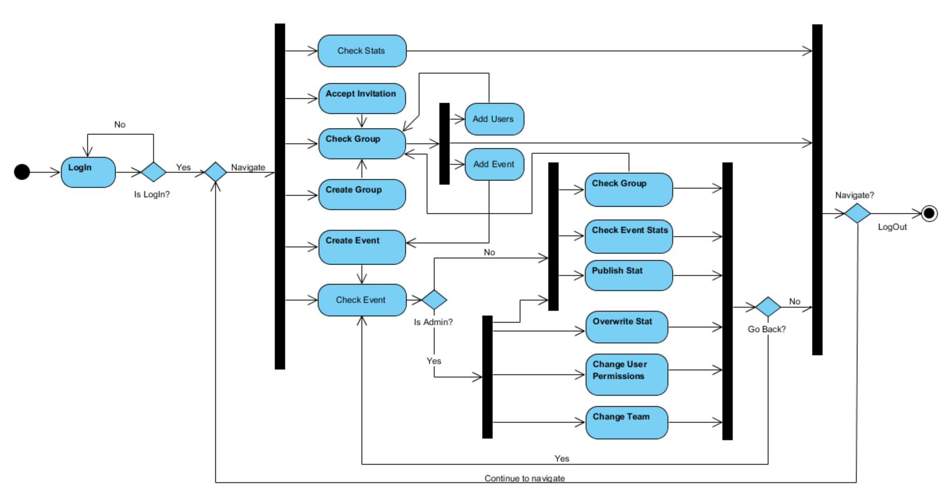
Class Diagram

Slide 41
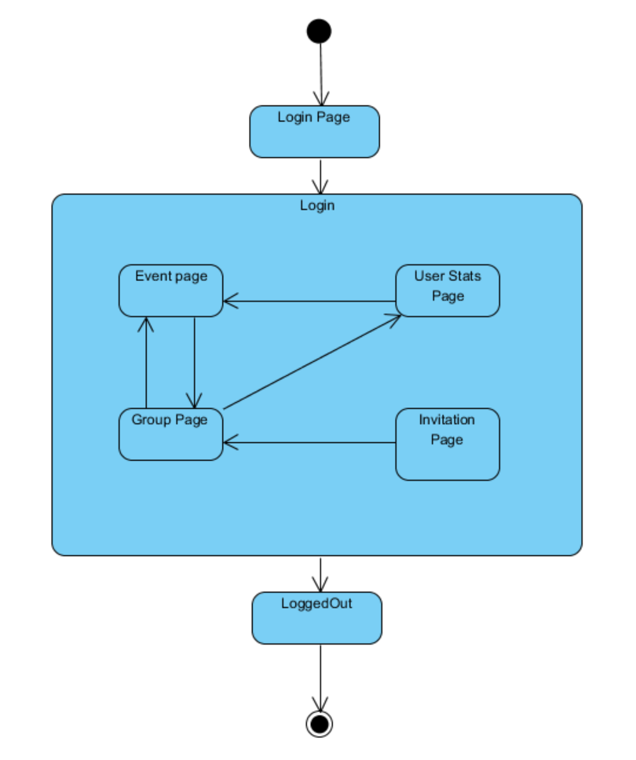
State Diagram

Slide 42
Dependency Matrix
Name of Requirement | Identifier | R0.1 | R0.2 | R1.1 | R1.2 | R1.3 | R1.4 | R1.5 | R2.1 | R2.2 | R2.3 | R3.1 | R3.2 | R3.3
User Login | R0.1 | -
User Register | R0.2 | X | -
User Creates Groups | R1.1 | X |  | -
User Checks Group | R1.2 | X |  | X | -
Admin Edits Group | R1.3 | X |  | X | X | -
User Accepts Invitation | R1.4 | X |  | X |  |  | -
Admin Adds Event to Group | R1.5 | X |  | X | X |  |  | - | X | X
User Creates Event | R2.1 | X |  |  |  |  |  |  | -
User Checks Event | R2.2 | X |  |  |  |  |  |  | X | -
Admin Edit Event | R2.3 | X |  | X | X |  |  |  | X | X | -
User Adds Stat to Event | R3.1 | X |  |  |  |  |  |  | X | X |  | -
User Check Stat | R3.2 | X |  |  |  |  |  |  | X | X |  | X | -
Admin Edits Stat | R3.3 | X |  | X | X |  |  |  | X | X |  | X | X | -

