Slide 1
HKL-PDF
Direction-resolved pair distribution function modelling of microstructure and finite crystallite shape

Slide 2
What is new about the Software
PDF software to model directional microstructural features such dislocation microstrain and anisotropic crystallite shapes
The code relates each pair distance to the HKL (Miller indices), allowing direct comparison with properties obtained in reciprocal space analysis
Crystallite shape is modelled via:
  Common Volume Function (CVF) to estimate the shape factor analytically for predefined shapes (like disks, rods, ellispoids, cubes, etc…)
  Calculation of the pair distance histogram for random shapes by calculating all the pair distances in the shape, normalized in fractional coordinates (allowing the refinement of lattice parameters, DW factors, etc…). A GUI interface is available for grid search and visualization
Whole set of visualization tools for Warren Plots, crystallite size distribution, and local dynamics, and refinement monitoring
It is highly parallelized by CPUs suitable for incorporation into supercomputers. (GPU extension is foreseen).
It counts with input file structure that does not require GUI interface to run. So one can use the current engine and develop its own GUI interface.

Slide 3
How it works?
Database creation: given the .cif file, the code calculates all the pair distances up to the maximum pair distance requested by the user. Each pair is associated with an [hkl] direction. Pair-type information, fractional coordinates, coordination numbers, and [hkl] metadata are stored in cache, so the calculations just need to be run once.
To refine lattice parameters, for example, a simple matrix multiplication using the metric tensor. Broadening parameters such as Debye-Waller parameters (constant in r) and microstrain parameters (that are HKL and r dependent) are assigned for each pair-type and direction and refined
Crystallite size is modelled by the calculation of the shape factor by CVF (using P. Scardi equations) and histogram calculation for finite shapes.

Slide 4
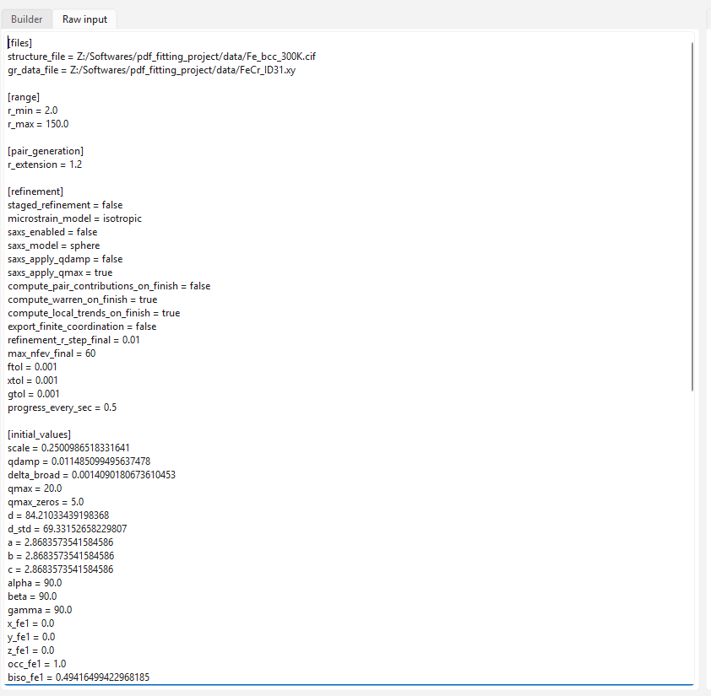
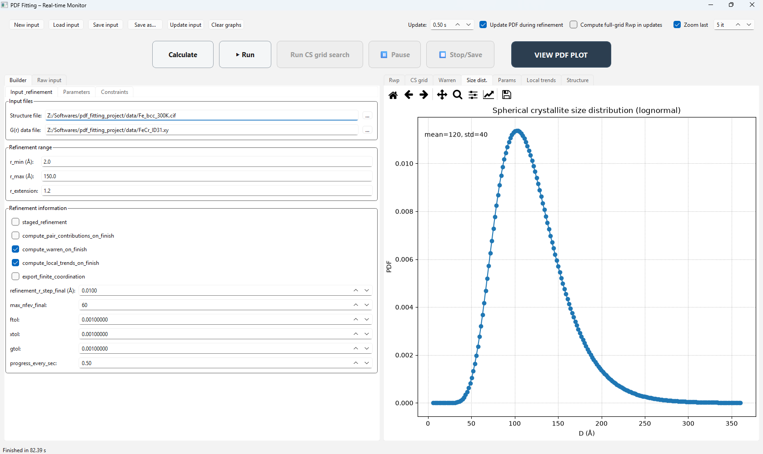
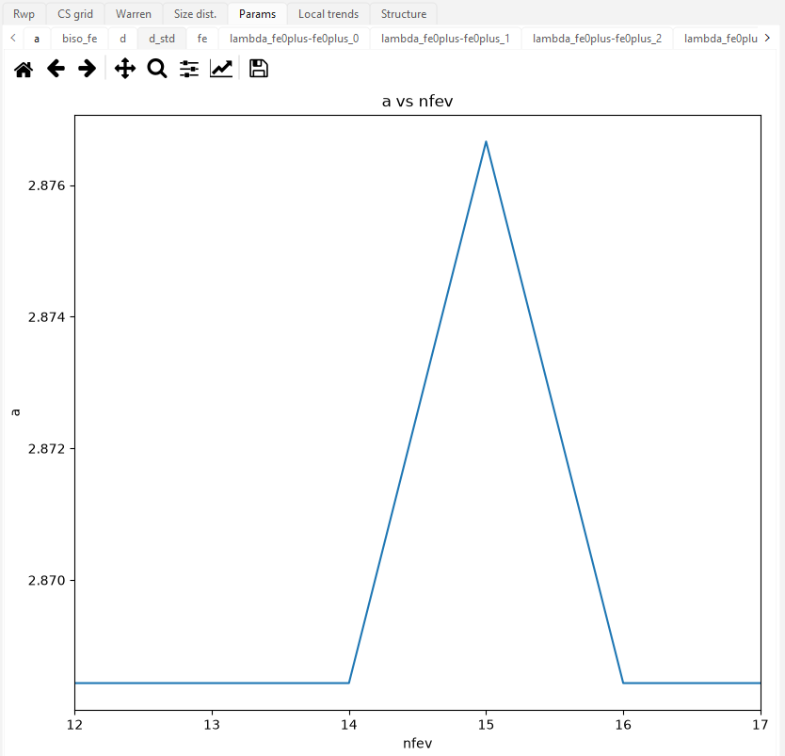
Visualization tools
Input file structure automatically updated
from the GUI builder. So any modification in
the GUI is directly translated to code
Complete user interface for refinement monitoring
Real time parameter monitoring during refinement

Slide 5
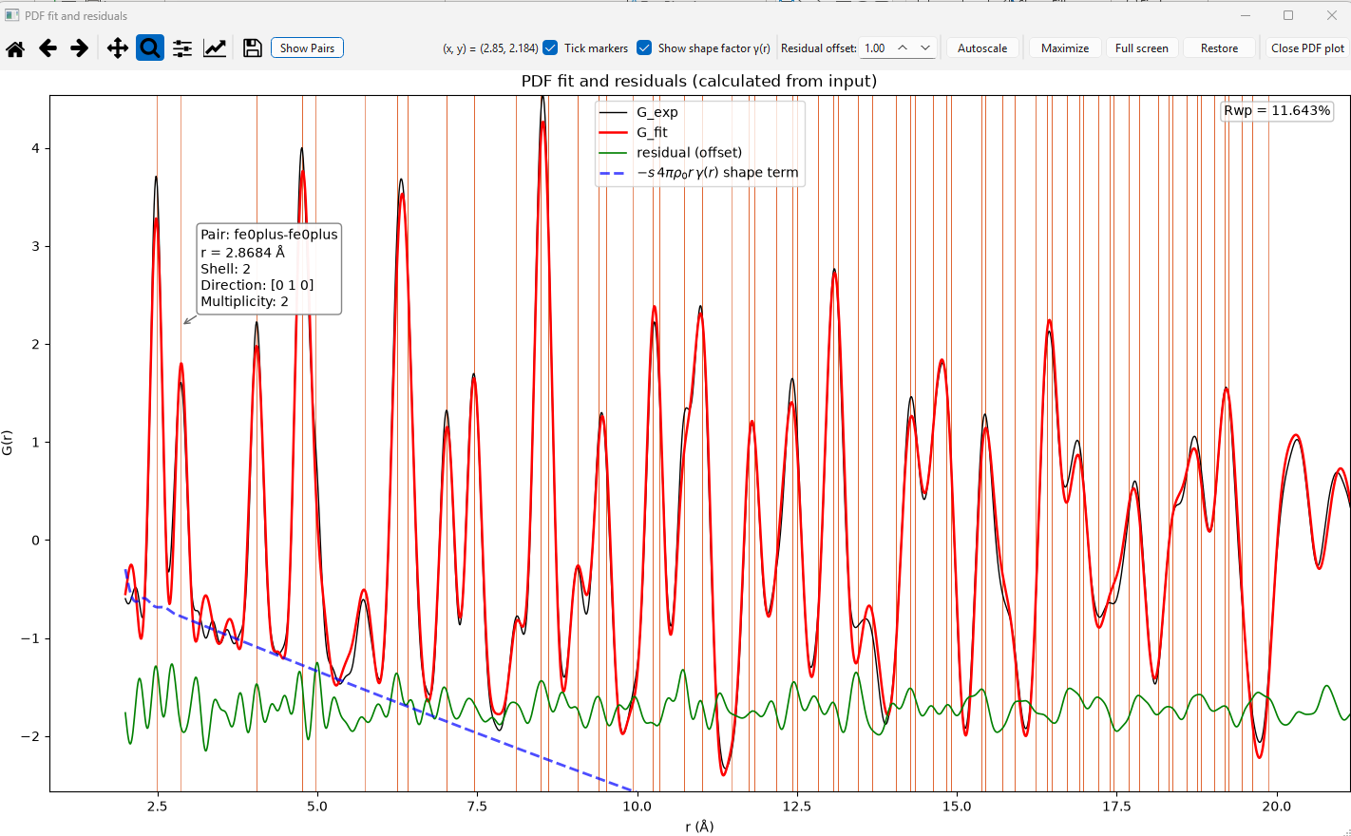
Visualization tools
Fitting visualization tool including tick markers for each pair with information on i) pair-type, ii) distance, iii) shell,
iv) direction, v) multiplicity. Full customizable colors are available.

Slide 6
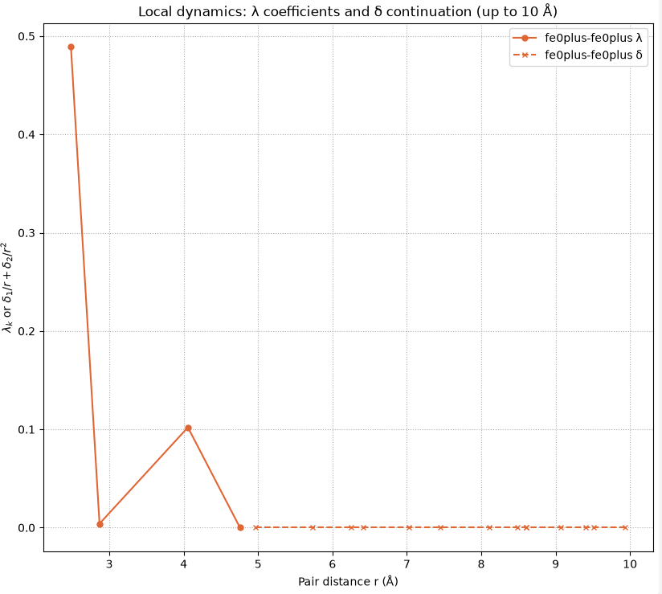
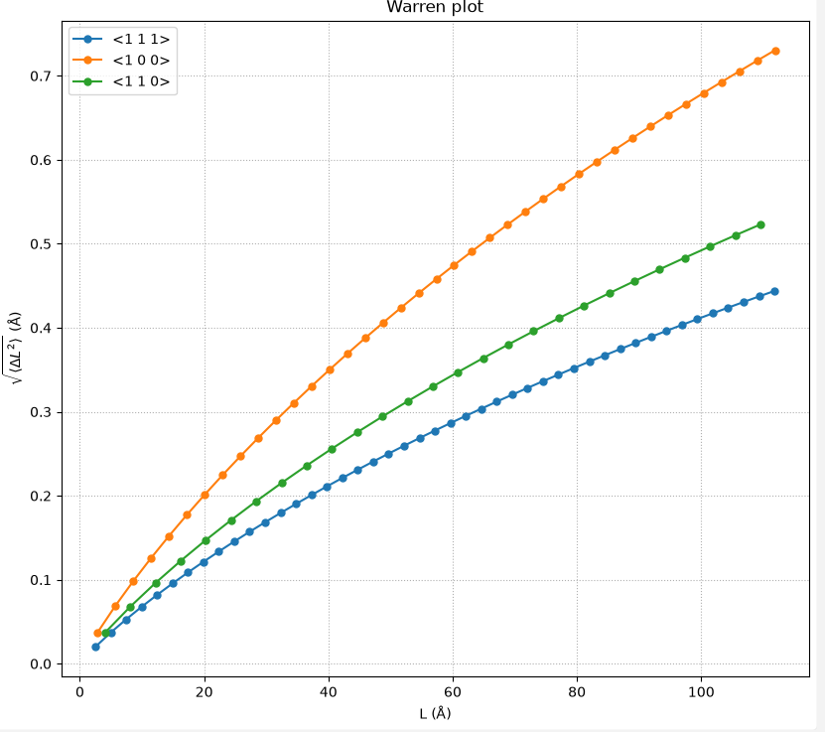
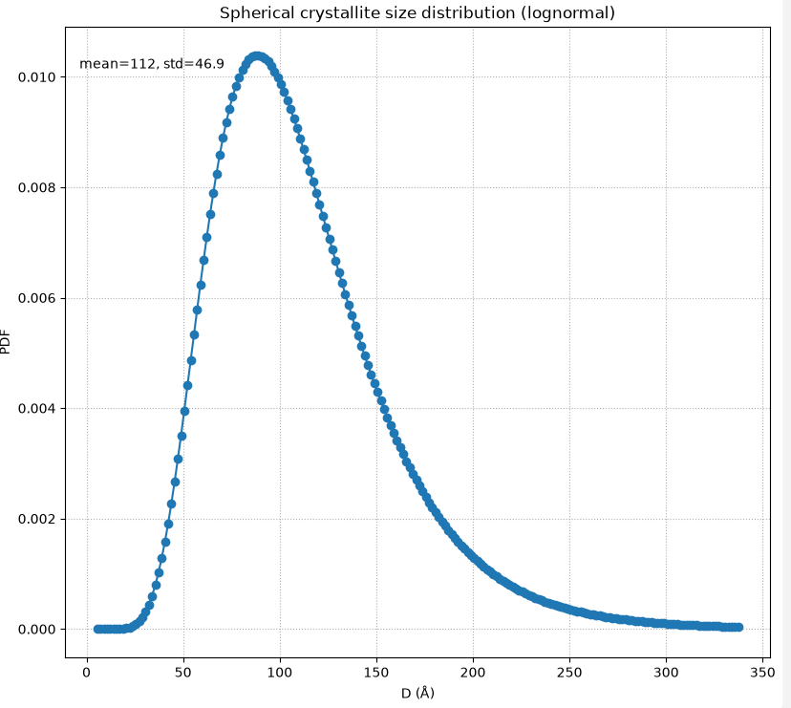
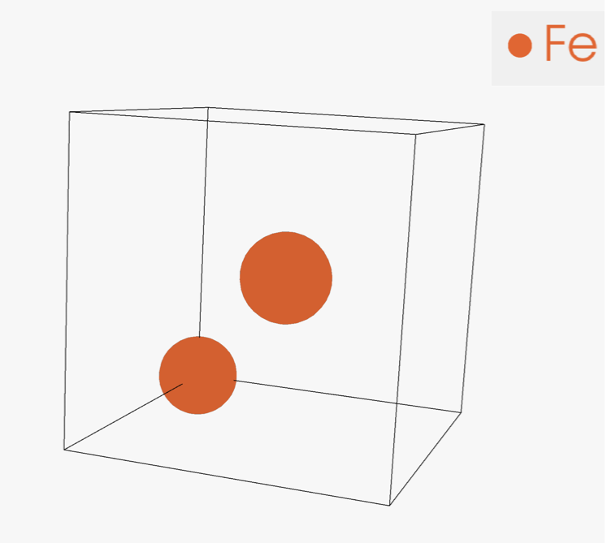
Visualization tools
Full microstructural analysis
Local structure visualization tools
Assymetric unit

Slide 7
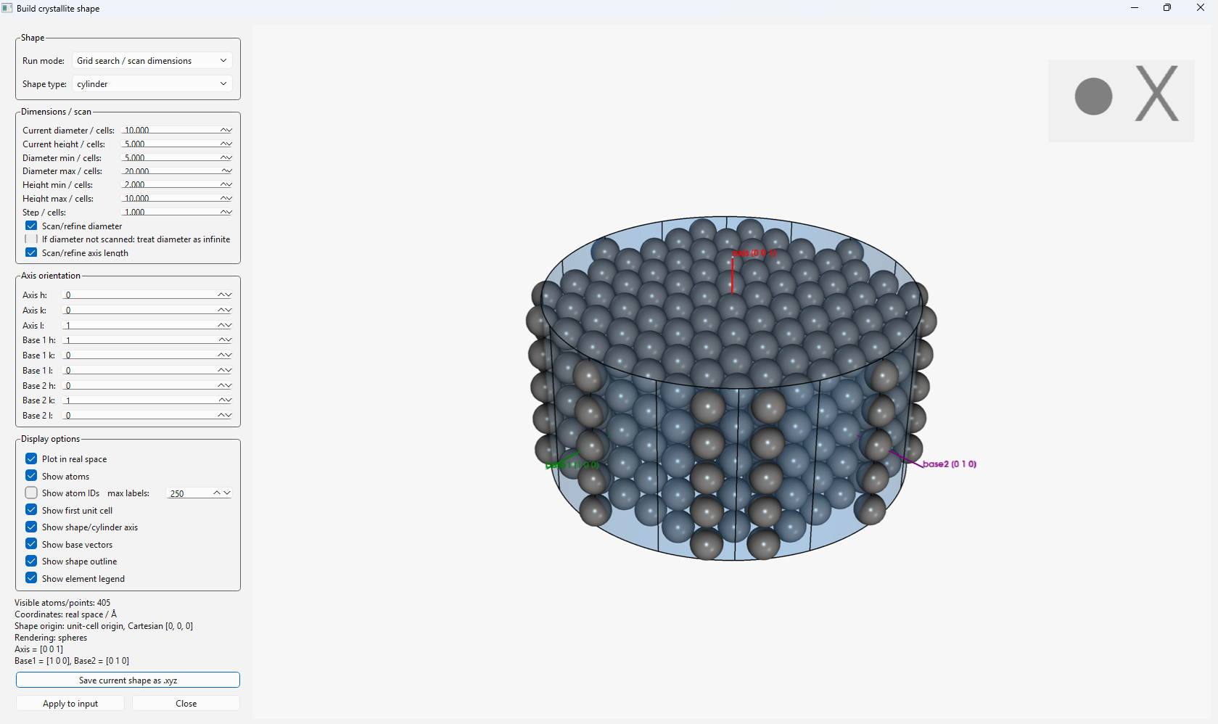
Visualization tool
Finite crystallite shape builder

Slide 8
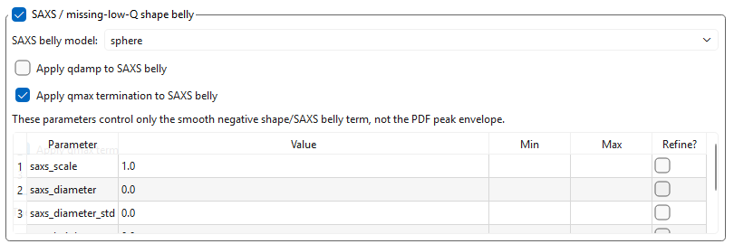
SAXS contribution

Slide 9
How to install and run
Follow GitHub instructions: https://github.com/MalaguttiMarcelo/HKL-PDF.git
Run the GUI HKL-PDF.exe
Documentation is available in the docs folder containing all the equations.
Follow the three examples:
  Ball-milled FeCr
  Ball-milled CaCO3
  Simulated Pd disks

Slide 10
Future developments
Multiphase analysis
Atomic-position refinement (XYZ)
Automated calculation of shape functions—or common-volume functions—for different shapes
A user-friendly module for generating stacking faults (needed for the complex organic materials developed by Bettina).

