Slide 1
YEARS 4 AND 5 MATHEMATICS ASSESSMENT
Page 1 of 3
Ordering and comparing fractions
Name:
Score:
out of 20
Q1
[1 mark]
Q2
[1 mark]
Circle the fraction equivalent to
2
Circle the smaller unit fraction.
3
3
4
6
1
1
5
6
8
5
7
Q3
[2 marks]
Q4
[2 marks]
Write each shaded fraction. Then write <, > or = in the box.
Each small section is one sixth. Write the shaded amount as a mixed numeral and as an improper fraction.
5
5
0
Mixed numeral
1
Improper fraction
2
Q5
[3 marks]
Q6
[3 marks]
Order the three fractions from least to greatest. Show how you worked it out.
Mark and label all three fractions on the number line. The line is divided into quarters.
7
13
1
1
3
5
1
1
8
12
8
4
4
2
Working
0
1
2
Least to greatest
Notes:
[Sources]
- Western Australian Curriculum: Mathematics - Scope and sequence | For implementation in 2026, School Curriculum and Standards Authority, 2025.
- Problem Solving Strategies and Skills card archive supplied by Mr Leahy; used to calibrate direct problem structure.

Slide 2
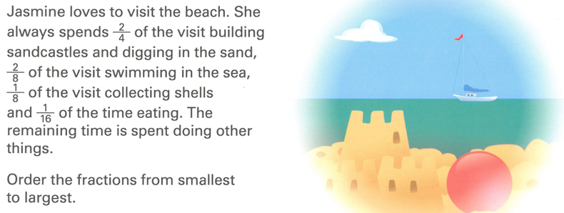
YEARS 4 AND 5 MATHEMATICS ASSESSMENT
Page 3 of 3
Ordering and comparing fractions
Q7
[4 marks]
Notes:
[Sources]
- Western Australian Curriculum: Mathematics - Scope and sequence | For implementation in 2026, School Curriculum and Standards Authority, 2025.
- Problem Solving Strategies and Skills card archive supplied by Mr Leahy; used to calibrate direct problem structure.

Slide 3
YEARS 4 AND 5 MATHEMATICS ASSESSMENT
Page 2 of 3
Ordering and comparing fractions
Q8
[4 marks]
Three friends are arguing about which fraction is the largest.
Mia: "I think 2/3 is the largest fraction.
"Noah: "No, 3/4 is the largest fraction.
"Grace: "You're both wrong. 7/12 is the largest fraction.“
Use the space below to prove who is correct.
Notes:
[Sources]
- Western Australian Curriculum: Mathematics - Scope and sequence | For implementation in 2026, School Curriculum and Standards Authority, 2025.
- Problem Solving Strategies and Skills card archive supplied by Mr Leahy; used to calibrate direct problem structure.

