Slide 1


High-Level Design MVP
Retail Orders Analytics
Goal: Clean monthly data → DW → BI

Slide 2



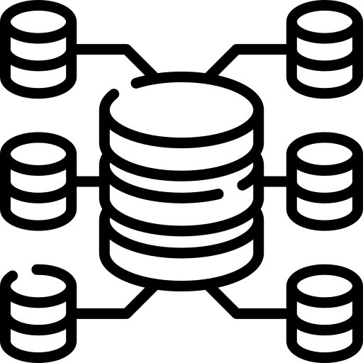


Data Processing Flow
1. Source & Ingestion (SFTP)
Source: Monthly CSV via SFTP
Landing: Store files as-is
2. Raw Layer (RAW)
Store files “as-is”
full text columns
Capture file metadata
3. Staging & Processing (STG)
Cast & validate (orders)
Quarantine invalid rows
4.Core Layer (CORE)
Conformed data
Business keys & standardized types
5.MDM Layer (MDM)
Cleansed golden records
Single source of truth
Marts & Analytics (MARTS)
Business facts & dimensions (sales_fact)
BI dashboards & reports

Slide 3



Supporting Layer: Audit & Monitoring
Pipeline-Level
Table-Level
File-Level
Pipeline-Level Audit
Tracks orchestration runs
DAG / pipeline name
Rows processed end-to-end
Start & finish timestamps
File-Level Audit
Tracks ingestion attempts
File name, row counts Start/end timestamps
Status: success / failed / partial
Table-Level Audit
Tracks per-table loads
Rows in / rows out
Status: success / failed / partial
Links back to file & pipeline run

Slide 4
Technical Architecture
1
2
Source:
SFTP → (CSV Files)
Detect filename pattern, validate checksum
Keep all versions (audit trail)
ETL:
Python scripts (SFTP ingestion → Landing → Staging)
dbt staging models: transformations, normalization
4
3
Storage / DWH:
PostgreSQL Schemas
Audit & quarantine tables
Modeling:
dbt (core, marts, MDM)
Data Quality: completeness, uniqueness, referential integrity
5
6
Orchestration:
Task Scheduler
BI / Analytics:
Metabase dashboards for Finance KPIs
Technical Architecture

Slide 5
Structure of DWH
Bronze Layer:
Raw & Audit Direct copy from source (SFTP, CSV) + Audit & Quarantine tables.
Silver Layer - Processing & Cleansing
Type casting, deduplication, integration & transformations (using dbt).
Gold Layer: Analytics / Marts
Denormalized tables/views for BI dashboards.
Core Layer: Conformed Data
Master data, single source of truth (used across marts).
Architecture Layers

Slide 6
Automate Data Pipelines
Dimension | Implementation (MVP)
Scheduling | Monthly jobs & Retries
DQ | Row counts & Checksum& Exceptions
Monitoring & Logging | File-level & Model-level
Retries & Alerts | 3 retries /15min · Email/Teams alerts
Security | SSH keys, secrets, least-privilege

Slide 7




Inconsistency Analysis & Cleansing
Detect (Profiling)
Validate schema/types, required fields& formats.· Find duplicates, encoding issues.
Typical Issues
Re-pushed monthly files causing conflicts.
Mixed types, illogical dates
Auto-Fix Rules
Standardize text/dates/numbers &casts.
Deduplicate (OrderID + ProductID),
Quarantine & Review
Route non-fixable rows.
SMEs decide fix/exclude.
Load & Report
Load only clean data to core/marts.
DQ report with counts, trends + KPIs.
Classify & Trace
Tag each row with DQ flags
Capture lineage

