Slide 1
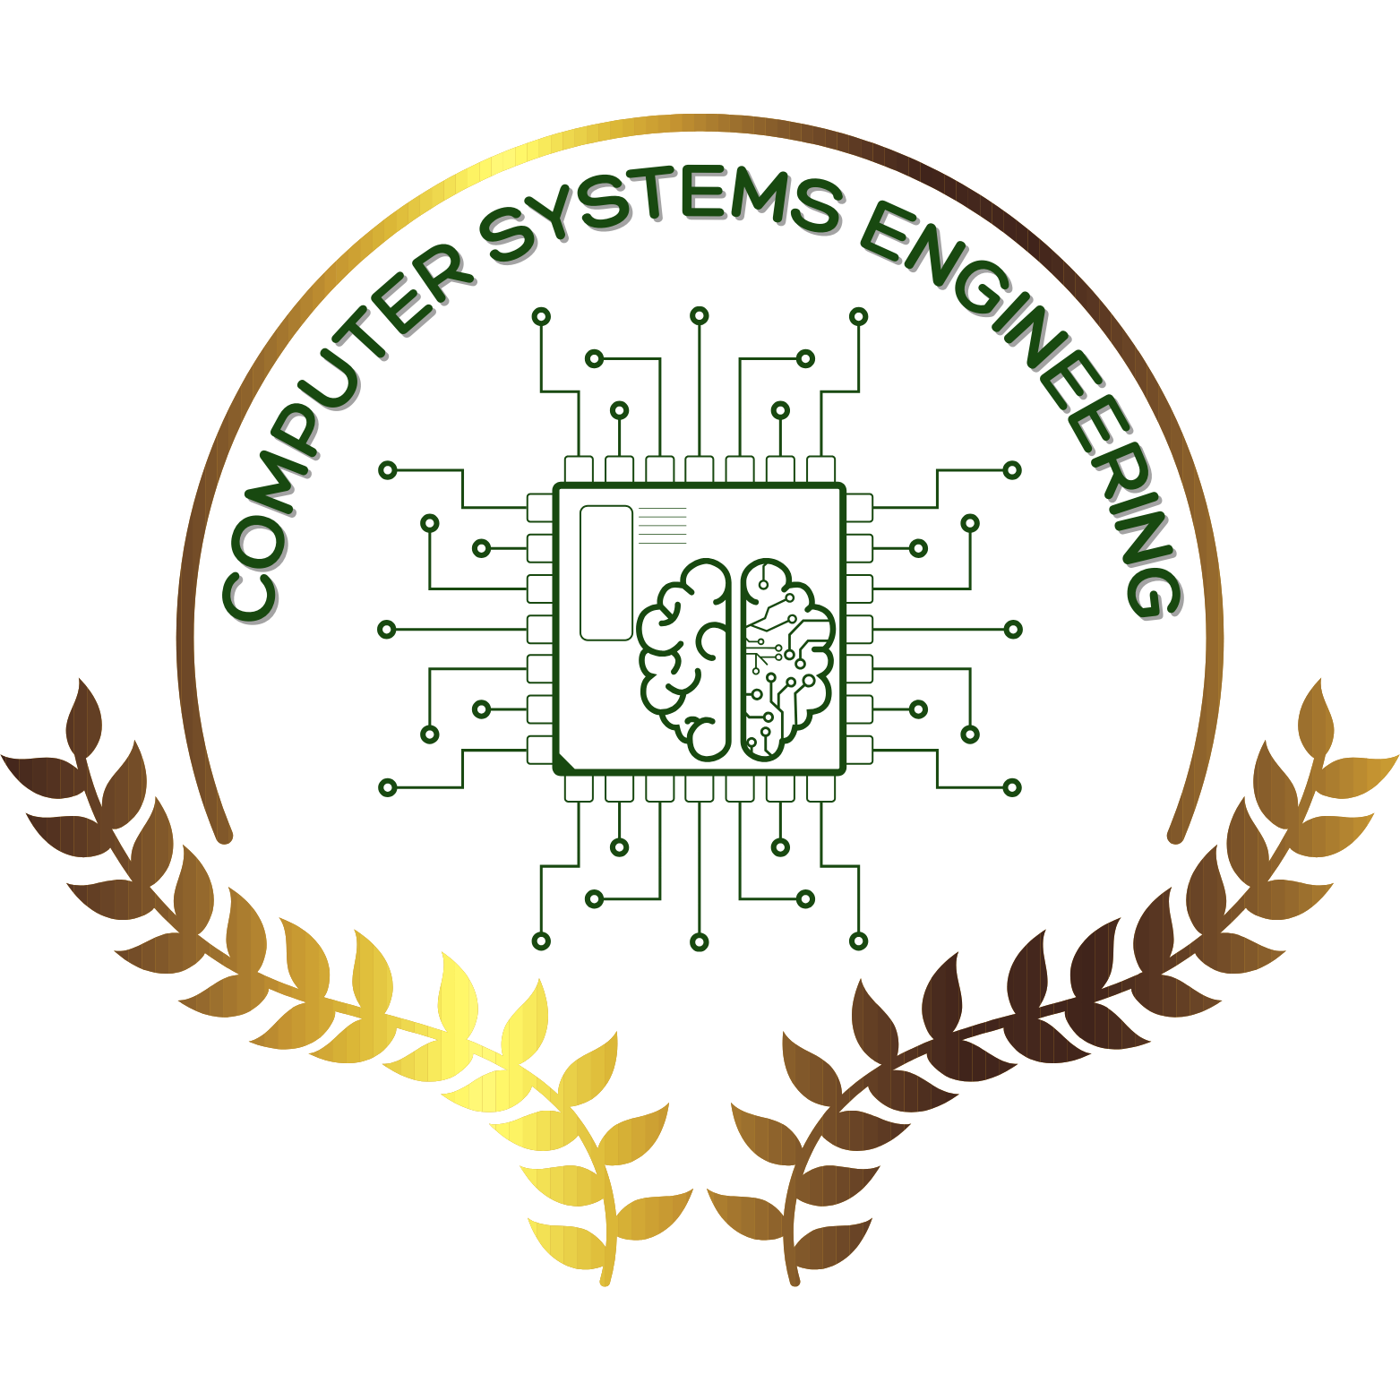
Diary Management System
Student Name : Hassanein Alaa 244163
Malak Hany 241559
Yasmin said 244173
Omar Moursy 243617
Hesham Amr 244875

Slide 2
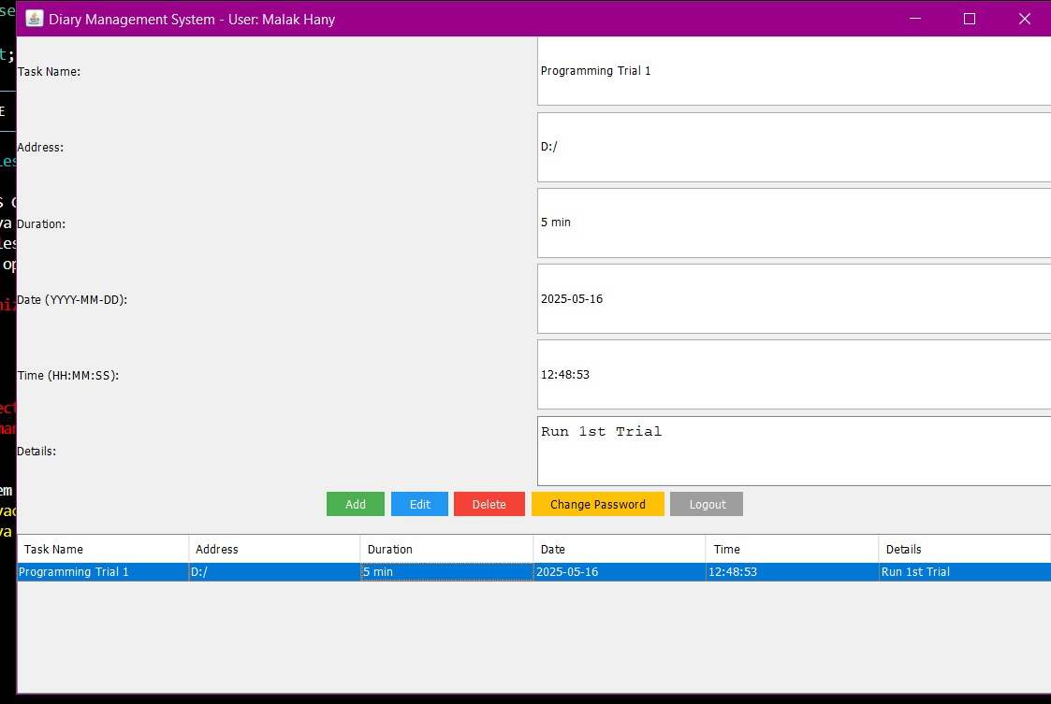
Diary management system ( Java Project)
A desktop application to manage personal diary entries
Built using Java programming language
Includes database storage and a graphical user interface

Slide 3
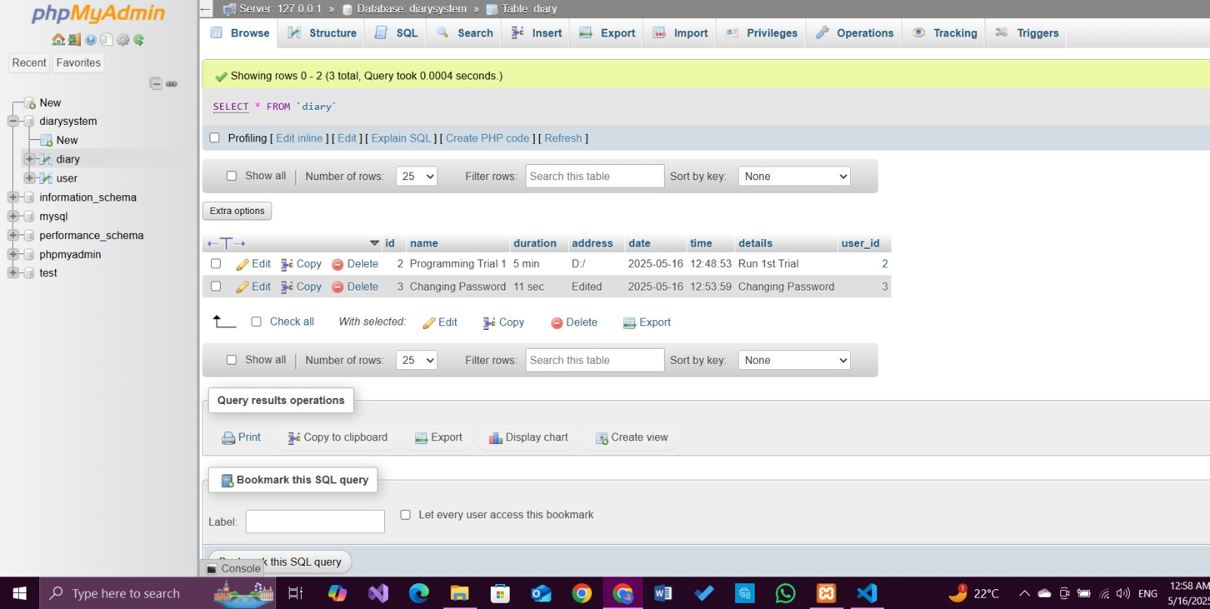
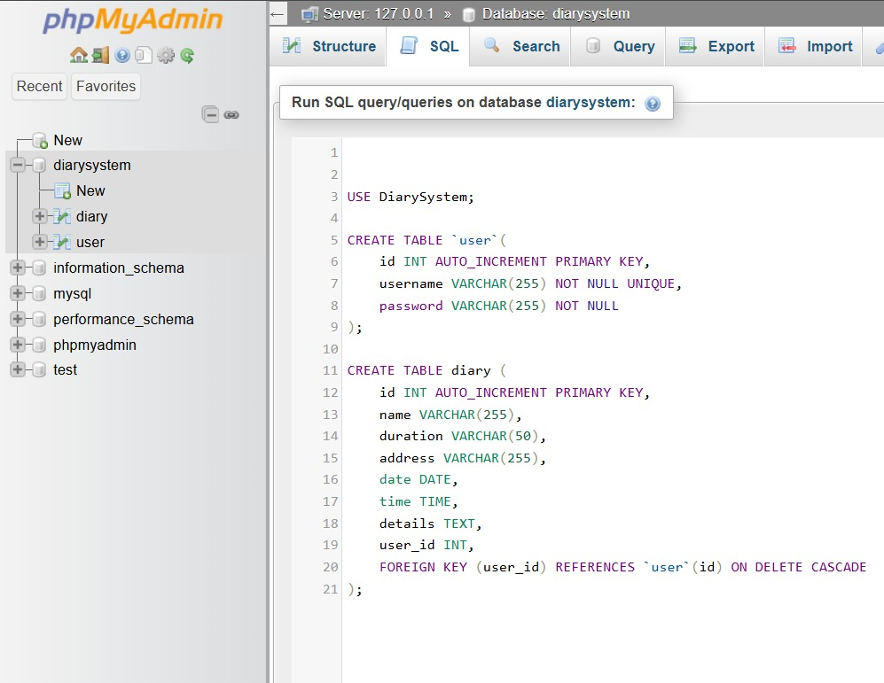
How we connect to the database
The app connects to a MySQL database
Stores and retrieves diary data from there
Uses a standard connection method for reusability

Slide 4
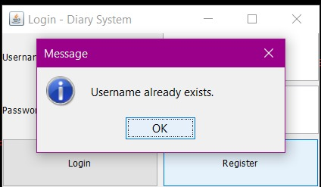
User’s Data Is Registered
Users register once, and there is stored for login
They cannot enter the same user twice
It shows a message for invalid input “Username already exists”

Slide 5
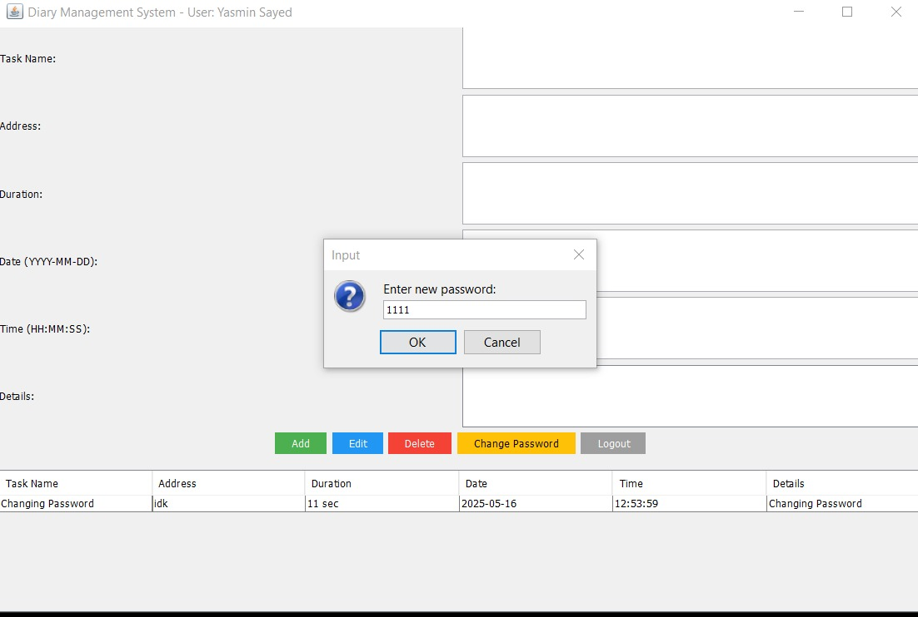

Password management
A part of the system handles user passwords
Allows users to store or change their password securely
This is done in a separate part of the code

Slide 6
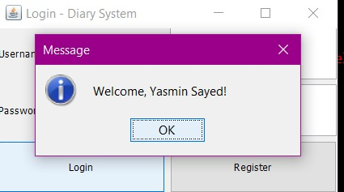
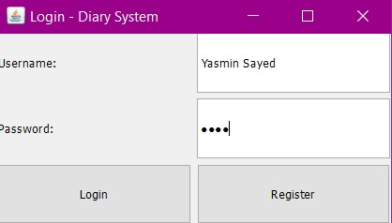
Creating the user interface
Interface created using Java Swing (GUI toolkit)
Includes tables, buttons, text fields, and panels
Everything appears in one main application window

Slide 7
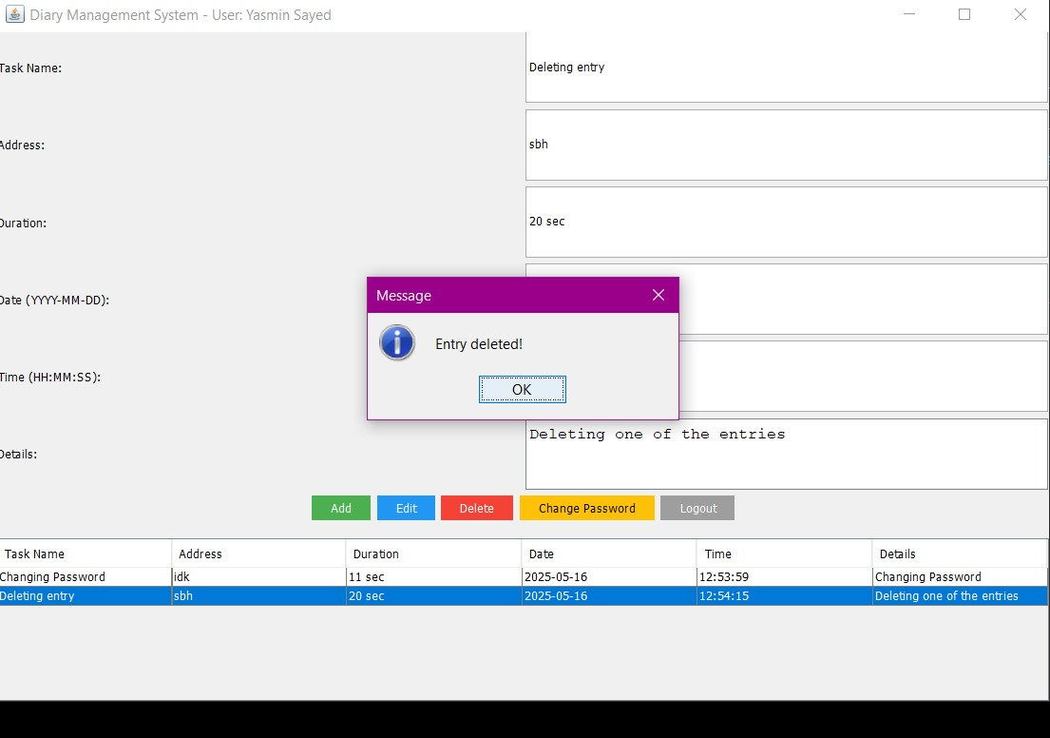
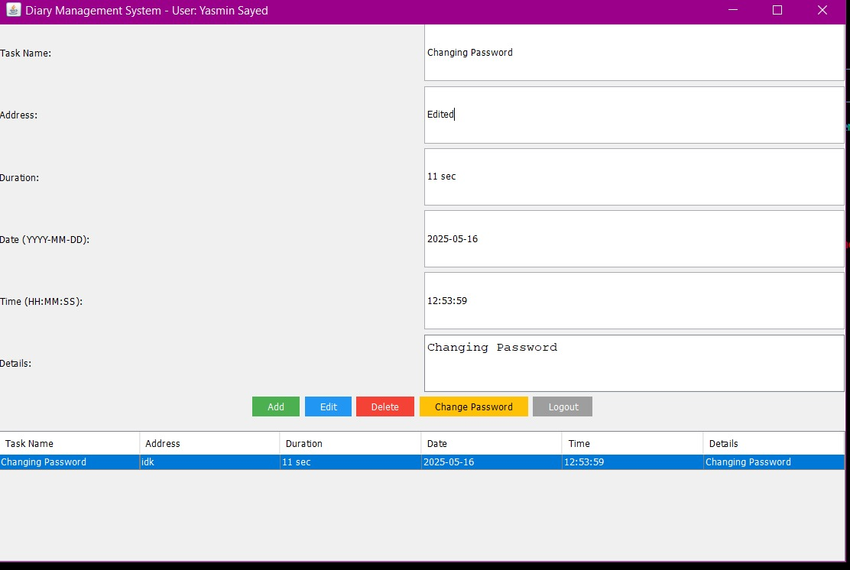
Making the app interactive
Users can click on items in the interface
Clicking on a diary entry loads it for editing or deleting
This improves the user experience

Slide 8
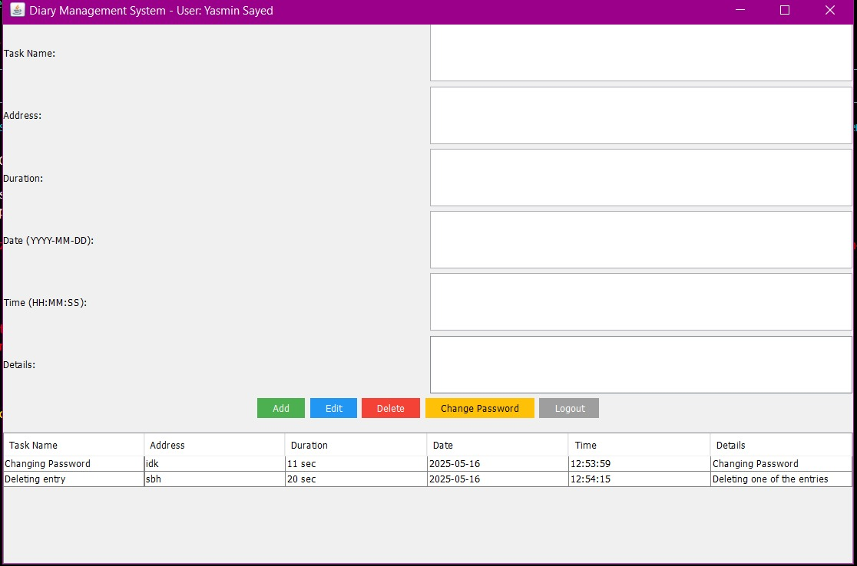
Add, Edit, Delete Entries
Users can add new notes
View all their saved entries in a table
Edit or delete existing entries with a click

Slide 9
Organized and Easy to Maintain
Code is split into parts
Each part has its own responsibility
Makes the program easier to understand and update

Slide 10
Summary
Simple but effective diary app built in Java
Combines user interface with database functionality
Demonstrates good structure and interactive features

