Slide 1

salahaddin university learning management system
University of Salahaddin - Erbil
College of Science
Department of Computer Science and IT
Supervisor : Shakhawan mohammed
Prepared by:
Malak kamaran Zina mazin

Slide 2
Outline:
Aims and Objectives
Introduction
Related work
Requirements
Progress and future plans
Gantt Chart
Conclusion
References

Slide 3
Aims and Objectives
Aims
Learning management system are online platforms where teachers and students can collaborate in order to improve student achievement.
Objectives:
The objectives of LMS is that create a login page that can user login this page successfully .
The teachers can upload file and create courses, assignment .
student be able to submit assignment and download file .
The published file will be save on system database with the date and time when ever all student can download it for many times .

Slide 4
Introduction
A learning management system is a server-based software program provides a place to learn and teach without depending on the time and space boundaries, and allows teacher to organize their entire class process for student and allow student to access the class online, Learning Management Systems are being extensively used in colleges, universities .it help organizations reduce development time manage training content, and evaluate learner performance.(Sharma and Vatta,2013,p.997)

Slide 5




Related work
A few examples about LMS :
Figure:1
Figure:2
Figure:4
Figure:3

Slide 6
Cont..
Our goal is “salahaddin University LMS”, which is a special LMS made for University of salahaddin in a very secure way different from the other LMS which are open source with a weak security or maybe a group of people made an LMS For themselves to do their work with and this type of LMS we can not take benefits from it again.

Slide 7
Requirements
Web programming language PHP
HTML,CSS,JavaScript for the client side
SQL server

Slide 8
Progress and Future plans
According to the information and the researches that are done by LMS, and creating graphical user interface for major page, we wrote SQL code for database and create relations between tables in database.
In future we have to start with a major work and complete the coding, finish off final report and be ready for final project.

Slide 9
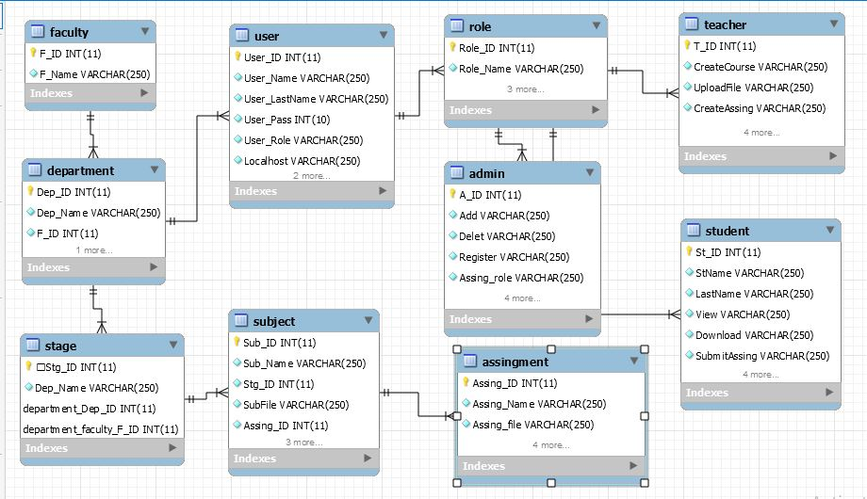
Relation between tables for database

Slide 10
Gantt Chart

Slide 11
Conclusion
None of learning platform are alike for selecting the best for education. it's an argument that made about learning and the quality of learning as being the most momentous element of technology enabled education.
a universal idea behind the selection of LMS is that LMS is organized and managed with an integrated system. learning management system normally offers discussion forums, file sharing management of assignment, lesson plans syllables, chat ..et

Slide 12
References
Sharma,A., Vatta,S. (2013) ‘Role of learning management system in education’ International Journal of Advanced Research in Computer Science and Software Engineering , 3(6),pp.997 , IJARCSSE [Online]. Available at: https://pdfs.semanticscholar.org/3d19/dc963e7fb8ce49bb6bcc9329aa03e22a6075.pdf (Accessed :12 January 2020).
https://www.webanywhere.com/2018/06/20/what-is-a-learning-management-system-lms/
https://teamtreehouse.com/library/designing-interfaces-in-php
https://i1.wp.com/abuomar.ae/wp-content/uploads/2015/02/edmodo-1rpysbu.jpg?zoom=2&resize=750%2C460&ssl=1 [1]
https://www.modern.pm/wp-content/uploads/2017/07/moodle-logo-1024x261.png [2]
https://upload.wikimedia.org/wikipedia/commons/7/77/Blackboard_Inc._logo.png [3]
https://statelibrarync.org/ldblog/wp-content/uploads/2014/10/SkillPort.png[4]
kats,Y.(2010) Learning management system technologies and software solution for online teaching[online].available at: https://books.google.iq/books?id=2OsPGIvgjGwC&printsec=frontcover&hl=ar#v=onepage&q&f=false(accessed:12 January 2020)

