Slide 1
Trial #1

Slide 2
Approach
To detect fall motion, we trained this model on images of people in falling motion.

Slide 3
Data Collection
We collected data from various sources:
Search Engines
Reddit
Fiverr
Instagram

Slide 4
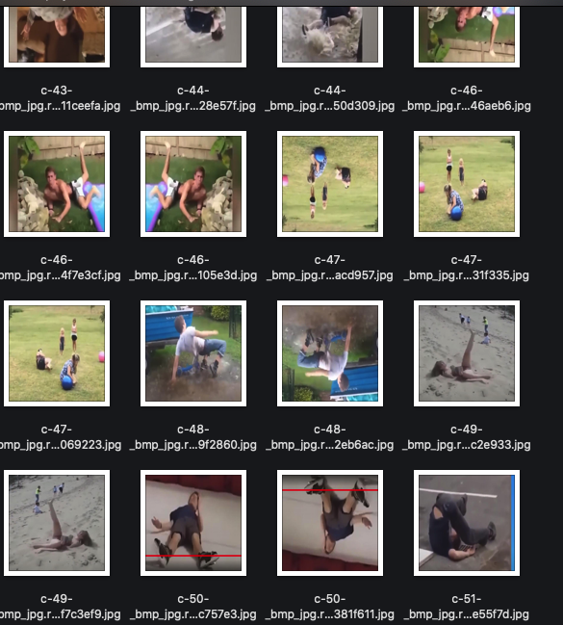
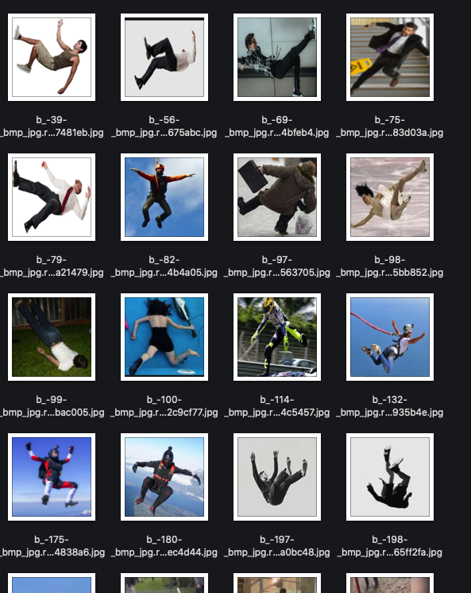

Slide 5
Data Annotation
We annotated the images using Roboflow.

Slide 6
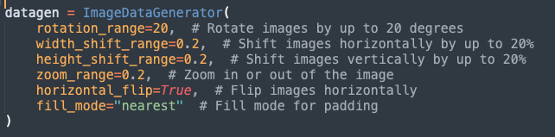
Preproccessing and Augmentation
We applied Augmentation techniques using tensorflow library in python to generate more and variant data

Slide 7
Results
This approach failed, since it is detecting all people as falling, even when they are not as the model doesn’t have a way to tell if this person is falling or not.

