Slide 1
Algorithms, Techniques and Dataset

Slide 2
YOLO
YOLO, which stands for "You Only Look Once", is a popular algorithm for object detection in computer vision. It's known for its speed and efficiency, making it ideal for real-time applications.\
Single-Shot Detection: Unlike some object detection methods that require multiple passes through an image, YOLO takes a single shot. It uses a convolutional neural network (CNN) to analyze the entire image in one go.

Slide 3
Important Features
Bounding Boxes and Class Probabilities: YOLO divides the image into a grid. For each grid cell, it predicts two things:
Bounding boxes: These boxes highlight the location and size of potential objects within the cell.
Class probabilities: YOLO assigns a probability score to each class of object (e.g., car, cat, person) for each bounding box. This indicates how likely it is that the box contains that specific object.
Check bounding box video in next slide.

Slide 4
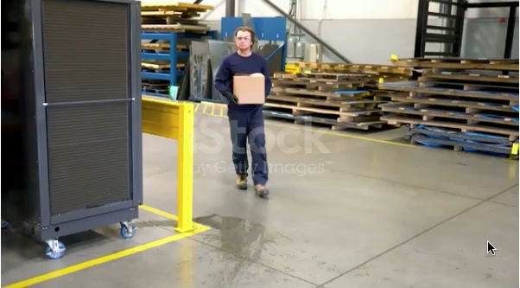

Slide 5
Roboflow
Roboflow is a platform built to streamline the process of building computer vision projects. It has capabilities such as:
Data Annotation.
Data Management.
Model Training.
Deployment.

Slide 6
Dataset
Collection: We collected a dataset of over 2000 images of people in falling motion.
Annotation: We used roboflows annotation tool to annotate the images.
File structure:

Slide 7
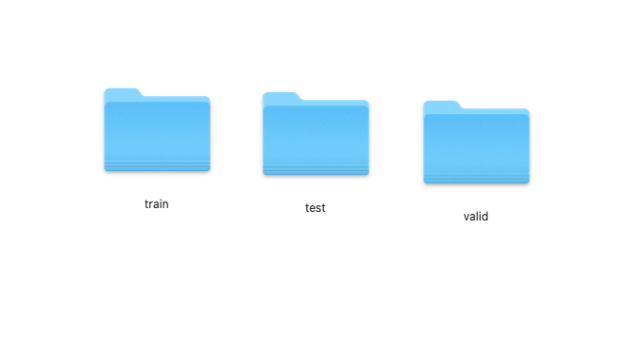

Slide 8
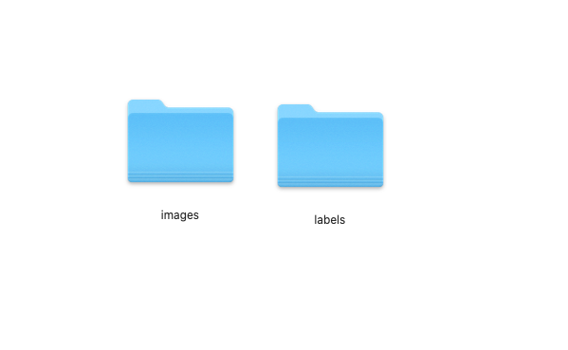

Slide 9
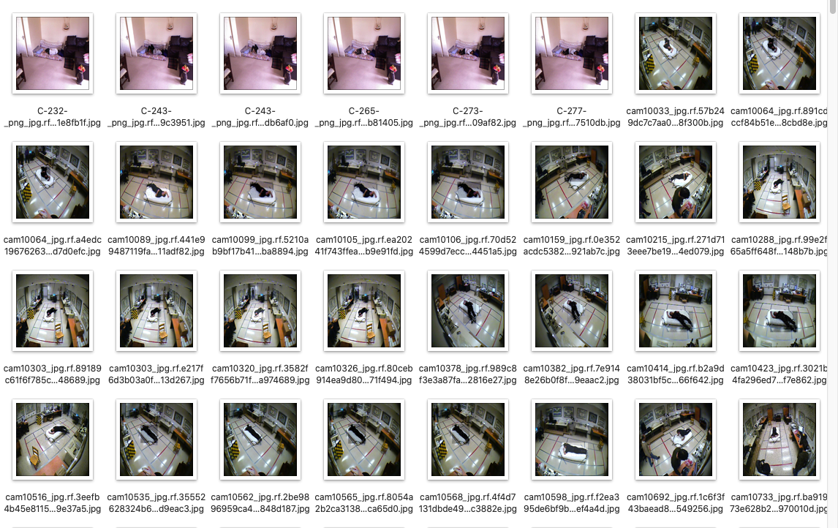

Slide 10
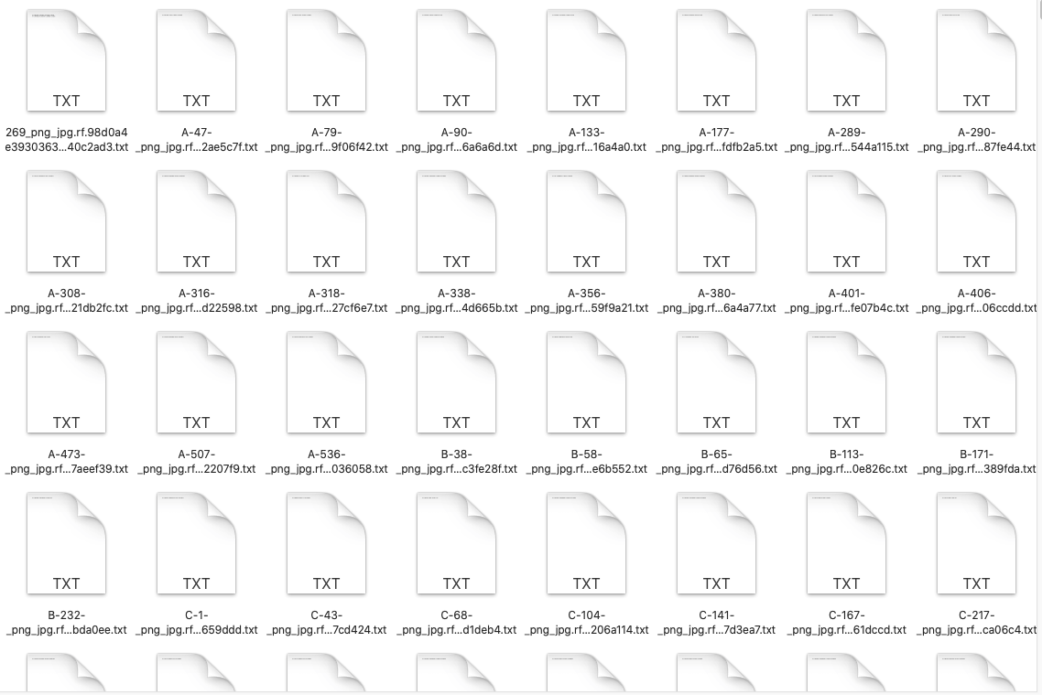

Slide 11

Lables

Slide 12
Inference
To make our model work on all devices even on less powerful ones, we decided to use inference for cloud computing.
We used the model we trained on Roboflow to make api calls on the images, that are ultimately frames of the video being captured live on the webcam.

Slide 13
openCV
We utilized OpenCV to capture the live webcam feed. This library provides efficient tools for video capture. OpenCV then divides the continuous video stream into individual frames, creating a sequence of images. These frames can be sent to Roboflow's API for further processing. Roboflow's API likely leverages its inference engine to analyze each frame using your trained computer vision model.

Slide 14
Citations
https://github.com/ultralytics/ultralytics
https://roboflow.com/
https://docs.opencv.org/4.x/index.html
https://docs.inferencesolutions.com/api/

