Slide 1


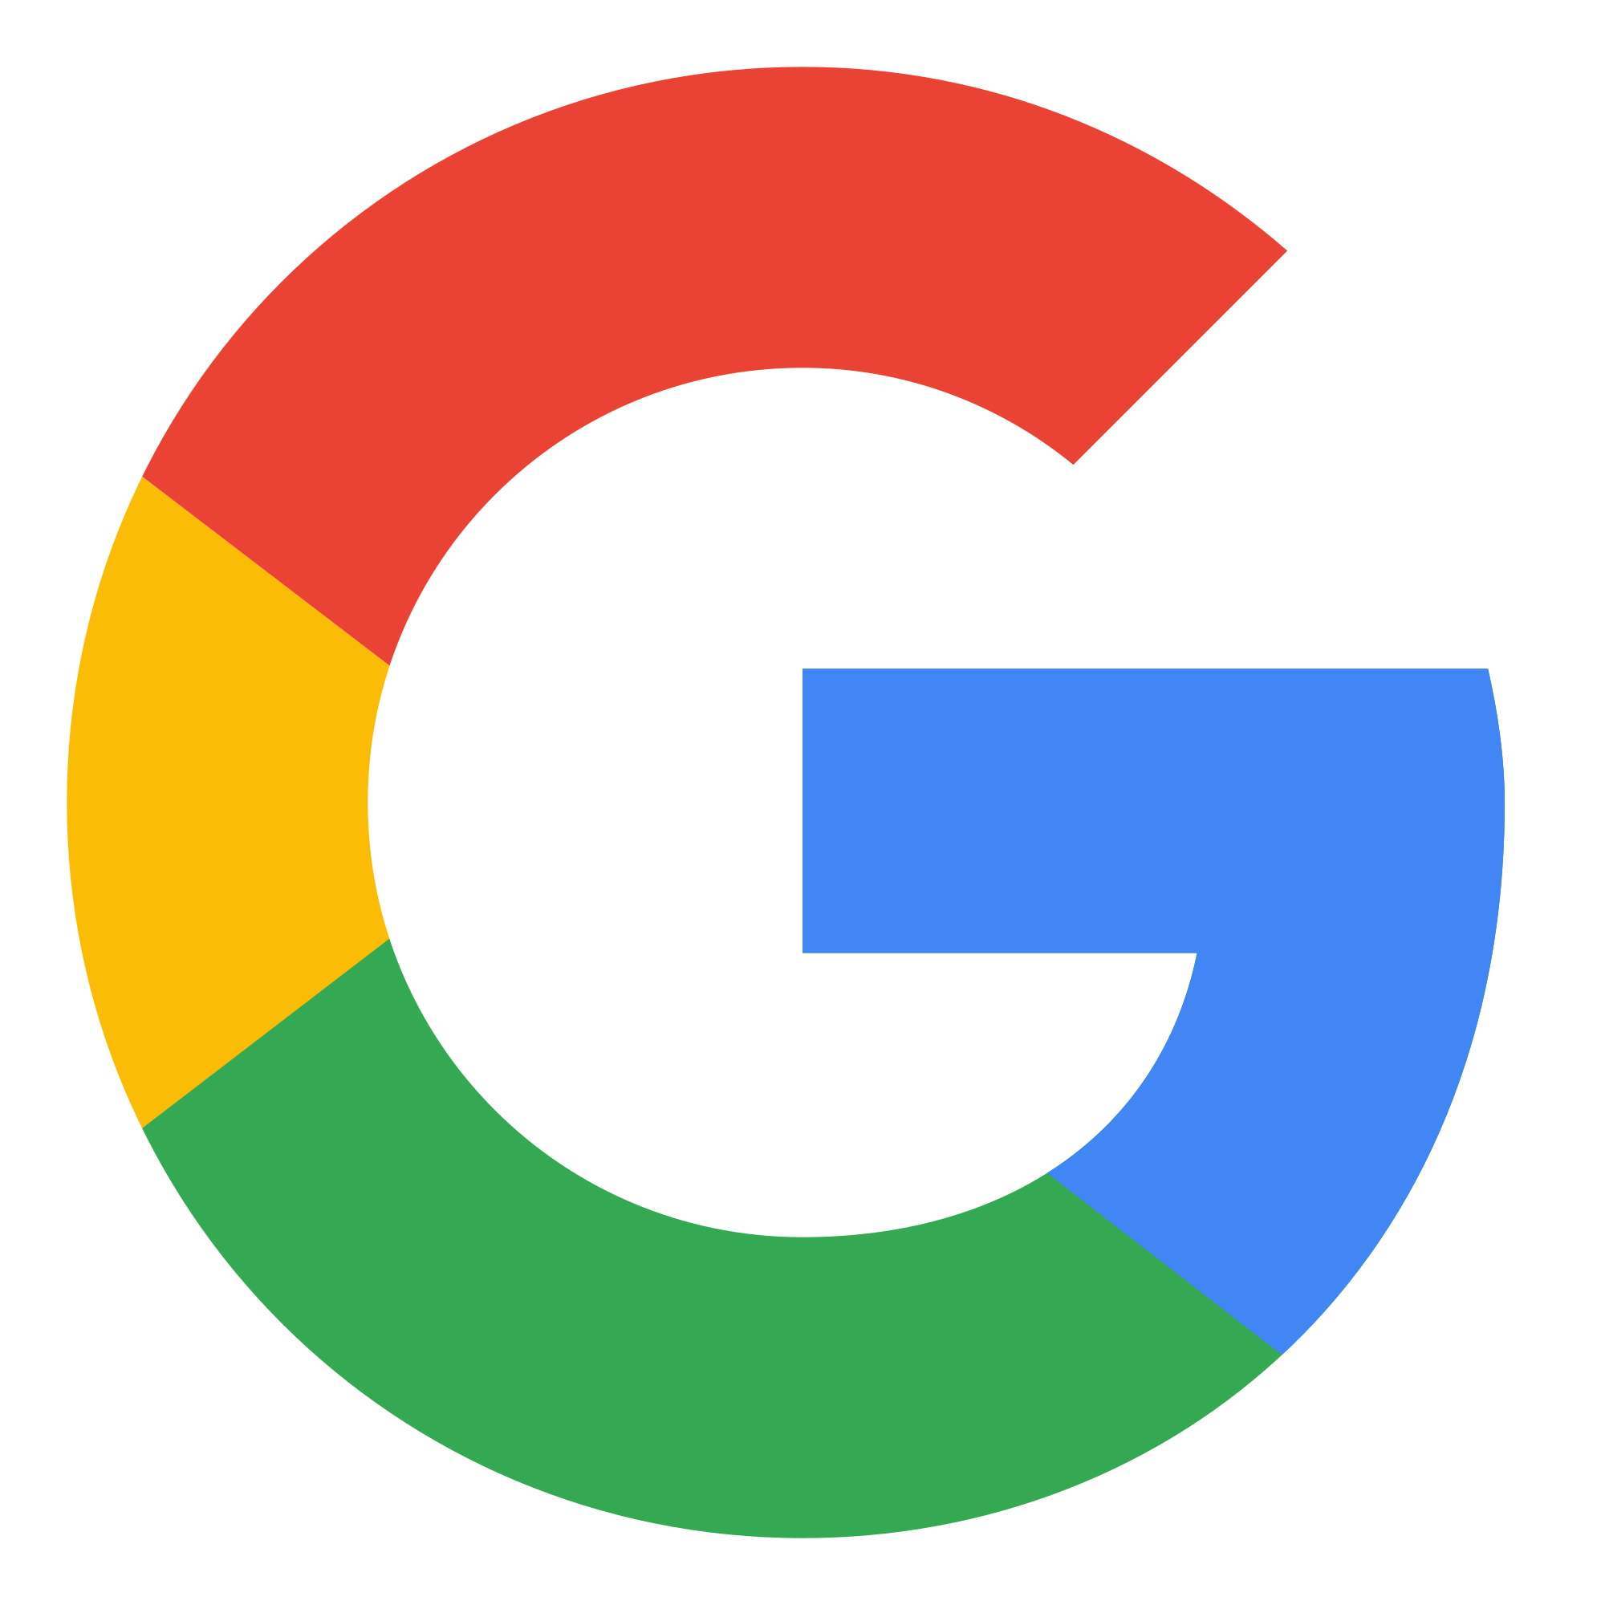




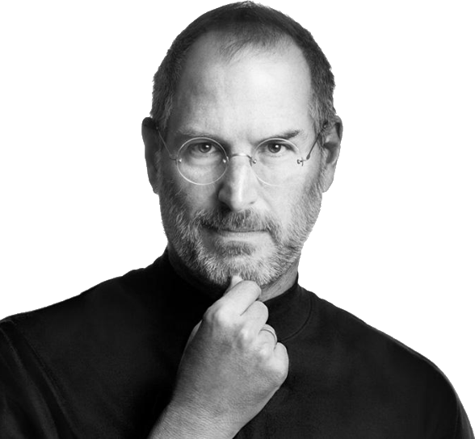



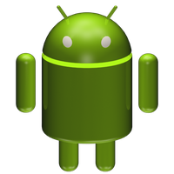







Android OS vs. iOS OS
Exploring the Key Differences Between the Leading Mobile Operating Systems
Malak AlKazem
Nada AbuZeid
11:11AM

Slide 2
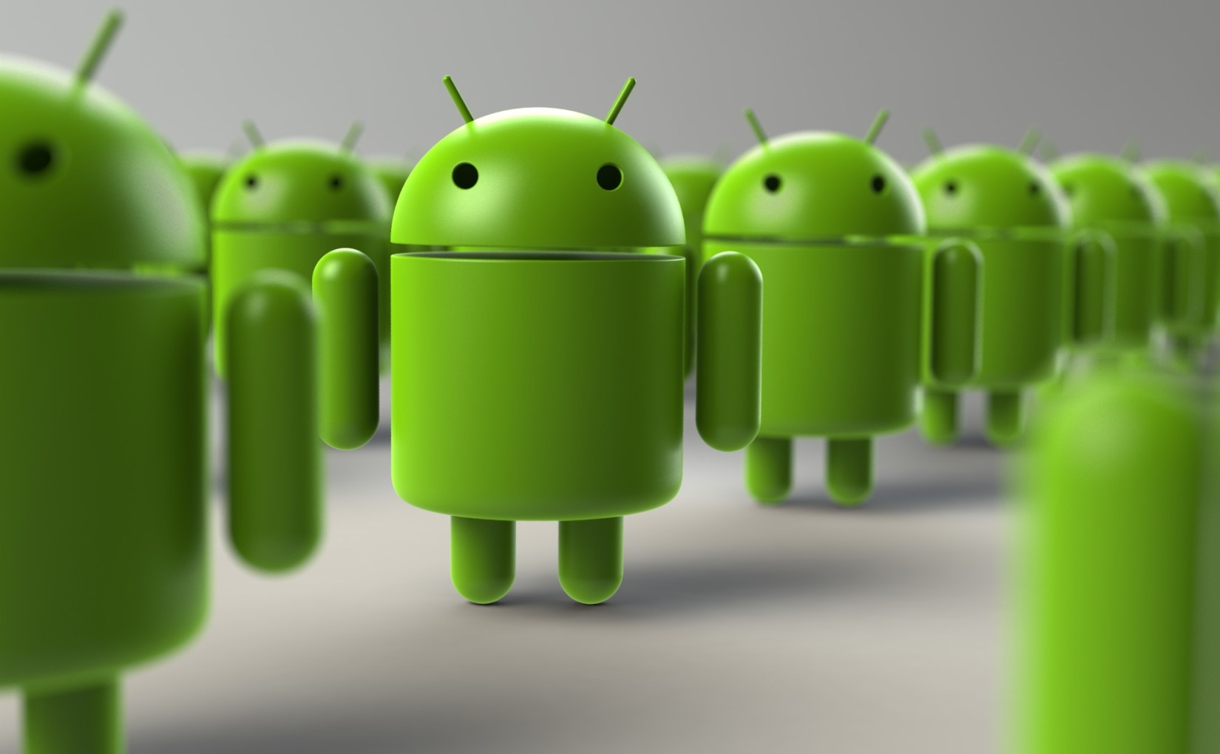
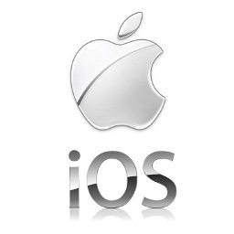
11:11AM

Slide 3


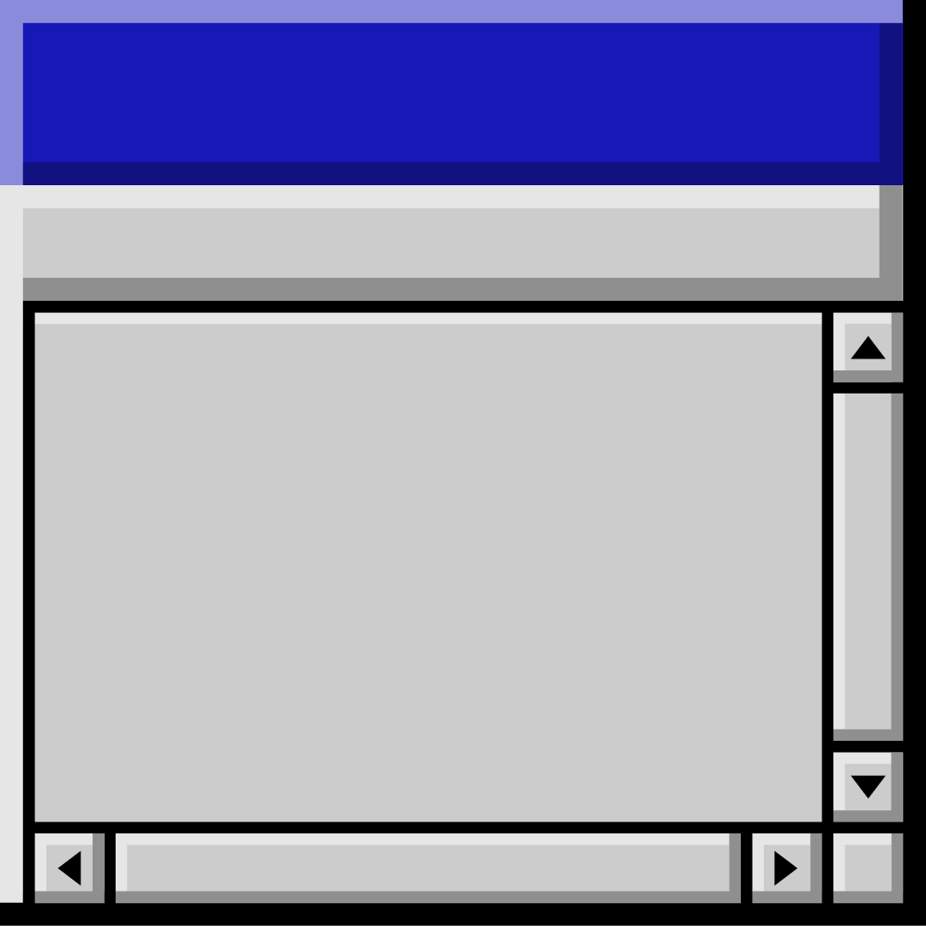



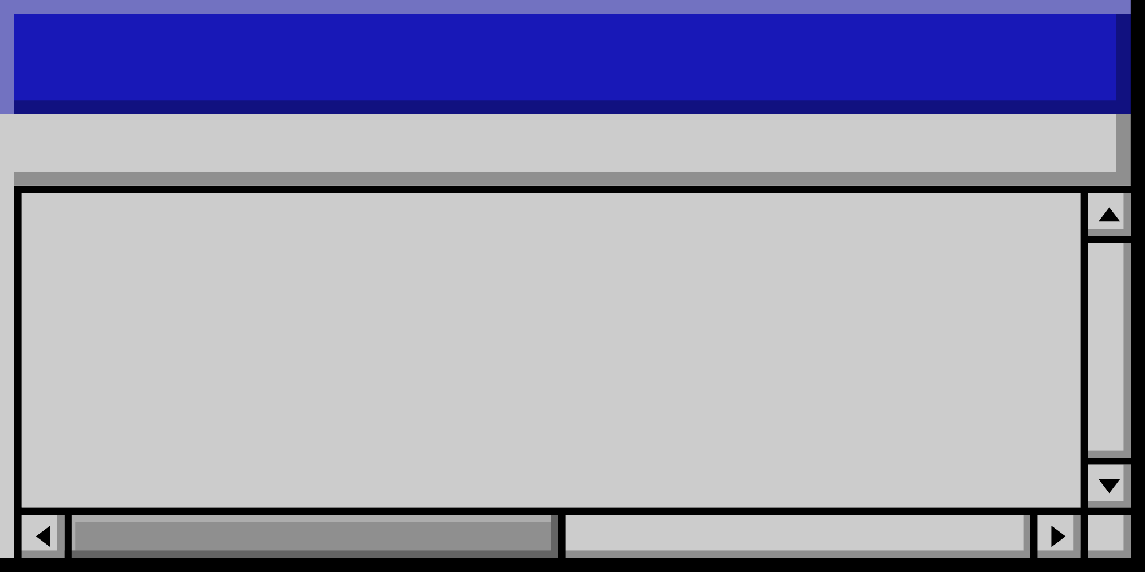
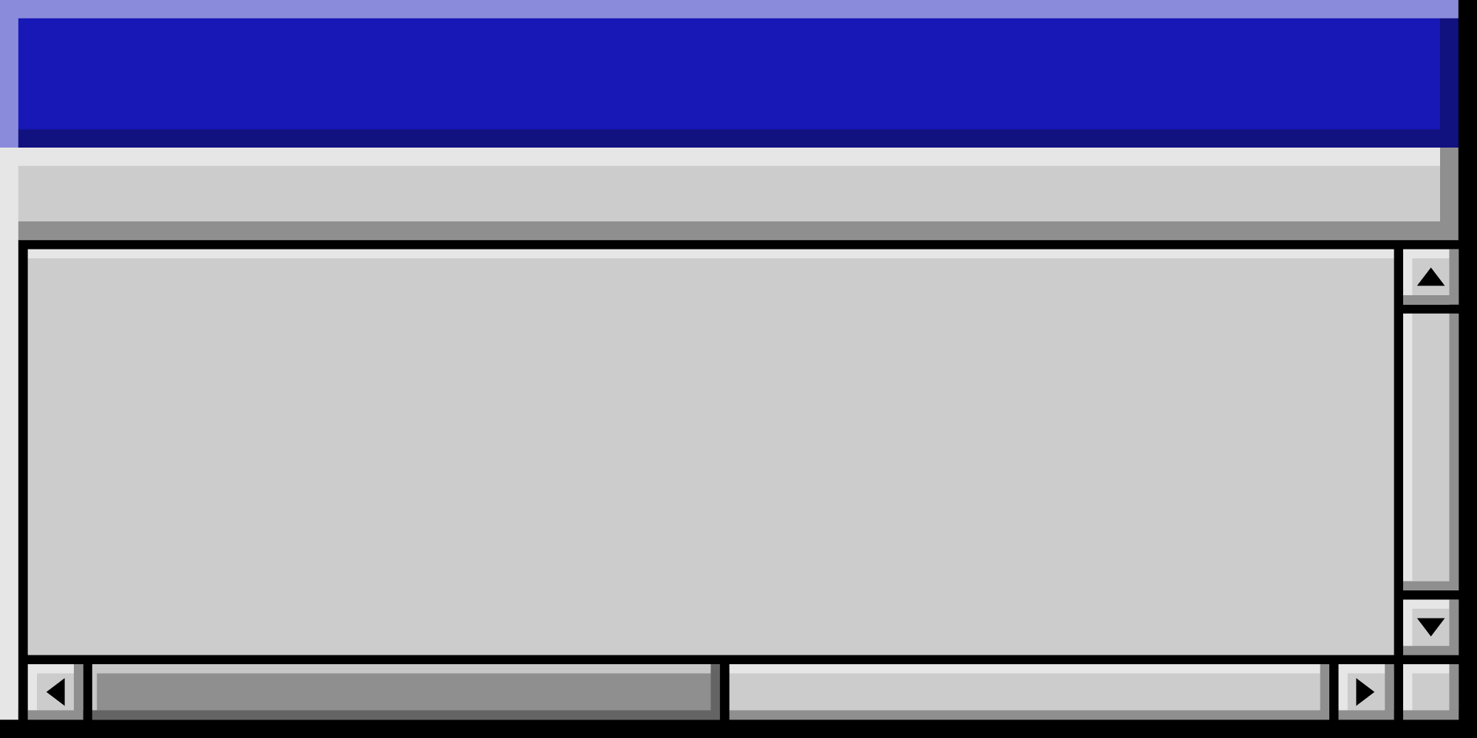










Part 1:
Introduction

Slide 4
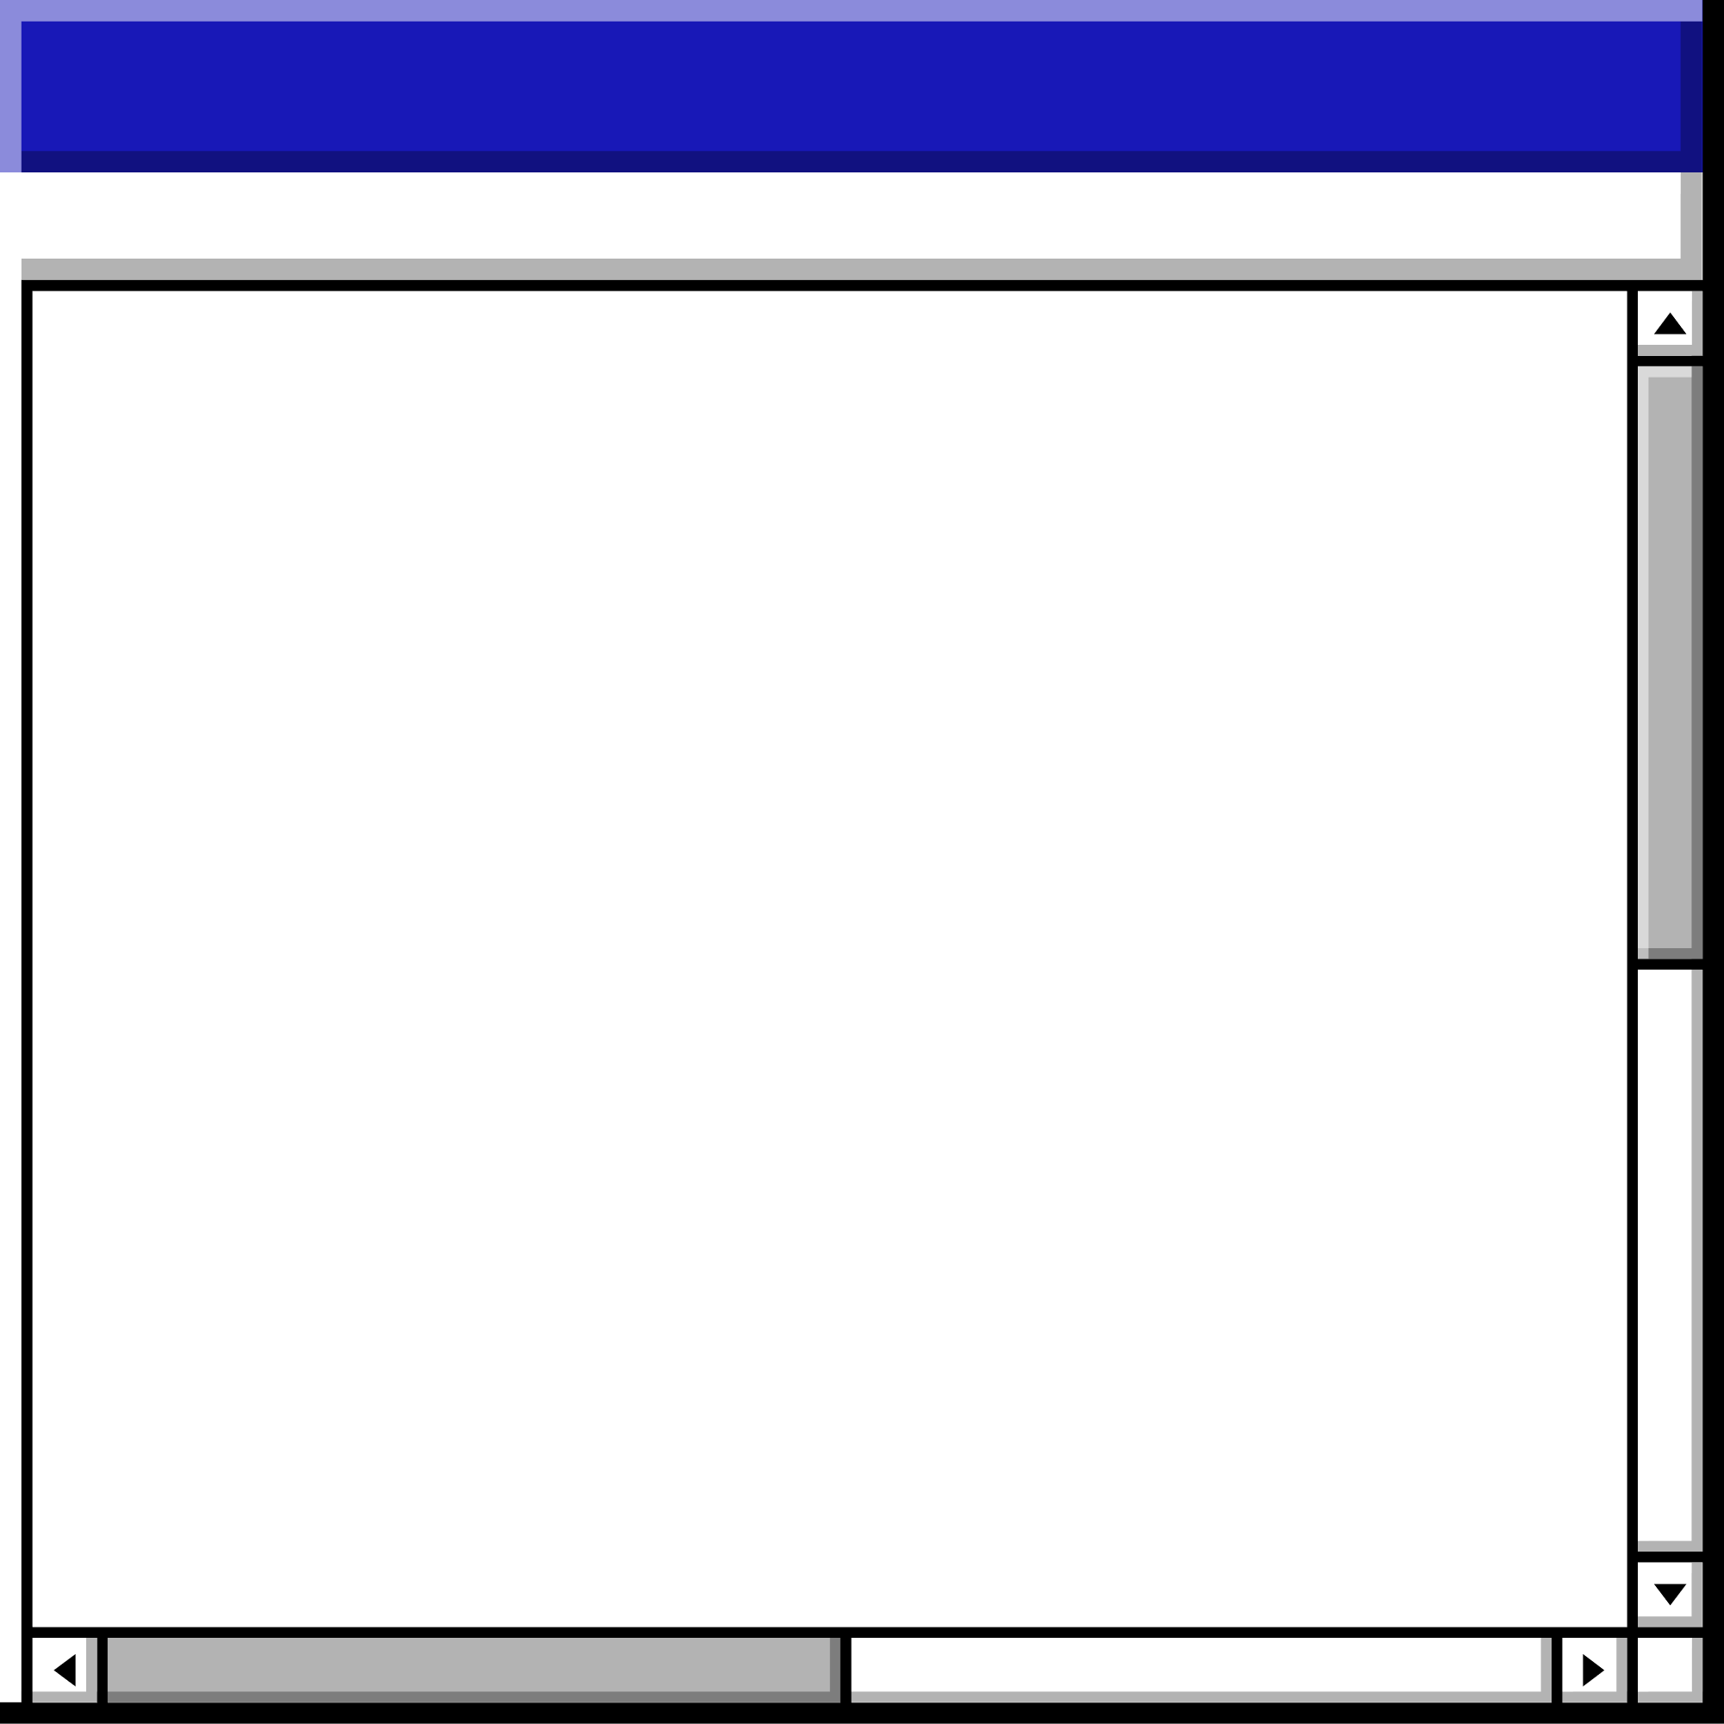
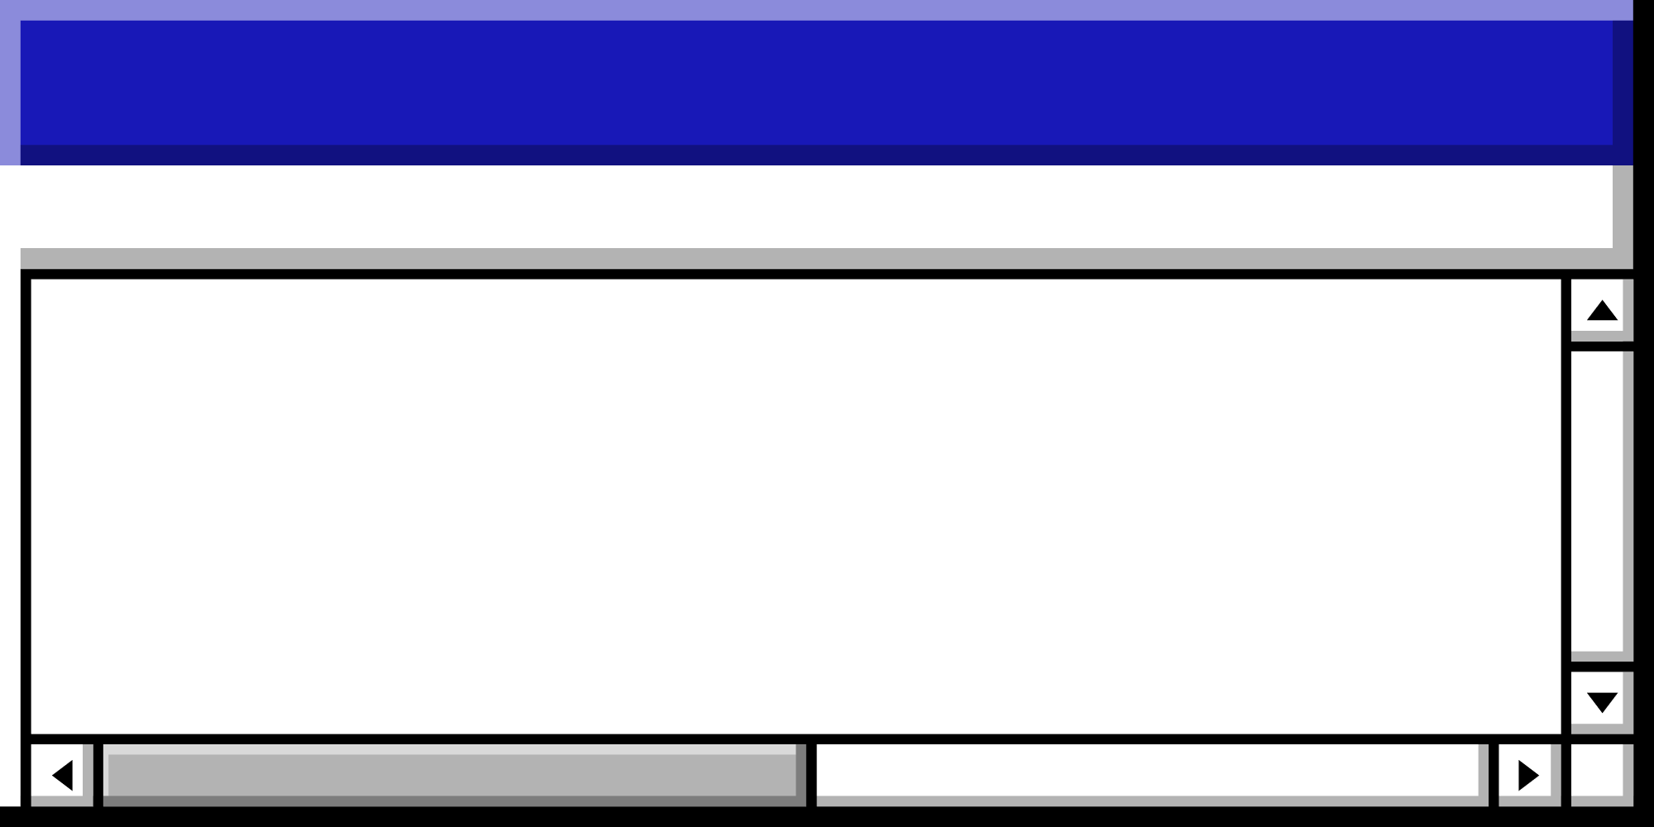

Agenda • Agenda • Agenda • Agenda • Agenda • Agenda • Agenda • Agenda • Agenda • Agenda • Agenda • Agenda • Agenda • Agenda
Overview of Mobile Operating Systems
Definition: Mobile OS is the software that controls a smartphone, tablet, or other portable device.
Functions: Manages hardware resources, provides user interface, runs applications.
Dominant Players: Android OS (Google) and iOS (Apple).
Introduction

Slide 5
Android OS
Developer: Google
Initial Release: September 23, 2008
Open Source: Based on the Linux kernel and other open-source software.
Customization: Highly customizable by manufacturers and users.
11:11AM

Slide 6
iOS
Developer: Apple Inc.
Initial Release: June 29, 2007
Closed Source: Proprietary software with limited customization.
Ecosystem: Deep integration with Apple's hardware and services.
11:11AM

Slide 7
Part 2:
MarketShare

Slide 8
Agenda • Agenda • Agenda • Agenda • Agenda • Agenda • Agenda • Agenda • Agenda • Agenda • Agenda • Agenda • Agenda • Agenda
Importance of Android OS and iOS in the Mobile Market
Market Share: Together, Android and iOS dominate the global mobile operating system market, accounting for almost all smartphones worldwide.
Android OS: Holds the largest market share globally, particularly strong in emerging markets due to its availability on a wide range of devices at various price points.
iOS: Commands a significant share in developed markets, known for its premium devices and loyal customer base.
Market Share

Slide 9
Innovation and Ecosystem:
Android OS: Open-source nature fosters innovation and customization, allowing manufacturers to tailor the OS to their hardware. Strong integration with Google services.
iOS: Provides a seamless and secure ecosystem with deep integration across Apple devices and services, driving high user engagement and satisfaction.
App Economy:
Both platforms have vibrant app ecosystems, with millions of applications available in Google Play Store (Android) and Apple App Store (iOS).
Revenue: iOS users tend to spend more on apps and in-app purchases, making it a lucrative platform for developers.
User Base:
Android OS: Appeals to a diverse global user base due to its flexibility and range of device options.
iOS: Attracts users seeking a premium, consistent experience with strong security and privacy features.
11:11AM

Slide 10
IPhone Vs Android User Stats (2023 Top Picks)
Here’s a quick look at the difference between iPhone and Android users:
In the US, iPhone has a 57.93% market share.
As of 2023, Android has a 70.29% global market share.
iPhone users have a 43.7% higher average salary than Android users.
Gen Z and Millennials are more likely to be iPhone users.
47% of former Android users say iPhone provides a better user experience.
29% of former iPhone users say Android is more affordable.
11:11AM

Slide 11
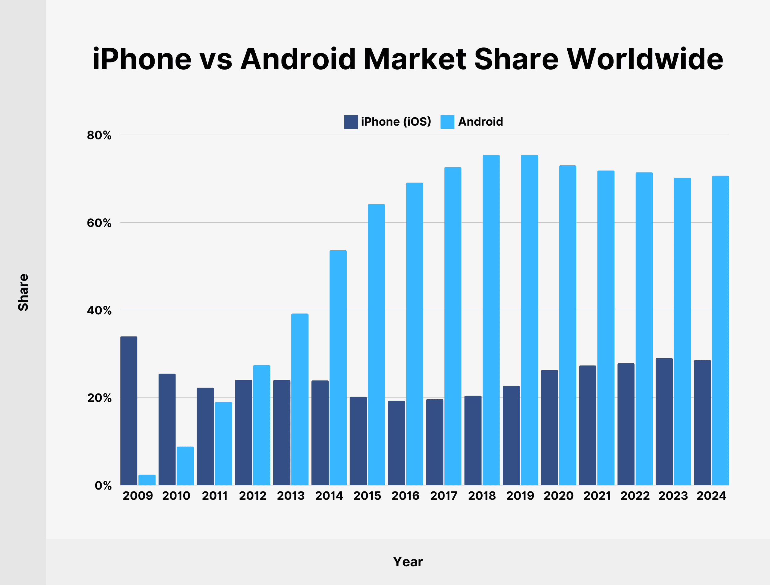
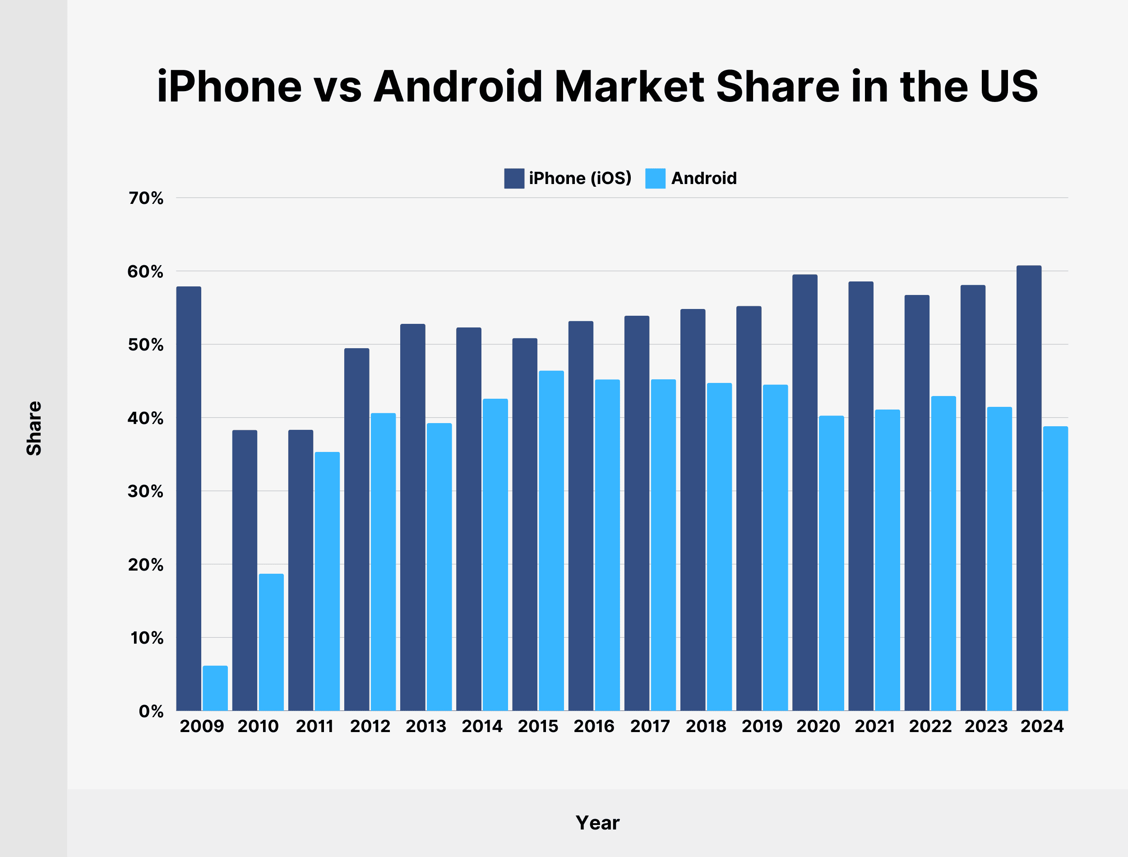
11:11AM

Slide 12
Part 3:
User Interface and Experience

Slide 13
Android OS
User Interface and Experience
Design Philosophy: Material Design, offering a clean, flat, and responsive interface.
Customization: Users can customize home screens, widgets, and app icons extensively.
Variety: Available on a wide range of devices with various screen sizes and hardware capabilities.
11:11AM

Slide 14
iOS
User Interface and Experience
Design Philosophy: Flat design with a focus on simplicity and ease of use.
Customization: Limited to changing wallpapers and rearranging app icons. No widgets on the home screen until iOS 14.
Consistency: Uniform experience across all Apple devices.
11:11AM

Slide 15
Part 4:
App Store and Applications

Slide 16
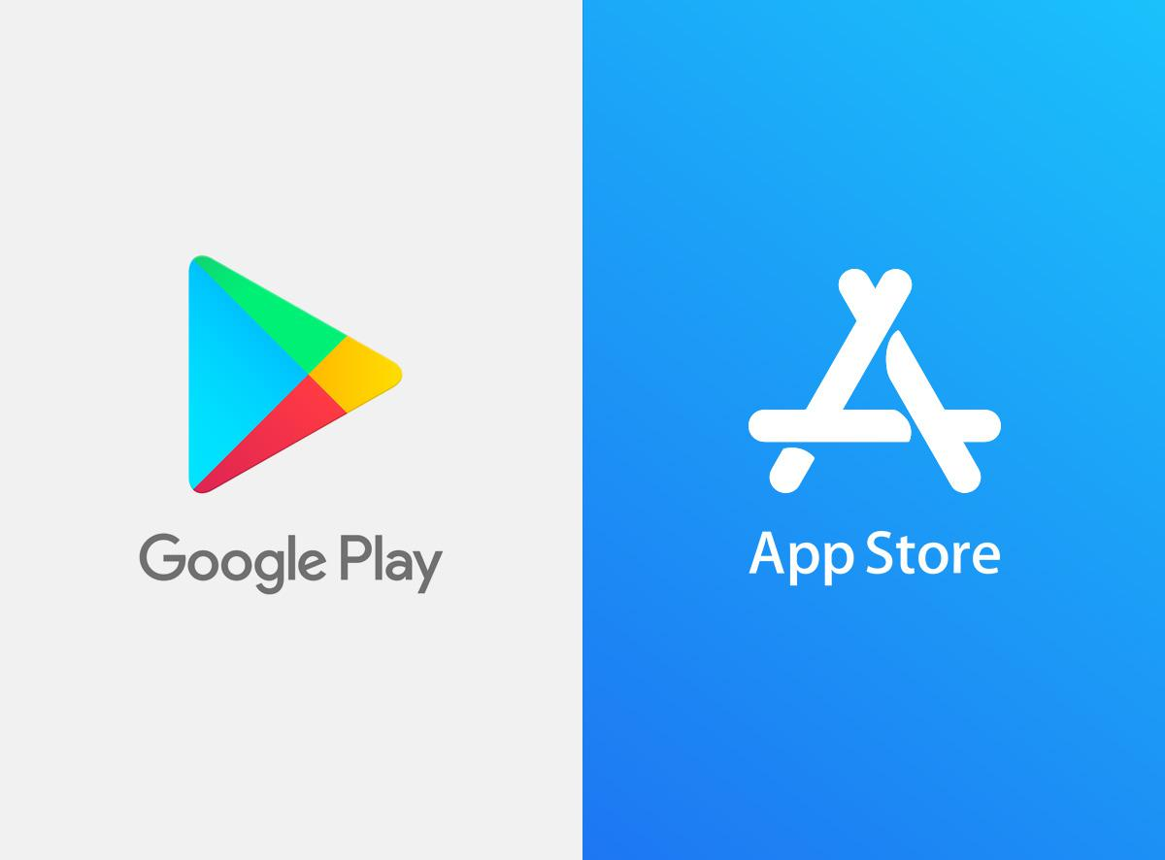
App Store and Applications
11:11AM

Slide 17
Android OS
App Store and Applications
Google Play Store: Primary source for apps, with a larger variety of apps, including those not found on iOS.
Third-party Stores: Users can install apps from various third-party app stores.
App Development: Java and Kotlin are the primary programming languages.
11:11AM

Slide 18
iOS
App Store and Applications
App Store: Only source for apps, with strict quality and security standards.
App Development: Swift and Objective-C are the primary programming languages.
Revenue Model: Higher app revenue and monetization opportunities compared to Android.
11:11AM

Slide 19
Part 5:
Hardware Integration

Slide 20
Android OS
Hardware Integration
Diverse Hardware: Used by numerous manufacturers like Samsung, Huawei, Google, and many others, leading to a wide range of devices in terms of quality and performance.
Fragmentation: Variability in hardware leads to fragmentation, where different devices run different versions of Android.
11:11AM

Slide 21
iOS
Hardware Integration
Exclusive Hardware: Only available on Apple devices (iPhone, iPad, iPod Touch), ensuring tight integration between hardware and software.
Consistency: Minimal fragmentation, as Apple controls both the hardware and the software.
11:11AM

Slide 22
Part 6:
Updates and Support

Slide 23
Android OS
Updates
and Support
Updates: Managed by manufacturers and carriers, leading to slower and less consistent updates.
Support: Google provides updates for Pixel devices directly, but other manufacturers may lag behind.
11:11AM

Slide 24
iOS
Updates
and Support
Updates: Apple provides timely updates to all supported devices simultaneously.
Support: Longer support life for older devices compared to many Android devices.
11:11AM

Slide 25
Part 7 :
Security

Slide 26
Android OS
Security
Open Source: More susceptible to security vulnerabilities due to its open nature.
Security Patches: Google releases monthly security patches, but adoption by manufacturers varies.
App Permissions: Improved over time, but historically more permissive than iOS
11:11AM

Slide 27
iOS
Security
Closed Ecosystem: More controlled environment, generally considered more secure.
App Store Review: Rigorous app review process to prevent malware.
Privacy Features: Strong focus on user privacy and data protection.
11:11AM

Slide 28
Part 8 :
Ecosystem and Integration

Slide 29
Android OS
Ecosystem
and Integration
Ecosystem: Integration with Google services (Google Drive, Gmail, Google Photos, etc.).
Cross-Platform: Supports a wide range of smart devices including smart TVs, wearables, and smart home devices.
Customization: Greater flexibility in integrating with various services and devices.
11:11AM

Slide 30
iOS
Ecosystem
and Integration
Ecosystem: Seamless integration with Apple's ecosystem (iCloud, Apple Music, Apple TV, etc.).
Continuity Features: Features like Handoff, Continuity Camera, and Universal Clipboard offer seamless transitions between Apple devices.
Closed Integration: Tight integration with Apple's ecosystem, but less flexible with third-party services.
11:11AM

Slide 31




Section Header • Section Header • Section Header • Section Header • Section Header • Section Header • Section Header • Section Header
Conclusion
Both Android OS and iOS have their strengths and weaknesses, catering to different user needs and preferences. Android offers greater customization, a wider range of devices, and flexibility, making it popular globally, especially in diverse markets. iOS, on the other hand, provides a consistent, secure, and tightly integrated user experience within Apple's ecosystem, appealing to users who prioritize seamless integration and premium hardware. The choice between the two often depends on personal preference, desired features, and budget.
Section Header • Section Header • Section Header • Section Header • Section Header • Section Header • Section Header • Section Header

Slide 32
Citations
https://explodingtopics.com/blog/iphone-android-users
https://google.com/

Slide 33
Thank you!
☺

