Slide 1
Resume Parsing / Candidate Profiling
Fine-Tuning Phi-3.5-mini-instruct with LoRA
Natural Language Understanding | Spring 2026

Slide 2
1. Project Idea
Goal: Extract structured candidate profiles from unstructured resume text using a fine-tuned LLM.
Input (Raw Resume Text)
Output (Structured JSON)
"Abhishek Jha Application Development Associate - Accenture Bengaluru, Karnataka B.E in Information Science, BVB College, 2017 Skills: C, C++, Java, Oracle PeopleSoft, Machine Learning, Database Management..."
{ "Name": "Abhishek Jha", "Email Address": "indeed.com/r/Abhishek-Jha/...", "Location": ["Bengaluru"], "Companies worked at": ["Accenture"], "Designation": ["App Dev Associate"], "Degree": ["B.E in Information Science"], "College Name": ["BVB College"], "Graduation Year": ["2017"], "Skills": ["C","C++","Java","ML",...], "Years of Experience": null }
>>>
10 Entity Types: Name, Email, Location, Companies, Designation, Degree, College, Graduation Year, Skills, Years of Experience

Slide 3
2. Dataset Information
Source: Entity Recognition in Resumes (Kaggle)
Format: JSONL (one JSON object per line)
Size: 220 resumes, 3,556 annotations
Split: 170 train / 25 validation / 25 test
Annotation: Character-level spans with entity labels
Preprocessing: Offset fixes, skill splitting,
deduplication, instruction-tuning format
Entity Type | Count
Companies worked at | 729
Designation | 521
Skills | 472
Location | 430
College Name | 330
Degree | 298
Graduation Year | 254
Email Address | 252
Name | 224
Years of Experience | 44
Resume lengths (words): min=29, max=2953, median=402, mean=518

Slide 4
2b. Data Preprocessing Pipeline
Preprocessing Steps
Instruction-Tuning Format
1. Cleaning
- Filtered out 2 UNKNOWN and 2 empty-label annotations
- Fixed ~6% annotation offset mismatches using
fuzzy text search near stated positions
2. Skills Normalization
- Raw annotations capture entire skill blocks as one span
- Split into individual skills (commas, bullets, newlines)
- Removed duration markers: "(Less than 1 year)"
- Removed section headers: "Technical Skills:", etc.
- Deduplicated within each resume
3. Entity Grouping
- Grouped annotations by entity type per resume
- Single-value fields (Name, Email): take first occurrence
- Multi-value fields (Companies, Skills): collect as lists
- Missing entities set to null
Each resume becomes a 3-message conversation:
System:
"You are an expert resume parser. Extract structured information..."
User:
"Extract the following entities from this resume and return them as JSON with these keys: Name, Email, ... Resume: ---\n{resume_text}\n---"
Assistant (target):
{ "Name": "Abhishek Jha", "Email": "indeed.com/r/...", "Location": ["Bengaluru"], "Companies": ["Accenture"], "Skills": ["C++","Java",...], ... }
220 resumes -> 170 train / 25 val / 25 test

Slide 5
3. Base Model Information
microsoft/Phi-3.5-mini-instruct
Property | Details
Parameters | 3.82 Billion
Architecture | Transformer Decoder (Causal LM)
Context Window | 128K tokens
Quantization | 4-bit NF4 (bitsandbytes) to fit on T4 GPU
Training Data | Web data, code, synthetic data
Key Strength | Strong instruction-following for structured extraction
GPU Used | Google Colab T4 (16 GB VRAM)

Slide 6
4. Fine-Tuning with LoRA
LoRA (Low-Rank Adaptation) decomposes weight updates into two small matrices instead of updating the full weight matrix. W' = W + B x A where A is (d x r) and B is (r x d), r << d This reduces trainable parameters from billions to millions while preserving fine-tuning quality.
LoRA Parameter | Value
Rank (r) | 16
Alpha | 32
Dropout | 0.05
Target Modules | All attention + MLP projections
Trainable Params | 8.9M (0.23% of 3.82B)
Training Config | Value
Epochs | 5
Batch Size | 1 (accum. 4)
Learning Rate | 2e-4 (cosine)
Optimizer | Paged AdamW 8-bit
Training Time | ~32 minutes

Slide 7
5. Evaluation Methods
Entity-Level Metrics (per entity type):
Precision = correct extractions / total extracted
Recall = correct extractions / total in ground truth
F1 = harmonic mean of Precision and Recall
Aggregation: Macro-Average F1 across all 10 entity types
JSON Validity Rate: % of model outputs that parse as valid JSON
Comparison: Same 25 test resumes evaluated before and after fine-tuning
Matching: Exact match for most entities; fuzzy (substring) matching for Skills

Slide 8
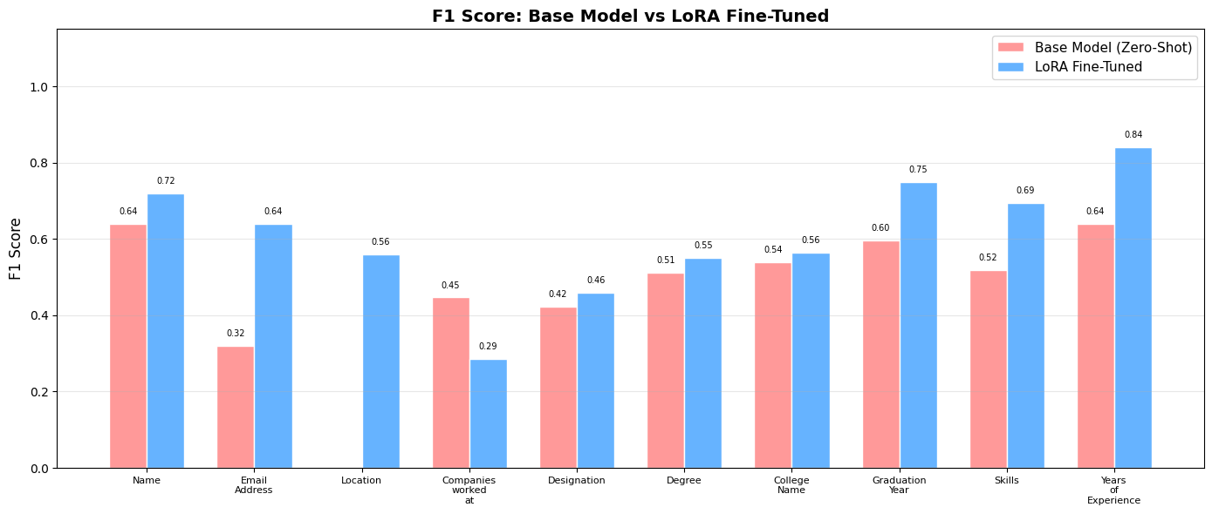
6. Results - F1 Score Comparison
Metric | Base Model | Fine-Tuned | Change
Macro F1 | 0.4636 | 0.6064 | +0.1428
JSON Validity | 68.0% | 72.0% | +4.0%

Slide 9
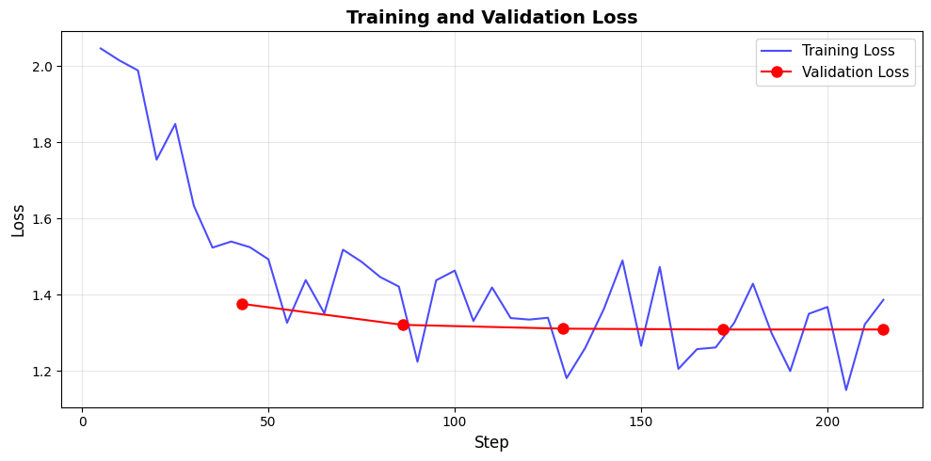
6. Results — Training & Validation Loss

Slide 10
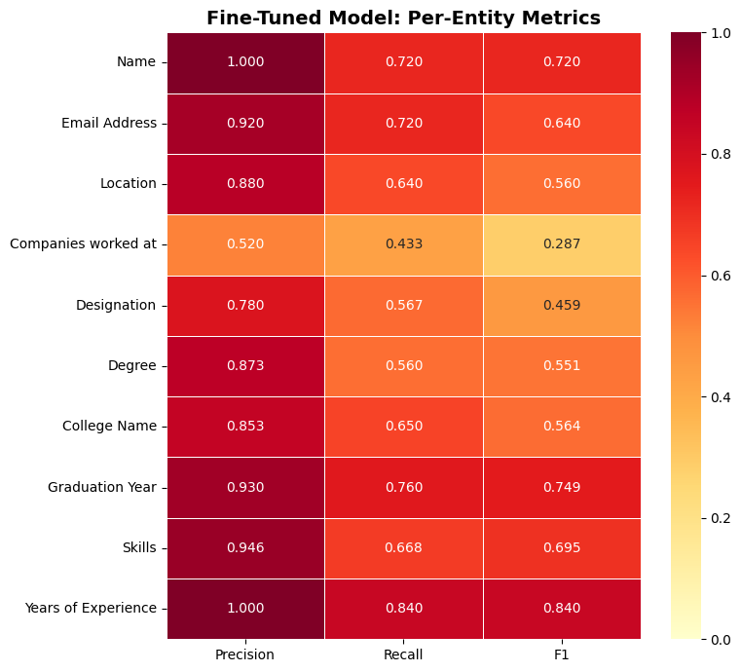
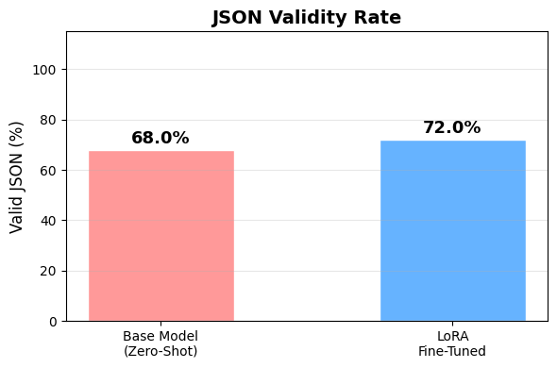
6. Results — Per-Entity Metrics & JSON Validity

Slide 11
6. Detailed Per-Entity Results
Entity Type | Base P | Base R | Base F1 | FT P | FT R | FT F1 | F1 Change
Name | 0.960 | 0.640 | 0.640 | 1.000 | 0.720 | 0.720 | +0.080
Email Address | 0.640 | 0.400 | 0.320 | 0.920 | 0.720 | 0.640 | +0.320
Location | 0.320 | 0.080 | 0.000 | 0.880 | 0.640 | 0.560 | +0.560
Companies worked at | 0.563 | 0.620 | 0.447 | 0.520 | 0.433 | 0.287 | -0.160
Designation | 0.717 | 0.473 | 0.423 | 0.780 | 0.567 | 0.459 | +0.035
Degree | 0.867 | 0.500 | 0.512 | 0.873 | 0.560 | 0.551 | +0.039
College Name | 0.860 | 0.613 | 0.540 | 0.853 | 0.650 | 0.564 | +0.024
Graduation Year | 0.770 | 0.753 | 0.596 | 0.930 | 0.760 | 0.749 | +0.153
Skills | 0.784 | 0.636 | 0.518 | 0.946 | 0.668 | 0.695 | +0.177
Years of Experience | 0.640 | 0.920 | 0.640 | 1.000 | 0.840 | 0.840 | +0.200
Biggest improvements: Location (+0.56), Email (+0.32), Years of Experience (+0.20), Skills (+0.18)

Slide 12
7. Structured Output
Ground Truth
Base Model (Zero-Shot)
LoRA Fine-Tuned
{ "Name": "Partho Sarathi Mitra", "Email": "indeed.com/r/...", "Location": ["Kolkata"], "Companies": ["Nokia & Microsoft mobile"], "Designation": ["Senior Sales Executive"], "Degree": ["B.com"], "College": ["Surendranath college Barrackpore"], "Grad Year": null, "Skills": null, "YoE": null }
{ "Name": "Partho Sarathi Mitra", "Email": "indeed.com/r/...", "Location": "Kolkata, West Bengal", "Companies": ["Nokia", "Microsoft mobile"], "Designation": "Senior Sales Executive", "Degree": "B.com", "College": "Surendranath college Barrackpore", "Grad Year": null, "Skills": null, "YoE": "March 2005 to April 2016" }
{ "Name": "Partho Sarathi Mitra", "Email": "indeed.com/r/...", "Location": ["Kolkata"], "Companies": ["Nokia & Microsoft mobile"], "Designation": ["Senior Sales Executive"], "Degree": ["B.com"], "College": ["Surendranath college Barrackpore"], "Grad Year": null, "Skills": null, "YoE": null }
Issues: wrong format, split company, hallucinated YoE
Matches ground truth perfectly

Slide 13
Limitations & Future Work
Limitations
Class Imbalance: "Years of Experience" has only 44 annotations (2%) vs
729 for "Companies worked at" (21%). The model defaults to null for rare entities.
Small Dataset: 220 resumes is limited for fine-tuning an LLM.
More data would likely improve performance across all entity types.
Companies worked at F1 decreased (-0.16): The base model sometimes
splits company names differently than the ground truth annotations.
JSON Validity only reached 72%: Some outputs still fail to parse as valid JSON.
Future Work
Data augmentation for rare entity types (especially Years of Experience)
Larger dataset collection to improve generalization
Constrained decoding to guarantee valid JSON output

Slide 14
Conclusion
LoRA fine-tuning improved Macro F1 from 0.46 to 0.61 (+31% relative improvement)
Only 0.23% of model parameters were trained (8.9M out of 3.82B)
Training completed in ~32 minutes on a free Google Colab T4 GPU
Biggest gains: Location (0.00 to 0.56), Email (0.32 to 0.64), Skills (0.52 to 0.70)
Fine-tuned model produces consistently structured JSON output
LoRA demonstrates that efficient fine-tuning can meaningfully improve
LLM performance on domain-specific NER tasks with minimal resources
Thank You

