Slide 1
Bank marketing campaign analysis
Presented by: Sandra waheed , Malak Maher ,
Sham Mohamed , Mariam Ramadan
Supervised by: Dr. Dalia Magdy

Slide 2
CONTENTS
Introduction
Data & Target Variable
Preprocessing & Data Balancing
Models & Evaluation
Results & Conclusion
Summary

Slide 3
INTRODUCTION
This project analyzes a bank marketing campaign dataset where customers were contacted by phone to subscribe to a term deposit.
The goal is to use machine learning to predict which customers are most likely to say “Yes”, allowing the bank to focus calls only on promising clients.

Slide 4
Objective & Goal
• Phone calls are expensive and time-consuming
• Most customers respond with “No”
• Random calling wastes resources and annoys customers
Objective: Build an AI model to predict customer response and improve campaign efficiency.

Slide 5
Dataset overview
The dataset contains 45,211 records with customer and campaign information, such as:
Age, job, education
Housing loan & personal loan status• Contact type (cellular, telephone)
Call duration
Previous campaign outcome (poutcome)
Example insight from data: • Longer call duration strongly increases the chance of a “Yes”.

Slide 6
Target variable
Target variable: y
Yes → Customer subscribes to term deposit
No → Customer does not subscribe
Dataset is highly imbalanced
Majority: No
Minority: Yes
This makes accuracy alone misleading.

Slide 7
Data preprocessing
The following preprocessing steps were applied:
Handling missing and unknown values
Encoding categorical variables (job, month, contact, etc.)
Feature scaling where required
Removing irrelevant or non-informative columns
These steps improved model stability and performance.

Slide 8
Dataset Balancing
Imbalanced data causes models to predict mostly "No“
Oversampling technique applied to increase "Yes" cases
To fix class imbalance, a balancing technique (such as oversampling) was applied:
Increased representation of “Yes” cases
Result:
Improved recall
Improved F1-score
More realistic business predictions

Slide 9
Three classification algorithms were implemented , trained and tested on the same balanced dataset for fair comparison.

Slide 10
Algorithms Used:
Logistic regression
Random forest
XGBoost
• Simple and interpretable
• Common baseline in banking projects
Helps understand how each feature affects customer decisions
Commonly used in similar projects such as customer response prediction and credit approval systems
Handles non-linear relationships
Strong performance with mixed data types
Robust to noise and overfitting compared to single decision trees
Frequently used in marketing analytics and customer segmentation tasks
Handles imbalanced datasets efficiently through boosting
Known for high accuracy on structured datasets
Used extensively in Kaggle competitions and real-world banking applications

Slide 11
Model Accuracy Results:
model | accuracy
Logistic regression | ≈ 0.82
Random forest | ≈ 0.91
XGBoost | ≈ 0.93
Based on academic and industry projects:
• Logistic Regression: Widely used as a baseline model • Random Forest: Popular for handling complex patterns • XGBoost: Most used in recent banking and marketing competitions due to superior accuracy
XGBoost achieved the highest overall performance

Slide 12
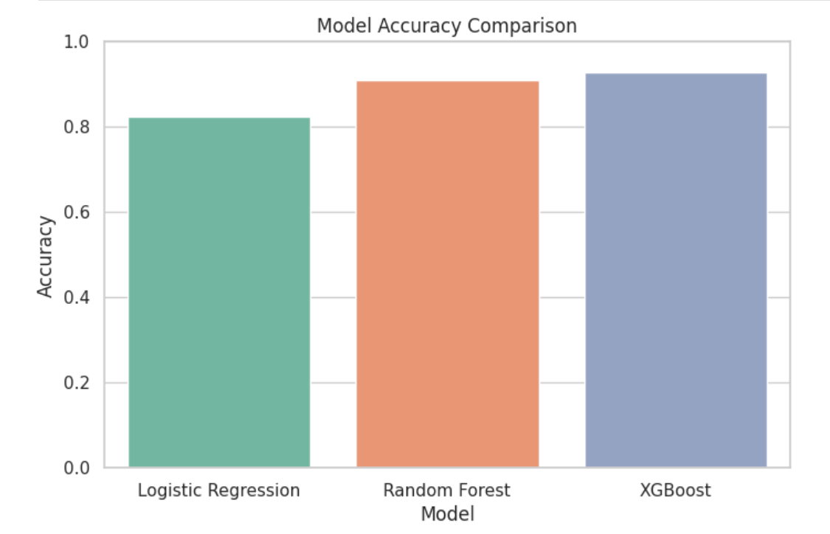

Slide 13
Model complexity analysis
model | time | memory
Logistic regression | O(n*d) | O(d)
Random forest | O(trees*n*d*log n) | High
XGBoost | O(trees*n*log n) | Medium
THEORETICAL COMPLEXITY TABLE
Model | Train time | Prediction time | Memory used
Logistic regression | 1.189867 | 0.001795 | 0.000000
Random forest | 12.607450 | 0.221381 | 6.726562
XGBoost | 2.713568 | 0.105811 | 0.085938
EMPIRICAL COMPLEXITY TABLE

Slide 14
Model Evaluation Metrics
Models were evaluated using:
Accuracy​
​
Precision ​
Recall
F1-score​
These metrics ensure balanced evaluation, especially with imbalanced data.

Slide 15
Summary table:
Model | Accuracy | Precision | Recall | F1-score
Logistic regression | 0.82 | 0.82 | 0.84 | 0.83
Random forest | 0.91 | 0.90 | 0.93 | 0.91
XGBoost | 0.93 | 0.93 | 0.93 | 0.93

Slide 16
Why XGBoost Is the Best Choice?
Based on both our results and real-world usage, XGBoost proved to be the strongest model.
Reasons:
• Achieved the highest accuracy in our project • Handles complex, non-linear relationships well
• Performs strongly on imbalanced datasets • Efficient and scalable for large banking datasets
XGBoost is widely used in similar situations such as:
• Bank marketing campaign prediction
• Credit scoring and loan default prediction
• Customer churn analysis
• Kaggle and industry data science competitions
Many studies and real-world banking systems report XGBoost as the top-performing model, which supports our decision to use it.

Slide 17
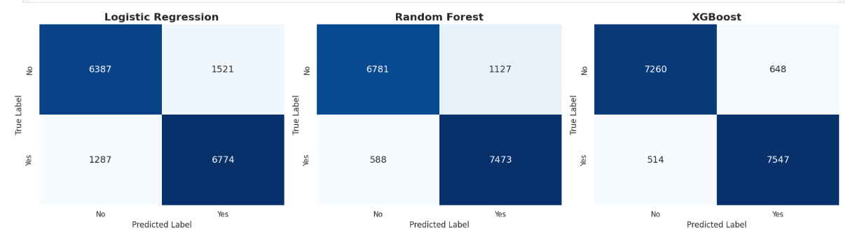
Confusion matrix

Slide 18
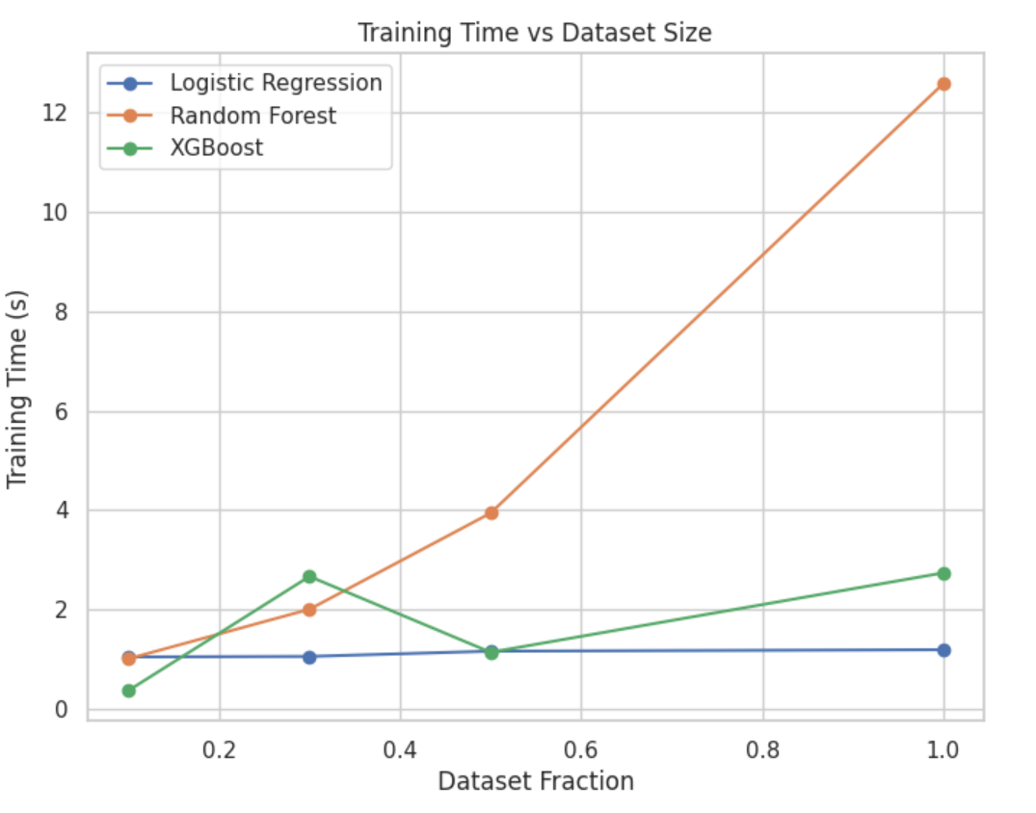
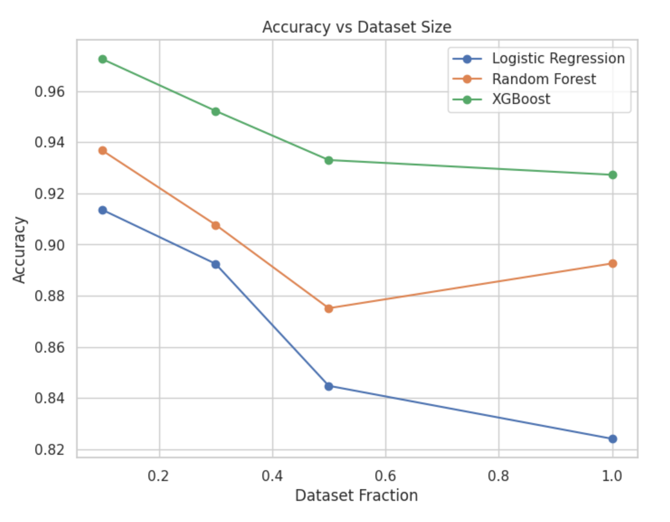
Scalability plot

Slide 19
fairness evaluation:
Logistic regression | Random forest | XGBoost
AGE < 30
AGE 30-55
AGE > 55
TPR
FPR
TPR
FPR
TPR
FPR
0.847 | 0.938 | 0.947
0.249 (Count: 2266) | 0.203 (Count: 2266) | 0.144 (Count: 2266)
0.834 | 0.919 | 0.933
0.176 (Count: 11668) | 0.123 (Count: 11668) | 0.066 (Count: 11668)
0.860 | 0.951 | 0.940
0.254 (Count: 2035) | 0.232 (Count: 2035) | 0.134 (Count: 2035)

Slide 20
Final Model Ranking, Insights & Conclusion
XGBoost – Best overall performance
Random Forest – Strong and reliable
Logistic Regression – Simple and interpretable
Business Understanding & Impact:
By using XGBoost, the bank can focus its calls on customers who are most likely to subscribe, which:
• Reduces marketing costs • Improves customer satisfaction by avoiding unnecessary calls • Increases the success rate of campaigns • Supports data-driven decision making

Slide 21
SUMMARY
This project demonstrates a strong understanding of both machine learning concepts and real business problems. Through thoughtful preprocessing, balancing, and model selection, raw marketing data was transformed into meaningful insights that support smarter and more efficient banking decisions.."

Slide 22
THANK YOU

