Slide 1

Maze path finding
Toka El Adly
Mayar Tarek
Malak Essam
001

Slide 2
Algorithms
001
003
002
Depth first search
(DFS)
Breadth first search
(BFS)
Dijkstra
001
002
003

Slide 3
ORDER OF Algorithm
START
01
02
03
Starting Point
Searching Algorithm
Finding the Goal Point

Slide 4
THE Algorithm
BFS
DFS
Dijkstra
DFS
Gets The Shortest Path Using Queues, and it searches by level order.
O(V+E)
Traverses a graph in a depthward motion and uses a stack.
O(V+E)
Gets the lower cost path
O(V^2)

Slide 5
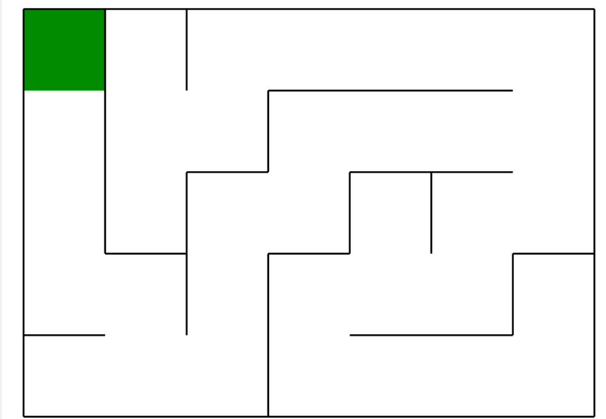
Pymaze
The module pyamaze is created for the easy generation of random maze and apply different search algorithm efficiently.

Slide 6
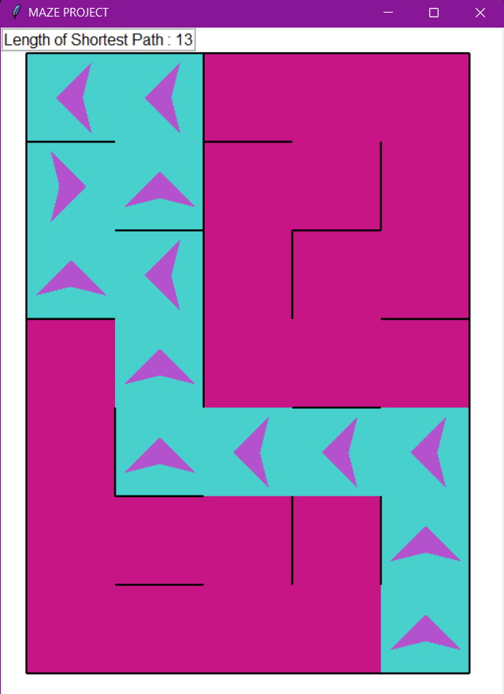
maze_map: It is a dictionary with the keys as the cells of the Maze and value as another dictionary with the information of the four walls of that cell in four directions; East, West, North and South.
{(1, 1): {'E': 1, 'W': 0, 'N': 0, 'S': 0}, (2, 1): {'E': 1, 'W': 0, 'N': 0, 'S': 1}, (3, 1): {'E': 1, 'W': 0, 'N': 1, 'S': 0}, (4, 1): {'E': 1, 'W': 0, 'N': 0, 'S': 1}, (5, 1): {'E': 0, 'W': 0, 'N': 1, 'S': 1}, (6, 1): {'E': 1, 'W': 0, 'N': 1, 'S': 1}, (7, 1): {'E': 1, 'W': 0, 'N': 1, 'S': 0}, (1, 2): {'E': 0, 'W': 1, 'N': 0, 'S': 1}, (2, 2): {'E': 0, 'W': 1, 'N': 1, 'S': 0}, (3, 2): {'E': 0, 'W': 1, 'N': 0, 'S': 1}, (4, 2): {'E': 0, 'W': 1, 'N': 1, 'S': 1}, (5, 2): {'E': 1, 'W': 0, 'N': 1, 'S': 0}, (6, 2): {'E': 1, 'W': 1, 'N': 0, 'S': 0}, (7, 2): {'E': 1, 'W': 1, 'N': 0, 'S': 0}, (1, 3): {'E': 1, 'W': 0, 'N': 0, 'S': 0}, (2, 3): {'E': 1, 'W': 0, 'N': 0, 'S': 1}, (3, 3): {'E': 0, 'W': 0, 'N': 1, 'S': 1}, (4, 3): {'E': 1, 'W': 0, 'N': 1, 'S': 1}, (5, 3): {'E': 1, 'W': 1, 'N': 1, 'S': 1}, (6, 3): {'E': 0, 'W': 1, 'N': 1, 'S': 1}, (7, 3): {'E': 1, 'W': 1, 'N': 1, 'S': 0}, (1, 4): {'E': 1, 'W': 1, 'N': 0, 'S': 1}, (2, 4): {'E': 0, 'W': 1, 'N': 1, 'S': 0}, (3, 4): {'E': 1, 'W': 0, 'N': 0, 'S': 1}, (4, 4): {'E': 1, 'W': 1, 'N': 1, 'S': 0}, (5, 4): {'E': 1, 'W': 1, 'N': 0, 'S': 1}, (6, 4): {'E': 0, 'W': 0, 'N': 1, 'S': 1}, (7, 4): {'E': 1, 'W': 1, 'N': 1, 'S': 0}, (1, 5): {'E': 0, 'W': 1, 'N': 0, 'S': 1}, (2, 5): {'E': 0, 'W': 0, 'N': 1, 'S': 1}, (3, 5): {'E': 0, 'W': 1, 'N': 1, 'S': 0}, (4, 5): {'E': 0, 'W': 1, 'N': 0, 'S': 1}, (5, 5): {'E': 0, 'W': 1, 'N': 1, 'S': 1}, (6, 5): {'E': 0, 'W': 0, 'N': 1, 'S': 1}, (7, 5): {'E': 0, 'W': 1, 'N': 1, 'S': 0}}

Slide 7
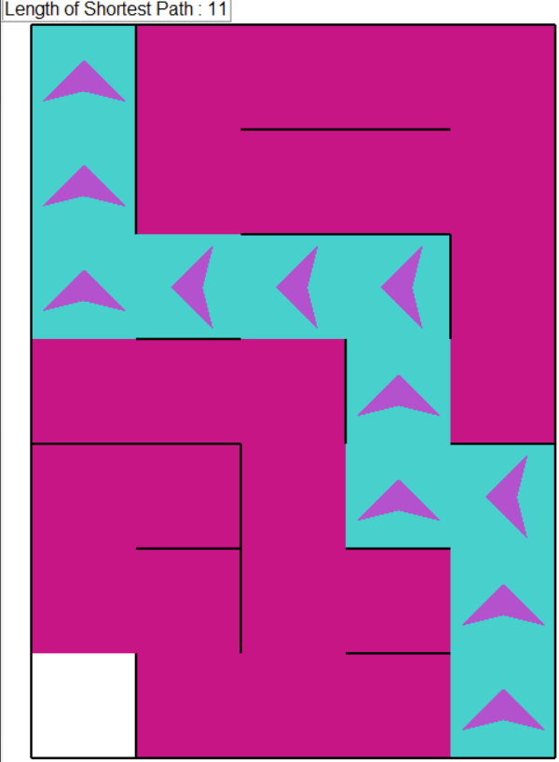
Breadth First Search
we have a queue (possible_cells) and a list (visited_lists).
first we put start (5,5) in both lists.
current cell = the first element in possible_cells queue.
then we check directions "EWSN" if next_cell is not in visited then we append this cell in both lists.
it stopped when the possible cells is empty or we reached the goal(1,1).
To get the bfs bath we create a dictionary (bfspath) that contains next_cells as a key while current_cell as a value till reach the start. And this is the shortest path lengths.

Slide 8
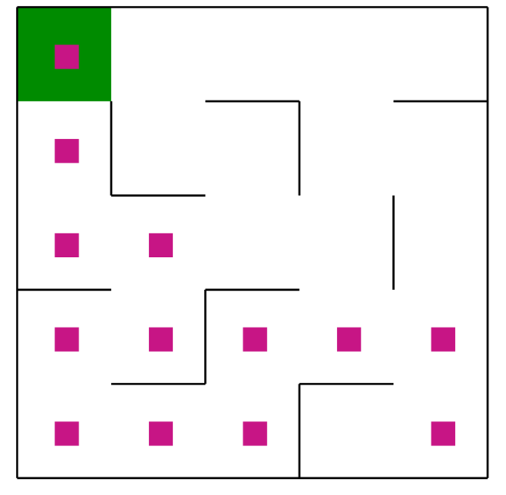
Depth First Search
we have two Stacks (Lists in python) one has (possible_cells) and on has (visited_lists).
Declare the start is the end of the maze (5,5)
current cell = the first element in possible_cells stack.
then we check directions "EWSN" if next_cell is not in visited then we append this cell in both lists.
it will stop when the possible cells is empty or we reached the goal(1,1).
To get the dfs bath we create a dictionary (dfspath) that contains next_cells as a key while current_cell as a value till reach the start. And this is the path length to the goal.

Slide 9


DFS Vs BFS
- | BFS | DFS
memory | BFS will generally use more memory, as we'll need to keep multiple paths in memory at the same time. | DFS only needs to keep track of a single path at any given time. Also, DFS is faster and better in memory.
shortest path | BFS guarantees to find the shortest path | DFS does not
List | BFS uses queue | DFS uses stack
complexity | O(V+E) | O(V+E)

Slide 10
Dijkstra Algorithm
Dijkstra Start
Search
Moving
Finding Hurdles
Hurdles everywhere
End
Using the EWNS it
calculates which path will
have the lower cost
It goes to the lower cost
point then it starts over
It starts on a given point
While moving if it found a
hurdle it will go to the
previous point and start over
If there is hurdles in
every path then it will
choose the shortest
It will stop when reaching
the goal point

Slide 11
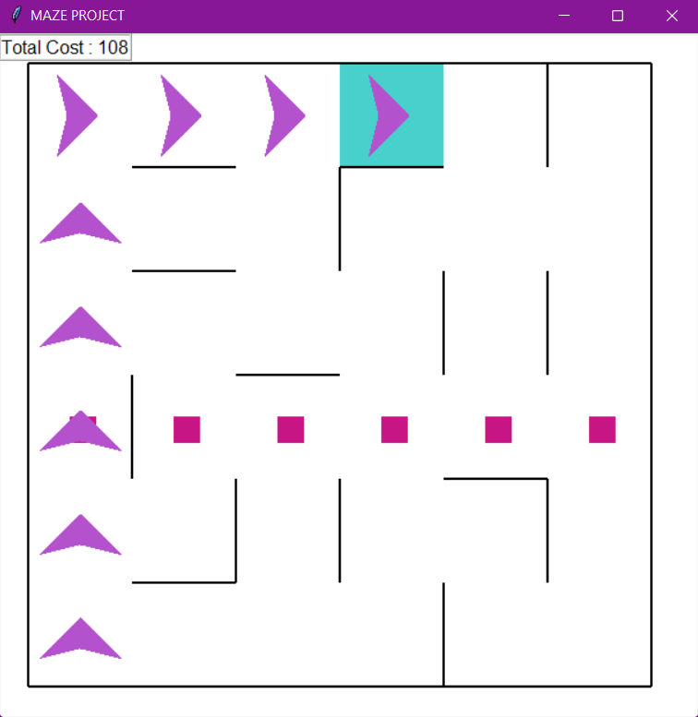
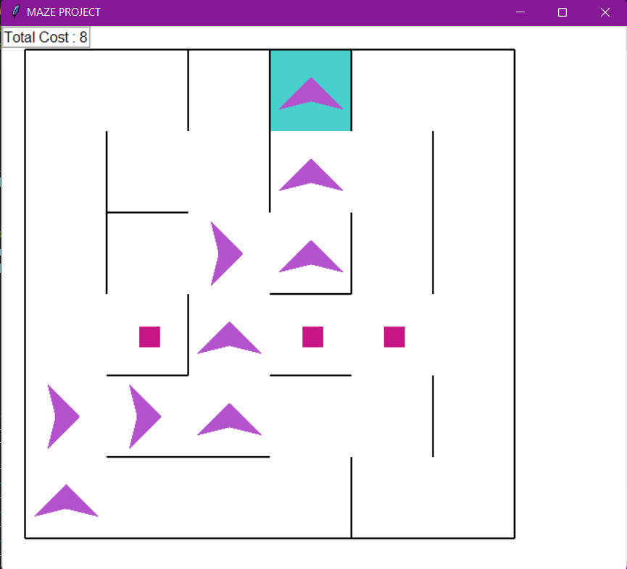
Dijkstra Algorithm

Slide 12
THANK YOU (any questions?)
001

