Slide 1
HU Break
A website to serve the students of HU

Slide 2
Overview
HU Break is a website designed for the students and staff of HU so they can save time ordering food. It allows users to brows and place an order fairly quickly with just a few clicks.
This makes the website have two benefits so far:
1- Expanding the restaurants reach which allows them to make more money.
2- Save valuable time and effort for the students and staff of the university.

Slide 3
What is the current problems in the old fashion ordering system
Because of the vast size of the Hashemite University, and the very crowded restaurants, students take too much time to order some food to eat. That can lead to some problems including:
1- Students may miss out on their lectures which results in making them lose valuable information.
2- Students may even ignore the feeling of hunger because of the hassle of ordering food in the university which can cause serious problems to their health.

Slide 4
So, what is the project objective?
The project’s main objective is to help staff and students of the Hashemite university and save their precious and valuable time giving them a better experience for their break time in their busy schedules.

Slide 5





Benefits that make the website better than old fashion ordering process
Convenience
Speed
Variety
Efficiency
Affordability

Slide 6

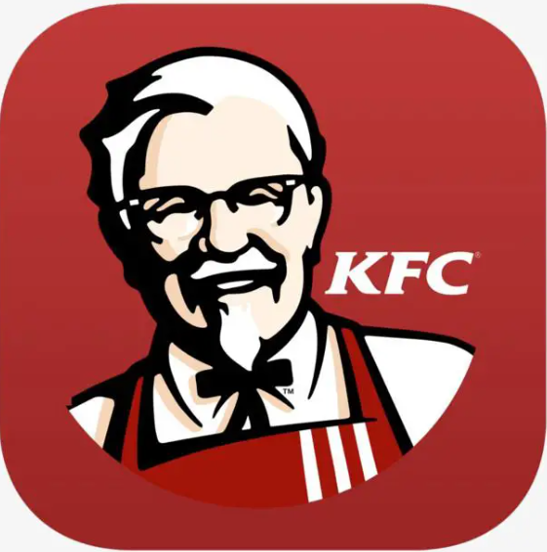
Related existing systems
Talabat
Kentucky Fried Chicken

Slide 7
Talabat Overall Problems
Small variety of restaurants that users can order from.
Very long order-waiting time.
High delivery fees.
Bad customer service.

Slide 8
KFC Overall Problems
Small variety of items in the menu.
Long order waiting time.
High delivery fees.
Complex design.

Slide 9
Other problems related with users from HU
Complex deign and ordering process.
High prices.
Fairly long delivery time.
Possibility of time interference between lectures and order arrival time.
The restaurants open time is at 11:00 am.

Slide 10
Overall Solution Approach
HU Break website provides all the benefits of the Existing Systems minus the delivery time and fees, plus due to our website being based around the Hashemite University’s restaurants; all students can order from any restaurant during the working hours of the University. Add on that the rating system that should provide the customer with critical info on which restaurants to avoid and which to order from, and overall in less complex and more user friendly environment.

Slide 11
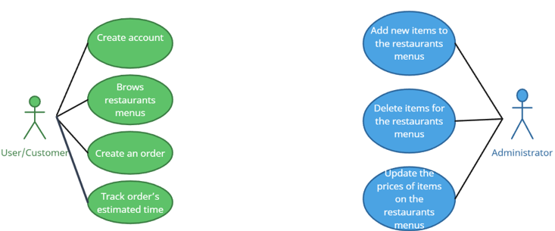
USE Case Diagram

Slide 12
Future Work
1-Make point of sale system (POS) for the restaurants that enables them to change the prices, make offers, and accept dine-in orders from the same page.
2-display the recommended items based on the rating of each item in the restaurant.
3-Include the ability for the user to write a comment in regards to his review of a certain restaurant.
4-Send a notification or an email to the customer when offers are available.

Slide 13
Future Work (cont.)
5-Give the customers the ability to customize their meal in detail.
6-Add a search box to make it easier to find the meal that the customer wants.
7-Add a user interface that enables the administrator to add or delete meals from the menu in an easy manner.
8-Implement a cleaner code.

Slide 14
Thank You

