Slide 1
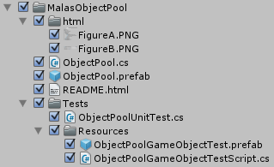
Grows as needed
Has Unit Tests
One pool for all scenes
Tested to be 42% faster

Slide 2
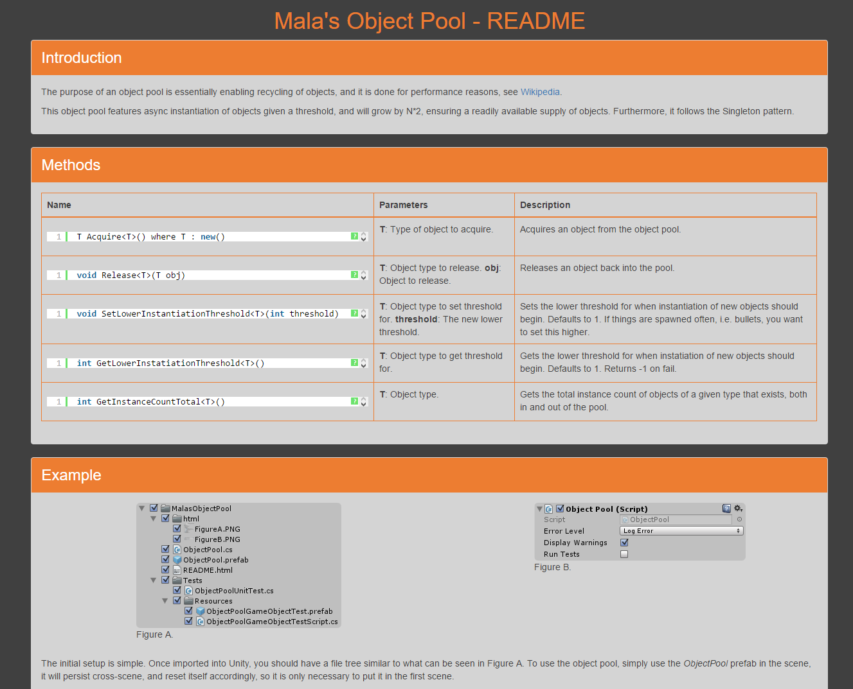
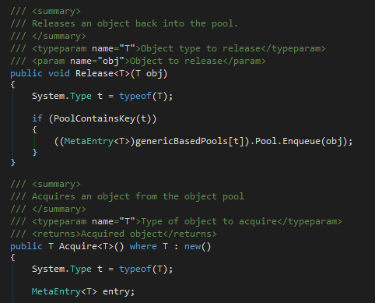
Fully documented
Easy to use
Contain any objects

