Slide 1
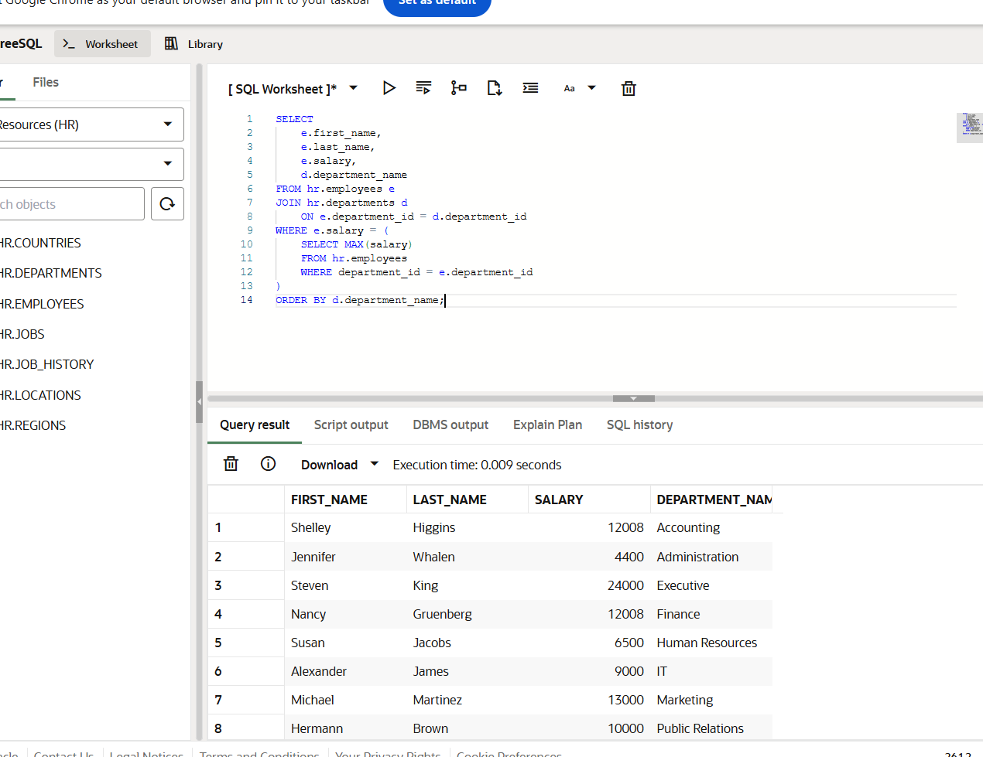
Notes:
This query attempts to retrieve employees with highest salary in each department using a subquery and aggregation.

Slide 2
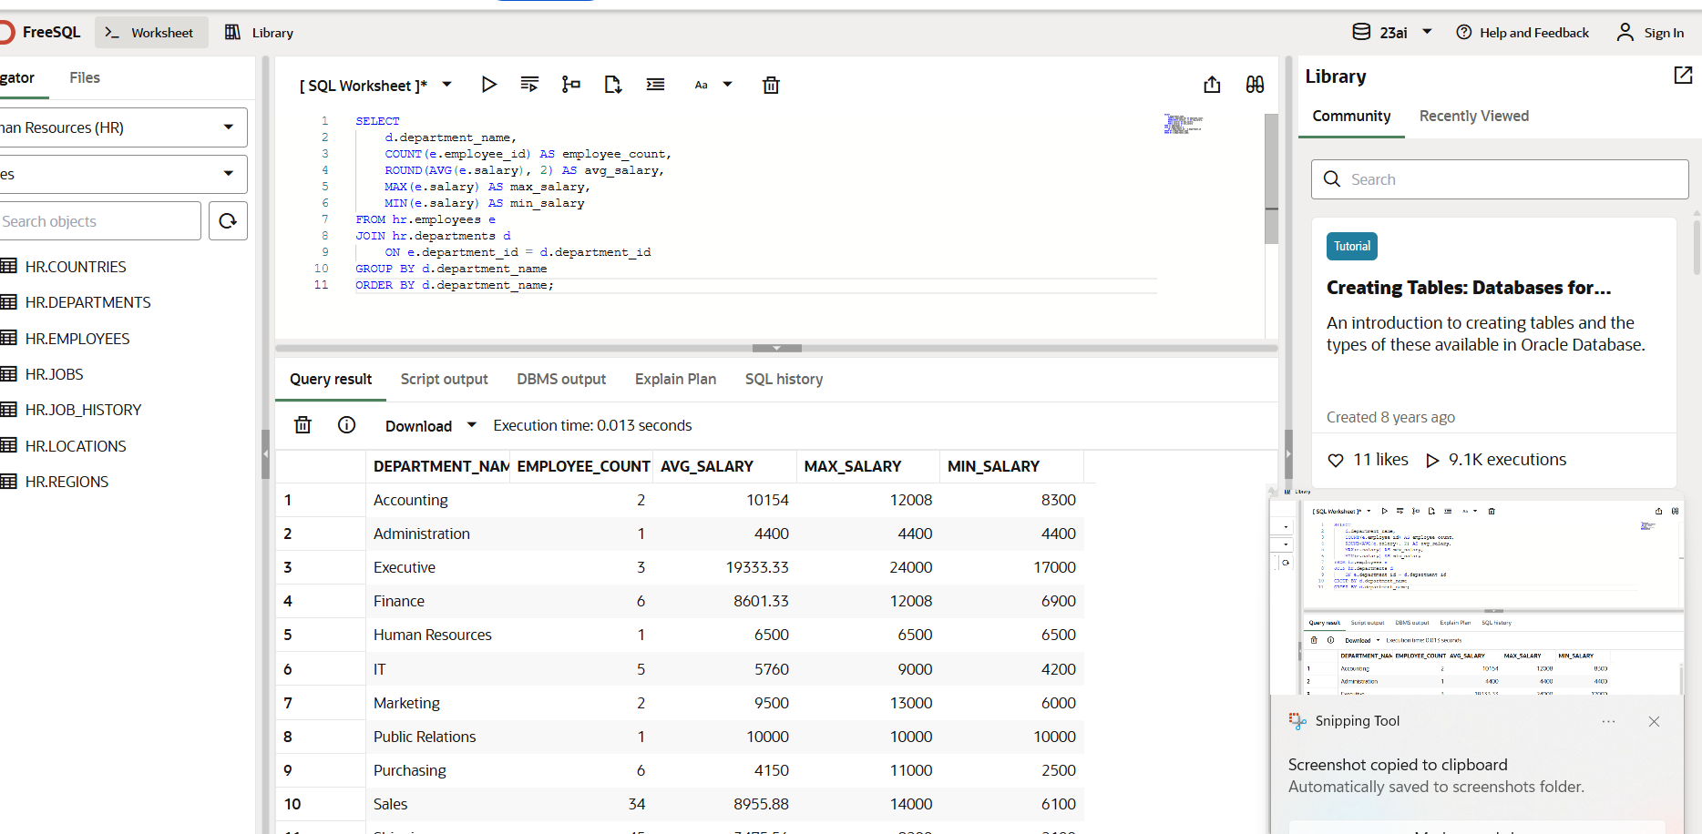
Notes:
For each department calculate: sort the results by department name: calculated total employees average salary,max and minimum salary with the help of join.

Slide 3
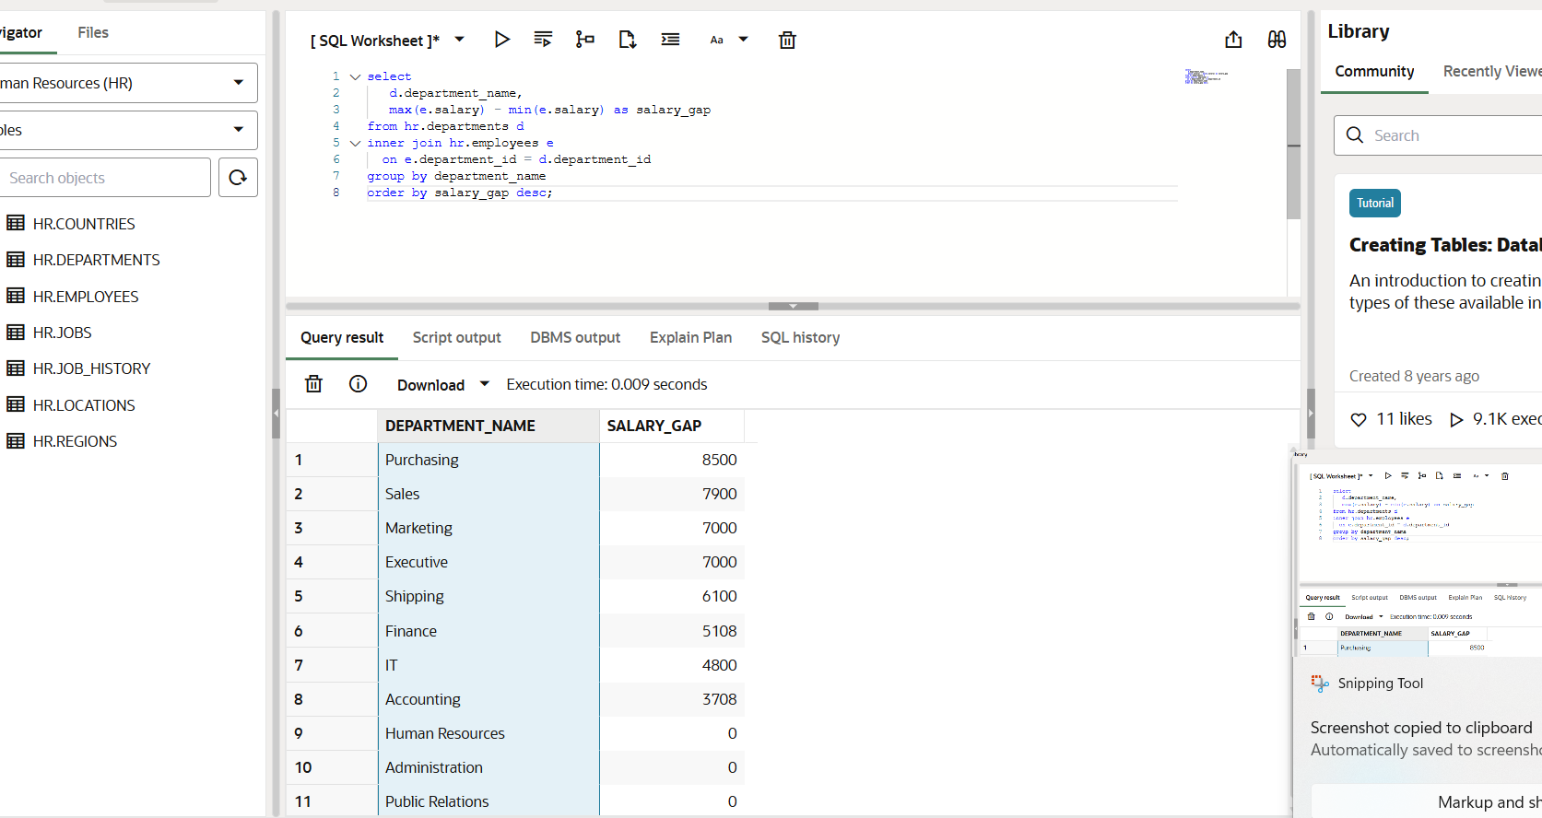
Notes:
This query calculates the salary gap for each department,which is the difference between the highest and lowes salary.

Slide 4
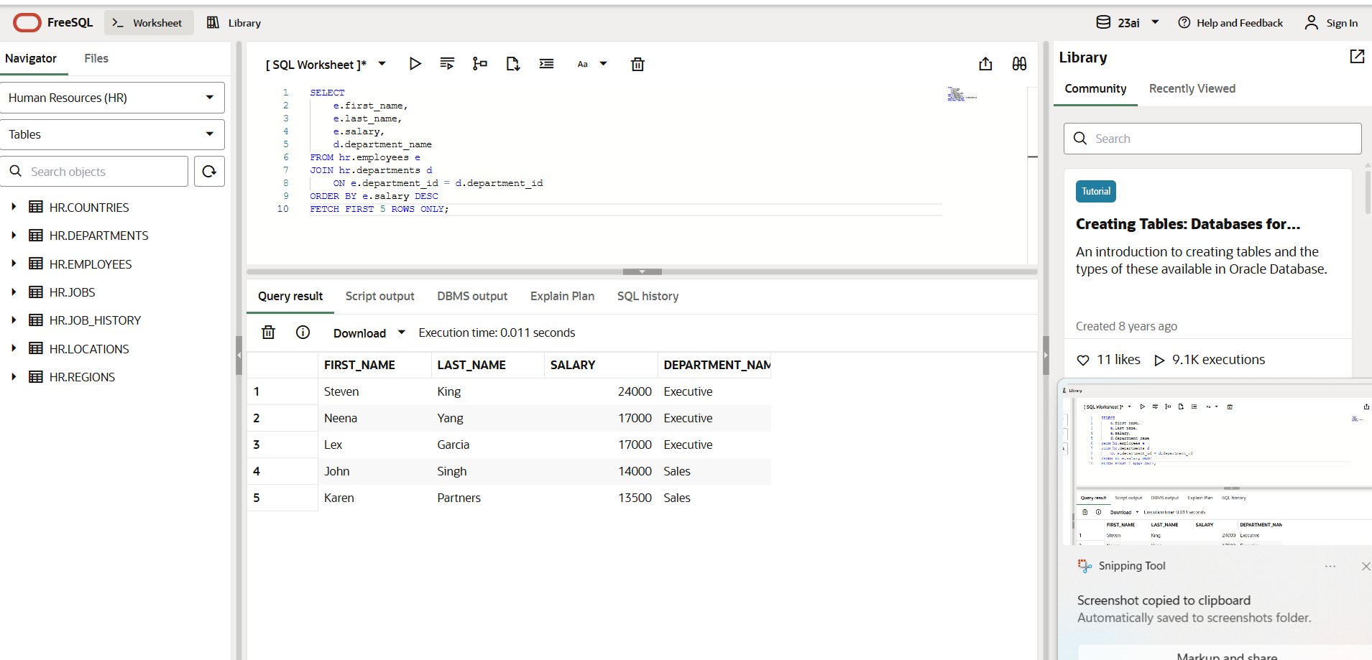
Notes:
L found the top 5 employees with the highest salary in the company.

Slide 5
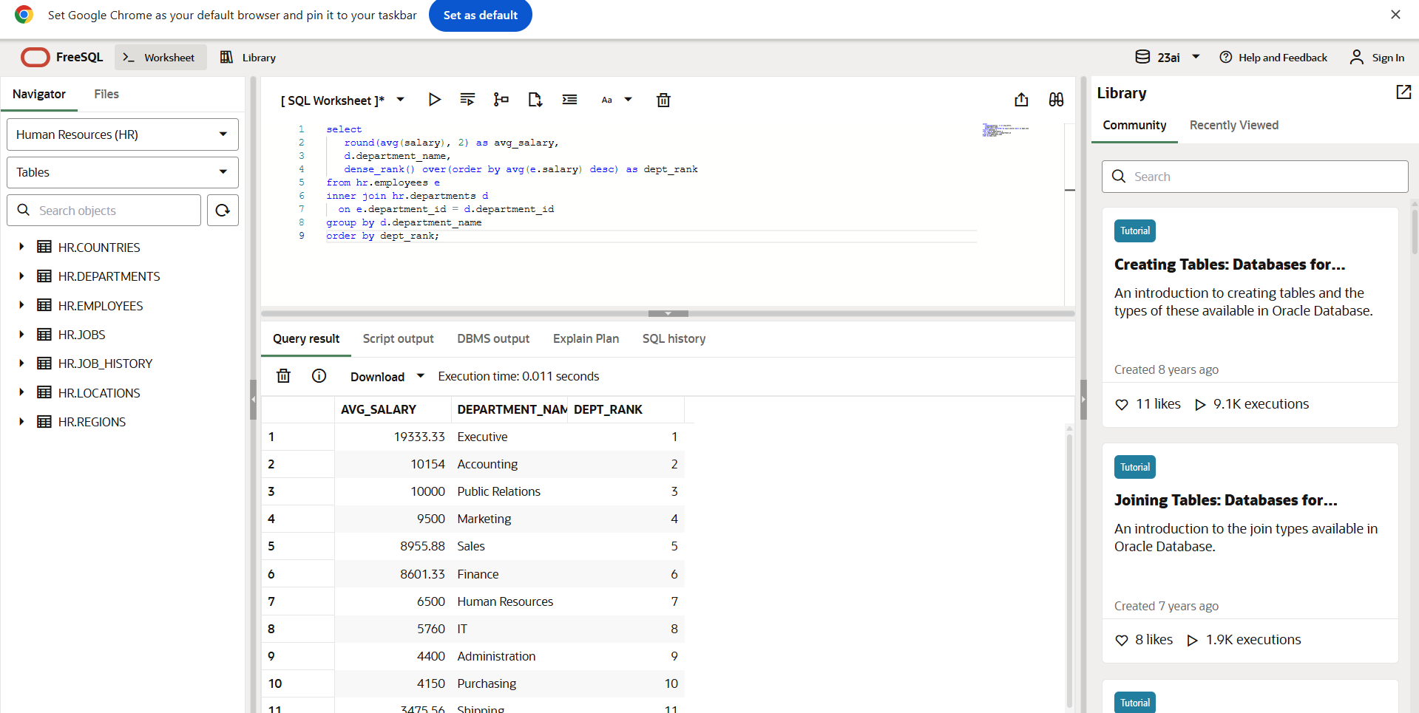
Notes:
This query calculates the average of salary for each department and ranks the departments based on their average salaries.

Slide 6
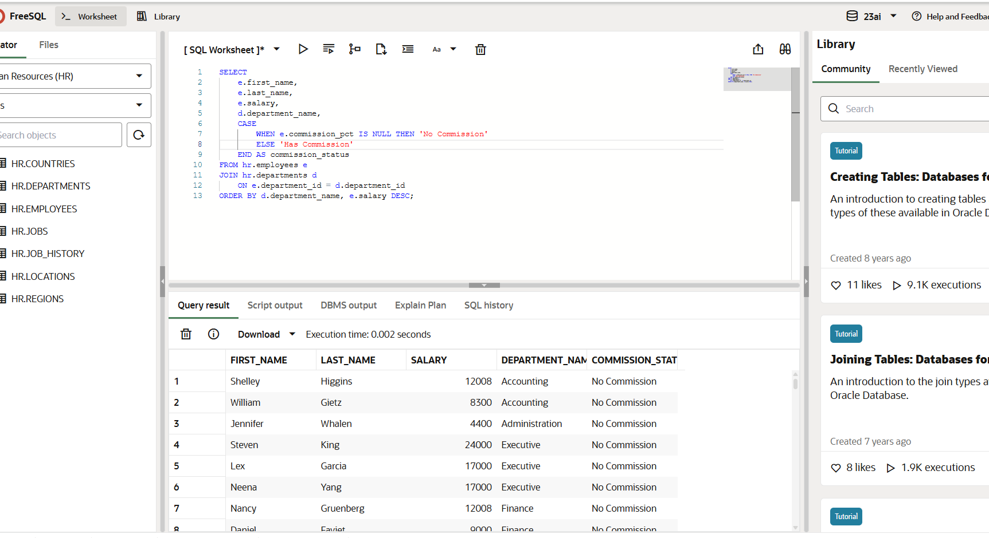
Notes:
This query lists all employees and categorizes them as ‘has commission’ or ‘no commission’ using a case when statement.

Slide 7
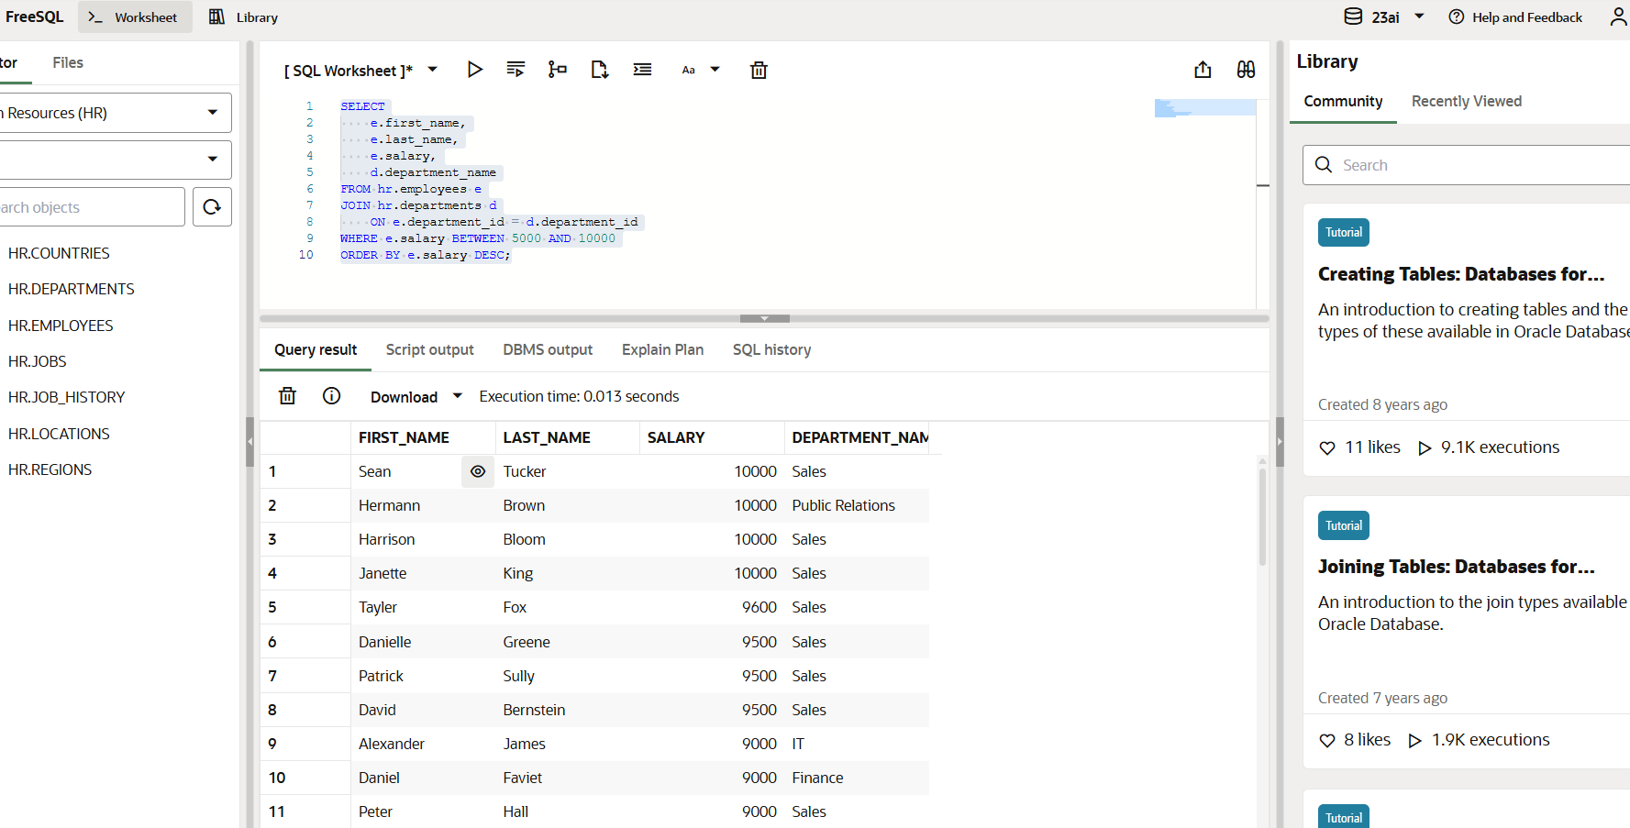
Notes:
This query lists employees whose salaries between 5000 and 10000 using between operator.

Slide 8
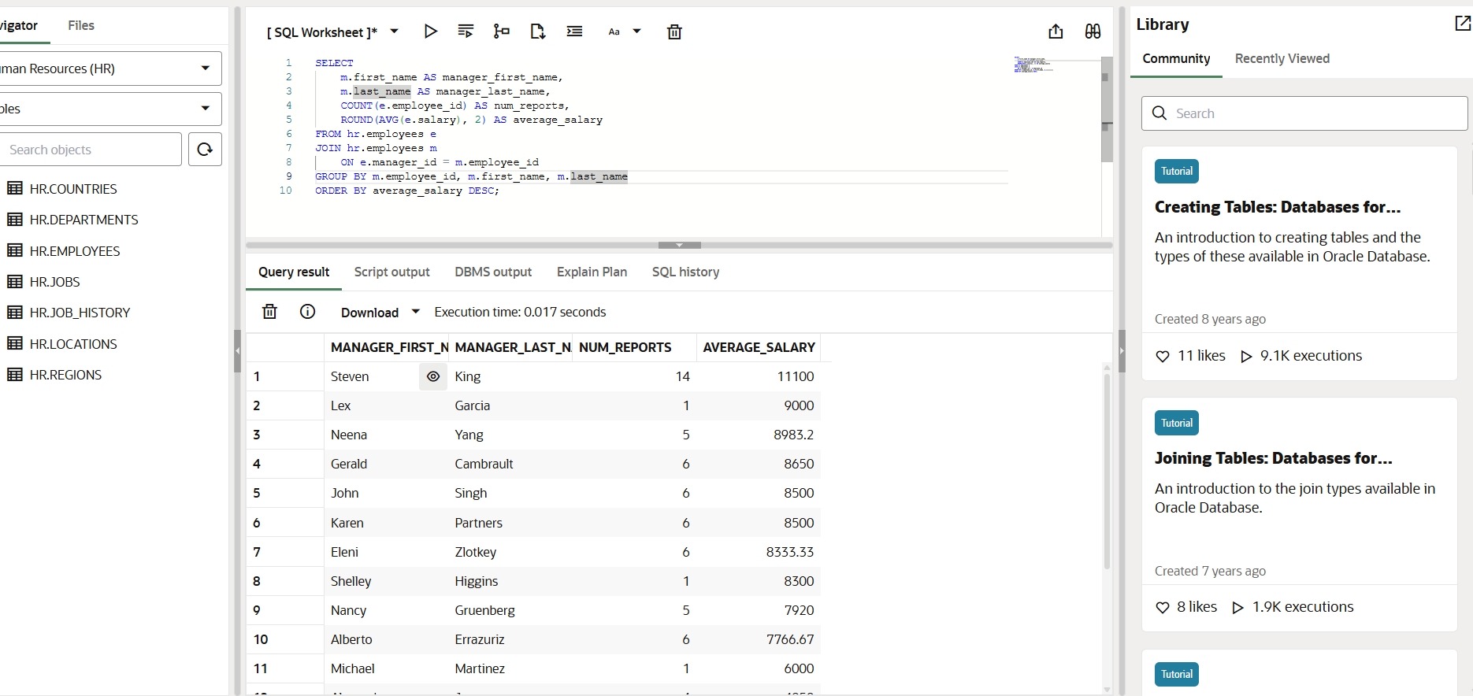
Notes:
This query analyzes manager performance by showing for each manager,the number of direct reports and the average salary of their team.

Slide 9
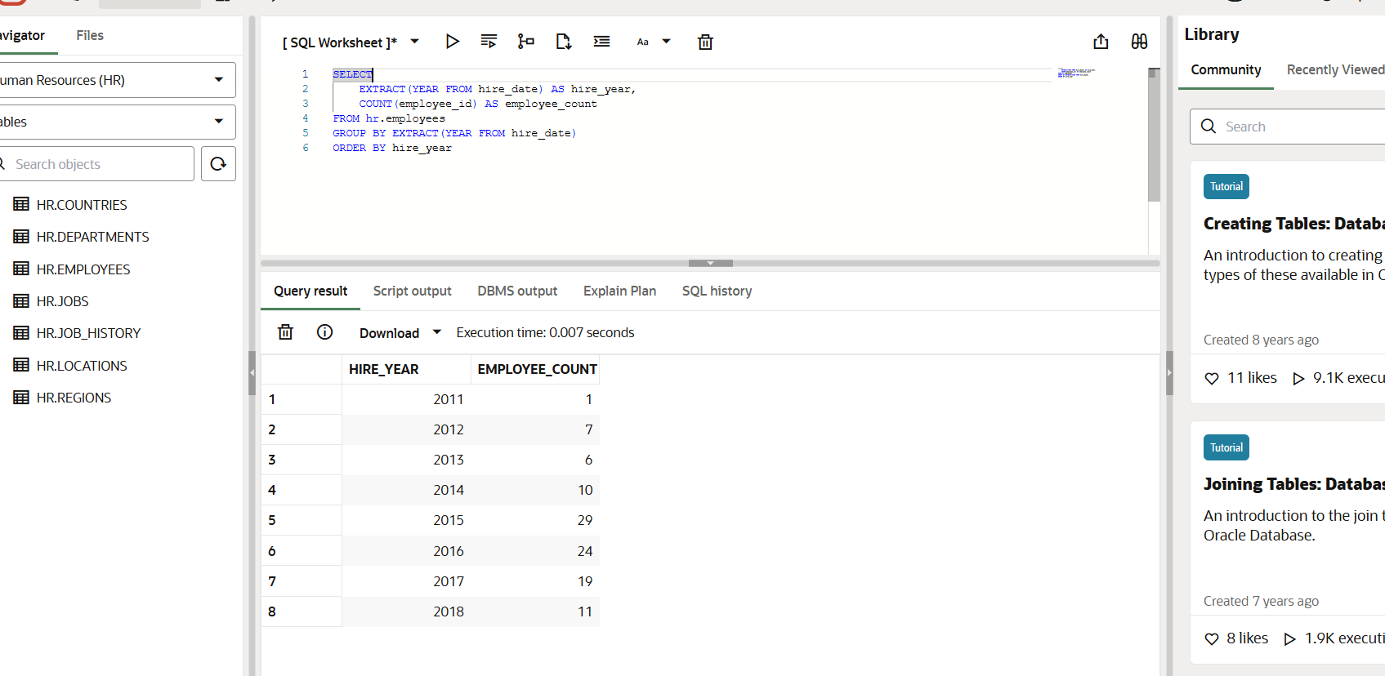
Notes:
Count how many employees were hired each year and count employees.

Slide 10
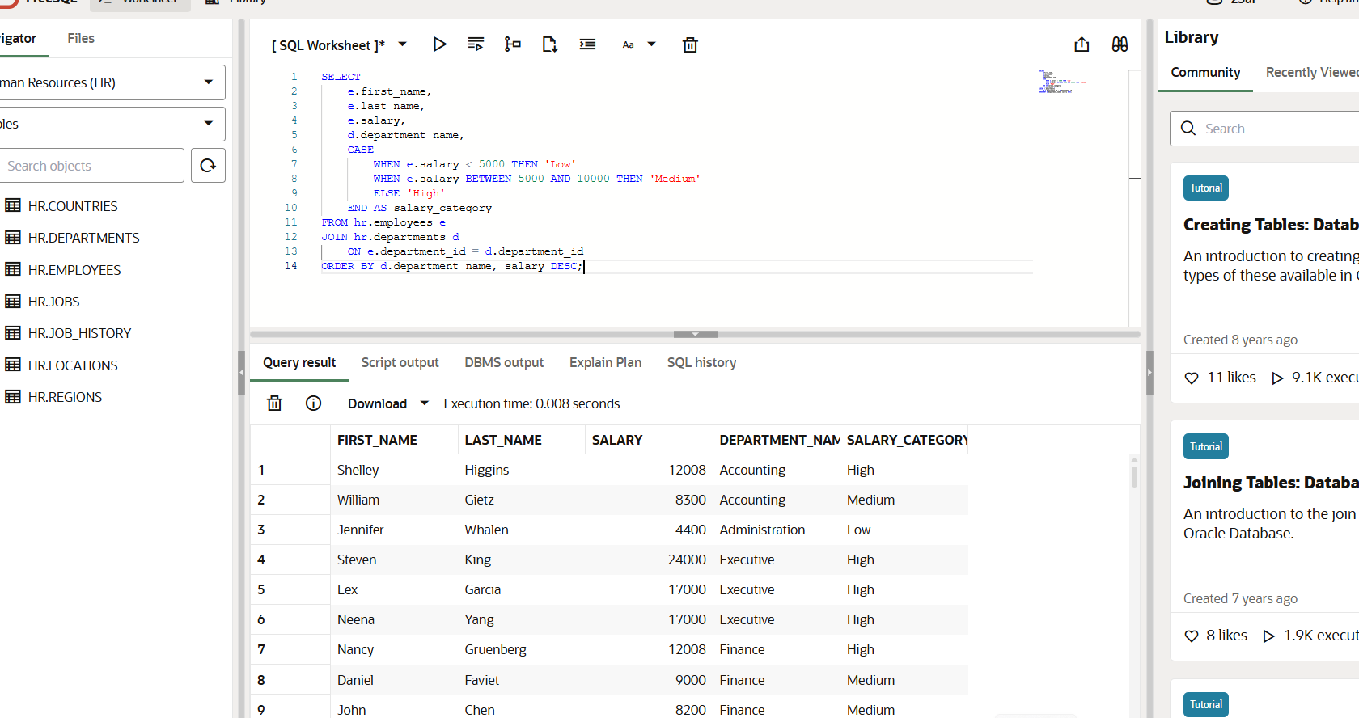
Notes:
This query categorized into salary bands “low” medium or high based on their salary.It also shows which department each employee belongs.

