Slide 1


FINAL YEAR PROJECT FOR THE PREOFESSIONAL BACHELOR’S DEGREE:
Title:
« Design and development of a maintenance management application for all types of equipment »
Notes:
Thank you for giving me the floor. Ladies and gentlemen, good morning. We are pleased to present the oral presentation delivered by one of our team members last year, entitled: 'Design and Development of a Maintenance Management Application for All Types of Equipment,' here before you today.
( clic)

Slide 2
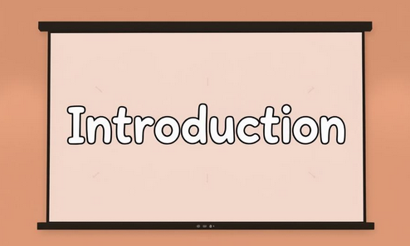
Notes:
Manually managing equipment at the urban commune of Fianarantsoa complicates the tracking of maintenance operations. To simplify this process, we designed an application that allows for the quick and efficient recording and monitoring of maintenance interventions. This solution facilitates equipment management by centralizing necessary information for optimal tracking and significant time savings, all while ensuring better organization.

Slide 3
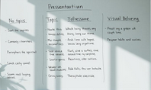
Presentation Plan
Presentation
Presentation of ENI, CUF, and the project
1
Analysis and Design
General Introduction to the Project and Its Features
2
Demonstration
Application Presentation
3
Notes:
Without further ado, here is the outline of this presentation: In the first part, we will present ENI, the Urban Commune of Fianarantsoa (CUF), and the project itself. Then, in the second part, we will go over the needs analysis and the design of the solution. I will explain the choices made to meet the project's requirements. Finally, in the third part, we will conclude with a demonstration to illustrate how the application works by showing the results achieved.
(clics)

Slide 4

Part I : Presentations
Presentation of ENI
ENI is a university specializing in computer science.
Presentation of UCF
The CUF is the Urban Commune of Fianarantsoa.
1
2
Projet description
The Objective and Features of the Application
3
Notes:
Now, moving on to the presentations of ENI, UCF, and the project

Slide 5

Presentation of ENI
Headquarter
Its headquarter is located in Tanambao, Fianarantsoa
Creation
ENI was established in 1983.
Mission
ENI trains technicians and engineers in computer science.
Program
ENI offers several specializations and study tracks.
Notes:
Let’s start with the presentatoin of ENI,
The National School of Computer Science (ENI) was founded on May 24, 1983, and its headquarters are located in Antanambao, Antaninarenina, in Fianarantsoa. It is part of the University of Fianarantsoa and specializes in training high-level technicians and engineers to meet the growing needs of the technological and scientific sectors. Its goal is to be a key driver for the dissemination of computer knowledge and technologies in the country.
ENI offers several training programs through its various specializations:
The Computer Science specialization offers training in Software Engineering and Databases, Systems and Network Administration, and General Computer Science.
The Artificial Intelligence (AI) specialization, launched recently, consists of two tracks: Governance and Data Engineering (GID) and Connected Objects and Cybersecurity (OCC).
The Digital Expertise specialization, created this year, offers two new tracks: the Digital Professions Track and the Information Systems Auditing (ASI)

Slide 6
Presentation of UCF
Creation
UCF was established in 1959.
Headquarter
Its headquarter is located in Tsianolondroa Fianarantsoa.
1
2
Mission
The UCF handles the administrative and financial functions of the commune.
3
Notes:
Passant maintenant à la présentation de la CUF
La CUF a été formellement créée en 1959, il y a actuellement 65 ans, et son siège est situé à Tsianolondroa Fianarantsoa. Elle est administrée par Ratsimbazafy Sahondramalala Esther.
La Commune Urbaine de Fianarantsoa assure :
- Les services administratifs
- Le développement économique
- La protection environnementale

Slide 7
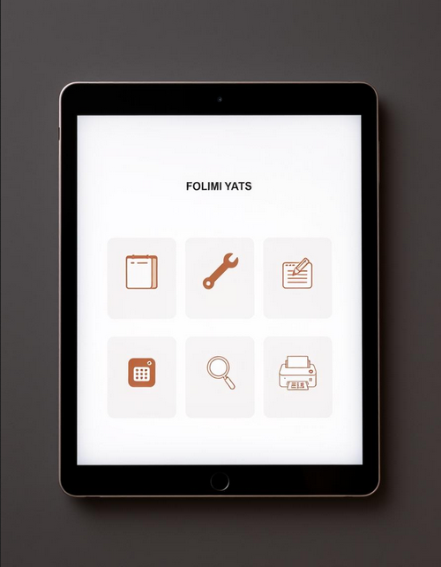
Description of the projet
Objective
To facilitate the work of the maintenance agent
1
Features
- Data management.
2
- Maintenance history.
- PDF printing of history records.
- Dashboard
- Sending mails to technicians.
Notes:
Now, let's move on to the project description. This project aims to modernize and optimize the management of maintenance activities to make operations more efficient and reliable. To achieve this objective, the key features implemented are as follows:
Data management with operations such as adding, modifying, deleting, and searching;
Structured tracking through maintenance history and the ability to export this history in PDF format;
Facilitated communication with the sending of emails to the relevant technicians;
An interactive dashboard providing an overview of maintenance operations.

Slide 8





Part II : Analysis and design
Existing system study
Understanding current maintenance processes
Modeling
Representation of data and processes,
Solutions
Proposed solutions to address the problems
Methodology and Tools
Methodology and tools for application development.
Notes:
Now that we have finished the presentations, let’s move on to Part II: Analysis and Design, a crucial step in the project development process. This section highlights the different phases that allowed us to transform needs into concrete and suitable solutions.

Slide 9
Critique of the Existing System
Strengths
Simplicity and familiarity
Preservation of a traditional aspect
Immediate accessibility
Technological independence
Low cost
Flexibility
Weaknesses
Paper-based maintenance processing
Time loss due to paper handling
High risk of human errors
Difficulty in tracking and traceability
Risk of losing or damaging records
Lack of data security
Notes:
Currently, the maintenance technician’s work is carried out entirely manually, with data management relying on paper records. Although this method is simple, familiar, and low-cost, it has many limitations. Indeed, it causes significant time loss during document handling, increases the risk of human errors, and complicates the tracking and traceability of operations. Moreover, paper records are vulnerable to loss or damage, which compromises the preservation of information. Finally, data security is also weak, posing an additional risk.

Slide 10

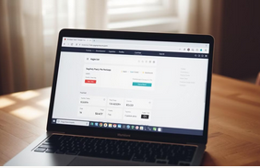

Proposed solutions
Solution 1
Develop a material maintenance management application.
Solution 2
Buy an off-the-shelf application
Solution 3
Outsource management to an IT services company for regular and efficient monitoring
Notes:
To address the issues related to the manual management of equipment maintenance within the UCF, three solutions were considered:
The first is to develop a maintenance management application.
The second is to purchase an off-the-shelf application such as MaintainX ($19–$49) or Fiix ($45–$75).
The third solution involves outsourcing equipment management to a Digital Service Company for regular professional monitoring, allowing the commune to refocus on its core missions.
After thoroughly analyzing each of these solutions, the first one was chosen, taking into account the current situation.

Slide 11
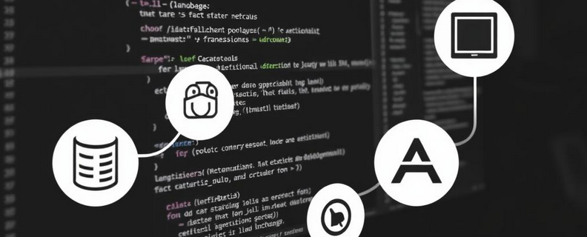




Methods and tools used
2TUP
UML
Notes:
The methods and tools utilized in this development are:
PostgreSQL: For data storage and management.
Visual Paradigm: A UML modeling tool for designing the application's architecture.
Django: A Python web framework for backend development.
Visual Studio Code: A code editor enabling efficient project management and development through its extensions.
2TUP: A design modeling method used for the application's process and flow diagrams.
UML: A standard modeling language used to design the structure and interactions of a software system.

Slide 12

Partie III : Application demonstration
Notes:
Now that we have finished the second part, we will continue with the demonstration of the application.

Slide 13
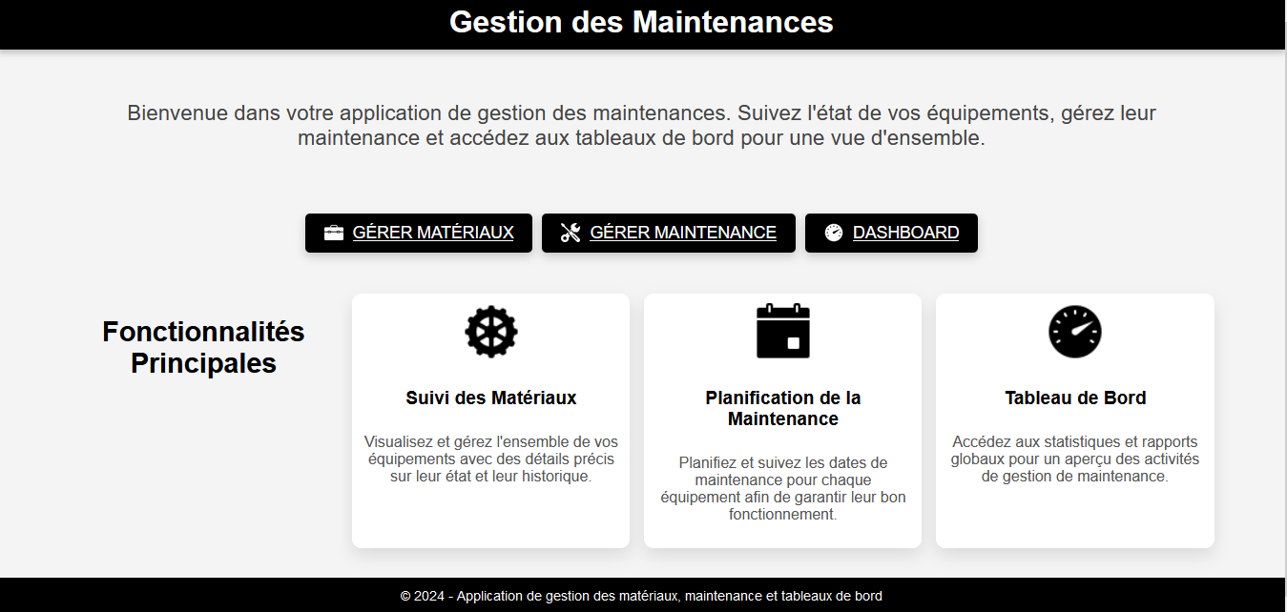
Notes:
Here is the application's home page. It includes links to the other pages, along with a description of what each page does.

Slide 14
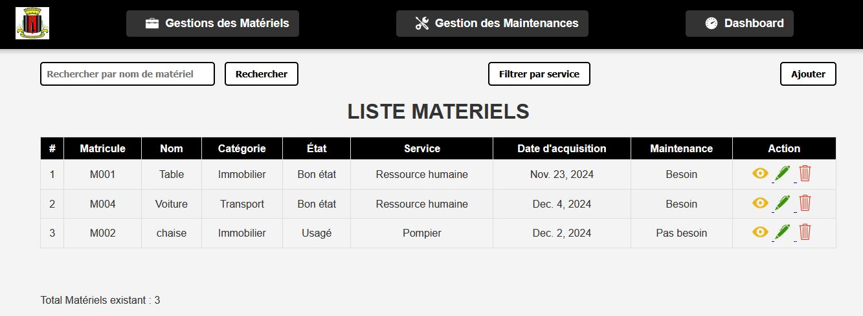
Notes:
After clicking on the first link, we arrive at this page: 'Equipment Management,' which contains all the equipment.

Slide 15
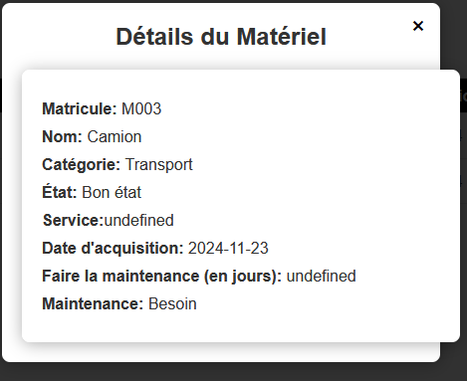
Notes:
After clicking on the eye-shaped icon, we get the details of the corresponding equipment

Slide 16
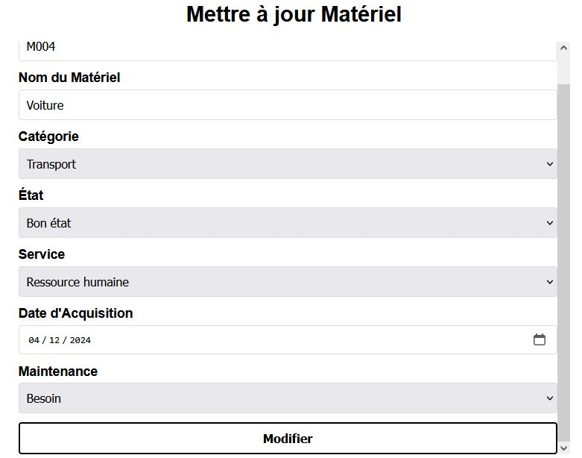
Notes:
Now, to edit a piece of equipment, you need to click on the pencil-shaped icon, make the desired changes, and when finished, click the 'Edit' button.

Slide 17
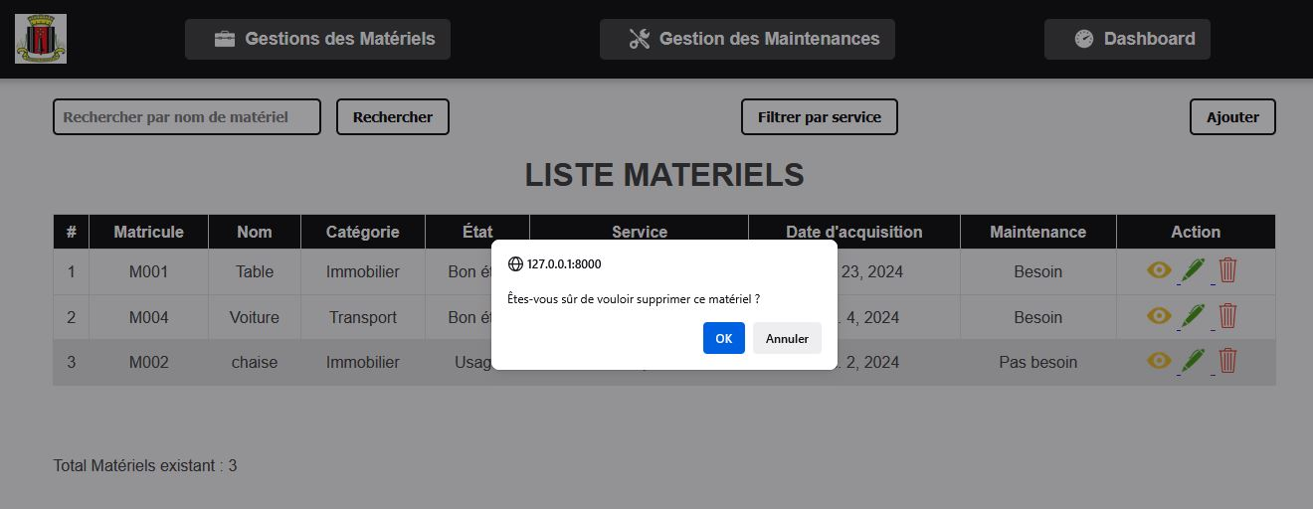
Notes:
To delete, click on the trash can icon, confirm, and the equipment will be deleted.

Slide 18
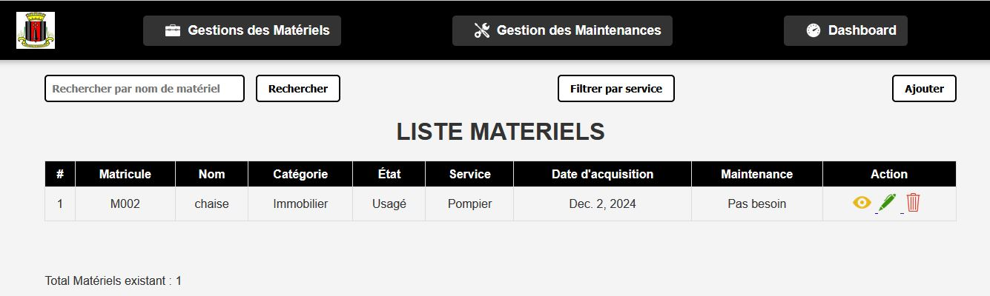
Notes:
We can also filter the equipment by department.

Slide 19
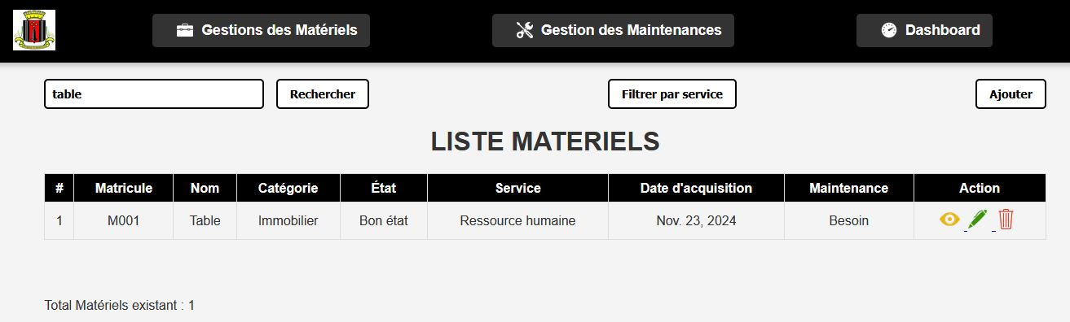
Notes:
We can also search for equipment by name; for example, here we are searching for all tables.

Slide 20
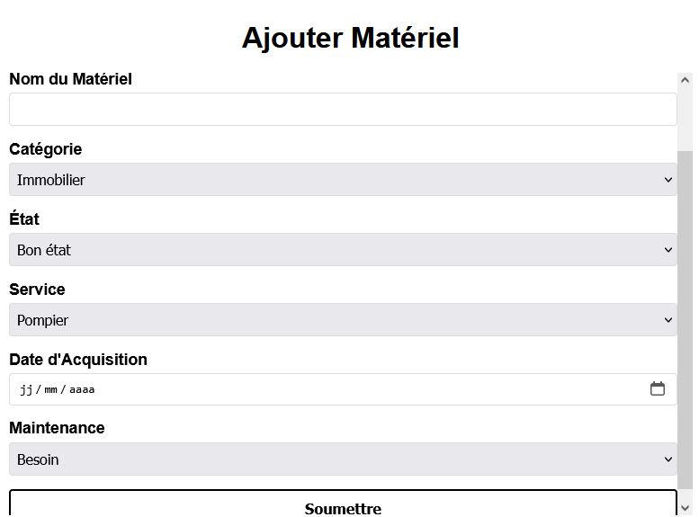
Notes:
To add a piece of equipment, click on the 'Add' button, fill out the form, then press the 'Submit' button.

Slide 21
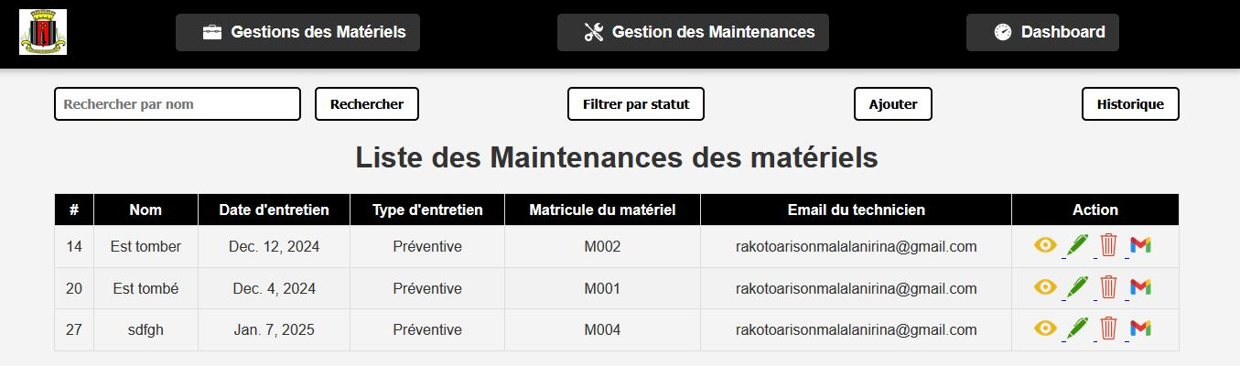
Notes:
Now, moving on to the maintenance management page. This page contains all the completed maintenance tasks. This page has the same features as the equipment management page, so we won’t show them again.

Slide 22
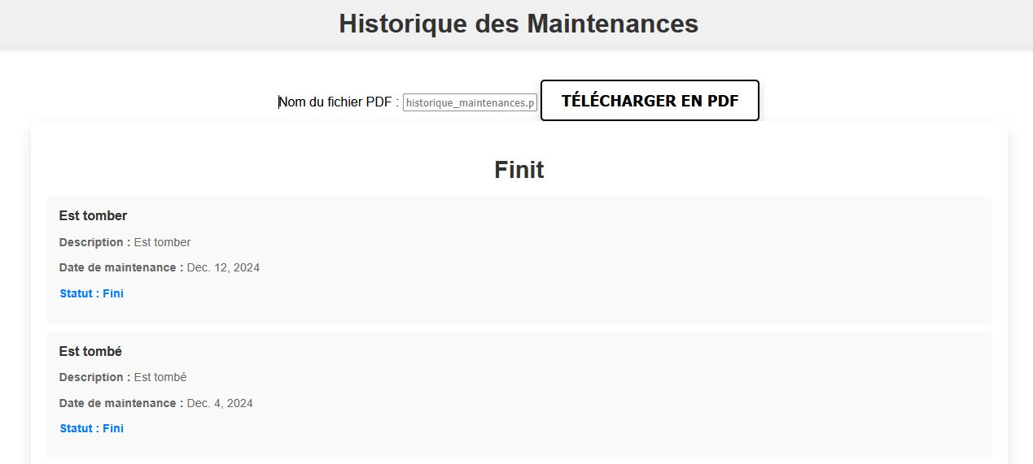
Notes:
Moving directly to the maintenance history. Here is the list of completed maintenance tasks for the equipment

Slide 23
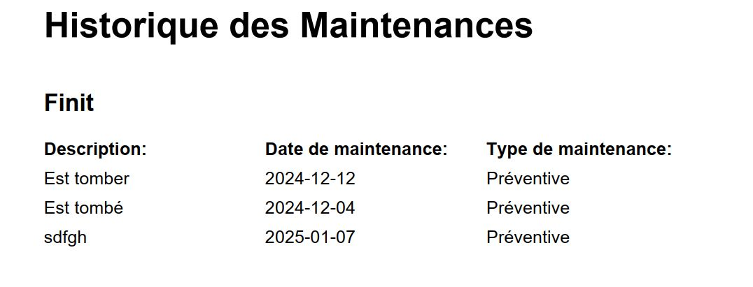
Notes:
And here is what the history looks like in PDF format for completed maintenance tasks

Slide 24
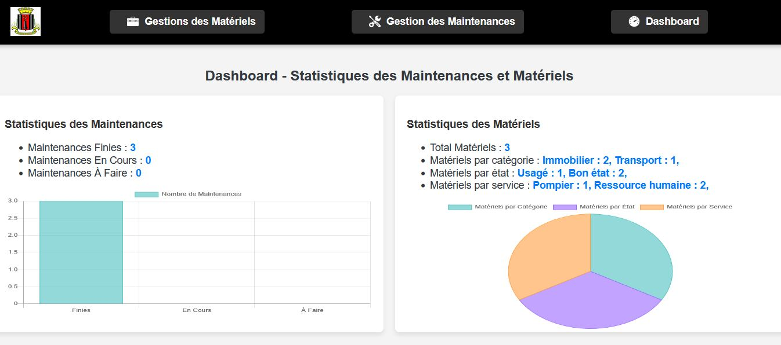
Notes:
Now, let's go to the dashboard page. On the left, we can see maintenance statistics by status — whether completed, in progress, or pending. On the right, we can see equipment statistics by category, condition, and department.

Slide 25
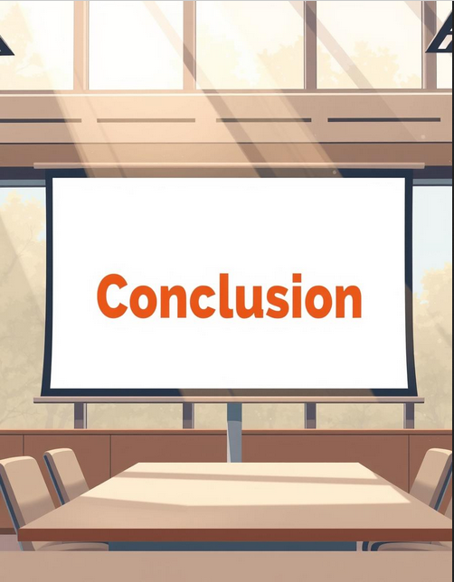
Notes:
To conclude, during the design and development of this application, all the features needed by the maintenance technician were added to eliminate manual work.

Slide 26

Thank you for staying with us until the end of the presentation.
Notes:
So, I would like to thank you for listening until the end. I apologize for any mistakes I may have made during this presentation. I am now available to receive your feedback.

