Slide 1
{“sessionName”:“Chat Bot/AI”}

Slide 2
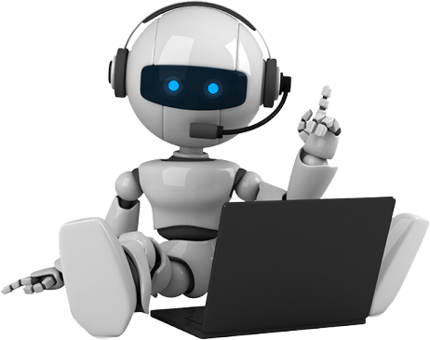
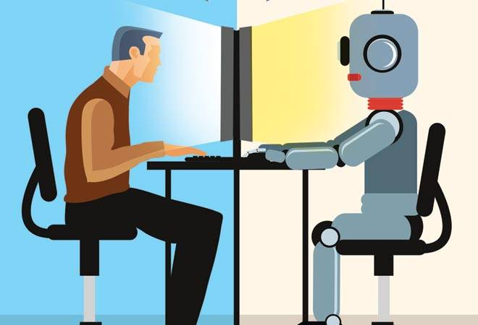
What we are going to discuss..?

Slide 3
What is a Chat bot?
A Computer program that stimulates human conversation or chat , through Artificial Intelligence.
Uses Artificial Intelligence Markup Language (AIML) to represent knowledge.
Can replace a human for monotonous jobs of answering queries, e.g. E-help desk.

Slide 4
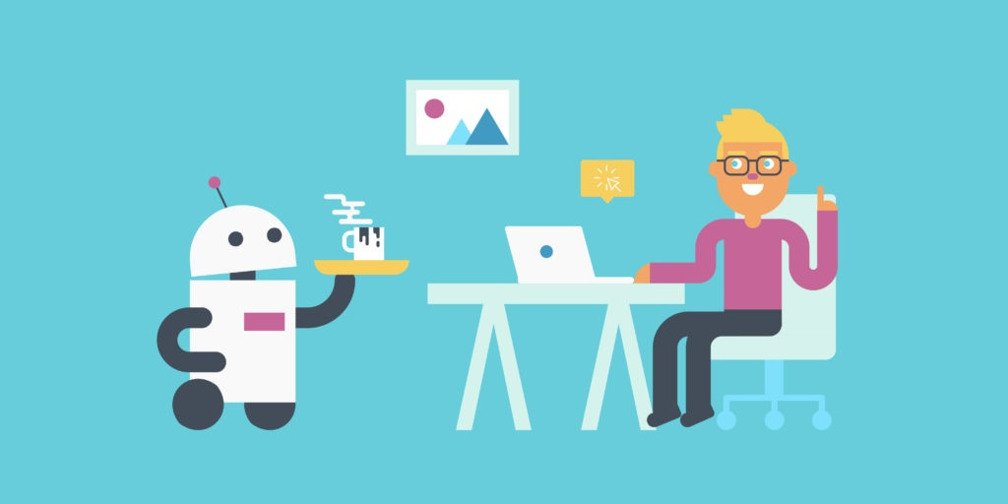
Where are they used ?
Personal Assistance
Notes:
Commercial chatter bots to help customers
At web-shops and e-commerce sites
To receive complains from users , online
Customer Support
Personal Assistance
Education
Entertainment
Health Care

Slide 5
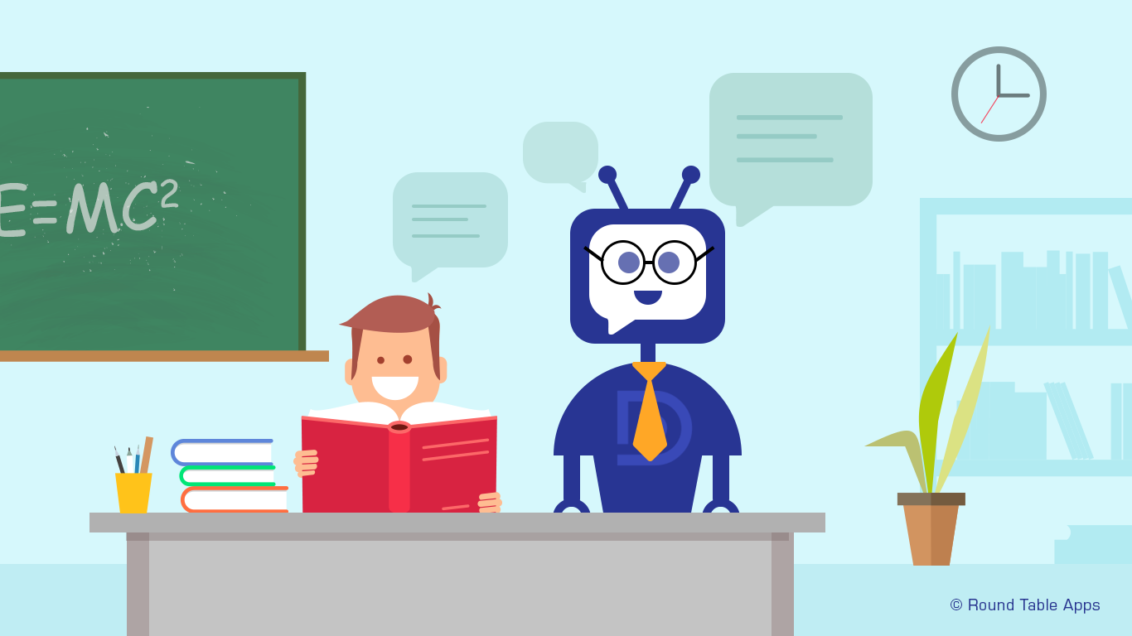
Education

Slide 6
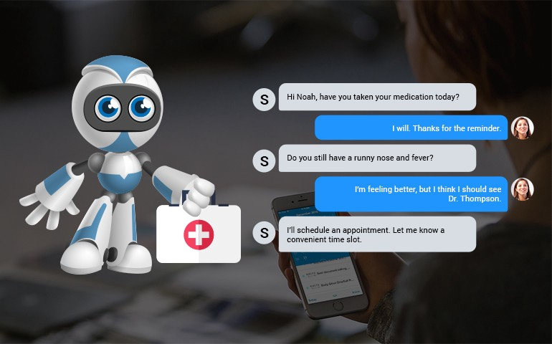
Personal Assistance

Slide 7
Why chat bots ?
Interactive experience > user engagement.
Distributable
Less user cognitive load
No human intervention

Slide 8
Bot development frameworks:
Microsoft Bot Framework
Wit.AI (Facebook Bot Engine)
DialogFlow (API.ai)
Rasa NLU

Slide 9
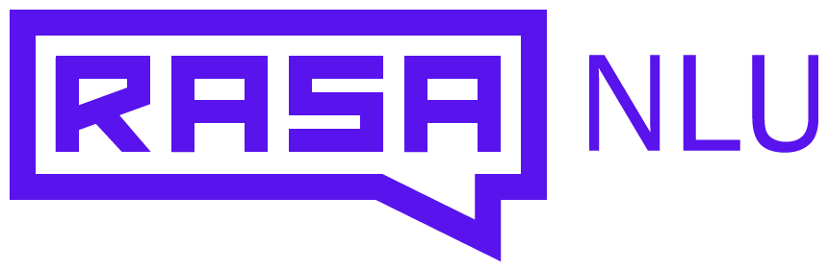
RASA NLU
Rasa is a framework for building conversational software: Messenger/Slack bots, Alexa skills, etc.
Rather than a bunch of if/else statements, the logic of your bot is based on a probabilistic model trained on example conversations.
Implementation :
The actions your bot can take in python code
Or use Rasa Core as a web service (HTTP server)
Notes:
Example ?

Slide 10
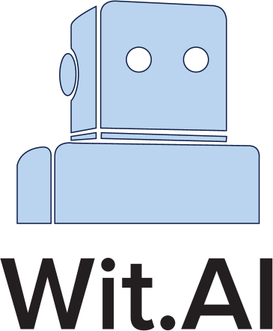
Wit.ai (facebook bot engine)
Wit is a natural language interface for applications capable of turning sentences into structured data.
No Dialogue Management Framework
You would need to implement DM yourself
Notes:
Example ?
Manual response setup
Wit.ai runs from its own server in the cloud, the Bot Engine is a wrapper built to deploy the bots in Facebook Messenger platform.

Slide 11

Dialog flow (api.ai)
Dialogflow is backed by Google and runs on Google infrastructure, which means you can scale to millions of users.
API.ai is built on few concepts such as agents, entities, intents, actions, and contexts.
API.ai can be integrated with many popular messaging, IoT and virtual assistant’s platforms.
Notes:
GUI based
Demo - example

Slide 12
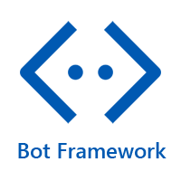
Microsoft bot framework
Microsoft Bot Framework gives just what we need to build, connect, manage and publish intelligent chat bots that interact naturally
It can be integrated with Slack, Facebook Messenger, Telegram, Webchat, GroupMe, SMS, email and Skype
Notes:
Example?

Slide 13
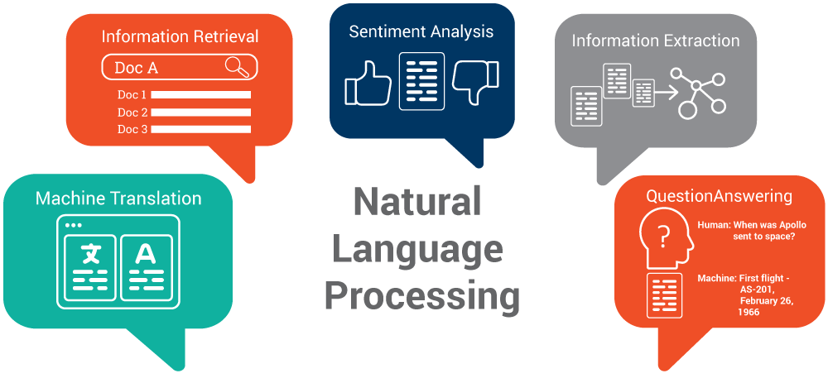
How Do Chat bots Work?
Natural language processing - Voice recognition - Google Allo, Apple’s Siri, and Microsoft’s Cortana.
Notes:
NLP is a field of computer science, artificial intelligence concerned with the interactions between computers and human (natural) languages, and, in particular, concerned with programming computers to fruitfully process large natural language data.
It also refers to AI method of communicating with an intelligent systems using a natural language such as English.
Processing of Natural Language is required when you want an intelligent system like robot to perform as per your instructions.
The input and output of an NLP system can be Speech, Written Text.

Slide 14
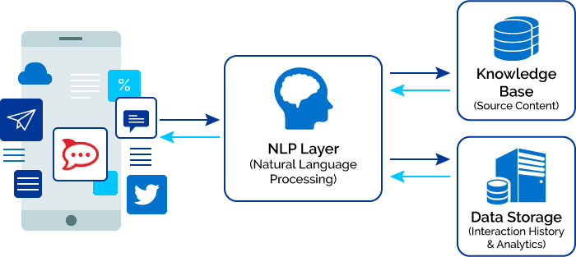
NLP ARCHITECTURE
Challenges in natural-language processing frequently involve speech recognition, natural-language understanding, and natural-language generation.

Slide 15
Components of NLP
Natural Language Understanding (NLU)
Mapping the given input in natural language into useful representations.
Analyzing different aspects of the language.
Natural Language Generation (NLG)
It is the process of producing meaningful phrases and sentences in the form of natural language from some internal representation
Text planning − It includes retrieving the relevant content from knowledge base.
Sentence planning − It includes choosing required words, forming meaningful phrases, setting tone of the sentence.
Text Realization − It is mapping sentence plan into sentence structure.

Slide 16
Difficulties in NLU
Lexical ambiguity − It is at very primitive level such as word-level. For example, treating the word “board” as noun or verb?
Syntax Level ambiguity − A sentence can be parsed in different ways. For example, “He lifted the beetle with red cap.” − Did he use cap to lift the beetle or he lifted a beetle that had red cap?
Referential ambiguity − Referring to something using pronouns. For example, A went to B. A said, “I am tired.” − Exactly who is tired?

Slide 17
Different types of bot platforms:
Facebook Messenger Bot
Slack Bot
Twitter Bot
Google Assistant
IBM Watson Bot

Slide 18

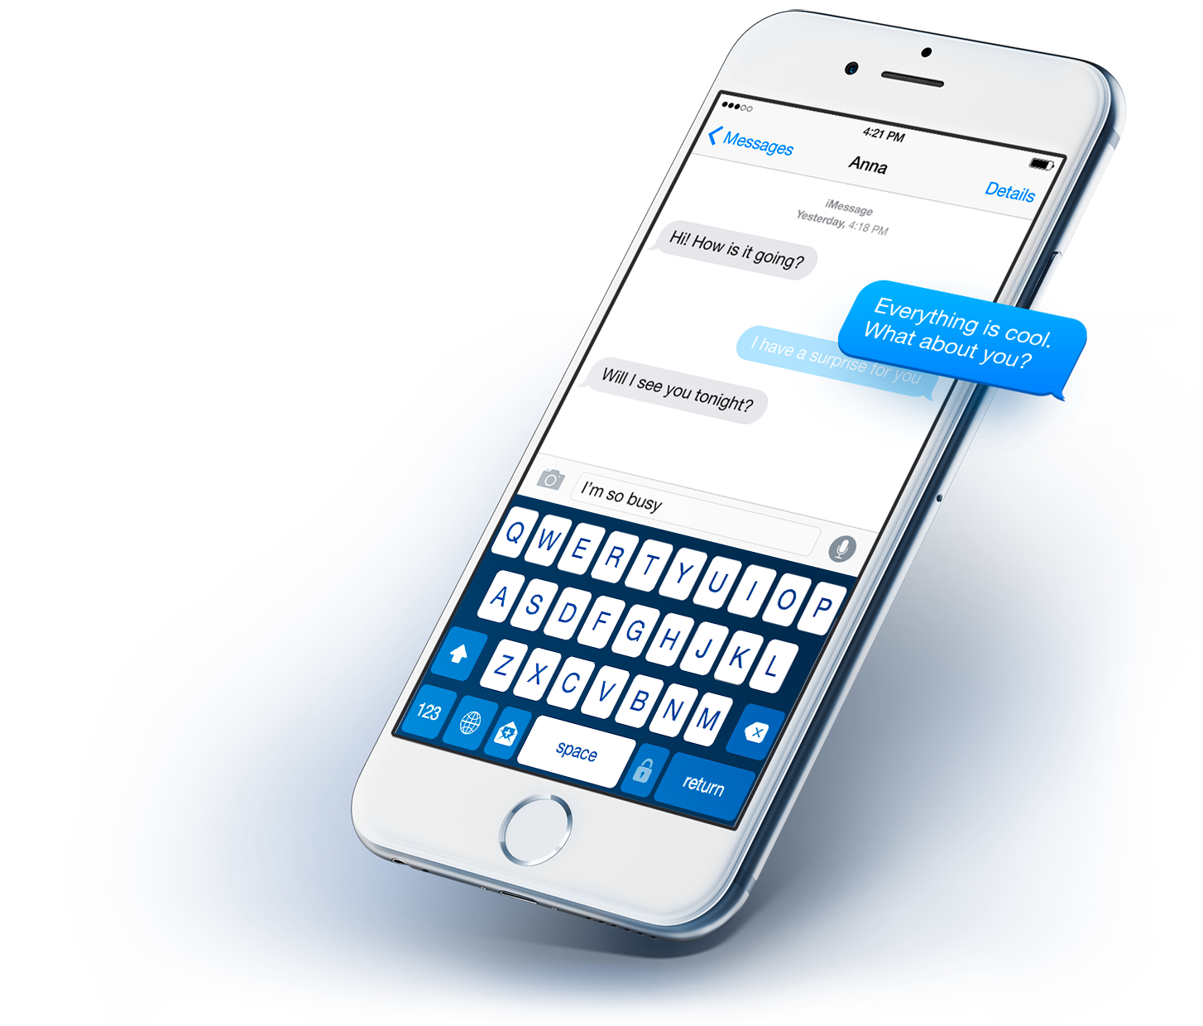
Face Book Messenger Bot:
A FB bot requires:
A Facebook app in which the Messenger platform has been activated
an Facebook page linked to the bot
a webserver with the bot logic – the "brain" of the bot
Notes:
Once you have met these conditions and have successfully linked your bot to a web server in the initial connection, you can go ahead and code the actual intelligence of your FB bot.

Slide 19

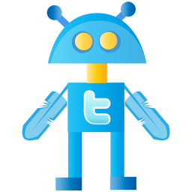
Twitter bot:
A Twitter bot – Automated tweets
Tweet mining and analyzing and integrating AI
Useful, informative, annoying or dangerous -- just like human tweeters
Notes:
Most Twitter bots work simply, sending out tweets periodically or responding to instances of specific phrases in user messages. More sophisticated Twitter bots perform various tasks, such as mining and analyzing tweets in real time. Socialbots, for example, incorporate artificial intelligence (AI) and sophisticated linguistic software to convincingly replicate human interaction.
Many Twitter bots are specialized for various purposes. Depending on what the particular purpose is, Twitter bots can be useful, informative, annoying or dangerous -- just like human tweeters

Slide 20
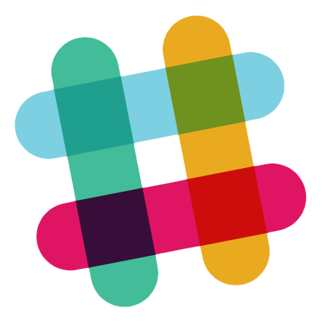
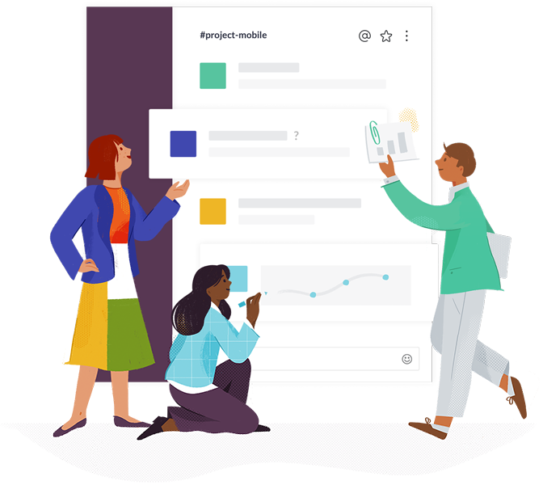
SLACK BOT:
Email management tools, sending reminders and notifications to team members, gathering and analyzing data, and even boosting company morale, the opportunities are endless.
Notes:
Slack chat bots, also known as Slack bots, can be designed to undertake a huge variety of tasks. From acting as email management tools, sending reminders and notifications to team members, gathering and analyzing data, and even boosting company morale, the opportunities are endless.
Slack bots are no different from typical chatbots; they're just found solely in Slack. These bots can be powered by rules or artificial intelligence (AI), natural language processing (NLP), and machine learning.

Slide 21
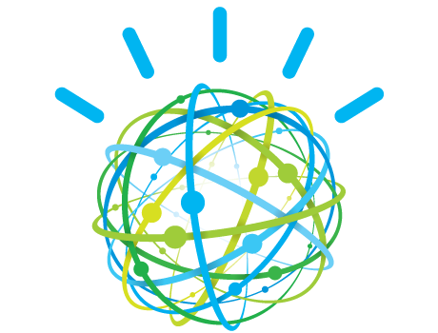
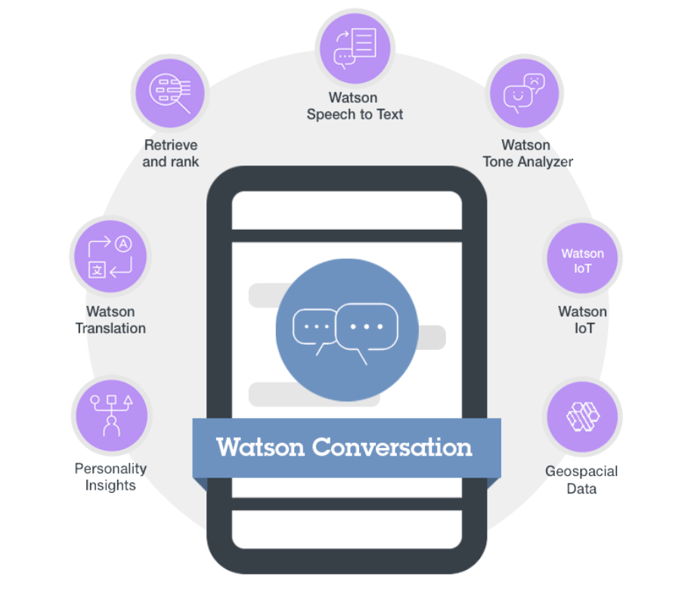
IBM WatsOn bot
Watson Bot is the question answering(QA) computing system that IBM built to apply advanced natural language processing, information retrieval, knowledge representation, automated reasoning, and machine learning technologies to the field of open domain question answering.

Slide 23
