Slide 1

How to improve dev process with hot-reloading your SPFx customization​
Stefan Bauer – N8D – https://n8d.at

Slide 2
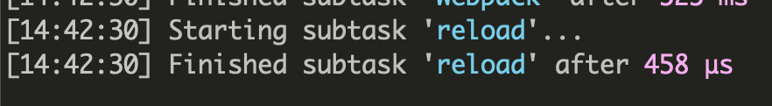

Slide 3
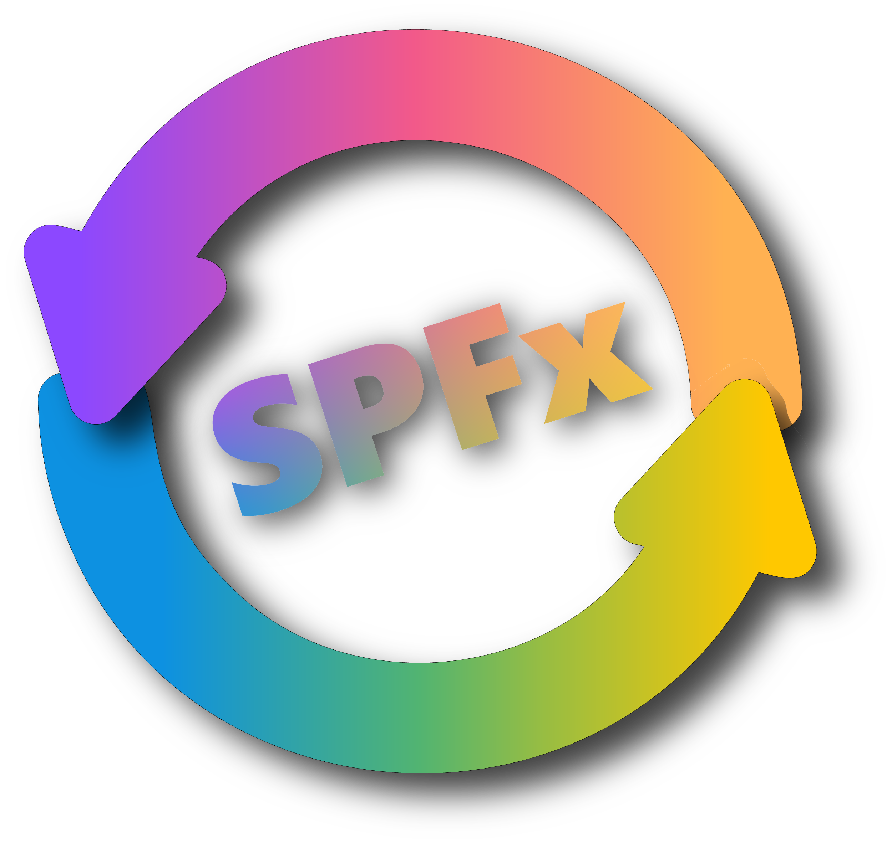
Pnp SPFx Live Reloader
https://github.com/pnp/sp-livereload/

Slide 4
PnP Live Reloader help you focus on your code – No more manual refresh of the browser window

Slide 5
Pnp SPFx Live Reloader – Future Features
Branding and Color Information
Fonts Info
Icon Finder SVG icons
Manifest Viewer
Performance Counter on Reload
What you think is missing

Slide 6
Further information
Web Socket – https://developer.mozilla.org/en-US/docs/Web/API/WebSocket HTWOO – https://lab.n8d.studio/htwoo/
Create site collection app catalog – M365 CLI
https://pnp.github.io/cli-microsoft365/sample-scripts/spo/add-app-catalog/ Make Liverreload on SharePoint Online Possible https://n8d.at/make-livereload-on-sharepoint-online-possible

