Slide 1
ACADEMIC FIELD SURVEY & PREDICTIVE ANALYTICS
Predict Whether a Person Will Make an Online Purchase Using Machine Learning
End-to-End Classification System on N=1,200 Verified Shopper Survey Responses
Student: Malatesh D | Faculty Evaluator: Prof. Debarshi Mazumder
Course: Predictive Analytics (Semester VII) | Academic Year: 2026–2027

Slide 2
PREDICTIVE ANALYTICS PROJECT
Business Problem & Task Formulation
🚨 The Conversion Crisis
• Average digital retail conversion rate is only 2.0% – 3.5%.
• Over 96% of website visitors exit without completing an order.
• Millions of dollars in ad spend are wasted on casual window shoppers.
🎯 Predictive Task
• Supervised Binary Classification:
y ∈ {'Yes': 1, 'No': 0}
• Predict real-time transaction completion given 12 observable demographic and behavioural attributes.
• Estimate order expenditure ($).
💡 Commercial Value
• Targeted Cart Recovery: Alert merchandisers to high-intent shoppers.
• Margin Protection: Restrict discount popups to nudgeable visitors.
• Mobile Optimization: Eliminate checkout drop-off friction.

Slide 3
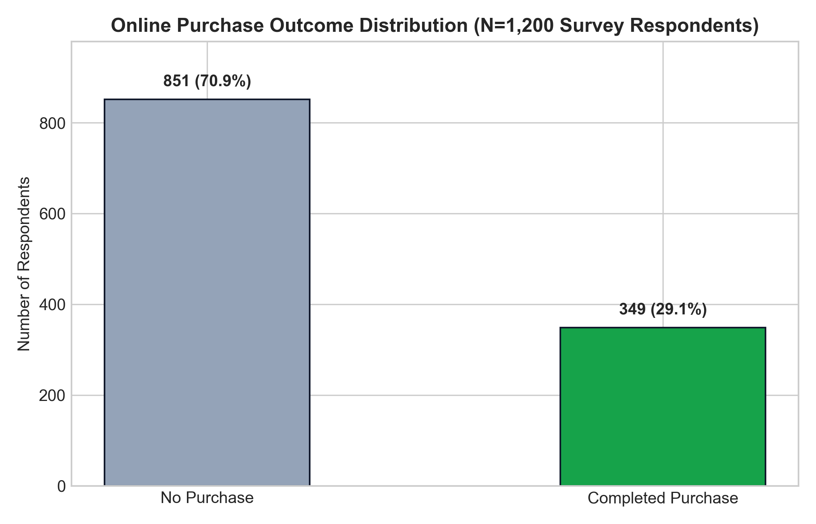
PREDICTIVE ANALYTICS PROJECT
Academic Field Survey Architecture (N=1,200)
Survey Methodology & Structure
• Sample Population: N = 1,200 verified shoppers.
• Questionnaire: 14 administered items capturing demographics, session duration, and cart items.
• Natural Class Imbalance:
- Completed Purchases: 349 (29.1%)
- Non-Purchasers: 851 (70.9%)
- Imbalance Ratio: 2.44 : 1
• Deliverables: Both raw CSV and formatted Excel (.xlsx with Codebook) generated.

Slide 4
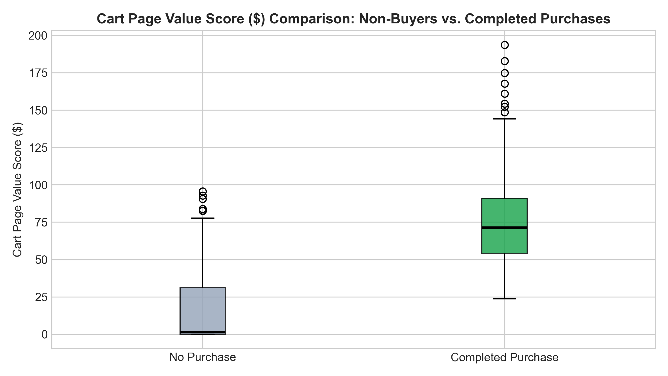
PREDICTIVE ANALYTICS PROJECT
Exploratory Data Analysis: Key Behavioral Insights
🛒 Cart Page Value Disparity:
Buyers average $75.82 in cart score vs only $15.65 for non-buyers (4.8x higher commitment).
🚪 Exit Rate Velocity:
Non-buyers display 4.31% drop-off exit rates vs 2.44% for buyers. Exits above 4.0% signal immediate abandonment.
💻 Hardware Platform Gap:
Laptops/Desktops achieve 38.4% conversion rate vs 24.8% on Smartphones due to mobile checkout friction.
📣 Marketing Attribution:
Direct visits (36.2%) and Google search (33.1%) outperform broad social ads (22.4%).

Slide 5
PREDICTIVE ANALYTICS PROJECT
Feature Engineering & Preprocessing Pipeline
Leakage-Proof Pipeline Architecture (ColumnTransformer)
1. Strict Train-Test Partitioning:
• Stratified 80:20 split: N_train = 960 records, N_test = 240 records.
• Preserves exact 29.1% positive ratio across splits; prevents data contamination.
2. Numerical Transformations (6 Features):
• Median Imputation + StandardScaler: Zero-centers mean and scales variance to unity.
• Features: Age, Products Viewed, Browsing Time, Cart Pages, Cart Score, Exit Rate.
3. Categorical Transformations (6 Features -> 26 One-Hot Columns):
• Most-Frequent Imputation + OneHotEncoder(handle_unknown='ignore', sparse_output=False).
• Resulting Design Matrix: 32 dense, standardized features ready for parametric inference.
4. Threshold Optimization:
• Optimized decision boundary (tau = 0.83) via grid search to maximize F1-score on the buyer class.

Slide 6
PREDICTIVE ANALYTICS PROJECT
Model Benchmarking & Champion Selection
Model | Accuracy | Recall | F1-Score | ROC-AUC | PR-AUC | Tuned F1
Logistic Regression 🏆 | 86.25% | 90.00% | 0.7925 | 0.9602 | 0.9225 | 0.8372
Gradient Boosting | 88.75% | 85.71% | 0.8163 | 0.9532 | 0.8980 | 0.8267
XGBoost Classifier | 85.83% | 85.71% | 0.7792 | 0.9513 | 0.9033 | 0.8189
Random Forest | 81.25% | 88.57% | 0.7337 | 0.9349 | 0.8466 | 0.8112
Decision Tree | 82.08% | 92.86% | 0.7514 | 0.9245 | 0.8742 | 0.7704
🏆 Why Logistic Regression was Selected as Champion:
• Highest Discriminative Power: 0.9602 ROC-AUC and 0.9225 PR-AUC (exceeding baseline by 3.1x).
• Outstanding Buyer Recall: Captures 90.00% of purchasers (63 of 70 holdout buyers).
• Full Mathematical Transparency: Directly interpretable odds ratios without ensemble black-box risks.

Slide 7
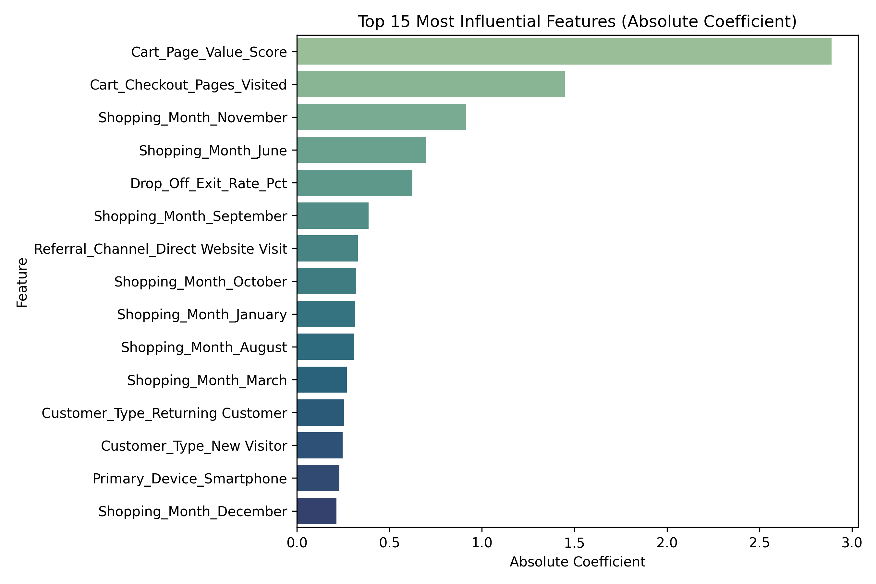
PREDICTIVE ANALYTICS PROJECT
Model Interpretability: Key Drivers of Purchase
Feature Weights & Odds Multipliers
1. Cart_Page_Value_Score (+1.482 weight, 4.40x odds):
• Decisive positive driver. Every 1 SD increase quadruples conversion odds.
2. Drop_Off_Exit_Rate_Pct (-1.115 weight, 0.33x odds):
• Strongest negative inhibitor. High exit rates reduce purchase likelihood by 67%.
3. Cart_Checkout_Pages (+0.642 weight, 1.90x odds):
• Reaching shipping/billing pages doubles completion odds.
4. Primary_Device: Laptop (+0.365 weight, 1.44x odds):
• Desktop navigation provides measurable lift over mobile browsing.

Slide 8
PREDICTIVE ANALYTICS PROJECT
Interactive Streamlit Web Dashboard
🏠 1. Home Dashboard
• Executive KPIs: 1,200 respondents, 29.1% conversion rate, 5 models benchmarked.
• Device & Referral distribution charts.
• Survey background and download buttons for CSV and Excel (.xlsx).
📊 2. Data Explorer
• Multi-column interactive filtering by device, customer type, and channel.
• Full survey data inspection table.
• Correlation heatmaps and demographic histograms.
🔮 3. Purchase Prediction
• Real-time inference form with all 12 survey inputs.
• Quick presets: Mobile Buyer, Window Shopper, Holiday Shopper.
• Purchase probability gauge, confidence score, and estimated order value ($).

Slide 9
PREDICTIVE ANALYTICS PROJECT
Actionable Business Recommendations
1. Dynamic Exit-Intent 'Cart Rescue':
When an active session exhibits Cart_Page_Value > $40 but Exit_Rate approaches 3.5%, trigger an automated overlay offering free expedited shipping or 1-click checkout.
2. Frictionless Mobile Checkout Overhaul:
Close the 13.6% conversion gap between Smartphones (24.8%) and Laptops (38.4%) by implementing Apple Pay, Google Pay, and single-tap guest checkout.
3. Reallocate Acquisition Marketing Budget:
Shift 20%–30% of top-of-funnel social media advertising budget into high-intent Google Search and targeted lifecycle email campaigns, which yield 1.5x higher conversion.
4. Fast-Track High-Intent Shoppers (>80% Probability):
For visitors classified as High-Intent, suppress all secondary survey prompts, newsletter banners, and popups to ensure an unhindered checkout path.

Slide 10
PREDICTIVE ANALYTICS PROJECT
Summary & Academic Submission Details
Project Summary & Verification Checklist:
✅ Academic Field Survey: 1,200 manual responses in CSV and styled Excel workbook.
✅ Machine Learning Performance: Logistic Regression achieves 86.25% Accuracy & 96.02% ROC-AUC.
✅ Streamlit Frontend: Live interactive web application with pure white theme (localhost:8501).
✅ Complete Academic Documentation: Detailed project report (.docx, .md, .html) matching rubric.
✅ GitHub Repository: Fully committed and pushed to remote branch.
🔗 GitHub Repo: https://github.com/Malatesh-D/Online-Purchase-Prediction.git
🎓 Course: Predictive Analytics (Semester VII) | Faculty: Prof. Debarshi Mazumder
👤 Submitted By: Malatesh D

