Slide 1
MACHINE LEARNING CLUSTERING

Slide 2
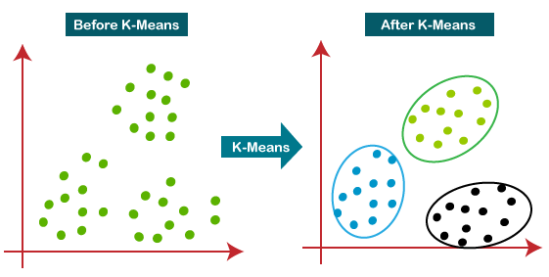
K-Means Clustering
Partitions data into K clusters by minimizing the distance between points and their assigned cluster centroids.

Slide 3
Application:
Popular for customer segmentation, image compression, and anomaly detection.
Advantages:
Simple and fast for large datasets.
Easy to interpret results.
Disadvantages:
Requires specifying the number of clusters.
Sensitive to outliers and initial placement.

Slide 4
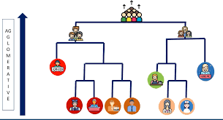
Agglomerative Clustering (Hierarchical Clustering)
Definition: Builds clusters by progressively merging the closest pairs, creating a hierarchy of clusters.

Slide 5
Application:
Gene expression data analysis, market segmentation.
Advantages:
No need to predefine the number of clusters.
Dendrogram visualization helps determine the optimal number of clusters.
Disadvantages:
Slow for large datasets.
Sensitive to noisy data and outliers.

Slide 6
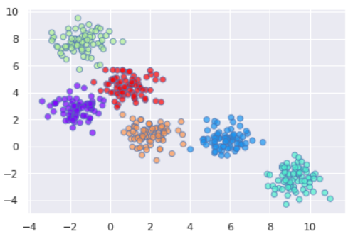
BIRCH Clustering (Balanced Iterative Reducing and Clustering using Hierarchies)
Definition: Iteratively reduces data to form compact representations, using these representations to form clusters.

Slide 7
Application:
Efficiently handles large-scale datasets, spatial data clustering.
Advantages:
Scalable to large datasets.
Handles noisy data and outliers well.
Disadvantages:
Not suitable for small datasets.
Requires tuning of thresholds and branching factors.

Slide 8
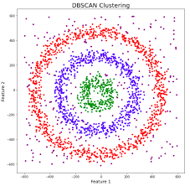
DBSCAN (Density-Based Spatial Clustering of Applications with Noise)
Clusters based on data density, identifying dense regions as clusters and marking sparse areas as noise.

Slide 9
Application:
Geospatial data, identifying anomalies in datasets.
Advantages:
Automatically determines the number of clusters.
Can handle noise and arbitrary-shaped clusters.
Disadvantages:
Struggles with varying densities.
Sensitive to distance and minimum sample parameters.

Slide 10
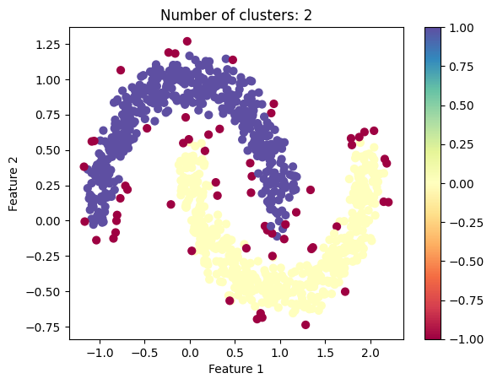
HDBSCAN (Hierarchical Density-Based Spatial Clustering)
Similar to DBSCAN, but produces a reachability plot for clusters at varying densities.

Slide 11
Application:
Geospatial data, biological data clustering.
Advantages:
No need to define a cluster number.
Handles variable density clusters well.
Disadvantages:
More complex than DBSCAN.
May require parameter tuning.

Slide 12
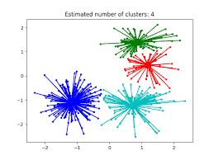
AFFINITY PROPAGATION CLUSTERING
Affinity Propagation is based on the concept of “message-passing” between data points to identify cluster centres and assign data points to these centres automatically.
It utilizes “exemplars,” which are typical data points representing other data points within the same cluster.

Slide 13
Application: Face clustering, social network analysis. Advantages: Automatically determines the number of clusters. Works well with non-convex clusters. Disadvantages: High memory usage. Sensitive to input parameters.

Slide 14
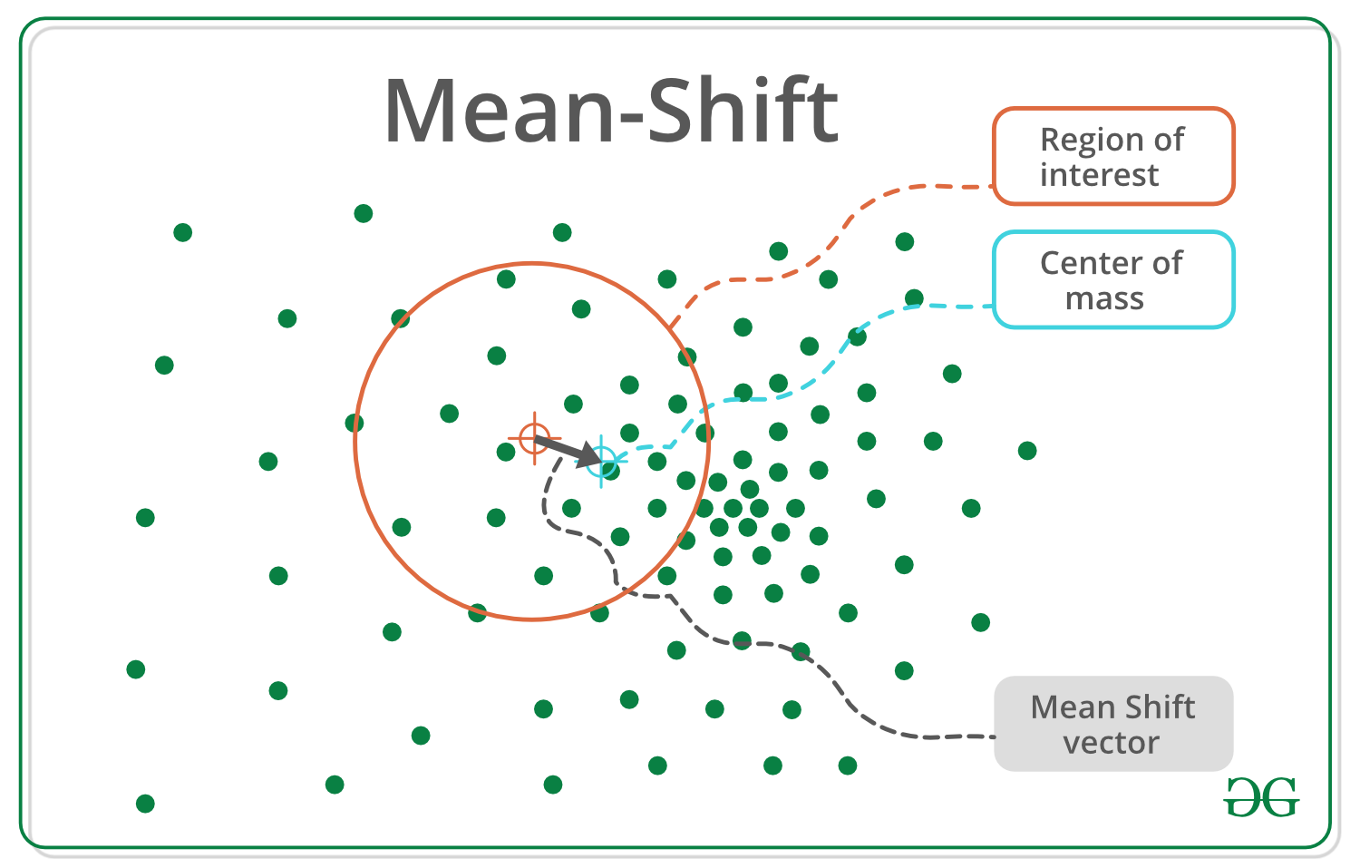
MEAN SHIFT CLUSTERING Meanshift is falling under the category of a clustering algorithm in contrast of Unsupervised learning that assigns the data points to the clusters iteratively by shifting points towards the mode.

Slide 15
Application: Image segmentation, object tracking, background modeling. Advantages: No need to specify the number of clusters. Can handle arbitrarily shaped clusters. Disadvantages: Computationally intensive. Sensitive to bandwidth parameter.

Slide 16
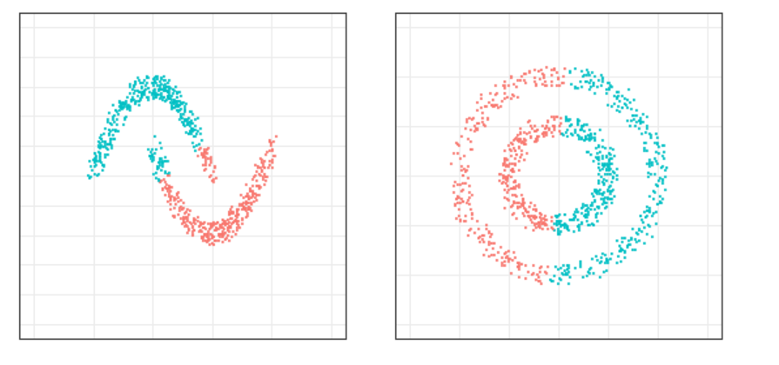
Spectral Clustering Spectral Clustering is a variant of the clustering algorithm that uses the connectivity between the data points to form the clustering.

Slide 17
Application: Image segmentation, graph data clustering. Advantages: Effective for complex-shaped clusters. Suitable for data with intricate structures. Disadvantages: Slow on large datasets. Requires tuning of the similarity graph.

Slide 18
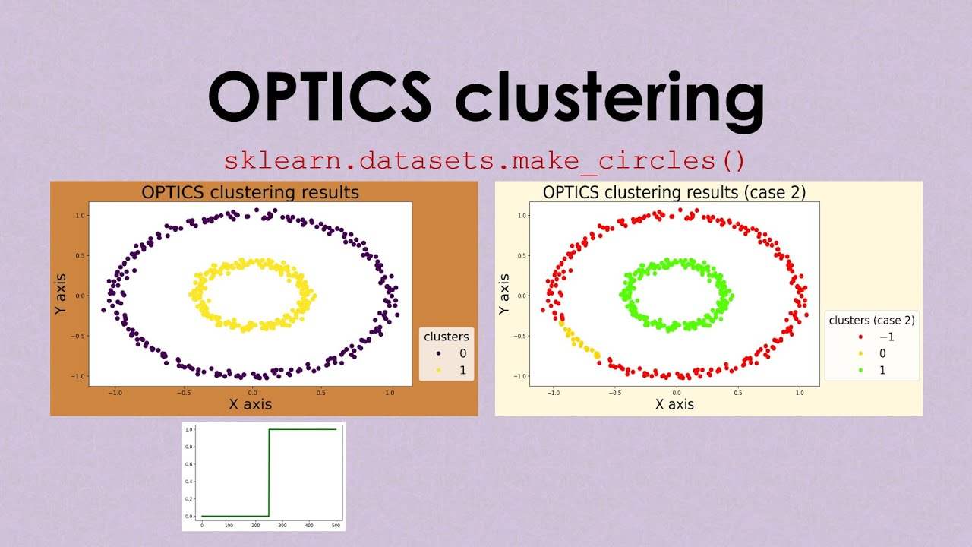
OPTICS (Ordering Points To Identify the Clustering Structure)
Similar to DBSCAN, but produces a reachability plot for clusters at varying densities.

Slide 19
Application:
Anomaly detection, hierarchical clustering.
Advantages:
Identifies clusters at multiple density levels.
Resistant to noise.
Disadvantages:
Computationally more intensive.
Interpretation requires a reachability plot.

Slide 20
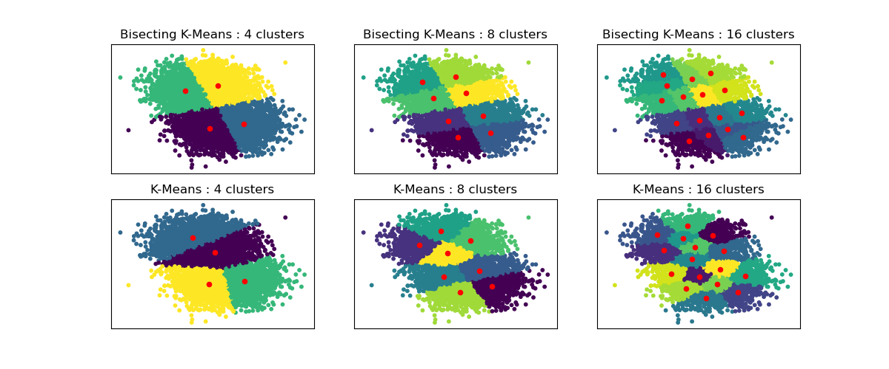
Bisecting K-Means Clustering
An extension of K-Means that applies a divisive hierarchical approach. Instead of assigning data points to clusters all at once, it starts with all points in a single cluster and iteratively splits them into two (bisecting) clusters until the desired number of clusters is reached.

Slide 21
Application:
Efficiently clustering large datasets, commonly used in document clustering and recommender systems where the data size is substantial.
Advantages:
Scales well to large datasets.
More efficient than standard hierarchical clustering.
Produces more stable results with less sensitivity to the initial conditions than standard K-means.
Disadvantages:
Requires specifying the number of clusters.
May still converge to a local minimum.
Performance can depend on the split chosen in each bisection step.

