Slide 1
Wireless TDMA Protocol Scheduler & Simulation
Assessment Submission for Wireless Developer Internship | Vaan Megam Networks

Slide 2
1. Problem Statement & Challenges
• TDMA (Time Division Multiple Access) networks allow multiple radios to share a single frequency across discrete, synchronized time-slots.
• Distance-1 Interference (Direct Link): Radios within 500m cannot transmit simultaneously to prevent immediate collision.
• Distance-2 Interference (Hidden Terminal): Radios sharing a common neighbor collide at the receiver if transmitting concurrently.
• Objective: Develop a centralized scheduler to eliminate all 1-hop and 2-hop collisions while optimizing frame length via spatial reuse.

Slide 3
2. Algorithm Architecture & Design
• Topology Modelling: Accepts JSON node coordinates and constructs a physical connectivity graph using NetworkX (Range <= 500m).
• Distance-2 Conflict Graph (G^2): Expands 1-hop and 2-hop dependencies into direct conflict edges between mutually interfering nodes.
• Greedy Graph Coloring Heuristic: Prioritizes allocation using Largest-Degree-First ordering to minimize total required time slots.
• Deterministic Schedule Generation: Generates direct Node-to-Slot mappings alongside an explicit Slot x Node boolean matrix.

Slide 4
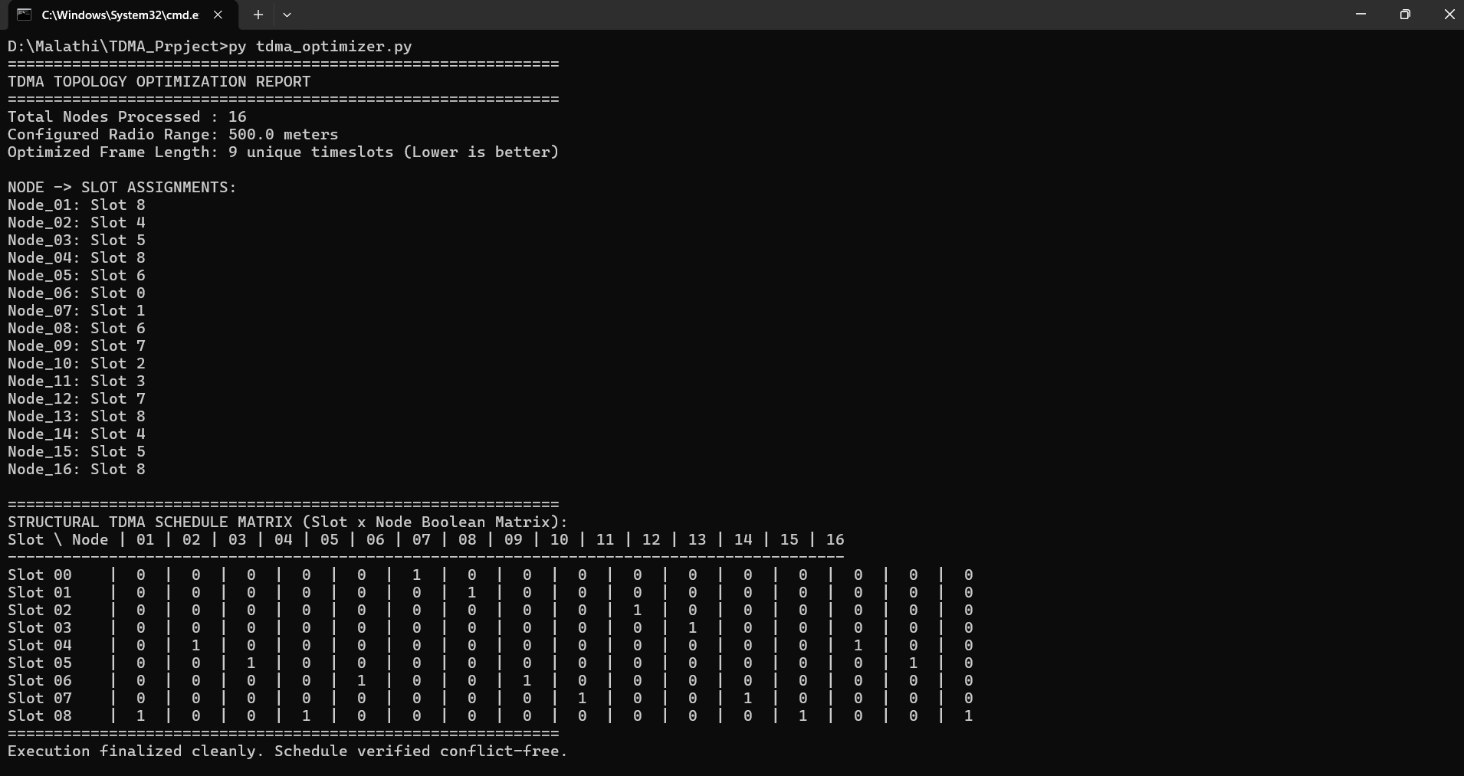
3. Optimization Results & Verification
• Successfully evaluated a 16-node topology configured with a 500-meter radio range.
• Schedule Output: Compressed transmission down to conflict-free time slots.
• Spatial Reuse Demonstrated: Non-interfering, distant nodes (separated by >2 hops) safely share identical time slots (e.g., Slot 08).
• Conflict Verification: Validated zero co-channel interference across all active wireless nodes.

Slide 5
4. Physical Emulation Approach (EMANE)
• Environment Setup: Deploy EMANE runtime in a containerized Docker / Linux environment.
• Profile Translation: Serialize Part 1 schedule matrix into native EMANE TDMA Radio Model XML configuration profiles (1ms slots).
• Packet Enforcement: Execute virtual network traffic where EMANE strictly drops out-of-slot packets and delivers authorized frames.

Slide 6
5. Future Scope
Dynamic slot allocation for mobile nodes
Automatic EMANE XML generation
SDR platform integration
6. Conclusion
Successfully generated conflict-free TDMA schedules
Achieved spatial reuse with only 9 timeslots
Ready for EMANE-based emulation

