Slide 1
Project 1 models and links
Tien Dang

Slide 2
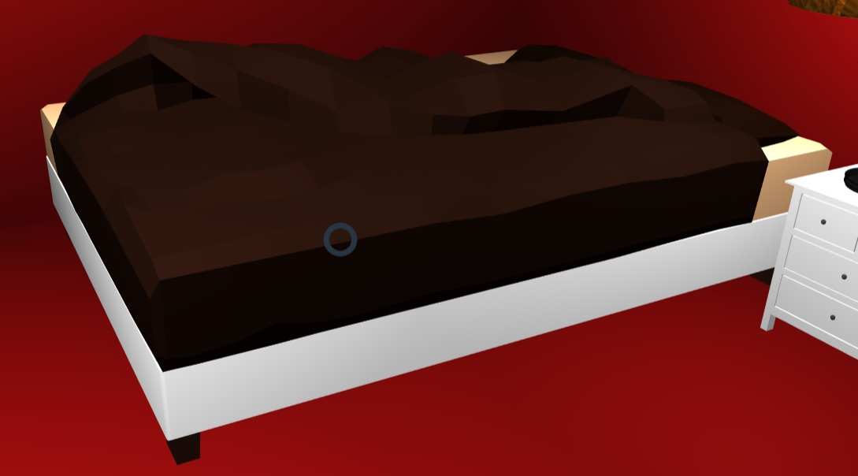
Bed model
https://sketchfab.com/models/d3825852d4264688af04c6e6a48dab84

Slide 3
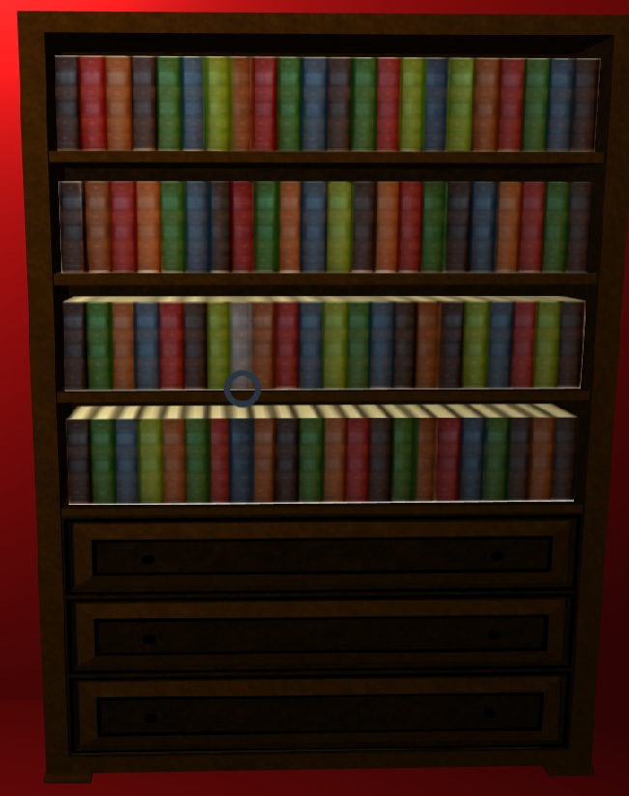
Bookshelf model
https://sketchfab.com/search?features=downloadable&q=bookshelf&sort_by=-pertinence&type=models

Slide 4

Ceiling Fan model
https://3dwarehouse.sketchup.com/model/ue1d0e739-0ed6-49ee-97fe-b9ad2b34b3d1/Ceiling-Fan-with-Light

Slide 5

Ceiling light model
https://sketchfab.com/models/a0465299981c48b4a086bf7baba45914

Slide 6
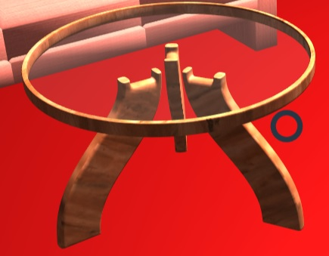
Small table model
https://sketchfab.com/models/b0c0c9c65d06443c87391134a62e2287#

Slide 7
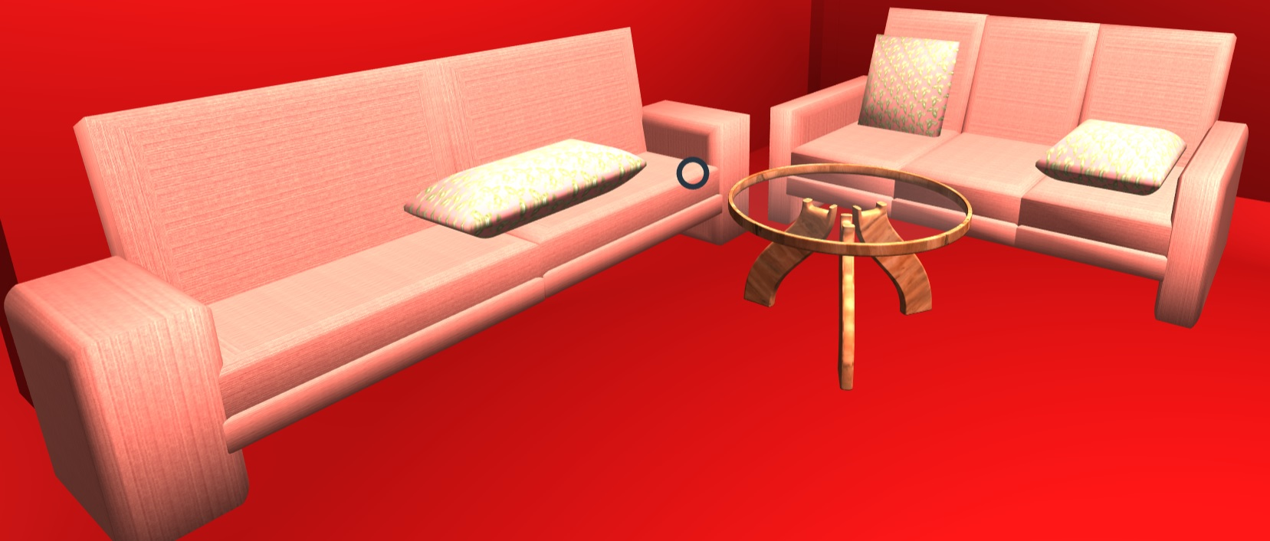
Sofa model
https://3dwarehouse.sketchup.com/model/a2c808d39f0510f748034ce347259770/Sof%C3%A1

Slide 8
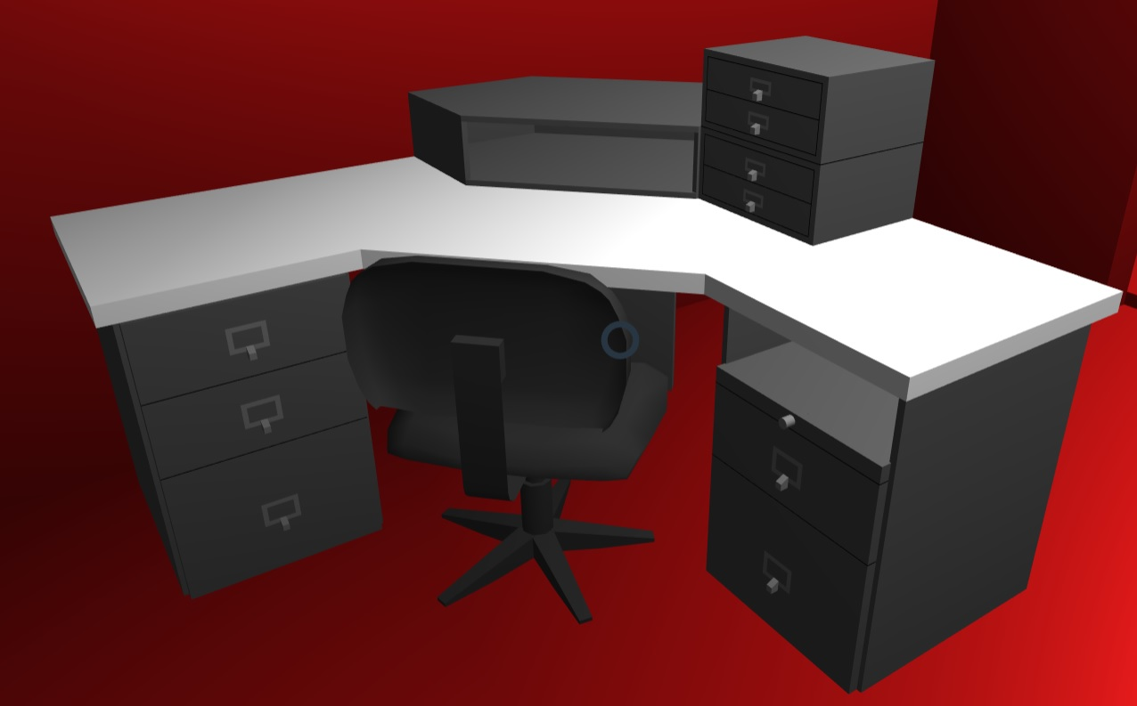
Desk model
https://3dwarehouse.sketchup.com/model/79fd7e61-20ae-4e68-b45d-1ea418fffec5/Desk

Slide 9

Door

Slide 10
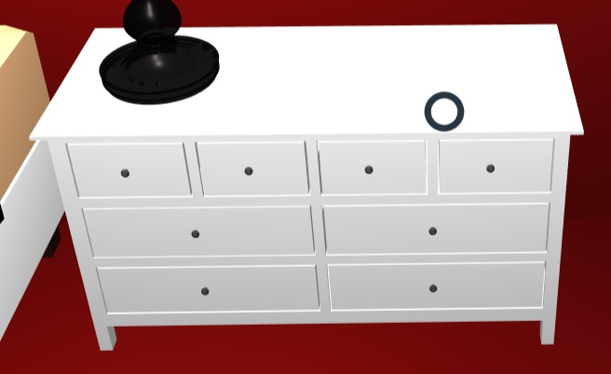
Dresser model
https://sketchfab.com/models/15562ed7b1d24a7a842d971f6555216e

Slide 11

Kitchen Cabinets

Slide 12
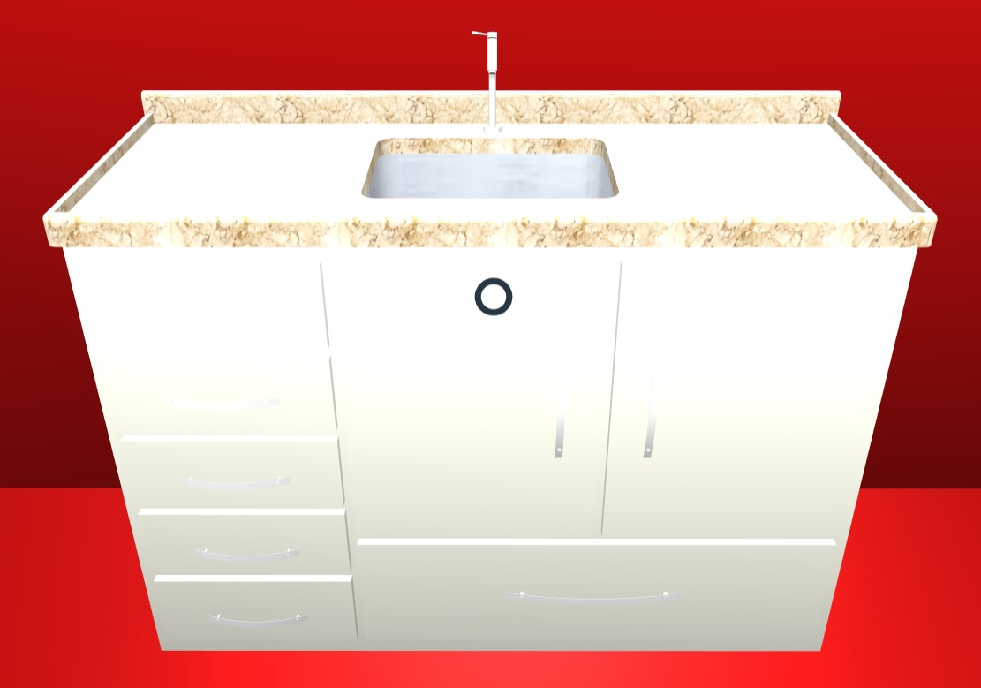
Kitchen Sink Model
https://3dwarehouse.sketchup.com/model/7ebb54a2c65de00cf0f0e7e9772f83ce/Pia-de-Cozinha-com-Gabinete

Slide 13

Lamp model
https://sketchfab.com/models/ef272b3001574c62846750f11ac8ac59

Slide 14
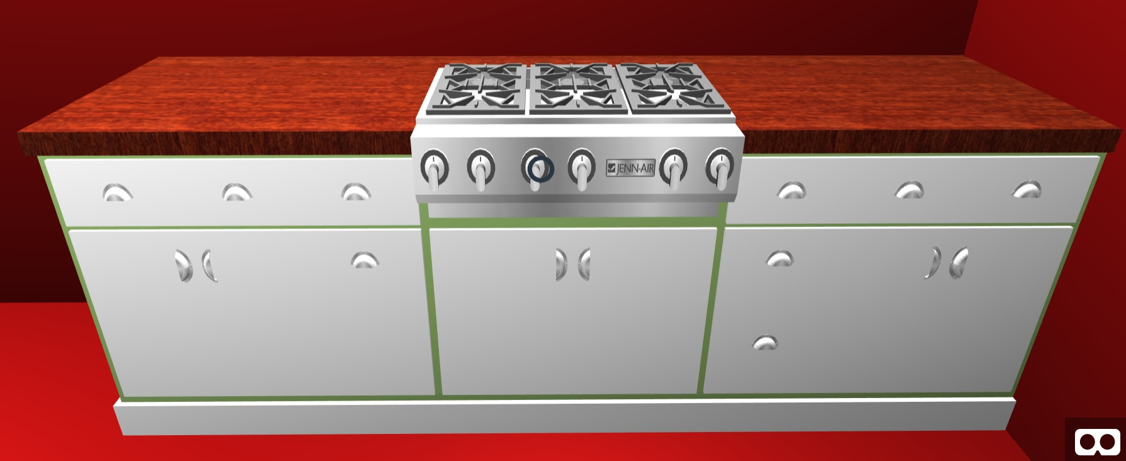
Oven Tops model
https://3dwarehouse.sketchup.com/model/115136d967aafb7d58a311513e993aad/Wood-Set-Counter-Top-Stove

Slide 15

Switches

Slide 16
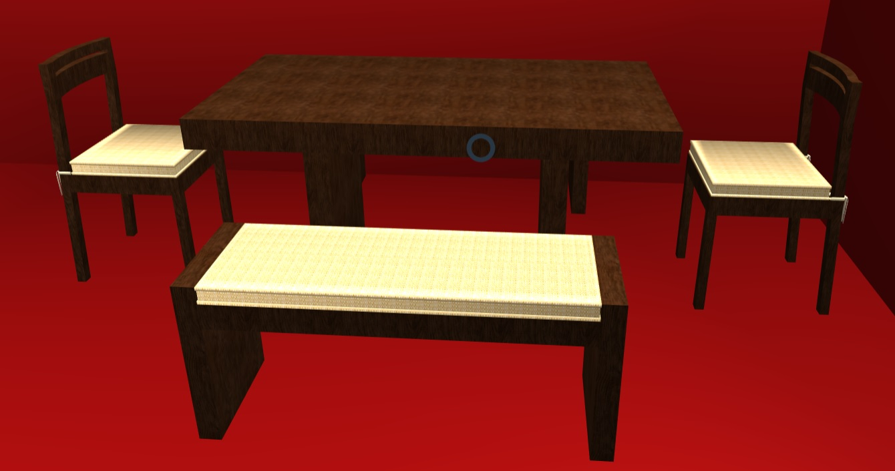
Table set model
https://3dwarehouse.sketchup.com/model/1fcc70eca69c2e8b1bb088904f7cb154/Dining-Room-Furniture

Slide 17
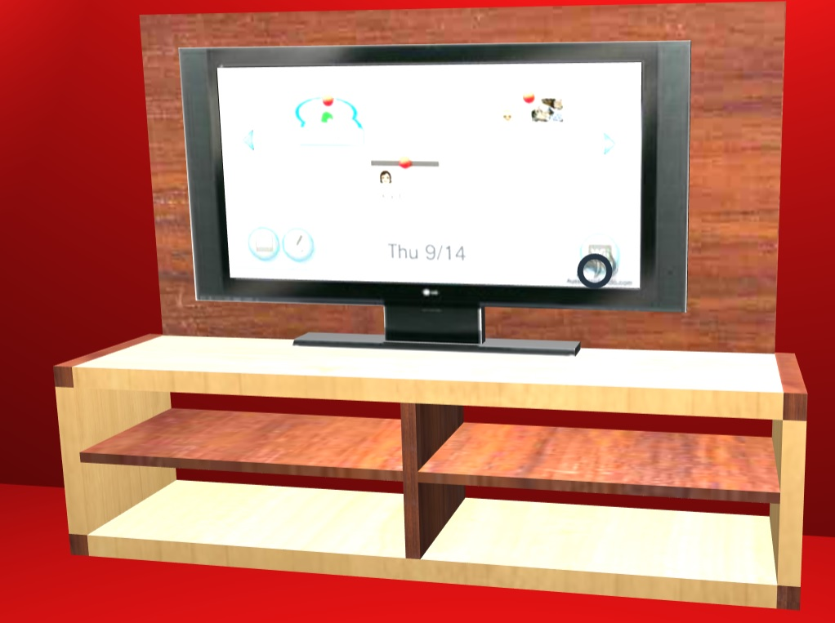
TV set model
https://3dwarehouse.sketchup.com/model/575e8ce01d53aed6aba4e214830b9b65/TV-Stand-with-Lcd-TV

