Slide 1
McDonald's

Slide 2

Introduction
McDonald's Corporation is an American multinational fast food chain, founded in 1940 as a restaurant operated by Richard and Maurice McDonald, in San Bernardino, California, United States.

Slide 3
Information about the dataset , useful analysis
count | mean | std | min | 25% | 50% | 75% | max
Calories | 260.0 | 368.269231 | 240.269886 | 0.0 | 210.000 | 340.0 | 500.00 | 1880.0
Calories from Fat | 260.0 | 127.096154 | 127.875914 | 0.0 | 20.000 | 100.0 | 200.00 | 1060.0
Total Fat | 260.0 | 14.165385 | 14.205998 | 0.0 | 2.375 | 11.0 | 22.25 | 118.0
Total Fat (% Daily Value) | 260.0 | 21.815385 | 21.885199 | 0.0 | 3.750 | 17.0 | 35.00 | 182.0
Saturated Fat | 260.0 | 6.007692 | 5.321873 | 0.0 | 1.000 | 5.0 | 10.00 | 20.0
Saturated Fat (% Daily Value) | 260.0 | 29.965385 | 26.639209 | 0.0 | 4.750 | 24.0 | 48.00 | 102.0
Trans Fat | 260.0 | 0.203846 | 0.429133 | 0.0 | 0.000 | 0.0 | 0.00 | 2.5
Cholesterol | 260.0 | 54.942308 | 87.269257 | 0.0 | 5.000 | 35.0 | 65.00 | 575.0
Cholesterol (% Daily Value) | 260.0 | 18.392308 | 29.091653 | 0.0 | 2.000 | 11.0 | 21.25 | 192.0
Sodium | 260.0 | 495.750000 | 577.026323 | 0.0 | 107.500 | 190.0 | 865.00 | 3600.0
Sodium (% Daily Value) | 260.0 | 20.676923 | 24.034954 | 0.0 | 4.750 | 8.0 | 36.25 | 150.0
Carbohydrates | 260.0 | 47.346154 | 28.252232 | 0.0 | 30.000 | 44.0 | 60.00 | 141.0
Carbohydrates (% Daily Value) | 260.0 | 15.780769 | 9.419544 | 0.0 | 10.000 | 15.0 | 20.00 | 47.0
Dietary Fiber | 260.0 | 1.630769 | 1.567717 | 0.0 | 0.000 | 1.0 | 3.00 | 7.0
Dietary Fiber (% Daily Value) | 260.0 | 6.530769 | 6.307057 | 0.0 | 0.000 | 5.0 | 10.00 | 28.0
Sugars | 260.0 | 29.423077 | 28.679797 | 0.0 | 5.750 | 17.5 | 48.00 | 128.0
Protein | 260.0 | 13.338462 | 11.426146 | 0.0 | 4.000 | 12.0 | 19.00 | 87.0
Vitamin A (% Daily Value) | 260.0 | 13.426923 | 24.366381 | 0.0 | 2.000 | 8.0 | 15.00 | 170.0
Vitamin C (% Daily Value) | 260.0 | 8.534615 | 26.345542 | 0.0 | 0.000 | 0.0 | 4.00 | 240.0
Calcium (% Daily Value) | 260.0 | 20.973077 | 17.019953 | 0.0 | 6.000 | 20.0 | 30.00 | 70.0
Iron (% Daily Value) | 260.0 | 7.734615 | 8.723263 | 0.0 | 0.000 | 4.0 | 15.00 | 40.0

Slide 4
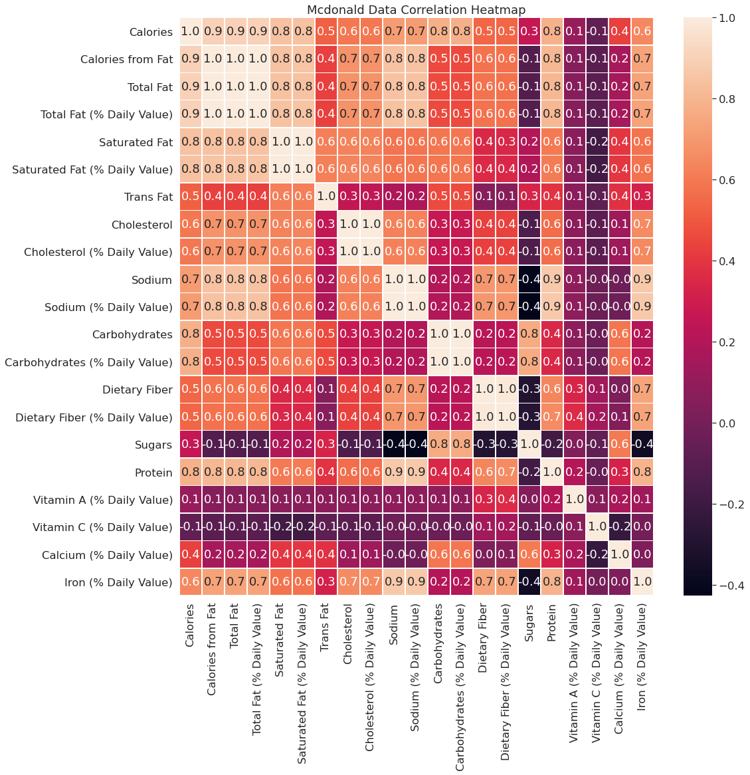
Heatmap of McDonald’s

Slide 5
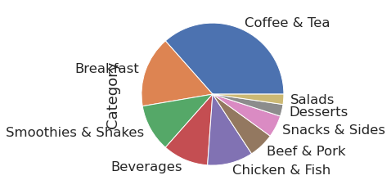
pie chart that includes the relative proportions of each cateogry of food (Pie chart for the "Category" column using the value_counts() method.

Slide 6
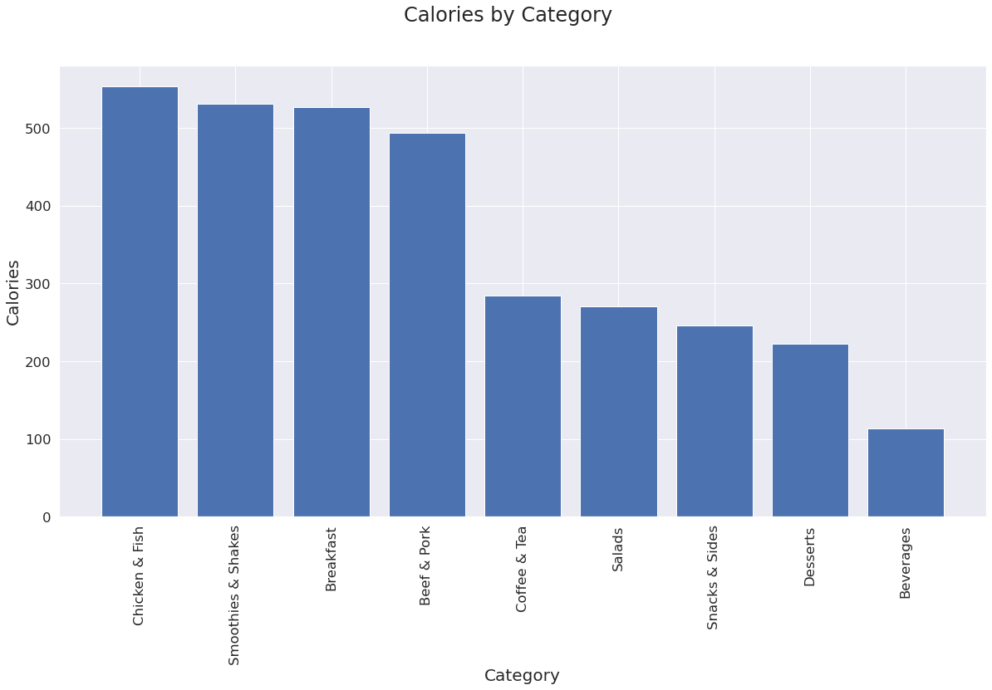
The purpose of the code below is to group all of the foods by category and to plot the #average calary count of items in the group.

Slide 7
The most dangerous for your heart breakfasts.It can be your last ...Cholesterol is a cause of heart attacks
Category | Item | Serving Size | Calories | Calories from Fat | Total Fat | Total Fat (% Daily Value) | Saturated Fat | Saturated Fat (% Daily Value) | Trans Fat | ... | Carbohydrates | Carbohydrates (% Daily Value) | Dietary Fiber | Dietary Fiber (% Daily Value) | Sugars | Protein | Vitamin A (% Daily Value) | Vitamin C (% Daily Value) | Calcium (% Daily Value) | Iron (% Daily Value)
31 | Breakfast | Big Breakfast with Hotcakes (Regular Biscuit) | 14.8 oz (420 g) | 1090 | 510 | 56.0 | 87 | 19.0 | 96 | 0.0 | ... | 111 | 37 | 6 | 23 | 17 | 36 | 15 | 2 | 25 | 40
32 | Breakfast | Big Breakfast with Hotcakes (Large Biscuit) | 15.3 oz (434 g) | 1150 | 540 | 60.0 | 93 | 20.0 | 100 | 0.0 | ... | 116 | 39 | 7 | 28 | 17 | 36 | 15 | 2 | 30 | 40

Slide 8
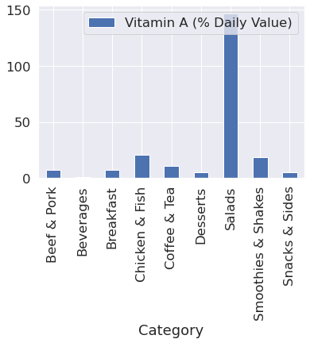
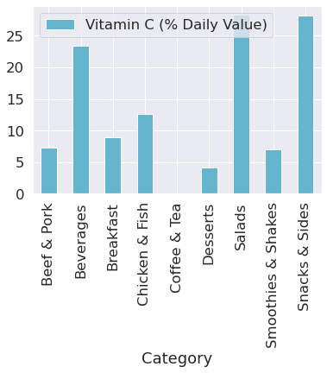
Checking the Vitamins

Slide 9
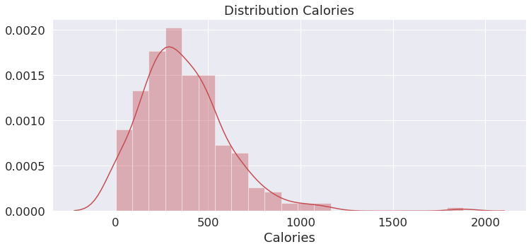
Distribution Calories

Slide 10
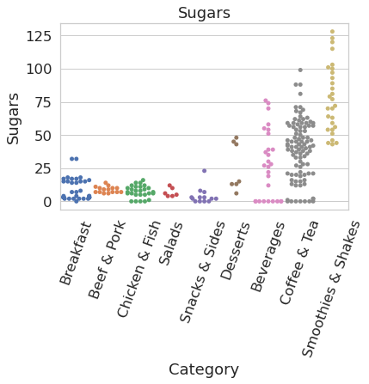
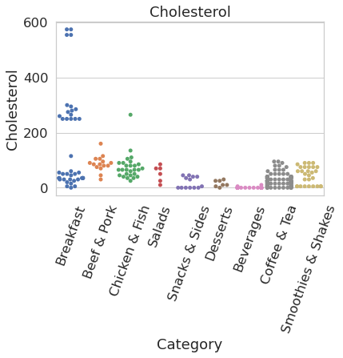
SwarmPlot for Cholesterol and Sugar

Slide 11


