Slide 1
Arogya Mithra
AI-Assisted Platform for Equitable Healthcare
Domain: AI for Equitable Healthcare
Problem Statement
Urban–rural healthcare inequality
Delayed diagnosis in rural regions
Inefficient telemedicine workflows
Limited support for frontline workers
Why This Matters
Delayed care increases health risks
Doctors handle non-critical cases
Frontline workers lack decision tools
Public health response is reactive

Slide 2
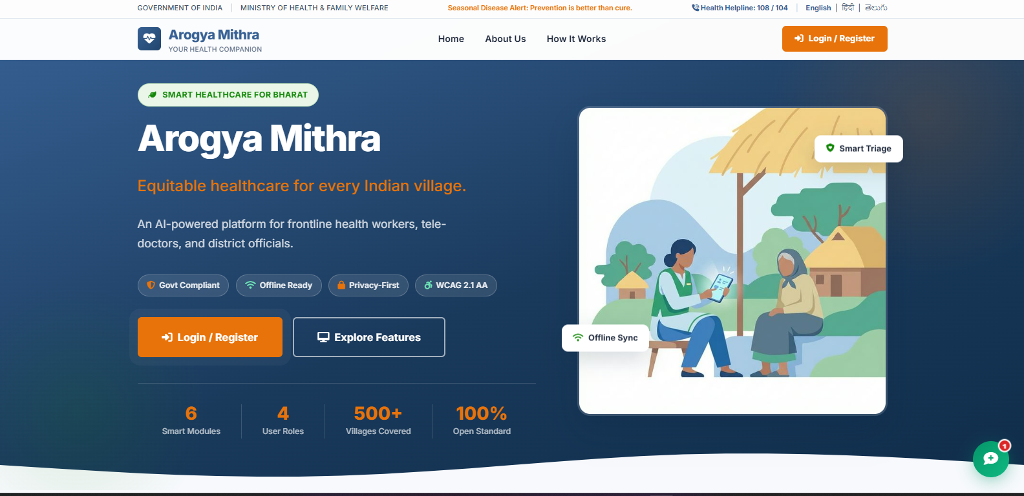
Core Features
Symptom triage (Low / Medium / High)
Patient health profiles
Doctor dashboard
Public health monitoring

Slide 3
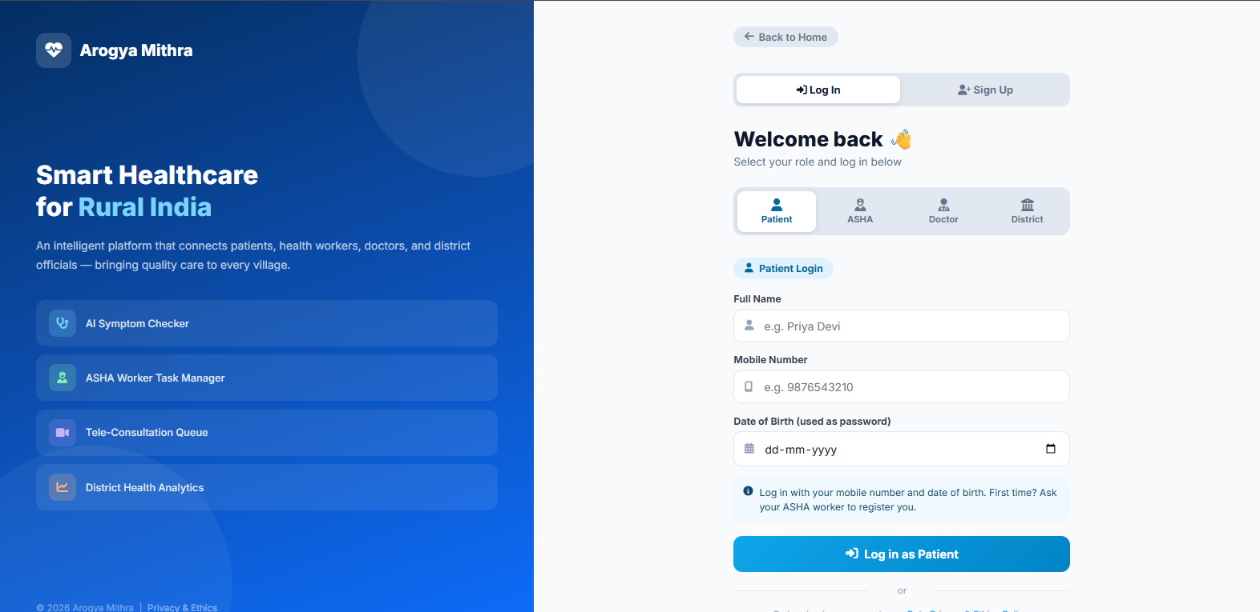
Target Users
Patients
Frontline Health Workers (ASHA / ANM)
Doctors
Public Health Officials

Slide 4
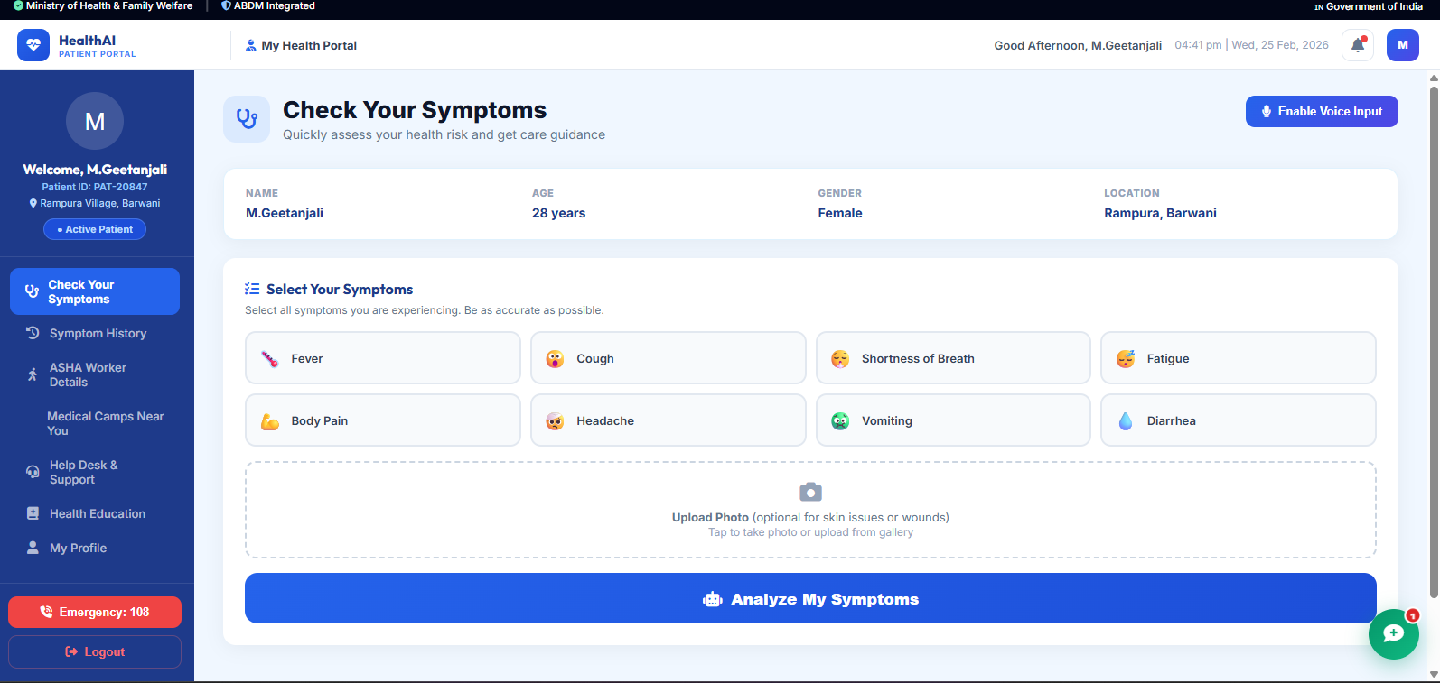
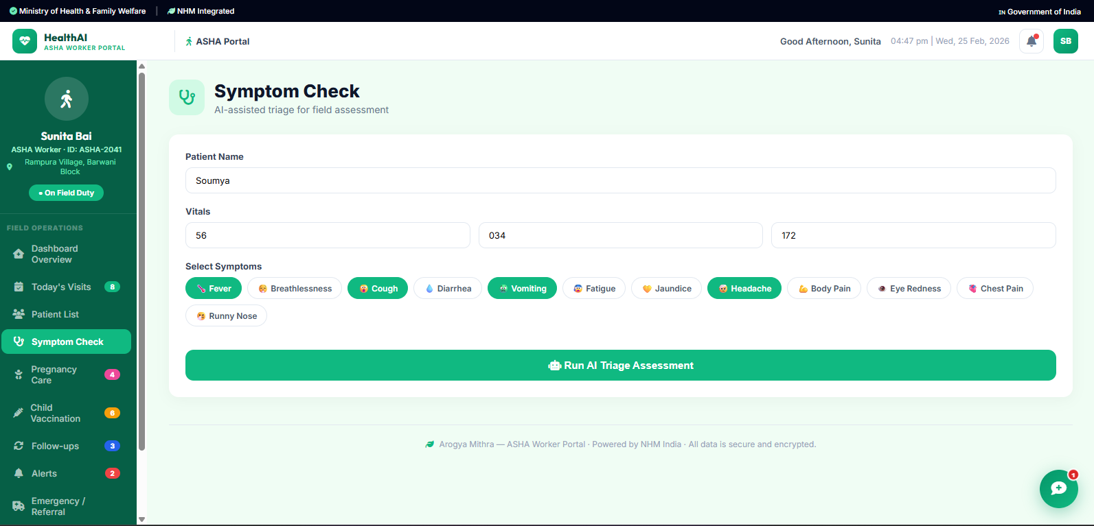


Workflow
Login → Symptom Entry → AI Risk Assessment

Slide 5
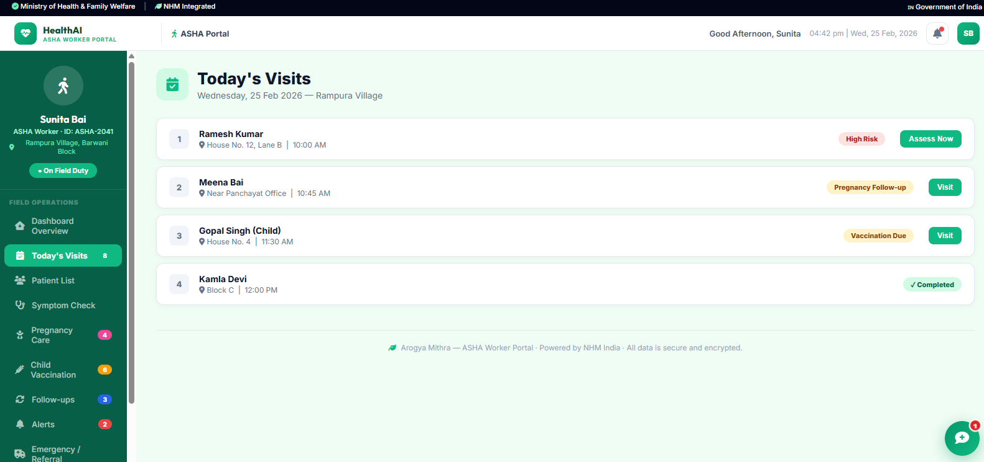

Slide 6
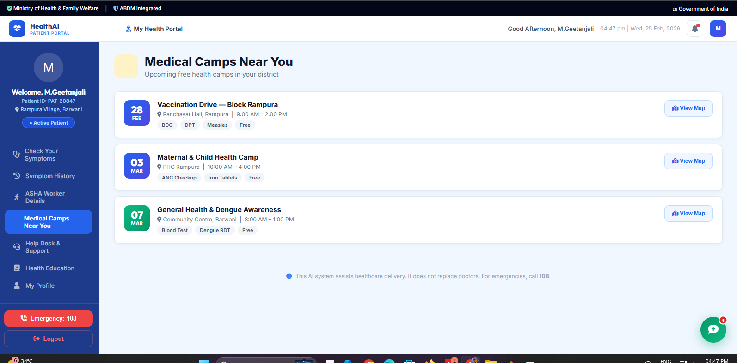

Slide 7
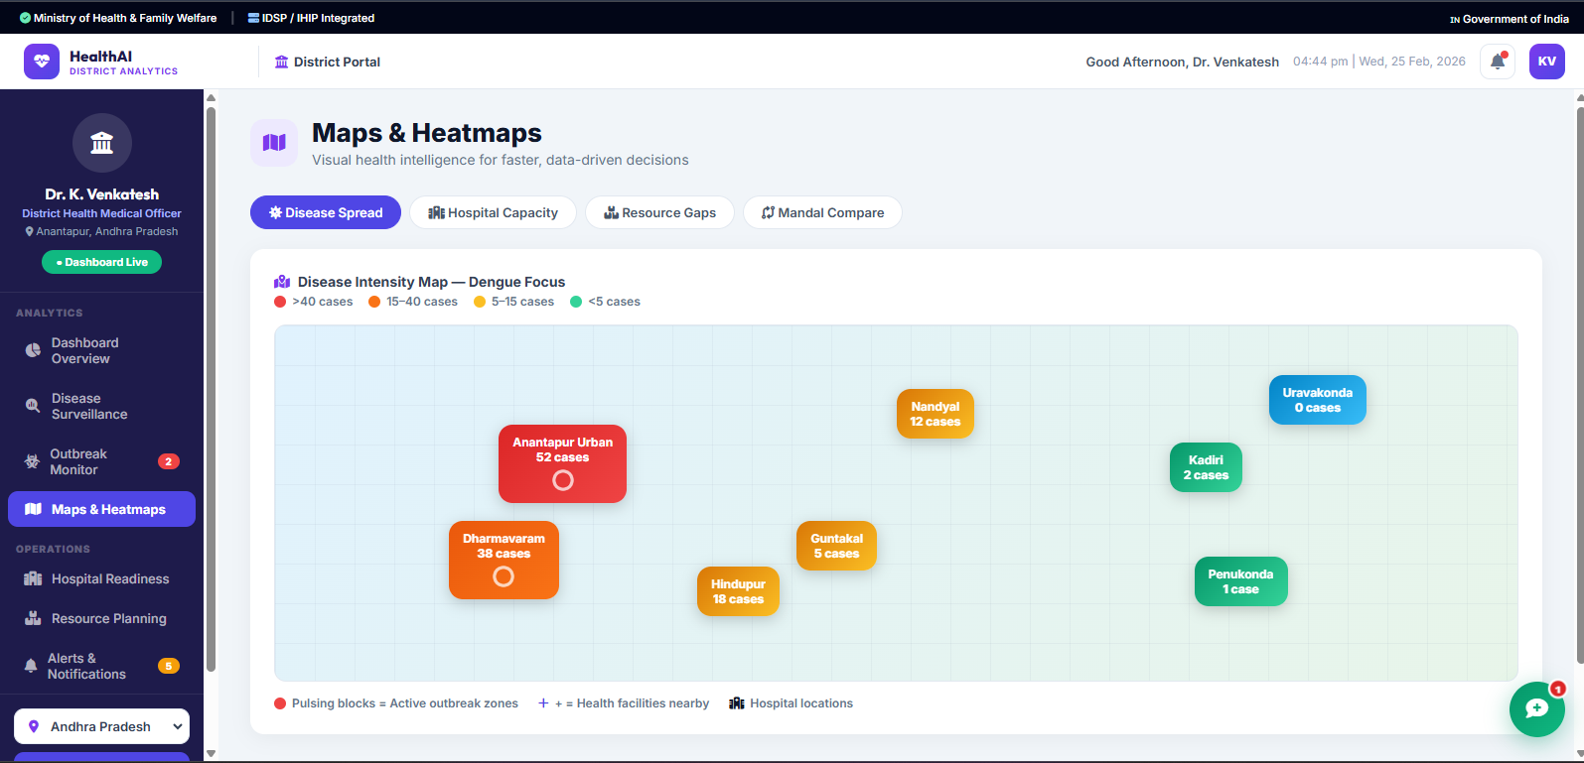
Solution Overview
• AI-assisted symptom triage
• Risk-based care guidance
• Telemedicine prioritization
• Public health intelligence
• AI assists, doctors decide

Slide 8
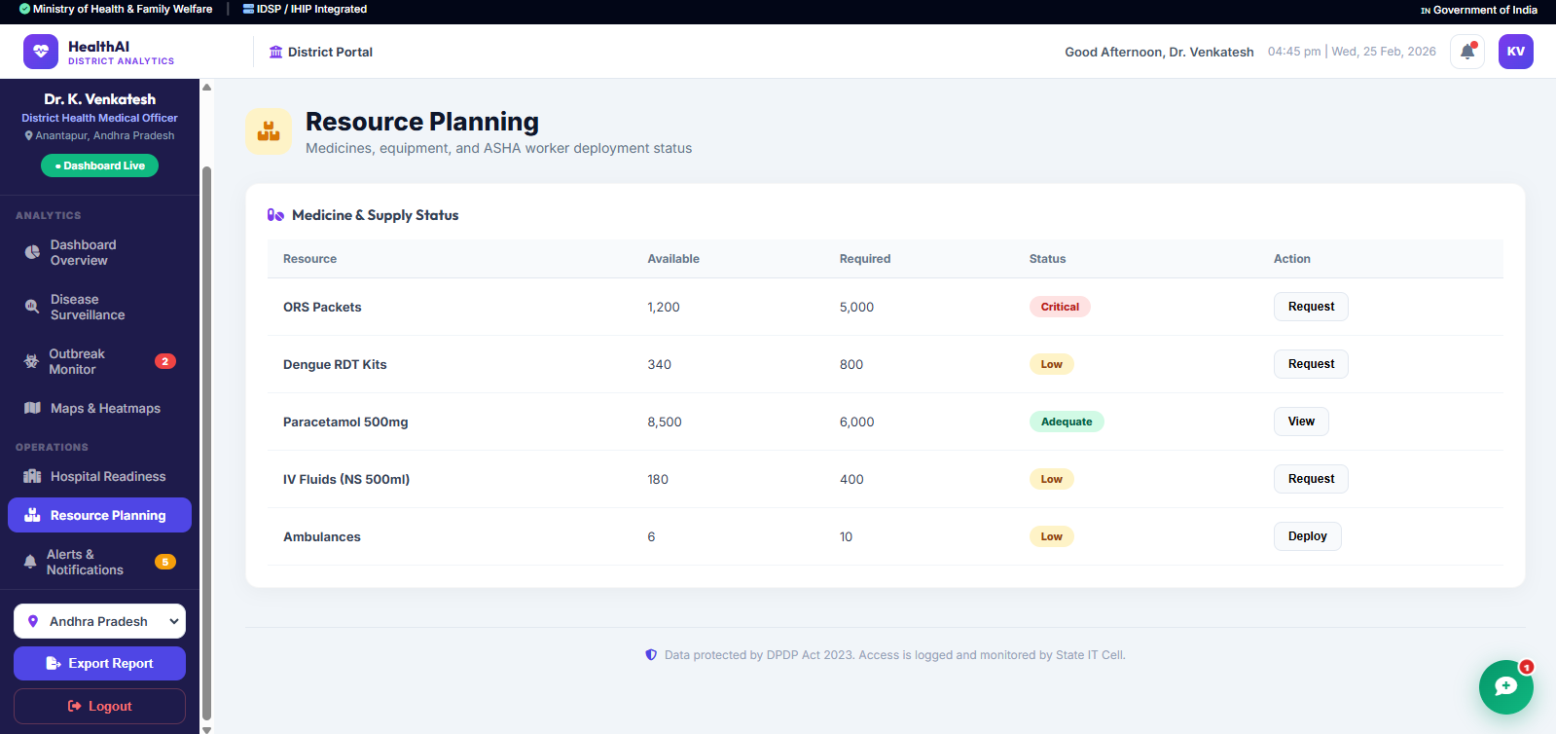

Slide 9
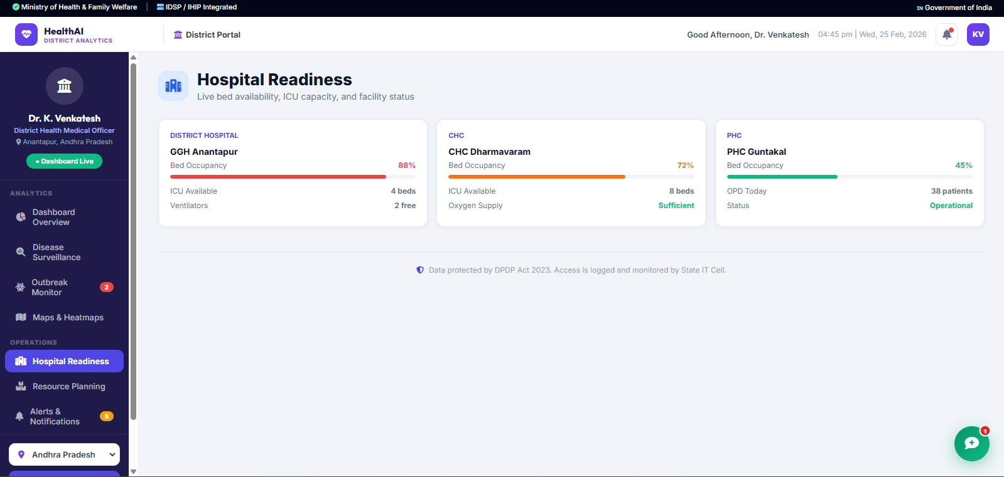

Slide 10
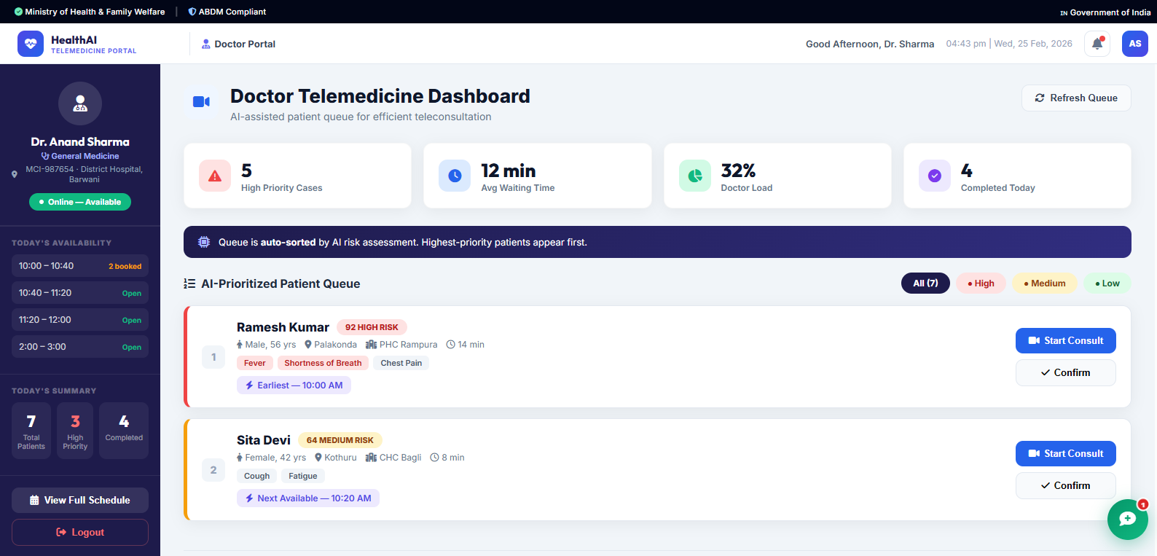

Slide 11
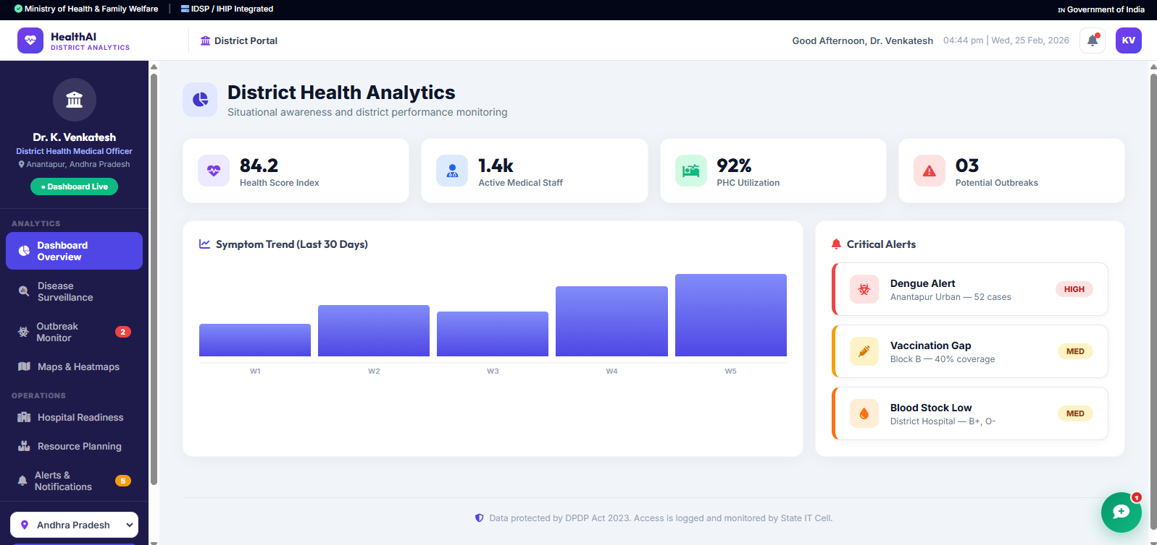

Slide 12
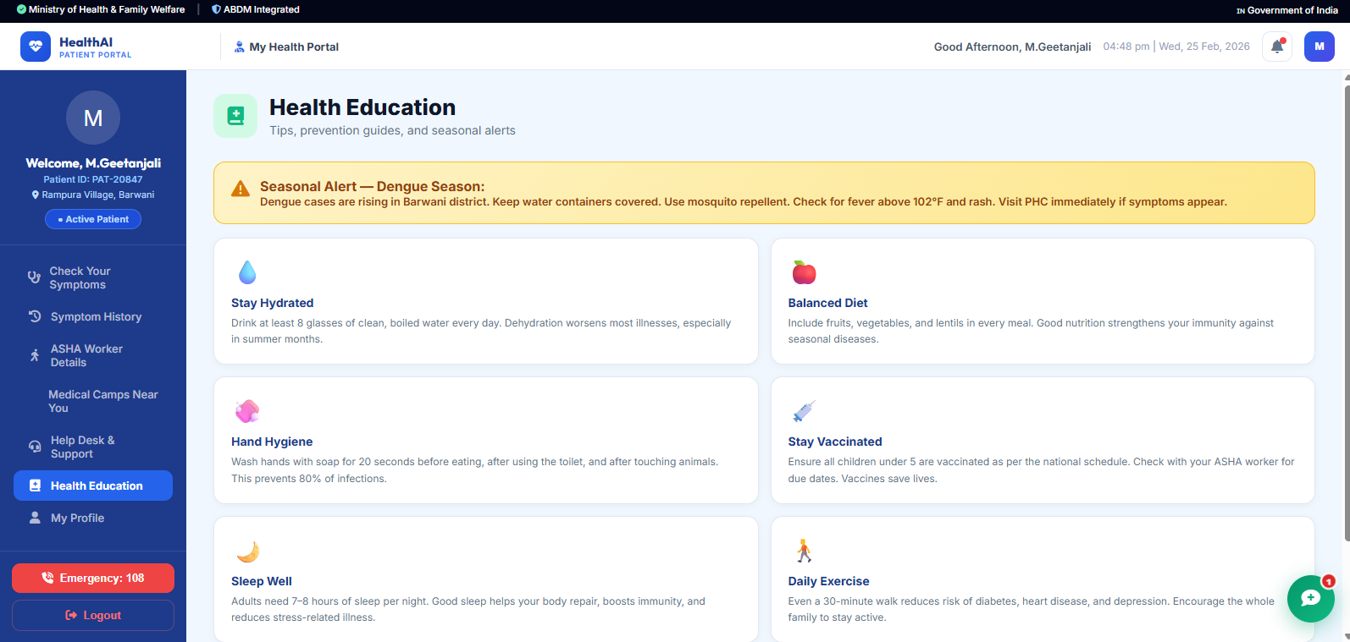

Slide 13
Usage & Benefits
How It Is Used Patients or ASHA workers enter symptoms AI classifies risk (Low / Medium / High) Care is guided to home monitoring, teleconsultation, or referral Doctors receive AI-prioritized consultation queues Health officials monitor disease trends and risks
Key Benefits
Reduced delayed diagnosis in rural areas Optimized telemedicine workflows Empowered frontline health workers Data-driven public health decision-making
Tools & Technologies
Frontend: Antigravity Web UI
Backend: Firebase Authentication, Firestore
AI/ML: Logistic Regression, Decision Tree, Random Forest
Design Focus: Explainability, scalability, ethical AI

Slide 14
Final Contribution
Arogya Mithra presents a practical implementation of an AI-powered multilingual symptom triage and referral system designed to support rural frontline health workers in identifying high-risk patients and prioritizing teleconsultations.
The project demonstrates how simple, explainable, and ethically designed AI can be integrated into real-world healthcare workflows to improve accessibility, reduce delays in care, and optimize the use of limited medical expertise. By assisting patients, health workers, doctors, and public health officials through role-based decision support, the system strengthens healthcare delivery without replacing clinical judgment.
This work highlights the potential of responsible, data-driven AI to advance equitable healthcare outcomes in underserved communities.

Slide 15
Contact Us:
Email:email
Email
email

Slide 16
Thank You

