Slide 1

Team Name : Binary Brains
Team Members :
Malavika Gupta
Tanisha

Slide 2

PROBLEM STATEMENT
In the competitive fashion retail industry, staying ahead of trends and engaging customers is essential. Current manual and inaccurate trend generation processes lead to missed opportunities, overproduction, waste, and financial losses due to unsold inventory. Additionally, fashion platforms often lack engaging and interactive features, resulting in low user retention and satisfaction. Consequently, brands risk losing market share to competitors utilizing AI and better engagement tools.
Our goal is to develop an AI-driven trend generation system for real-time, accurate trend prediction and creation, alongside an engaging, interactive platform to enhance user engagement and satisfaction. This approach aims to align product offerings with market demands, drive higher customer loyalty, and reduce environmental impact through precise production planning.

Slide 3




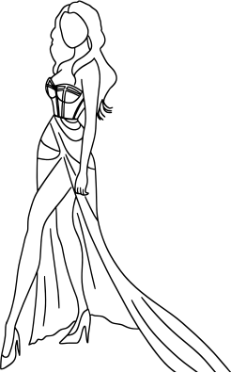
SOLUTION
AI-DRIVEN TREND GENERATION SYSTEM :
OBJECTIVE
Accurately predict and create fashion trends in real-time to align product offerings with market demands.
SOLUTION
DETAILS
Implement machine learning models that analyze historical sales data, social media trends, and fashion forecasts.
Integrate Natural Language Processing (NLP) to analyze customer reviews and feedback for trend insights and to analyze textual data from social media, fashion blogs, and customer reviews to understand the sentiment and context behind emerging trends.
IMPLEMENTATION
STEPS
Partner with AI technology providers to develop custom algorithms.
Train models using existing sales and social media data.
Regularly update the models with new data to improve accuracy.
STYLE
TRANSFER
TECHNIQUES
Use AI to combine different fashion elements and styles to generate new designs. For example, blending vintage styles with modern trends to create something fresh and appealing.

Slide 4
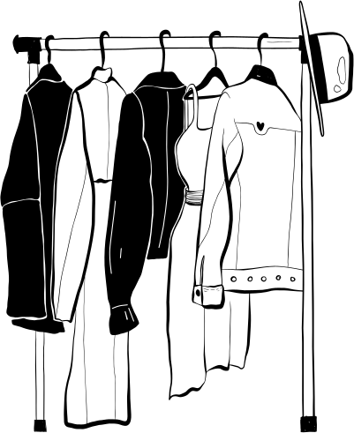

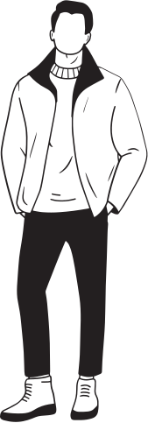
ENGAGING AND INTERACTIVE PLATFORM :
OBJECTIVE
Enhance user engagement and satisfaction on the fashion platform.
SOLUTION
DETAILS
Introduce "creating new trends" feature where the user can create their own fashion designs and then setting up polls on the platform to choose the most innovative and best designs and reward Myntra points to the winners.
Create a fashion community space for users to share styles, participate in challenges, and give feedback.
IMPLEMENTATION
STEPS
Partner with AI technology providers to build virtual designing platform with variety of inbuilt features.
Launch community events and fashion challenges to drive participation.

Slide 5

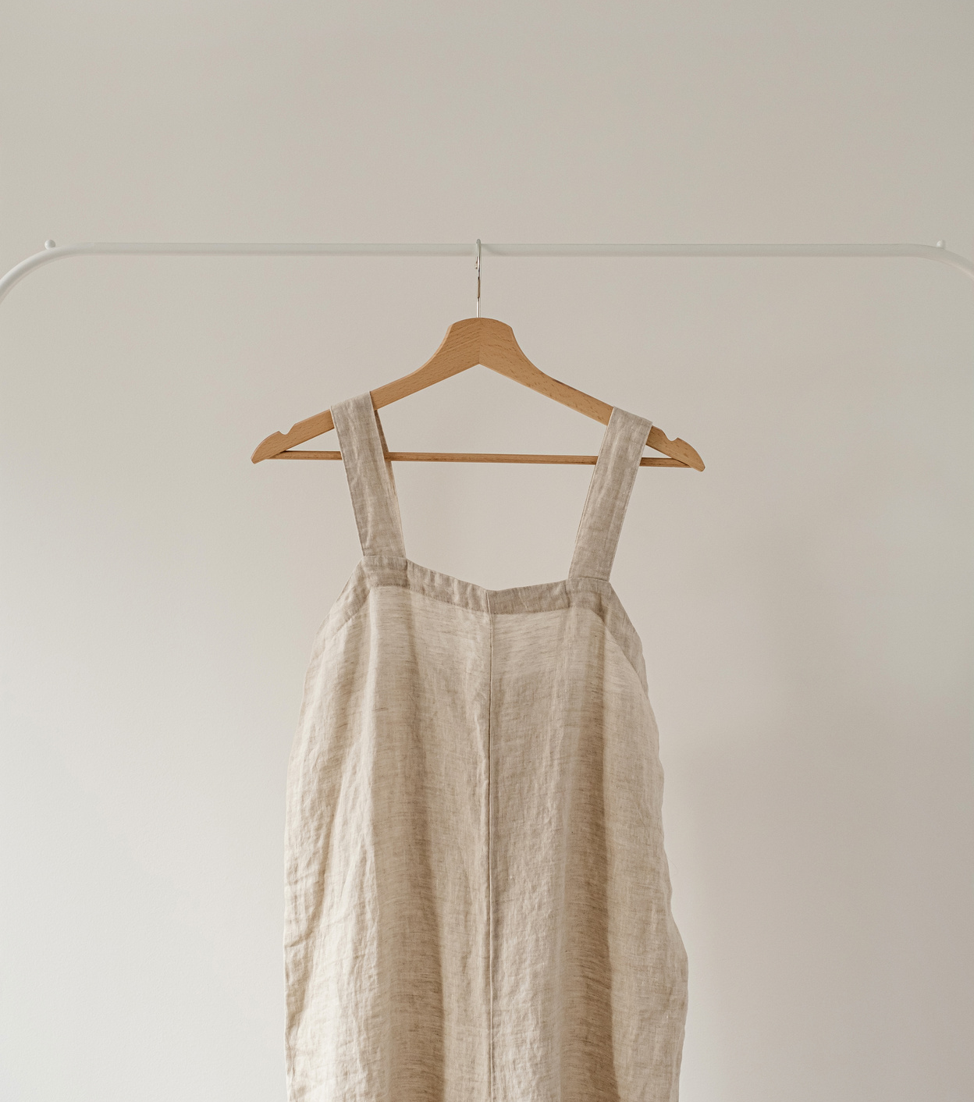
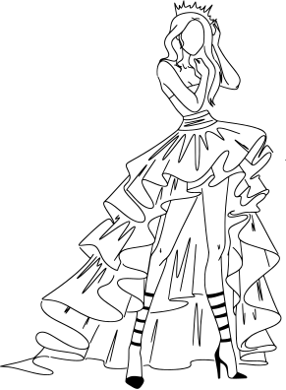
IMPACTS
AI-DRIVEN TREND GENERATION SYSTEM :
ENGAGING AND INTERACTIVE PLATFORM :
Reduction in Overproduction and Waste
Increased User Engagement
Faster Response to Market Changes
Improved Customer Retention
Innovation in Design
Enhanced Social Shopping Experience
Enhanced Customer Satisfaction
Positive Brand Perception
These are technically and operationally feasible solutions because of very less initial investment and the ROI being high. All the data is easily available from fashion retailers and social media platforms. These considerations will help the platform to stay competitive and meet the demands of modern consumers.

Slide 6
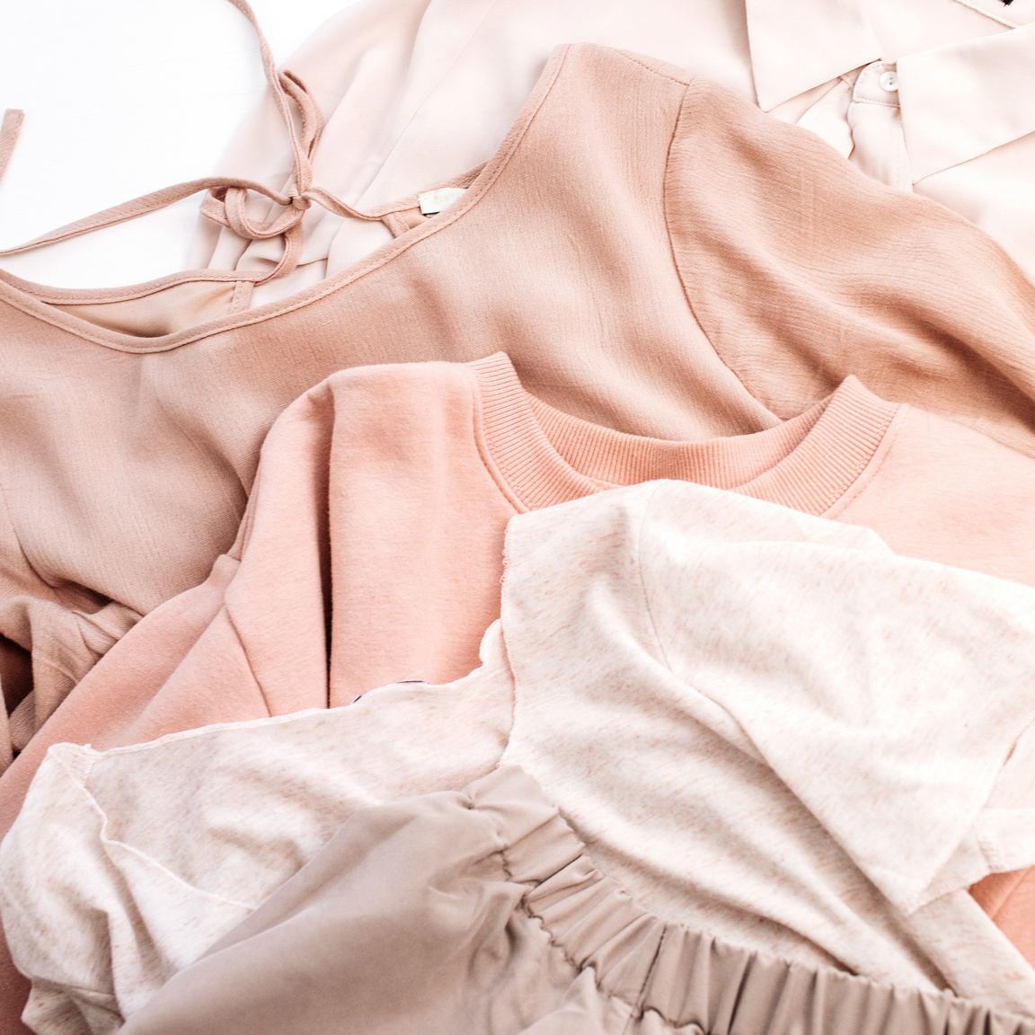
WHERE TO FIT IN MYNTRA APP
To integrate the creating new trends feature, on the Home Page, add a new section for dressing up the model, including user reviews and challenges. Clicking on challenges will lead users to the Model Dress-Up page, where they can mix and match outfits available on Myntra.
After creating their style, users can post their outfits on the already existing Community Page, share their creations and participate in polls. New features like polls and challenges in the community enhance interaction and gather valuable feedback.
The trend prediction model can be integrated using API in the backend logic using libraries like requests in Python or http in Node.js. The predictions can be directly shown on the home page with links to the selected outfits. Regular monitoring and maintenance are crucial to ensure the model remains effective and scales with user demand.

