Slide 1
HiPerVison Projects on Shelton Vision's Textile Inspection Systems: Back-end web based interface
-Malavika R Nair

Slide 2
Overview
Introduction
Approach
Solutions
Technologies & Toolkits
Architecture
Design
Implementation
Testing
Comparison of solutions
Conclusion

Slide 3
Introduction
Project- HiPerVison Projects on Shelton Vision's Textile Inspection Systems: Backend web-based interface
Primary Client- Dr Mike Millman, Chief Technology Officer, Shelton Machines Ltd
Company’s vision –To have a web based interface that can be used by any device,be it a browser, mobile phone or tablet

Slide 4
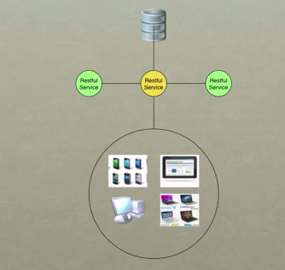
Approach
Why REST?
Stateless
No overhead of headers (unlike SOAP)
Easier and Quicker than SOAP
Supports variety of data formats
Can be consumed very easily by clients

Slide 5
Approach contd..
Unique URI to describe resources
Using standard HTTP verbs GET, POST, PUT,DELETE
Easy to use from virtually all OS, language and tool platforms

Slide 6

Solution 1 – using Java

Slide 7
Technologies & Toolkits
AJAX: send request and receive response
JSON: store and send data
JAX-RS(JSR 311): Java API for RESTful Web Services
Jersey - JAX-RS Reference Implementation for building RESTful Web services
WebLogic-Web application container

Slide 8
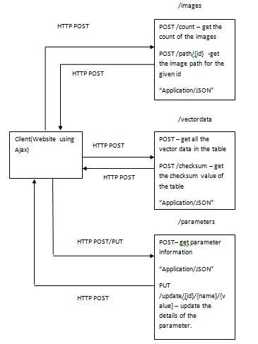
Architecture Diagram

Slide 9


Implementation
Server
SQL Server – MS SQL Server 2005
Web Server – Oracle WebLogic

Slide 10


Implementation contd..
Service
Database Connection
Conversion to JSON
Backend User Interface API
Jersey API annotations
@Path
@GET
@POST
@Produces
……

Slide 11
Implementation contd..
3 Resources:
Images, VectorData, Parameters
URIs:
/path
/count
/checksum
/update

Slide 12
Implementation contd..
Some Code….
import javax.ws.rs.Produces;
import javax.ws.rs.Consumes;
import javax.ws.rs.POST;
import javax.ws.rs.Path;
import javax.ws.rs.PathParam;
import javax.ws.rs.core.MediaType;
import javax.ws.rs.core.Response;
@Path("/v1/images/")
public class V1_Images {
@Path("/count/")
@POST
@Produces(MediaType.APPLICATION_JSON)
public Response returnImageCount() throws Exception { }

Slide 13


Implementation contd..
Client
JavaScript(jQuery, Highcharts,Datatables)
Some Code….
$(document).ready(function(){
var count=0;
$('#start').attr("disabled", false);
$('#stop').attr("disabled", true);
function calculateCount(callback){
$.ajax({type: 'POST',
url: "http://localhost:7001/com.sheltonmachines.service/api/v1/images/count/",
cache: false,
success: function(data){
callback(data[0].number);
},
error: function(jqXHR, textStatus, errorThrown) {
console.log("Error!!"+ jqXHR.responseText); }
});
}

Slide 14
Implementation contd..
Deploy
<web-app>
<servlet>
<servlet-name>Backend Rest Service</servlet-name>
<servlet-class>com.sun.jersey.spi.container.servlet.ServletContainer</servlet-class>
<init-param>
<param-name>com.sun.jersey.config.property.packages</param-name>
<param-value>com.sheltonmachines.service</param-value>
</init-param>
<load-on-startup>1</load-on-startup>
</servlet>
<servlet-mapping>
<servlet-name>Backend Rest Service</servlet-name>
<url-pattern>/api/*</url-pattern>
</servlet-mapping>
</web-app>

Slide 15
Testing
Functional Testing
- Manual
Non-Functional Testing
Tools used:
-Fiddler
-Chrome Developer Tool
-Windows Task Manager
-Understand (SciTool)
Testing Environment:
Operating System: Windows 7 Home Premium
Hardware: 4.00GB RAM, 32-bit (x86)
Default browser: Google Chrome, Version 39.0.2171.99 m

Slide 16

Solution 2
-using C#(ASP.NET)

Slide 17


Technologies & Toolkits
ASP.NET Web API 2 (C#)
Visual Studio Express2013 for web
.Net 4.5
IIS Express - Web application container

Slide 18
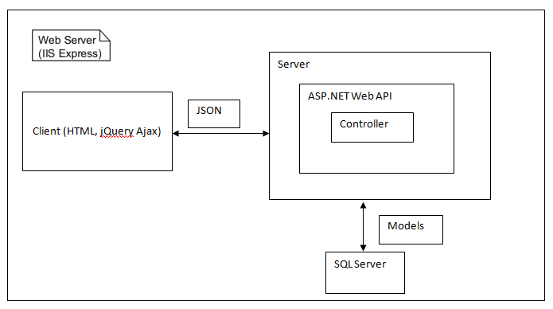
Architecture Diagram

Slide 19
Implementation
Server
SQL Server – MS SQL Server 2005
Web Server – IIS Express
Service
Model
Controller
Client
JavaScript(jQuery) [Same client as in solution1]

Slide 20
Implementation contd..
Model
namespace BackendApp.Models
{
public class Image
{
public string Id { get; set; }
public string Name { get; set; }
public string Path { get; set; }
}
public class ImageCount
{
public int Number { get; set; }
}
}
Controller
namespace BackendApp.Controllers
{
public class ImagesController : ApiController
{
public IEnumerable<ImageCount> GetImages()
{
ImageCount[] count = null;
SqlConnection con = new SqlConnection(@"Data Source=MALU-PC\SQLEXPRESS;Initial
Catalog=TestDB;Integrated Security=True;");
con.Open();
SqlCommand cmd1 = new SqlCommand("SELECT Count(IMAGE_PATH) AS number FROM Images",
con);
SqlDataReader dr1 = cmd1.ExecuteReader();
while (dr1.Read())
{
………..

Slide 21
Testing
Functional Testing
- Manual
Non-Functional Testing
Tools used:
-Fiddler
-Chrome Developer Tool
-Windows Task Manager
- Understand (SciTool)
Testing Environment:
Operating System: Windows 7 Home Premium
Hardware: 4.00GB RAM, 32-bit (x86)
Default browser: Google Chrome, Version 39.0.2171.99 m

Slide 22
Scenarios
Solution 1- using Java
Image Streaming
Graph Display
Parameter Update
Solution 2-using C#
Image Streaming

Slide 23
Comparison
 | Solution1-using Java (all 3scenarios) | Solution 2-using C# (one scenario)
Implementation Effort | 4 weeks | 2 weeks
No:of code lines for the solution | 6974 | 6318
Met functional requirements | Yes | Yes
Portability to other platforms | Yes | Yes, using external software

Slide 24
Comparison – Image Streaming
 | Solution1-using Java | Solution 2-using C#
Response Bytes (content: Headers) | 151 | 399
CPU load on the process | 50% | 90%
Refresh rate of the image on a database change | 150ms | 161ms
Time elapsed to display an image at client side | 130-500 ms | 200-700 ms

Slide 25
Conclusion
Solution 1 (using Java) had better performance
The server side code could be able to communicate with a C++ application using JNI which is a future requirement of the customer
The web application is platform independent

Slide 26
Personal Reflection
Understanding REST architecture
Understanding Java and .Net platforms
Understanding jQuery and HTML
Use toolkits to implement the scenario
Challenges

Slide 27
THANK YOU!

