Slide 1
Technologies associated with Autonomous Vehicles

Slide 2
Technologies:
Sensor Technology:
LiDAR
RADAR
Cameras
Ultrasonic sensors
Self Driving cars uses a combination of sensors to detect and identify objects.
Communication Protocol:
Autonomous vehicles use protocols like CAN for communication between Sensors and controller

Slide 3
Cont..
Actuation Technology:
Airbags
Anti-Lock Brakes.
Vehicle overspeed warning devices.
Seatbelts.
Stability Control System.

Slide 4
LiDAR:
LiDAR - light detection and ranging
It is a popular remote sensing method used for measuring the exact distance of an object on the earth's surface.
It provides 360-degree view for objects.
There are three primary components of a LiDAR instrument are the scanner, laser and GPS receiver.
Other elements that play a vital role in the data collection and analysis are the photodetector and optics.

Slide 5
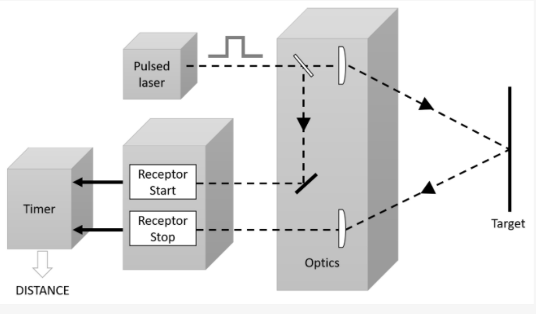
LIDAR Sensor
The measurement principle used for imaging using lidar is time-of-flight (TOF), where depth is measured by counting time delays in events in light emitted from a source.
Pulsed Time of flight(TOF) measurement principle

Slide 6
Advantages of LiDAR:
Resolution and Accuracy:
LiDAR generates instantaneous, massive amounts of measurements, and can be accurate to a centimeter.
3D Mapping:
LiDAR data can be easily converted into 3D maps to interpret the environment.
Low Light Performance:
LiDAR is unaffected by ambient light variations, and performs well in low any light conditions.
Speed:
LiDAR data are direct distance measurements that don’t need to be deciphered or interpreted– thus enabling faster performance and reducing processing requirement.

Slide 7
THANK YOU

